Slide 1
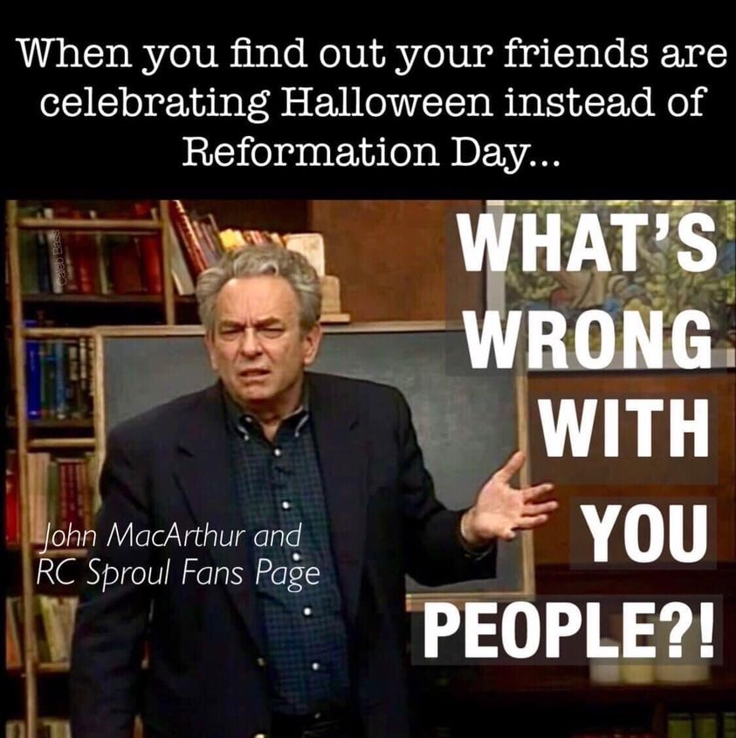
Notes:
Happy Reformation Day – 1517 the nailing of the 95 thesis on the Wittenberg door

Slide 2
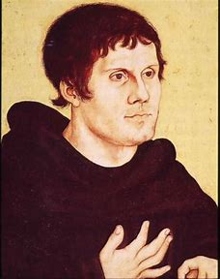
We are not forgiven because we love God but we are forgiven because God loves us
Notes:
Martin Luther – anguish of sin with no hope or assurance of salvation.
Many of you here today may be under the same anguish
Power of Christs blood
Luther – fasted until he was skin and bones
Locked himself up in the prison of his own room
Do I have enough faith, do I have enough love

Slide 3
Definite Atonement
John 10:11, 14-18, 24-29
Notes:
Reformation Day who daily struggled

Slide 4
The Doctrines of Grace
Oct 24 – Unconditional Election – Ephesians 1:4-6
Oct 31 – Definite Atonement – John 10:11-29
Nov 7 – Total Inability – Romans 3:9-12
Nov 14 – Effectual Call – 1 Corinthians 2:9-13
Nov 21 – Perseverance – Romans 8:32-35

Slide 5
Did the Son of God die to make salvation merely possible or to make people saved?
Notes:
Those who oppose the doctrines of grace say that the cross is only the means of salvation. We say that the cross actually accomplishes the work
They would say it doesn’t make people saved but saveable

Slide 6
Second Main Point: Article 3
The death of God’s Son is the only and entirely complete sacrifice and satisfaction for sins; it is of infinite worth, more than sufficient to atone for the sins of the whole world.
Notes:
There is no barrier to God’s grace – the sacrifice of Christ has sufficient value
Behold the Lamb of God that talks away the sin of the world – means of mans salvation is the cross of Christ
Man is totally responsible for his own sin
The application of the atonement – specific group of people, the church

Slide 7
Jesus died not only to make a bonafide offer of salvation to all people indefinitely, but to actually secure the salvation of a definite group: his sheep, his bride, his people, the many, the children.
  -John Piper
Notes:
Definite atonement means that the blood is actually applied to the bride of Christ

Slide 8
The Intent of Atonement Is His Sheep
The good shepherd - the true shepherd
Lays down his life for His sheep v11, 15
I know my own and my own know me v14, 16, 26, 27

Slide 9
Penal Substitutionary Atonement
Jesus bore our sins on the cross
Jesus took our exact punishment
Opposing Governmental view – “not the actual sins but that God’s law was broken and some kind penalty must be paid so that God can give the offer.”

Slide 10
He himself bore our sins in his body on the tree, that we might die to sin and live to righteousness.
-1 Peter 2:24

Slide 11
All we like sheep have gone astray; we have turned-every one-to his own way; and the Lord has laid on him the iniquity of us all.
-Isaiah 53:6

Slide 12
Hebrews 7:27-28
Hebrews 9:12
Hebrews 9:24-28

Slide 13
The Order of Salvation
Election
Atonement
General Call
Regeneration
Faith/Repentance
Justification
Sanctification
Glorification
Outward Call
Faith
Repentance
Regeneration
Justification
Perseverance
Glorification

Slide 14
If the atonement is a vicarious sacrifice whereby Christ died in the place of sinners such that the claims of divine justice against them have been satisfied, how can the atonement be anything but particular or definite?
  -Kevin DeYoung

Slide 15
“Christ did not come to put men in a redeemable position but to redeem himself a people.”
-John Murray
Notes:
Medders illustration

Slide 16
The Atonement Is Purposeful
v15 The Knowledge of Father and Son
v17 Obedience
v18 Voluntary Sacrifice

Slide 17
Gathered together against your holy servant Jesus, whom you (God) anointed, both Herod and Pontius Pilate, along with the Gentiles and the peoples of Israel, to do whatever your hand and your plan had predestined to take place.
-Acts 4:27-28
Notes:
"A soldier returned from the World war minus one arm and both legs. One man said, "It is such a pity that you should have lost your limbs in the war." "I did not lose them I gave them for my country."
"I gave my life for thee

Slide 18
The Atonement Is Effectual
v28 I give them eternal life
v28 No one will ever snatch them out of my hand

Slide 19
Consequently, he is able to save to the uttermost those who draw near to God through him, since he always lives to make intercession for them.
  -Hebrews 7:25
Notes:
Blood Transfusion for COVID
Spanish Flu, SARS, measels
Effective in faith

Slide 20
Application #1: Work Hard By Grace
So you also must consider yourself dead to sin and alive to God in Christ Jesus.
Romans 6:11
Notes:
Shall we continue to sin that grace may abound
People will be apathetic and fatalistic

Slide 21
Application #2: Put On Humility
Definite Atonement, the death blow to our sins, must also be the death-blow to our pride. The definite atonement of Christ brings a definite humility to our lives, seen in specific, sacrificial service.
-Medders
Notes:
Definiteness of Christ’s atonement – Christ died for you, he knew your name on the cross, your specific sins – birth certificate to death certificate
Letter of atonement but miss the spirit
Theological correctness and refuse to pray for people
Christ knows our name on the cross – shouldn’t we know the names of our brothers and sisters in Christ
Hands dirty to serve one another in love

Slide 22
Application #3: Live Out Unity
One flock and one shepherd
Look for ways you can love and serve every four pointer or even zero pointer out of the humility of the cross.

