Slide 1

“New Wineskins”
Luke 5:33-39

Slide 2
“New Wineskins”
Luke 5:33-39
Intro: Luke presents a contrast between the legalism of the religious leaders and the Grace of the Gospel.
Their religion at this time was external and ritualistic.
Jesus makes it clear, He wasn’t going to alter Judaism, He came to replace it.
While Judaism was concerned with an outward display of self- righteousness, Jesus was concerned about the attitude of the heart.

Slide 3
“New Wineskins”
Luke 5:33-39
I. The Inquiry
The Pharisees saw Jesus’ lack of adherence to their religious practices as a lack of spirituality.
While they fasted twice per week, only one fast was required in scripture, on Yom Kippur,
Lev. 16:29-31.
Fasting weekly was not the issue, several OT and NT saints did that. Making it a required part of one’s religious practice was.
There were 3 major religious expressions:
1. Prayer, 2. Alms Giving, 3. fasting. The Jews relegated all 3 to external, self- righteous behavior.

Slide 4
“New Wineskins”
Luke 5:33-39
II. The Response
Jesus counters with an illustration from a wedding.
Since mourning and fasting go together, it would be out of order to expect the guests at a wedding to fast when the Bridegroom is still in their presence.
This is the first instance where Jesus refers to Himself as the Bridegroom.
The Megillat Taanit, “Scroll of Fasting”, prohibited fasting at any happy gathering or celebration.

Slide 5
“New Wineskins”
Luke 5:33-39
III. The Illustrations
A. Patched Garments:
Jesus contrasted the old pharisaic religion with the new garment of the Gospel You can’t patch the Gospel into Judaism.
B. New Wine in Old Wineskins:
New wine will destroy old wineskins.
The Jewish religion was like the old, stiff, lifeless wineskins, unable to yield to New Wine of the Gospel.
C. The Old is Better:
One will stay with that which is old and comfortable.
Jesus didn’t come to add old with new, but to impart new life with the New Wine of the Gospel.

Slide 6
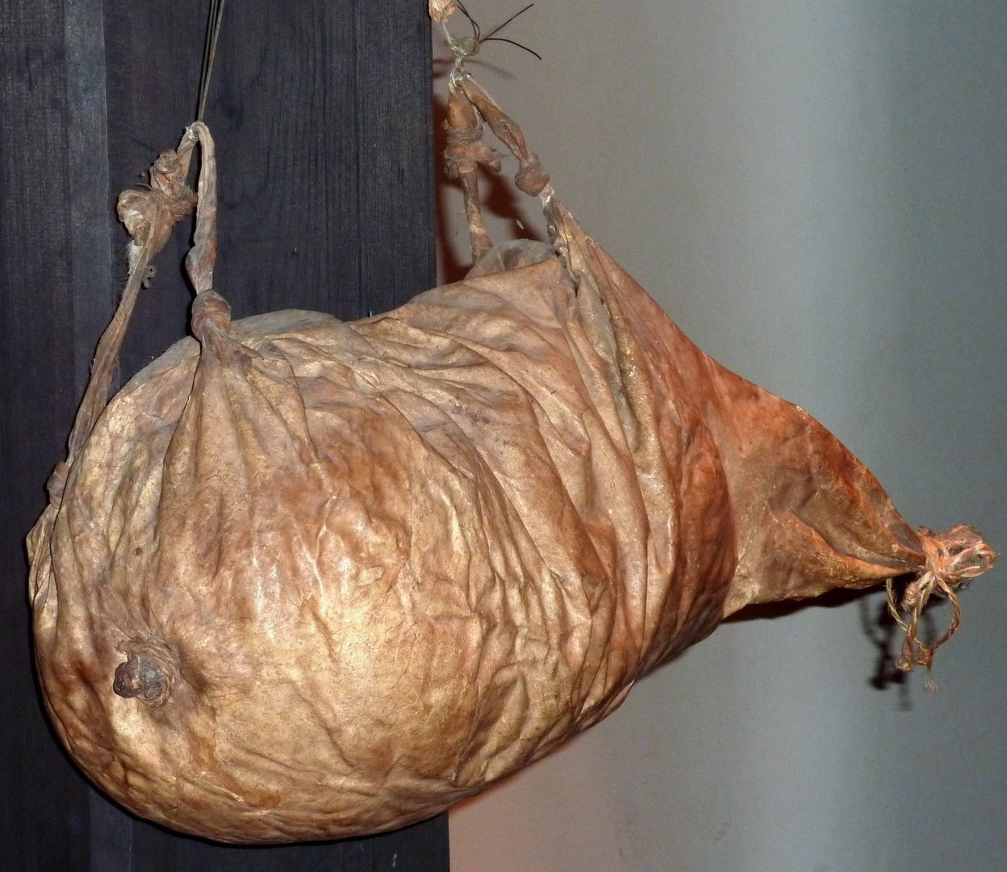

Slide 7
“New Wineskins”
Luke 5:33-39
III. The Illustrations
A. Patched Garments:
Jesus contrasted the old pharisaic religion with the new garment of the Gospel You can’t patch the Gospel into Judaism.
B. New Wine in Old Wineskins:
New wine will destroy old wineskins.
The Jewish religion was like the old, stiff, lifeless wineskins, unable to yield to New Wine of the Gospel.
C. The Old is Better:
One will stay with that which is old and comfortable.
Jesus didn’t come to add old with new, but to impart new life with the New Wine of the Gospel.

