Slide 1

Romans 12:3-11
Notes:
PRAYER EMPHASIS - GROW AS THE FAMILY OF GOD THROUGH GIFT BASED MINISTRY
GROW IN
PRAYER
EVERYONE CONNECTED TO THE BODY OF CHRIST
GROWING IN THE WORD OF GOD
EVERYONE CARING FOR ONE ANOTHER AND EXPERIENCING
PARTICIPATING IN SERVING ONE ANOTHER

Slide 2
Use Your Spiritual Gifts
Notes:
ROMANS – JUSTIFIED BY GRACE THROUGH FAITH
PROBLEM OF SIN
GIVEN THE SPIRIT - VICTORY
GOD HAS GIVEN US LOCAL CONGREGATIONS TO PUT INTO PRACTICE THE ONE ANOTHERS OF SCRIPTURE

Slide 3

1. Use Your Gift By Grace
Through Faith
Notes:
BASED ON JUSTIFICATION BY GRACE THROUGH FAITH
WE ARE TO USE OUR GIFTS BY GRACE THROUGH FAITH

Slide 4
ROMANS 12:3 ESV
For by the grace given to me I say to everyone among you not to think of himself more highly than he ought to think, but to think with sober judgment, each according to the measure of faith that God has assigned.
Notes:
GRACE OF SPEAKING – GOD SPEAKING
LET THOSE WHO SPEAK – SPEAK THE WORDS OF GOD
LET THOSE WHO SERVE – BY THE STRENGTH
RIGHT SELF EVALUATION
SINNER SAVED BY GRACE
PRESENTED MYSELF AS A LIVING SACRIFICE
BY FAITH
SPIRITUAL GIFTS – I CANT DO THAT
GOD WORKING BY HIS SPIRIT THROUGH YOU

Slide 5
COLOSSIANS 1:29 ESV
For this I toil, struggling with all his energy that he powerfully works within me.
Notes:
RESTING IN JESUS COMES BEFORE DOING
POWER DOESN’T COME FROM OUR OWN WORK
BATTLE BELONGS TO THE LORD
WEARINESS – OLDER
SARAH: PROMISED SON
ANA – 84 YEARS, WIDOWED 40 OF THOSE YEARS
SAMUEL – 60 ANNOINTED DAVID

Slide 6
“Someone Can’t Do Everything,
But
Everyone Should Do Something.”
Notes:
USE OLD AGE AS AN EXCUSE
I CANT DO WHAT I USED TO BE ABLE TO DO
WE GET TIRED
WE KEEP SERVING GOD RIGHT UP UNTIL THE DAY WE DIE
PRAISE GOD WE ARE AN OLDER CONGREGATION – GOD WORKS HE GETS THE GLORY

Slide 7

2. Use Your Gift To
Build Up One Another
Notes:
FOCUS OF OUR GIFT IS NOT OURSELF BUT ONE ANOTHER

Slide 8
ROMANS 12:5 ESV
so we, though many, are one body in Christ, and individually members one of another.
Notes:
You do not belong to yourself YOU BELONG TO CHRIST
YOU BELONG TO ONE ANOTHER
Focus and end of using OUR GIFT – BENEFIT OF ONE ANOTHER
Coordinated and connected to one another
WORD OF GOD AND PROPER AND CONNECTED LEADERSHIP

Slide 9
EPHESIANS 4:16 ESV
from whom the whole body, joined and held together by every joint with which it is equipped, when each part is working properly, makes the body grow so that it builds itself up in love.
Notes:
CHURCH UNITY IS MORE THAN THE ABSENCE OF CONFLICT
HARD WORK FOR US TO BE CONNECTED
COMMUNICATION IT TAKES COORDINATION
FREEDOM FOR NEW PEOPLE TO DO WHAT GOD HAS LAID UPON THEIR HEART
OVERSIGHT AND COORDINATION OF THE DEACONS – PROPERLY AND ORDERLY

Slide 10

Notes:
MINISTRY RIVERSIDE – DO THINGS AS TEAMS
MY WAY BUT OUR WAY
DO THINGS TOGETHER TO BUILD ONE ANOTHER UP
GROW AT DOING THINGS AS A TEAM
MEN’S BREAKFAST !!!!!!!!

Slide 11
U se Your Gift Because
It Is Indispensable
Notes:
YOUR GIFT IS ONE OF A KIND
NEEDED BY THE BODY

Slide 12
ROMANS 12:4 ESV
For as in one body we have many members, and the members do not all have the same function,
Notes:
EACH MEMBER HAS BEEN GIVEN
A SPECIFIC GIFT
A SPECIFIC MINISTRY

Slide 13
ROMANS 12:7 ESV
if service, in our serving; the one who teaches, in his teaching
Notes:
ARTICLE GROWTH GROUPS
SERVING GIFTS
SPEAKING GIFTS
THE VINE AND THE TRELLIS

Slide 14
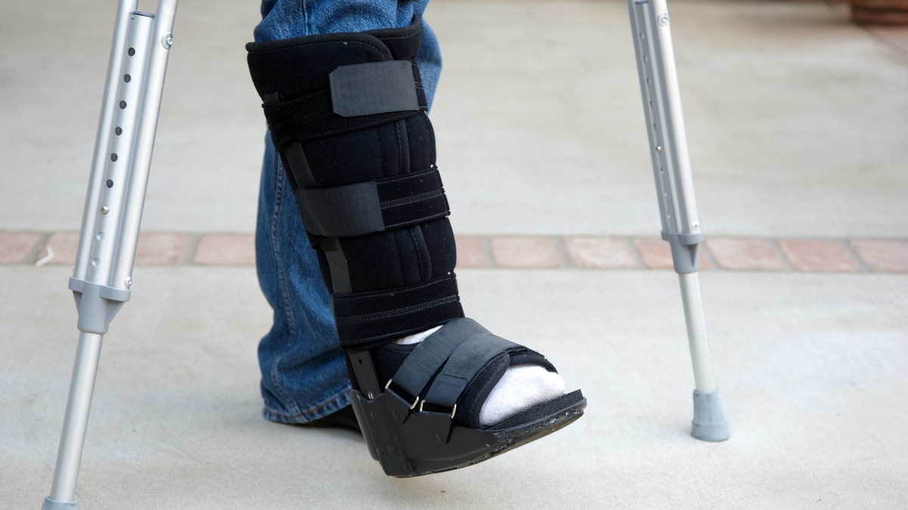
Notes:
LINDA – BONE SPURS
ONE PART ISNT FUNCTIONING IT IMPACTS THE WHOLE BODY
CARING FOR ONE ANOTHER CAN HELP US OVERCOME
TERRI – BROKE HER ANKLE
PROVIDED BOOT
NEW THE NEED TO HAVE BOTH EVEN

Slide 15
Use Your Gift Because God Gave It To You
Notes:
GOD GAVE YOU GRACE – TO USE
NOT TO HOARD IT

Slide 16
ROMANS 12:6 ESV
Having gifts that differ according to the grace given to us, let us use them: if prophecy, in proportion to our faith;
Notes:
DIFFER
GRACE – WHAT IS GIVEN, IN WHAT AMOUNT
USE THEM
BY FAITH – INSIDE I CAN’T
BY FAITH GOD SAYS YOU CAN

Slide 17
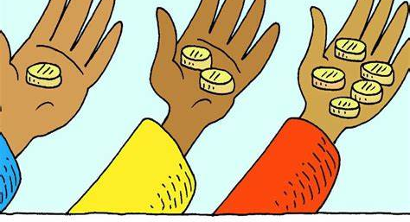
Notes:
DIFFERENT GIFTS AND ABILITIES AND DIFFERENT FAITH
DIDN’T USE – AFRAID OF GOD
AFRAID OF FAILURE – DIDN’T WANT TO LOSE IT
REBUKED – GOD GAVE HIM THAT TALENT TO INVEST IT

Slide 18
Application
What Is Your Gift? Are you using it?
Do Something To Serve The Church
Already Serving: Never Do Something By Yourself That You Could Do With Someone Else
Notes:
SPEAKING OR SERVING
ARE YOU SERVING
HOW DO I FIND MY GIFT? TRY SOMETHING
ALREADY SERVING – MAKE SPACE FOR OTHERS
MAYBE SOMEONE ELSE IS SUPPOSED TO BE DOING THAT
TEAM – TAKE SOMEONE WITH YOU

