Slide 1

Advent Part Two:
“The Scandal of Christmas”
(Curated from resources by Andreas Köstenberger)
Matthew 1:18-25
December 8, 2019

Slide 2
Online Resources:
www.biblicalfoundations.org/advent-reading-plan
www.crossway.org/books/the-first-days-of-jesus-tpb
www.thegospelcoalition.org/course/first-days-jesus

Slide 3
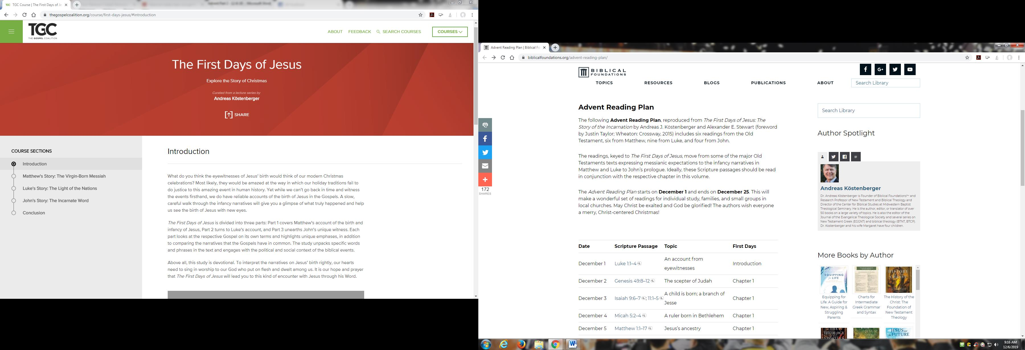

Slide 4

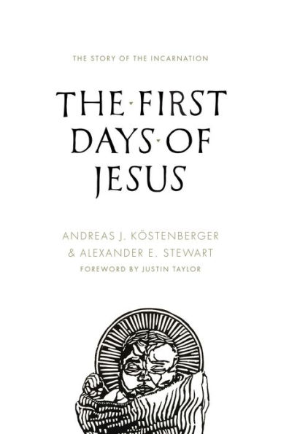
Scandals include:
Virgin birth
The incarnation
Jesus’ lowly birth
The cross

Slide 5
Matthew 1:18-25 (ESV) – [18] Now the birth of Jesus Christ took place in this way. When his mother Mary had been betrothed to Joseph, before they came together she was found to be with child from the Holy Spirit.

Slide 6
[19] And her husband Joseph, being a just man and unwilling to put her to shame, resolved to divorce her quietly. [20] But as he considered these things, behold, an angel of the Lord appeared to him in a dream,…

Slide 7
… saying, “Joseph, son of David, do not fear to take Mary as your wife, for that which is conceived in her is from the Holy Spirit. [21] She will bear a son, and you shall call his name Jesus, for he will save his people from their sins.”

Slide 8
[22] All this took place to fulfill what the Lord had spoken by the prophet: [23] “Behold, the virgin shall conceive and bear a son, and they shall call his name Immanuel” (which means, God with us).

Slide 9
[24] When Joseph woke from sleep, he did as the angel of the Lord commanded him: he took his wife, [25] but knew her not until she had given birth to a son. And he called his name Jesus.

Slide 10
Isaiah’s Prophecy = 700+ years
United States History = 243 years

Slide 11
“The virgin birth is incredible and amazing but not impossible; as the angel told Mary, “for nothing will be impossible with God” (Luke 1:37). God in the flesh was born as a baby, grew up as a human being, and walked this earth as a man…

Slide 12
This is one of the strongest responses to the problem of evil. God didn’t remain aloof and distant. He entered our world of pain, frailty, vulnerability, suffering, and death. He walked alongside us and endured the full fury of evil, oppression, and injustice.” –Andreas Köstenberger

Slide 13
Hebrews 7:26 (ESV) – For it was indeed fitting that we should have such a high priest, holy, innocent, unstained, separated from sinners, and exalted above the heavens.

Slide 14
“We must protect the (doctrine of the) Virgin Birth, because it is only through the Virgin Birth – it is only when God bypasses the sin of Adam – that God is able to provide a Savior who is unstained by original sin…

Slide 15
… In order for us to have a perfect sacrifice, Adam's work had to be bypassed. The Second Adam – the perfect man and Savior of the world, Jesus Christ – was sent to us through a virgin's womb and the agency of the Holy Spirit, …

Slide 16
… in order to perform a union of God and man without sin. The Virgin Birth isn't just some casual notion or quaint doctrine. It is absolutely critical to our salvation, because what we need is a Savior.”
–Mike Woodruff

