Slide 1
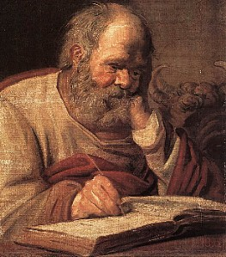
“The Lamb Praised”
Luke 2:21-38
Doctor Luke

Slide 2
“The Lamb Praised?”
Luke 2:21-38
Intro: Although lacking in notjing, spiritually speaking, Jesus still had to obey the Law. Gal. 4:4; Matt. 5:17.
God’s laws concerning purification of the women following the birth of a child had most to do with hygiene and the blood expended in the process.
It is interesting that the Redeemer had to be redeemed like any other Jewish boy, Num. 18:15.
The ceremony is called, Pidyon Haben, the Redemption of the son.

Slide 3
“The Lamb Praised?”
Luke 2:21-38
I. The Reasons for Simeon’s Praise
Luke depicts Simeon as righteous and devout, vs. 25
He was a man filled with the Holy Spirit; he cultivated his walk with God.
A. His praise was because of who appeared, Vss. 26-30.
1. God in human flesh, Jn. 1:1,14,
2. The Lamb of God, 1 Peter 1:18-20,
3. The One and only way to God, Jn 14:6, Acts 4:12.
B. His praise was because of why He appeared, V. 30-32
1. He came to be the Savior of all, Jn. 3:16; Rev. 22:17
C. He praised because of what He would accomplish,
Vss. 34-35

Slide 4
“The Lamb Praised?”
Luke 2:21-38
II. The Characteristics of our Praise
Anna was considered a prophetess, one of only 7 mentioned in the Talmud.
She was advanced in years and faithful in her devotion to God, Vs. 37.
1. Their praise was vocal, vs. 28,
Ps. 47:1; 98:4; 135:1; Heb. 13:15; Rev. 4:1-11.
2. It was visible, vs. 28,
Ps. 63:4; Ps. 134:2; 2 Sam. 6:14.
3. Their praise was verbal, vs. 38, Ps. 107:2.
Anna verbalized her reasons to others why she praised the Lord.

Slide 5
“The Lamb Praised?”
Luke 2:21-38
III. The Ministry of our Praise
When God’s people take time to praise Him for who He is, what He has done and what He will accomplish:
A. The Sovereign will be exalted; Vss. 28,38.
The focus went from ritual to lifting up the Lord.
B. The Saints will be edified; Vs. 33.
We are encouraged by the praise of others.
C. Sinners will be evangelized, Vs. 38.
In our praise the lost hear of Jesus’ love.

