Slide 1
Total Inability
Romans 3:9-12
Notes:
Clearwater River – heavy metals such as lead, cadmium, zinc, and arsenic

Slide 2
The Doctrines of Grace
Oct 24 – Unconditional Election – Ephesians 1:4-6
Oct 31 – Definite Atonement – John 10:11-29
Nov 7 – Total Inability – Romans 3:9-12
Nov 14 – Effectual Call – 1 Corinthians 2:9-13
Nov 21 – Perseverance – Romans 8:32-35

Slide 3
Man Is Unable To Please God
v9 All are under sin
v10 No one is righteous, not one
v12 No one does good, not one

Slide 4
For the mind that is set on the flesh is hostile to God, for it does not submit to God’s law; indeed it cannot. Those who are in the flesh cannot please God.
-Romans 8:7-8

Slide 5
We grow up hearing that nobody is perfect and to err is human. We are quite willing to acknowledge that none of us is perfect. That we are sinners is easy to admit; that none of us does good is a bit much. Not one person in a thousand will admit that sin is this serious. –RC Sproul
Notes:
Righteous Deeds -
Paint Clothes

Slide 6
Man Is Unable To Understand
v11 No one understands
Man’s reasoning is distorted

Slide 7
The natural person does not accept the things of the Spirit of God, for they are folly to him, and he is not able to understand them because they are spiritually discerned.
-1 Corinthians 2:14
Notes:
Two countries – the flesh and the Spirit

Slide 8
Man Is Unable To Seek God
His affections are distorted
His will is distorted

Slide 9
The heart is deceitful above all things, and desperately sick; who can understand it.
-Jeremiah 17:9
Notes:
peas

Slide 10
Light has come into the world, and people loved the darkness rather than the light because their works were evil. For everyone who does wicked things hates the light and does not come to the light, lest his works should be exposed.
-John 3:19-20

Slide 11
Depravity means more than committing a few sins—it means my nature and will are corrupted. You and I are not people who stubbed our big toe on the cobblestone well of sin. We are people who jumbed into the well and now lie in it with legs broken and no strength, trapped. -Medders

Slide 12
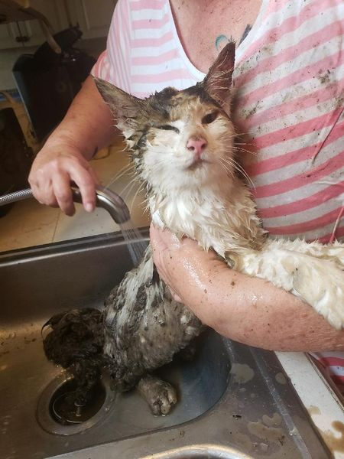
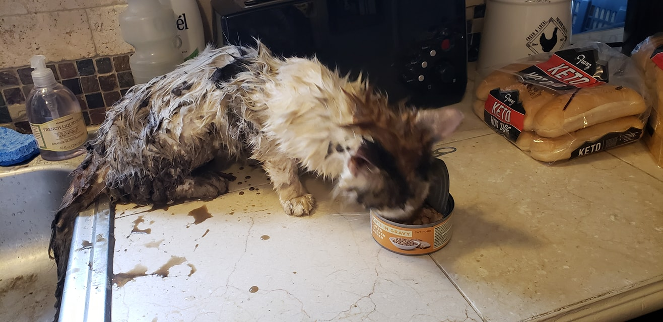
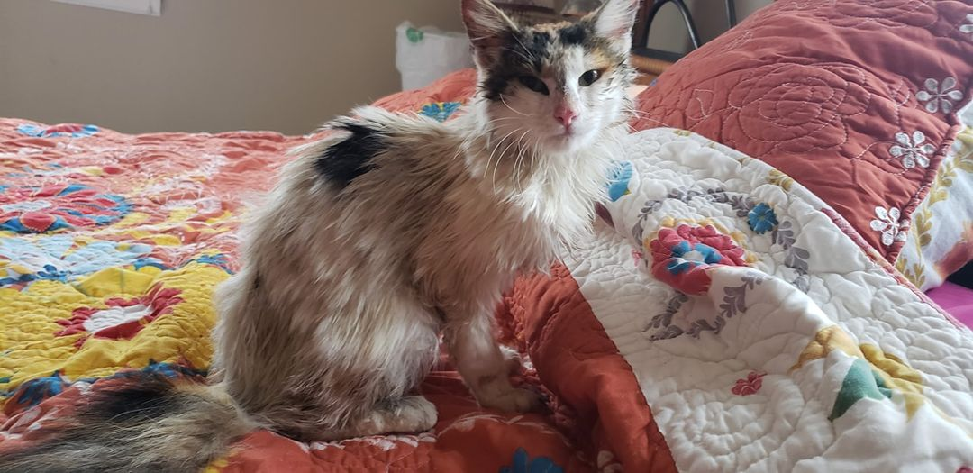
Notes:
I met the farmer in the road today and I said, "My cat was missing for 17 days..." and he interrupts, "...and then she came back yesterday, all caked in mud!" Whaaaaaat?!?!? "Well," he continued, "I guess you could say I saved your cat's life..." and then he proceeded to tell me how he was at the edge of his field and heard a howling coming from his pile of irrigation pipes. He looked inside them all, and saw some eyes staring back at him from far down the pipe, through lots of mud. She tried to back out, he says, but was unable to get any traction in the mud. So, he pulled the cap off the far end of the pipe, stood the pipe on end, and out fell our GingerPants! He said she made a beeline for our house, and he thought, "Someone's gonna have a mess to clean up...!" Haha!

Slide 13
Application #1: Total Humility
Instead of thinking humbly of the sinner right here…a head grasp of total depravity points me to all those nasty sinners out there. -Medders
Notes:
Jesus says why do you look at the speck in your brothers eye, but don’t notice the beam of wood in your own eye
Mind our’s first and when we look at the beam in the other guys eye we will be a little more gentle because we already dealt with ours
I am the worst of them. And Christ still came to save me is the heart cry of GRACE

Slide 14
Application #2: Total Sympathy
Total depravity unites us in a common plight
Total depravity is the death nail to racism
We should have sympathy, empathy and love
Notes:
Discipling someone that was drunk
AA meeting after AA meeting and never had victory
Counseling him, you are pretty good at this have you been an alcoholic
No but I understand two things – I understand sin – I also understand GRACE
Perception amongst sinners that we have it all together and the church is no place for an alcoholic because we wouldn’t understand.
Do we act and put on this false front that we are better than we actually are

Slide 15
Application #3: Total Dependency
“I am the vine and you are the branches. Whoever abides in me and I in him, he it is that bears much fruit, for apart from me you can do nothing.” –John 15:5

