Slide 1
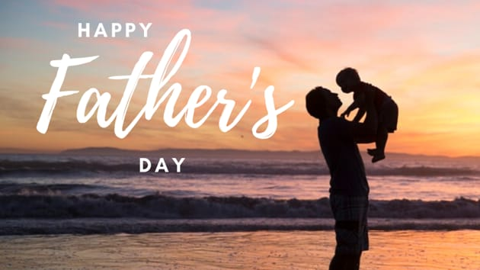

Slide 2
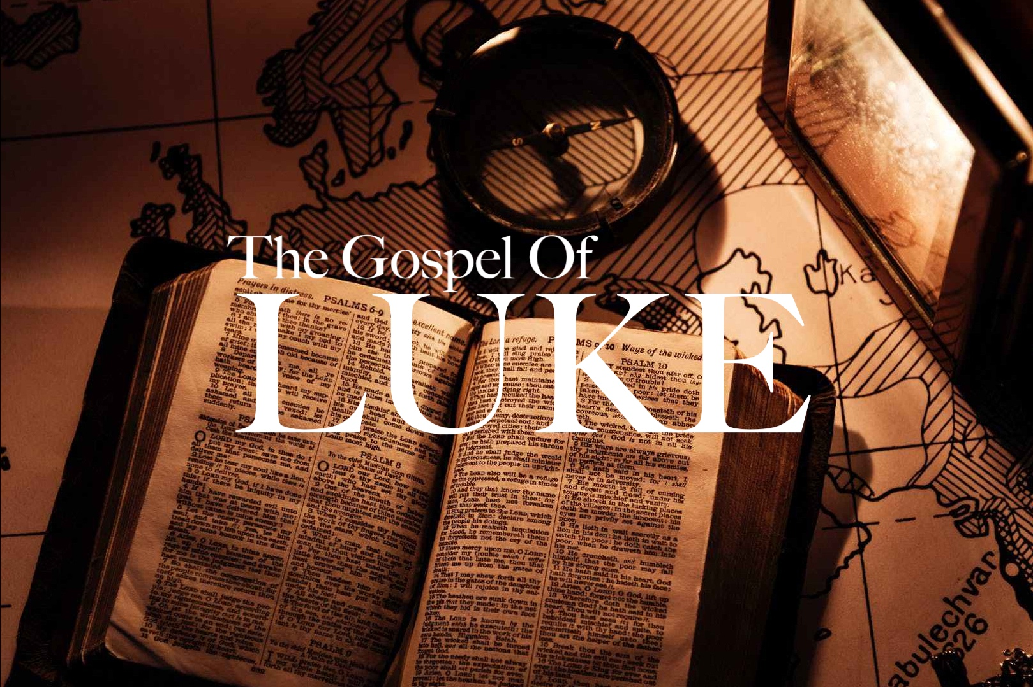
“Our Confession and Calling”
Luke 9:18-27

Slide 3
“Our Confession and Calling”
Luke 9:18-27
Intro: Knowing who Jesus is, is the most important determination one can make in his/her life.
With Jesus, it’s not simply a matter of having knowledge about Him, but understanding who He is and what He demands from us as Disciples.
In Luke’s Gospel record there are several entities that have made known the true identity of the Lord.

Slide 4
“Our Confession and Calling”
Luke 9:18-27
Intro: In spite of the overwhelming evidence regarding the Lord’s identity as the prophesied Messiah, the Jewish leadership saw Him as a fraud, Mk. 3:22.
The masses pondered whether or not Jesus could be the prophesied Son of David, a Hebrew phrase meaning the Messiah, Matt. 12:23.
There was no clear consensus as to who Jesus was:
1. Some thought He was a Prophet, Lk. 7:16,
2. Others thought Him to be a good man, Jn. 7:12,
3. Some called Him a deceiver, Jn. 7:12.

Slide 5
“Our Confession and Calling”
Luke 9:18-27
I. The Confession
Vss. 18-20
A. The Confession of the Crowds:
At this point Jesus wasn’t concerned about what the Jewish leadership thought about Him.
The reason they missed who Jesus was, He wasn’t the kind of Messiah they were looking for.
B. The Apostles’ Confession
1. It was revealed by God, Matt. 16:17
2. It was a personal confession, not a recitation,
3. It was imperfect and incomplete.

Slide 6
“Our Confession and Calling”
Luke 9:18-27
II. Jesus Foretells His Death
Jesus tells His Disciples two things:
1. Don’t tell anyone what you have confessed,
2. I must suffer and be killed by the Jewish leaders.
What Jesus implied was the cross of Calvary was mandatory. Isaiah 53.

Slide 7
“Our Confession and Calling”
Luke 9:18-27
III. Discipleship Demanded
Confessing Jesus as the Messiah was step #1. Jesus demanded total allegiance to Him;
1. We must deny ourselves, Phil. 3:7-8,
2. We must take up our cross daily. “There are no crown wearers in Heaven that were not cross bearers below”. C.H. Spurgeon
3. Follow Him. Intentionally comply with God’s will, regardless of cost to us.

