Slide 1

LIVING AN INSPIRED LIFE
OUR ultimate calling
Gloria Morris

Slide 2
E
dging
G
od
O
ut

Slide 3
EGO
I am what I have

Slide 4
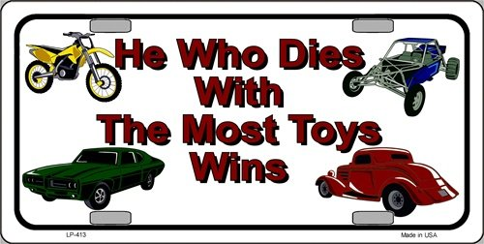

Slide 5
    “He who dies with the most toys is, nonetheless, still dead.”
    Anonymous

Slide 6
EGO
I am what I have
    I am what I do
    I am what other people think of me

Slide 7
EGO
I am what I have
    I am what I do
    I am what other people think of me
    I am separate from everybody else

Slide 8
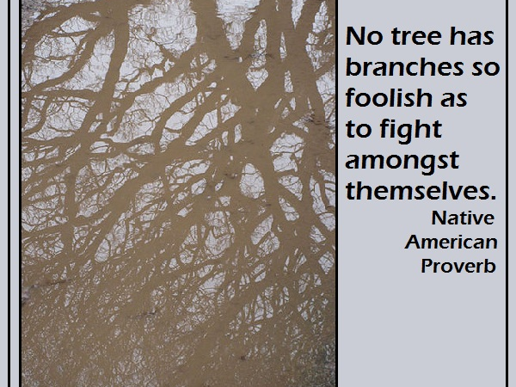

Slide 9
EGO
I am what I have
    I am what I do
    I am what other people think of me
    I am separate from everybody else
    I am separate from what is missing in my life
    I am separated from God

Slide 10
INSPIRATION
Inspiration is not just a feeling, it is a willingness to be connected to God.
Am I handling this situation the way Jesus would have handled it?

Slide 11
“You have heard that it was said ‘love your neighbor and hate your enemy’”
Matt 5:43

Slide 12
“But I tell you: love your enemies and pray for those who persecute you, that you may be sons of your Father in heaven”
Matt 5:44-45

Slide 13
“He causes His sun to rise on the evil and the good”
Matt 5:45

Slide 14
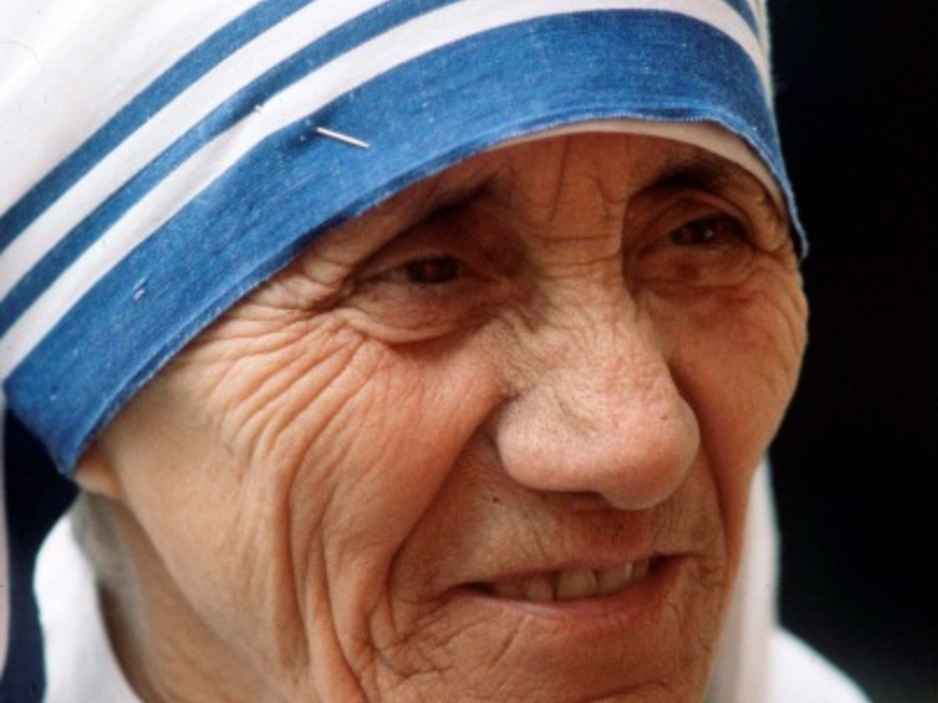

Slide 15
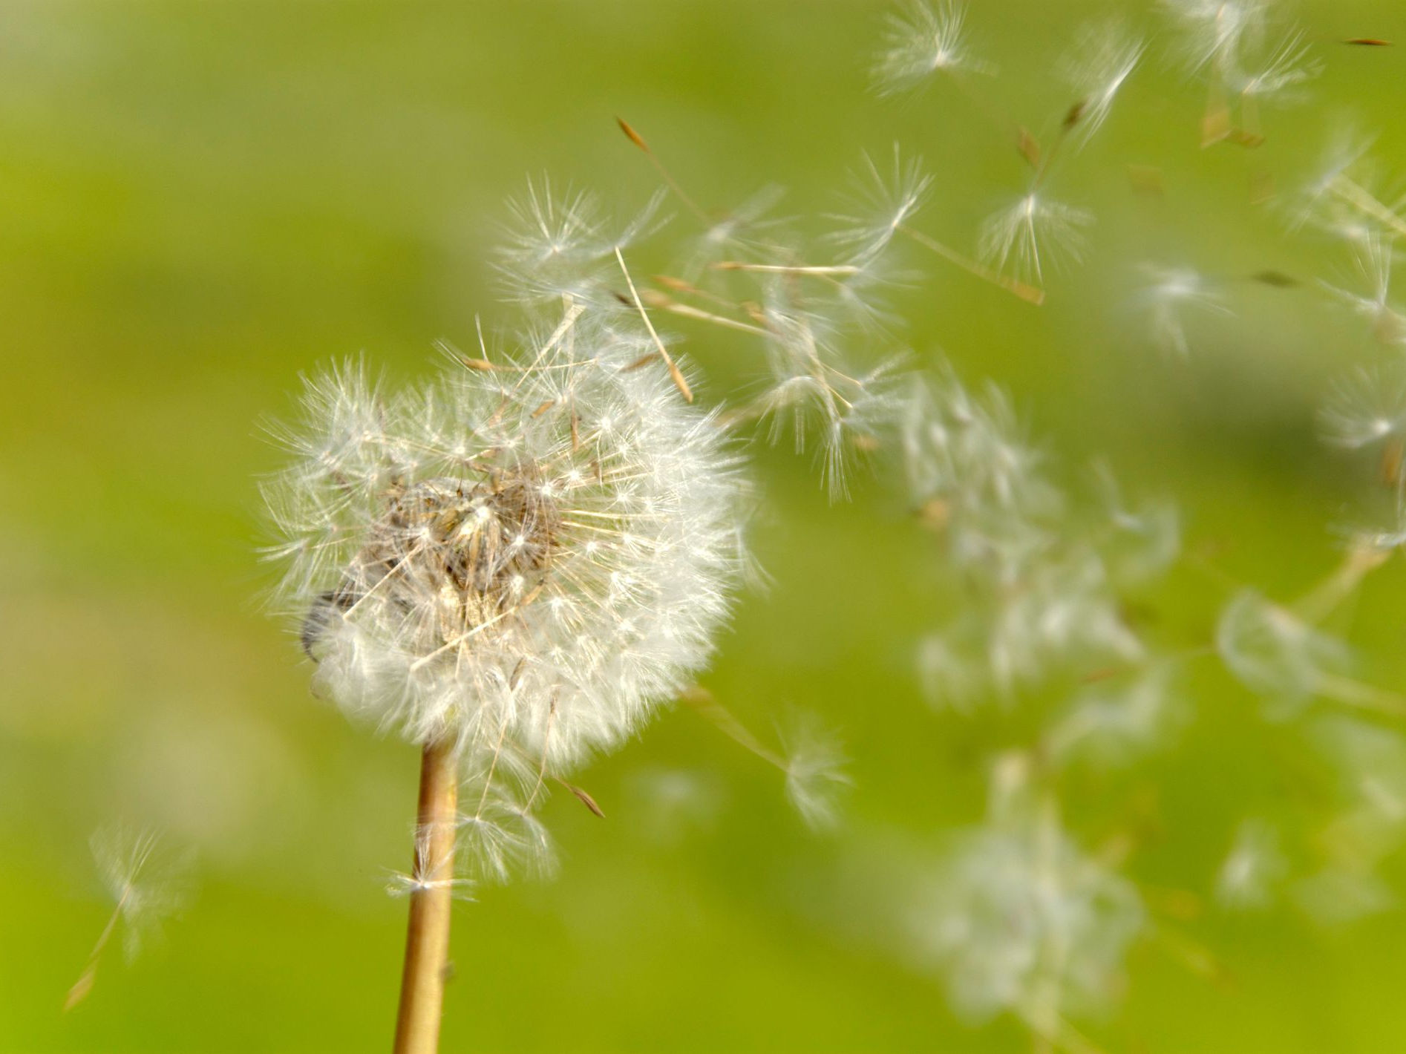

Slide 16
QUALITIES OF INSPIRATIONAL PEOPLE:
They send out signals that they love others
“Dear friends, let us love one another, for love comes from God.”
1 John 4:7

Slide 17
QUALITIES OF INSPIRATIONAL PEOPLE:
They are jubilant about the work they do
“Whatever you do, work at it with all of your heart, as working for the Lord, not for men.”
Colossians 3:23

Slide 18
QUALITIES OF INSPIRATIONAL PEOPLE:
They see the world as a friendly place
“For God so loved the world, that He gave His only begotten Son . . . . “
John 3:16

Slide 19
QUALITIES OF INSPIRATIONAL PEOPLE:
They are at peace with themselves
“Let the peace of Christ rule in your hearts, since as members of one body you were called to peace. And be thankful.”
Colossians 3:15

Slide 20
QUALITIES OF INSPIRATIONAL PEOPLE:
They are kind rather than judgmental
“Be kind to one another, tenderhearted, forgiving one another, as God in Christ forgave you.”
Ephesians 4:32

Slide 21
QUALITIES OF INSPIRATIONAL PEOPLE:
They are confident without being arrogant
“This is how love is made complete among us so that we will have confidence on the day of judgment: In this world we are like Jesus.”
1 John 4:17

Slide 22
QUALITIES OF INSPIRATIONAL PEOPLE:
They tend to be cheerful
“A joyful heart makes a cheerful face . . . .”
Proverbs 15:13

Slide 23
QUALITIES OF INSPIRATIONAL PEOPLE:
They love to play
“And the streets of the city shall be full of boys and girls playing in its streets.” Zechariah 8:5
“And said, ‘Truly, I say to you, unless you turn and become like children, you will never enter the kingdom of heaven.’” Matthew 18:3

Slide 24
QUALITIES OF INSPIRATIONAL PEOPLE:
They are elated to be the company of young children as well as older people
“Children are a heritage from the LORD, offspring a reward from him.” Psalm 127:3
“Do not rebuke an older man [or woman] but encourage him [her] as you would a father [mother], younger men [women] as brothers [sisters].” 1 Timothy 5:1

Slide 25
QUALITIES OF INSPIRATIONAL PEOPLE:
They listen rather than lecture
“My dear brothers and sisters, take note of this: Everyone should be quick to listen, slow to speak and slow to become angry.”
James 1:19

Slide 26
