Slide 1
Thinking Outside the Box:
Jesus Feeds Thousands
John 6:1-15

Slide 3
3
1
2
4

Slide 5
Thinking Outside the Box
1. The Problem: Thousands of people vs. 5 loaves, 2 fish
2. The Solution: Jesus
3. The Lesson: Let the Gospel explode your box!

Slide 6
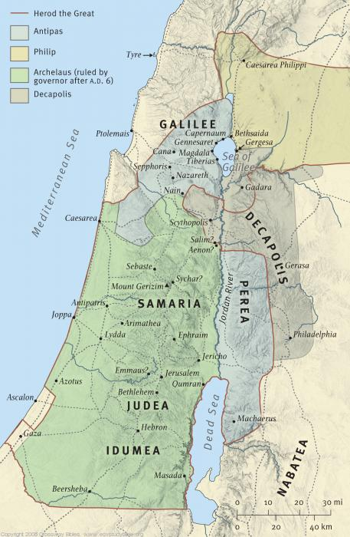

Slide 7
Thinking Outside the Box
1. The Problem: Thousands of people vs. 5 loaves, 2 fish
2. The Solution: Jesus
3. The Lesson: Let the Gospel explode your box!

