Slide 1
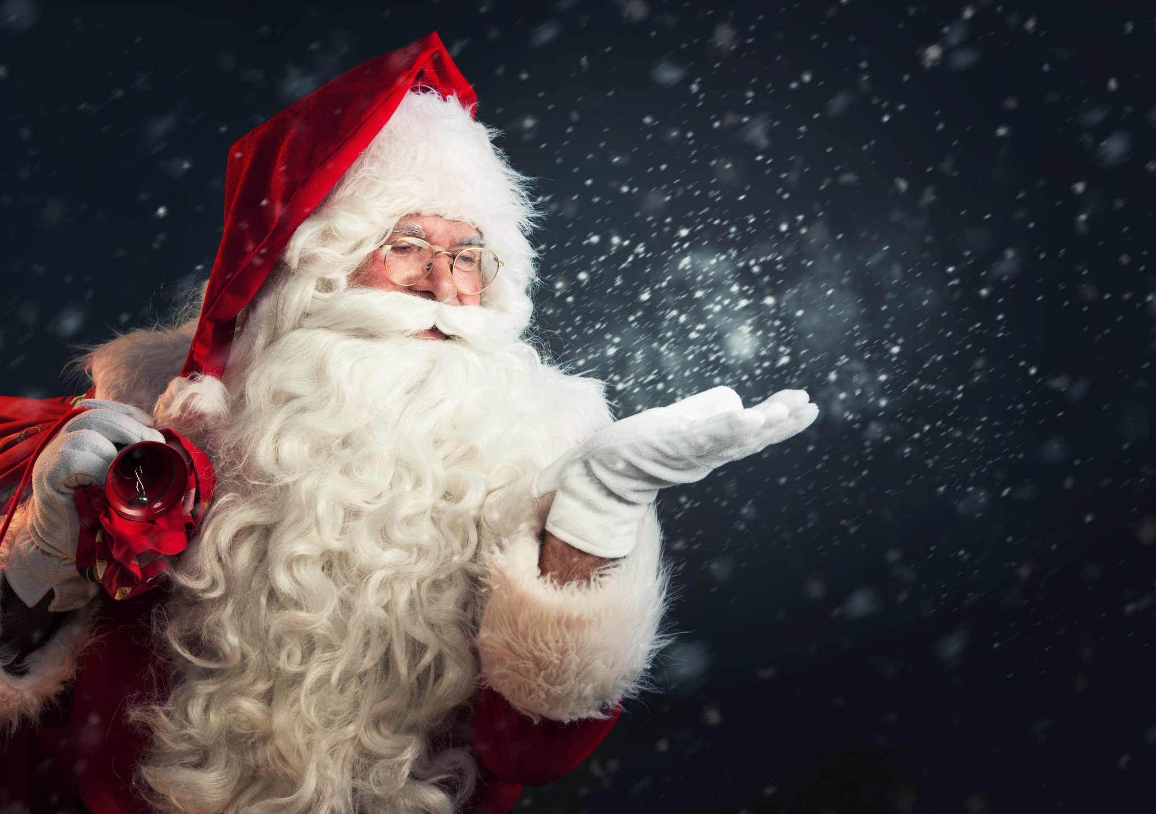
Matthew 1:18-25
Notes:
POPULAR CULTURE HAS BESTOWED GOD LIKE POWERS ON SANTA CLAUSE
OMNISCIENT
He knows when you are sleeping, He knows when your awake, he knows if youve been bad or good
POWER SHIFT SPACE AND TIME – ALL GIFTS – ONE NIGHT
IMMORTAL
ONLY GOD IS ALL POWERFUL AND ALL KNOWING – SALVATION OF MANKIND
CHRISTMAS IS THE PROCLAMATION OF THE POWER AND SALVATION OF OUR ALMIGHTY GOD

Slide 2
Why Is The Virgin Birth
Important?
Notes:
DEBATED – SCIENTIFIC REASONING
DIFFICULT TO UNDERSTAND
DIFFICULT TO BELIEVE
ESSENTIAL TO OUR SALVATION
THREE REASONS – PROVIDENCE, PLAN

Slide 3
It Demonstrates
God’s Providence
Notes:
VIRGIN BIRTH – GOD ACTIVELY WORKS TO SAVE MAN
HE DOES WHAT WE CANNOT DO FOR OURSELVES

Slide 4
MATTHEW 1:18 ESV
Now the birth of Jesus Christ took place in this way. When his mother Mary had been betrothed to Joseph,
Notes:
V16 HOW CAN JESUS BE THE SON OF MARY BUT LEGALLY THE SON OF JOSEPH
BETROTHAL PERIOD – LEGALLY MARRIED
SIN NATURE IS PASSED ON THROUGH ADAM
CURSE OF JEKONIAH – JOSEPH
JESUS DID NOT RECEIVE A SIN NATURE

Slide 5
before they came together she was found to be with child from the Holy Spirit.
Notes:
HOW WAS JESUS BORN OF A VIRGIN
IT IS A MIRACLE
MIRACLE BY THE WORK OF THE HOLY SPIRIT

Slide 6
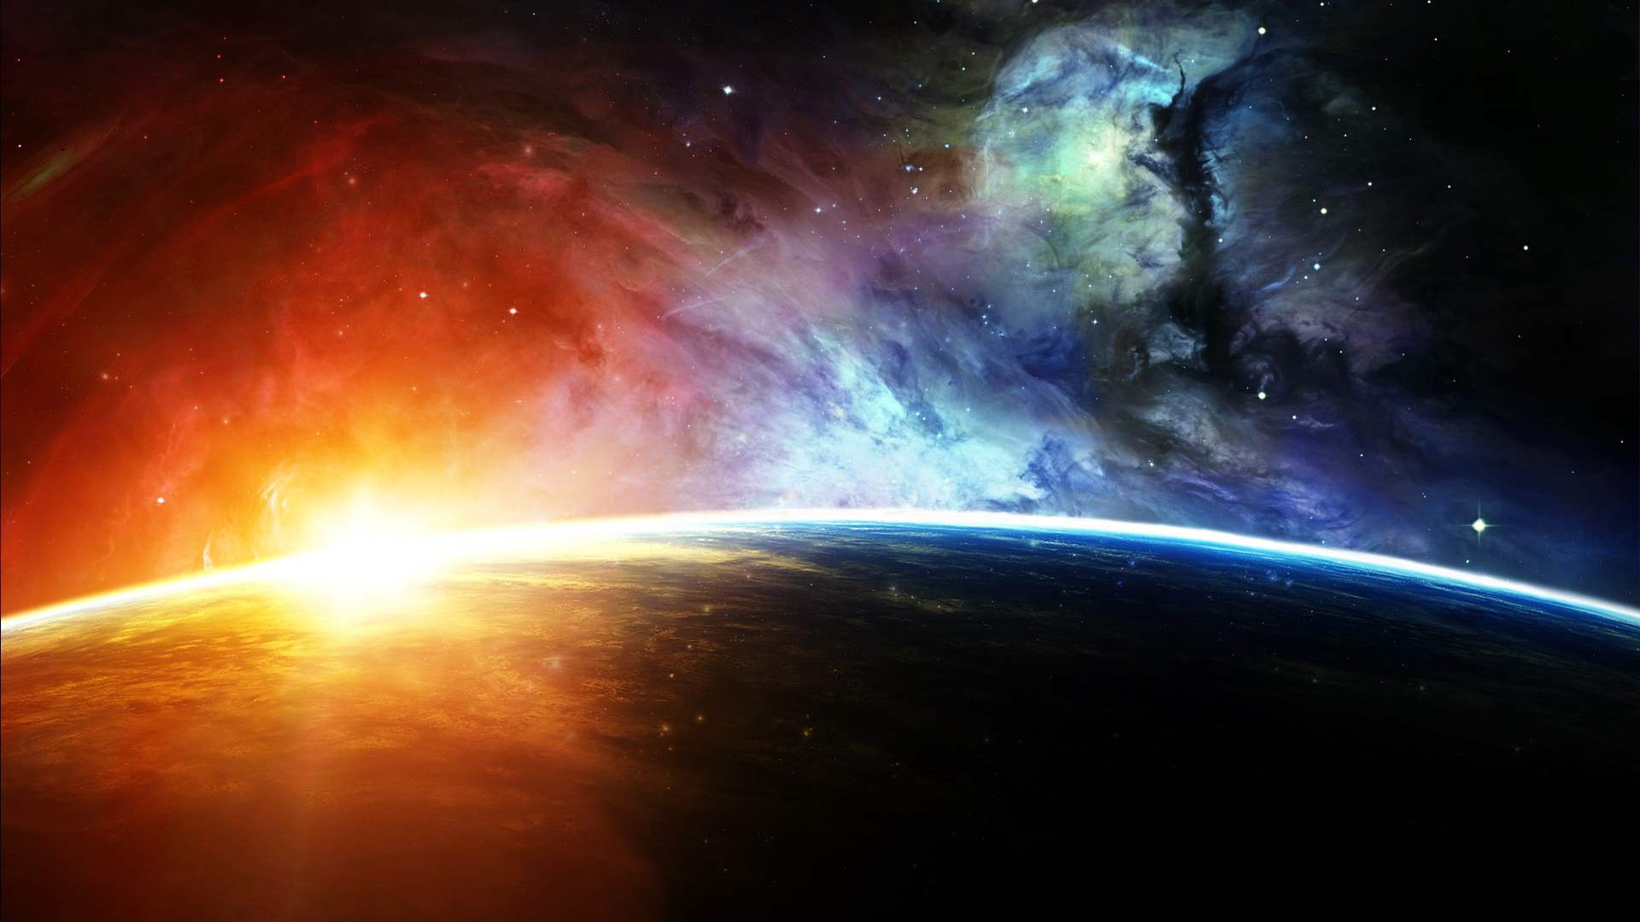
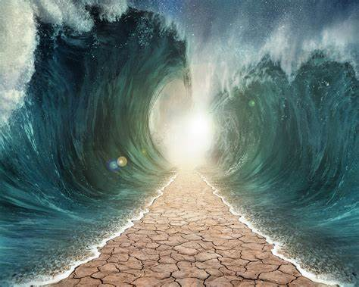
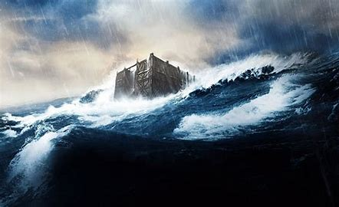

Notes:
IMPOSSIBILITY OF THE VIRGIN BIRTH – CREATED A BABY OUT OF NOTHING
CREATED THE UNIVERSE OUT OF NOTHING
WORLDWIDE FLOOD
PART THE RED SEA
JESUS TO RAISE FROM THE DEAD – RESURRECTION PROVES HIS INCARNATION

Slide 7
MATTHEW 1:20 ESV
But as he considered these things, behold, an angel of the Lord appeared to him in a dream, saying, “Joseph, son of David, do not fear to take Mary as your wife, for that which is conceived in her is from the Holy Spirit.
Notes:
JOSEPH WAS A RIGHTEOUS MAN – TRULY GODS COVENANT MAN BY FAITH
DIRECTED BY THE WORD OF GOD
DO GOD’S WILL SO HE CONSIDERED – TOOK TIME TO PRAY AND CONTEMPLATE
PROVIDENCE OF GOD – HE REVEALS HIS WILL TO JOSEPH
WILL JOSEPH ACT WITH FAITH OR WITH FEAR

Slide 8
Pray for illumination and direction in the way you should go. Follow Providence as far as it agrees with the word, and no further.
Notes:
FERGESON – John Flavel - PROVIDENCE OF GOD
PROVIDENCE IS GOD’S SOVEREIGN SUPERINTENDANCE OF ALL THINGS
GOD’S POWER SUSTAINS AND GUIDES HUMAN DESTINY
THEISM AND NATURALISM – GOD LETS THINGS GO
PROVIDENCE SAYS THAT GOD GUIDES AND IS ACTIVELY INVOLVED IN HUMAN HISTORY

Slide 9
It Is Essential To God’s Plan

Slide 10
MATTHEW 1:21 ESV
She will bear a son, and you shall call his name Jesus, for he will save his people from their sins.
Notes:
JESUS – YAHWEH SAVES
HIS PEOPLE
FROM SIN AND SEPARATION FROM GOD
SINLESS AND GOD HIMSELF – BORN OF GOD

Slide 11
GALATIANS 4:4–5 ESV
But when the fullness of time had come, God sent forth his Son, born of woman, born under the law, to redeem those who were under the law,
Notes:
GOD’S PERFECT TIMING – HIS PROVIDENCE
BORN AS A MAN – UNDER THE LAW
REDEEM – SET US FREE FROM THE BONDAGE OF SIN
FULLY GOD AND FULLY MAN CAN SAVE

Slide 12
It Fulfills God’s Prophecy

Slide 13
MATTHEW 1:22–23 ESV
All this took place to fulfill what the Lord had spoken by the prophet: “Behold, the virgin shall conceive and bear a son, and they shall call his name Immanuel” (which means, God with us).

Slide 14
ISAIAH 7:10-17
ISAIAH 8:3-4
ISAIAH 9:2, 6-7
Notes:
FEARS
WARS? HEALTH? CULTURAL DECLINE
NO FEAR STAND FIRM
UNTO US A CHILD IS BORN
SUFFERING SERVANT

Slide 15
Application
How Is Your Faith Today?
Pray For Faith
Notes:
BELIEVE – Believe in the Magic of Christmas
CHAPEL PSYCHIATRISTS
INSTEAD OF BELIEVING IN THE MAGIC OF CHRISTMAS
BELIEVE IN THE POWER OF JESUS CHRIST
FATHER DEMON POSSESSED SON – I BELIEVE HELP MY UNBELIEF
Luke 11:13 - If you then, who are evil, know how to give good gifts to your children, how much more will the heavenly Father give the Holy Spirit to those who ask him!”

