Slide 1
Saved Baptized Membership or
The Blessing of Committed Relationships
Acts 2:42-47

Slide 2
How To Enjoy the Blessings of Covenant Commitment
Be Saved
Be Baptized
Be A Member

Slide 3
Be Saved
Peter’s Sermon – Joel’s Promise, David’s Promise, Man’s Rebellion
v37-38 Grace – Repent and Believe

Slide 4
And there is salvation in no one else, for there is no other name under heaven given among men by which we must be saved.
  -Acts 4:12

Slide 5
For by grace you have saved through faith. And this not of your own doing; it is the gift of God. Not a result of works, so that no man can boast. For we are his workmanship created in Christ Jesus for good works, which God prepared beforehand, that we should walk in them.
-Ephesians 2:8-10

Slide 6
Be Baptized
Were Baptized
All 3000

Slide 7
Do you not know that all of us who have been baptized into Christ Jesus have been baptized into his death? We were buried therefore with him by baptism into death, in order that, just as Christ was raised from the dead by the glory of the Father, we too might walk in newness of life.
-Romans 6:3-4

Slide 8
Be A Member
v41 Added that day
v47 Added to their number

Slide 9
Do you not know that your bodies are members of Christ? Shall I then take the members of Christ and make them members of a prostitute? Never! Or do you not know that your body is a temple of the Holy Spirit within you, whom you have from God? You are not your own!
-I Corinthians 6:15, 19

Slide 10
Church membership is how we formally recognize and commit to one another as believers. It’s your way of saying, “This is the particular group of Christians I am inviting into my life and asking to keep me accountable for following Jesus. I’m asking them to take responsibility for my Christian walk.
-Collin Hansen Rediscover Church

Slide 11
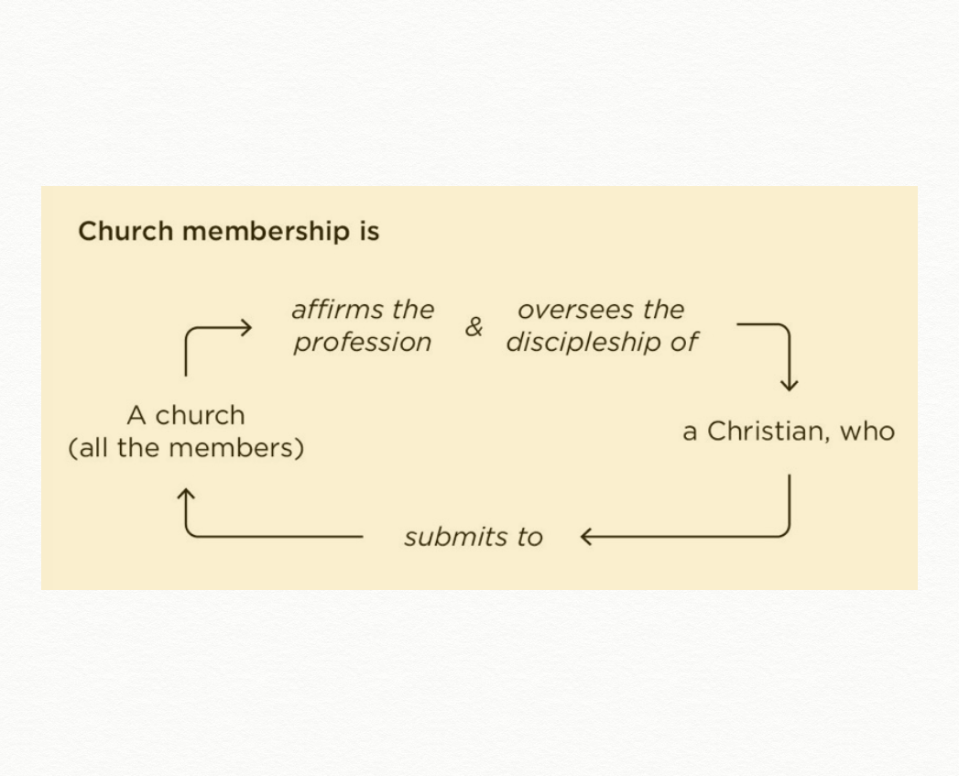

Slide 12
Just as our faith should “put on” good works (Col 3:10, 12; James 2:14-16), so we should “put on” our universal membership locally.
-Collin Hansen

Slide 13
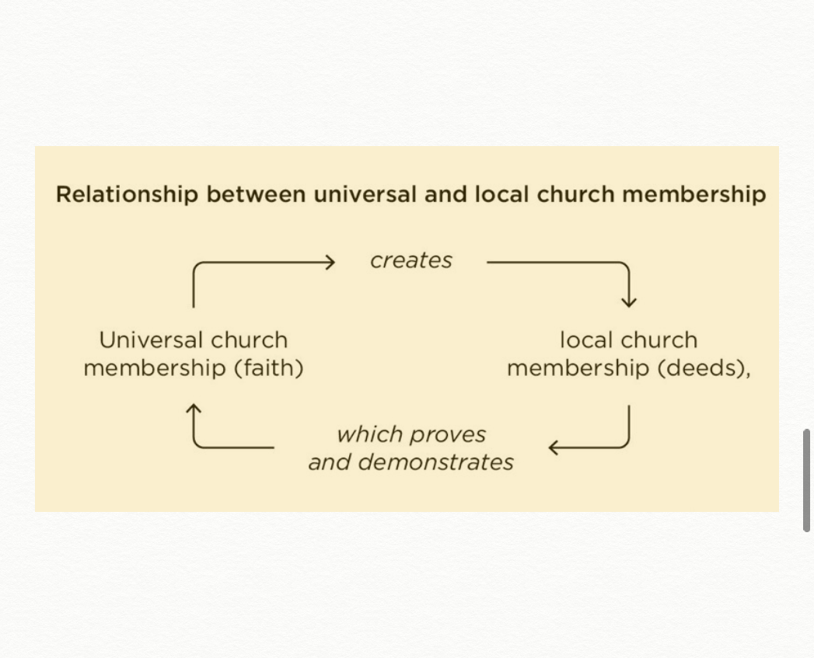

Slide 14
Membership and Doctrine
Dedicated to the apostle’s teaching
We commit to uphold sound doctrine
We commit to voluntarily help one another grow in the Word
We commit to prayerfully consider Biblical leaders

Slide 15
Membership and Member Care
All things in common
We commit to meeting physical needs of those in need
We commit to the “One Another’s”

Slide 16
Membership and Witness
We commit to glorify God together
We are a testimony to God’s work in a specific place and people

Slide 17
Application
Be Baptized
Become A Member
Uphold Doctrine, Care, and Witness
Read “Rediscover Church”

