Slide 1
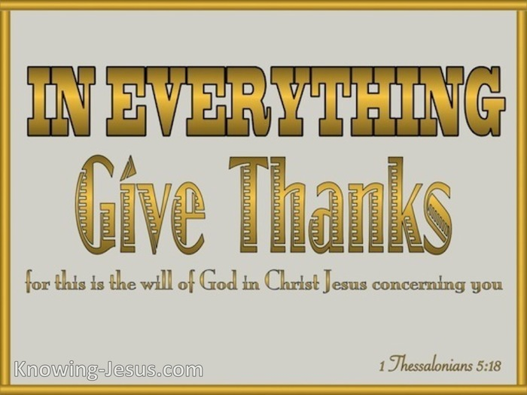
I Thessalonians 5:18

Slide 2
“In Everything Give Thanks”
I Thessalonians 5:18
Intro: Christians are to be characterized by their attitude of being thankful.
Our lives should be led in a way that pleases and honors God. To do that we need to be people who:
1. Support the weak, show goodness and grace to all people, do not return evil for evil,
2. Rejoice always, be fervent in prayer, and thankful in every circumstance.
A man's spiritual maturity is reflected in a heart of thanksgiving and praise for all the Lord has accomplished for him.

Slide 3
“In Everything Give Thanks”
I Thessalonians 5:18
I. Our Ability to be Thankful
It’s dependent on two major factors:
1. How we view our circumstances, Rom. 8:18,
2. Our understanding of our position here on Tera Firma. 1 Peter 2:11, Phlip. 3:20.
Old Testament saints understood their temporary status, that they were sojourners and exiles here on earth.
Ps. 39:12, 119:19; 1 Chron. 29:15; Heb. 11:9-10, 13.

Slide 4
“In Everything Give Thanks”
I Thessalonians 5:18
II. The Response of the Redeemed
A continual response of thanksgiving should be a normal characteristic of every Christian’s life.
2 Cor. 4:15, 9:11.
Living a Spirit filled life produces joy and a rejoicing attitude, Eph. 5:18.
Not only should we be thankful for our salvation, but because God has provided us everything for our spiritual necessities, 1 Peter 1:3.

Slide 5
“In Everything Give Thanks”
I Thessalonians 5:18
III. God Expects a Thankful Response
In light of all which God has provided for us, we are expected to live thankful lives.
1. We are to abound in thanksgiving,
Col. 2:6-7,
2. We are to devote our lives to prayer with an attitude of thanksgiving, Col. 4:2.
Being thankful in everything is one of the core characteristics of who we are to be as redeemed individuals.

Slide 6
“In Everything Give Thanks”
I Thessalonians 5:18
IV. Hindrances to a Thankful Life
1. Doubt. We don’t believe God’s word,
2. Selfishness. We want control of our lives,
3. Worldliness. Their focus is on the temporal.
4. A critical spirit. Nothing is ever good enough,
5. Impatience. They can’t wait on God’s process.
6. Rebellion. They’ve been hurt and refuse to be thankful.

Slide 7
“In Everything Give Thanks”
I Thessalonians 5:18
Conclusion
Jesus’s eucharisteo was fueled by his belief in future grace.
Jesus, the founder and perfecter of our faith . . . for the joy that was set before him endured the cross, despising the shame, and is seated at the right hand of the throne of God. Hebrews 12:2
He got through the cross by not focusing on the cross but on the promised joy that would result from it.

