Slide 1
Romans 6:1-6

Slide 2
Understanding Baptism

Slide 3
Baptism Is Pledging Allegiance
Spiritual Baptism and Water Baptism
v1-2 Grace works
Outward sign of an inward reality
Notes:
That baptism is not a work, emphasis here is on the spiritual reality the physical action is in view, all in the church in Corinth were physically bapitized
Argument in verses 1-2 is that grace works, grace leads to obedience it is lived out in physical reality

Slide 4
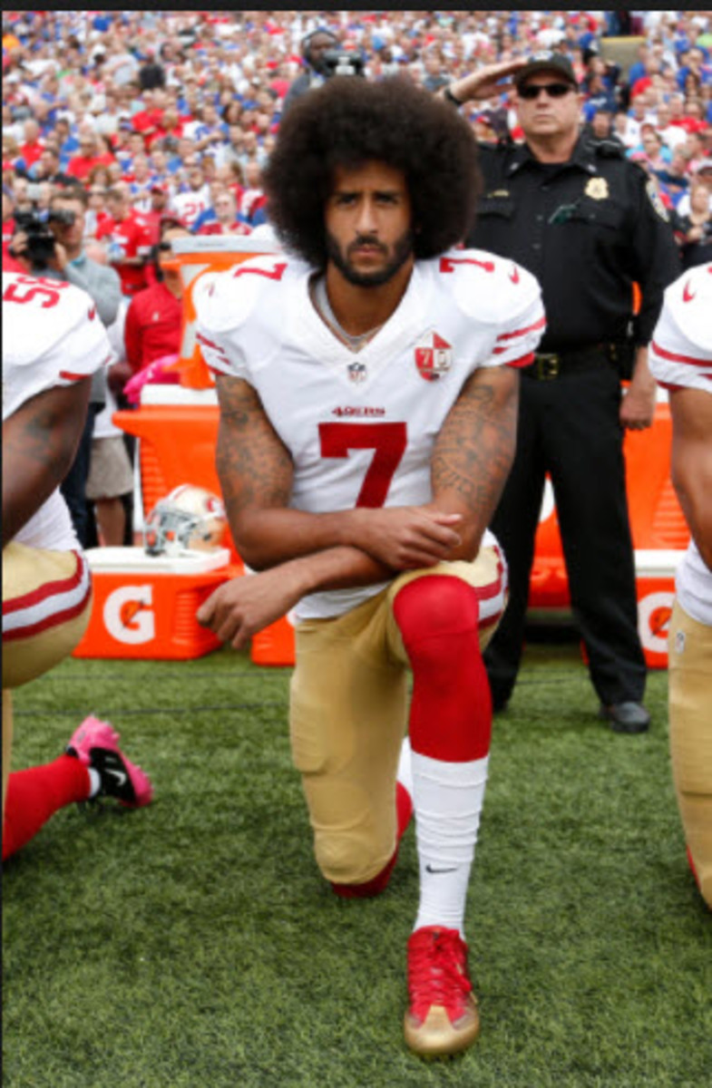

Notes:
Uniform – salute, if we didn’t we would not be acting like a Soldier

Slide 5
Baptism Is Union With Christ
Spiritual Reality of being “in Christ”
Were and have been – “5 times”
Vicarious Substitutionary Atonement

Slide 6
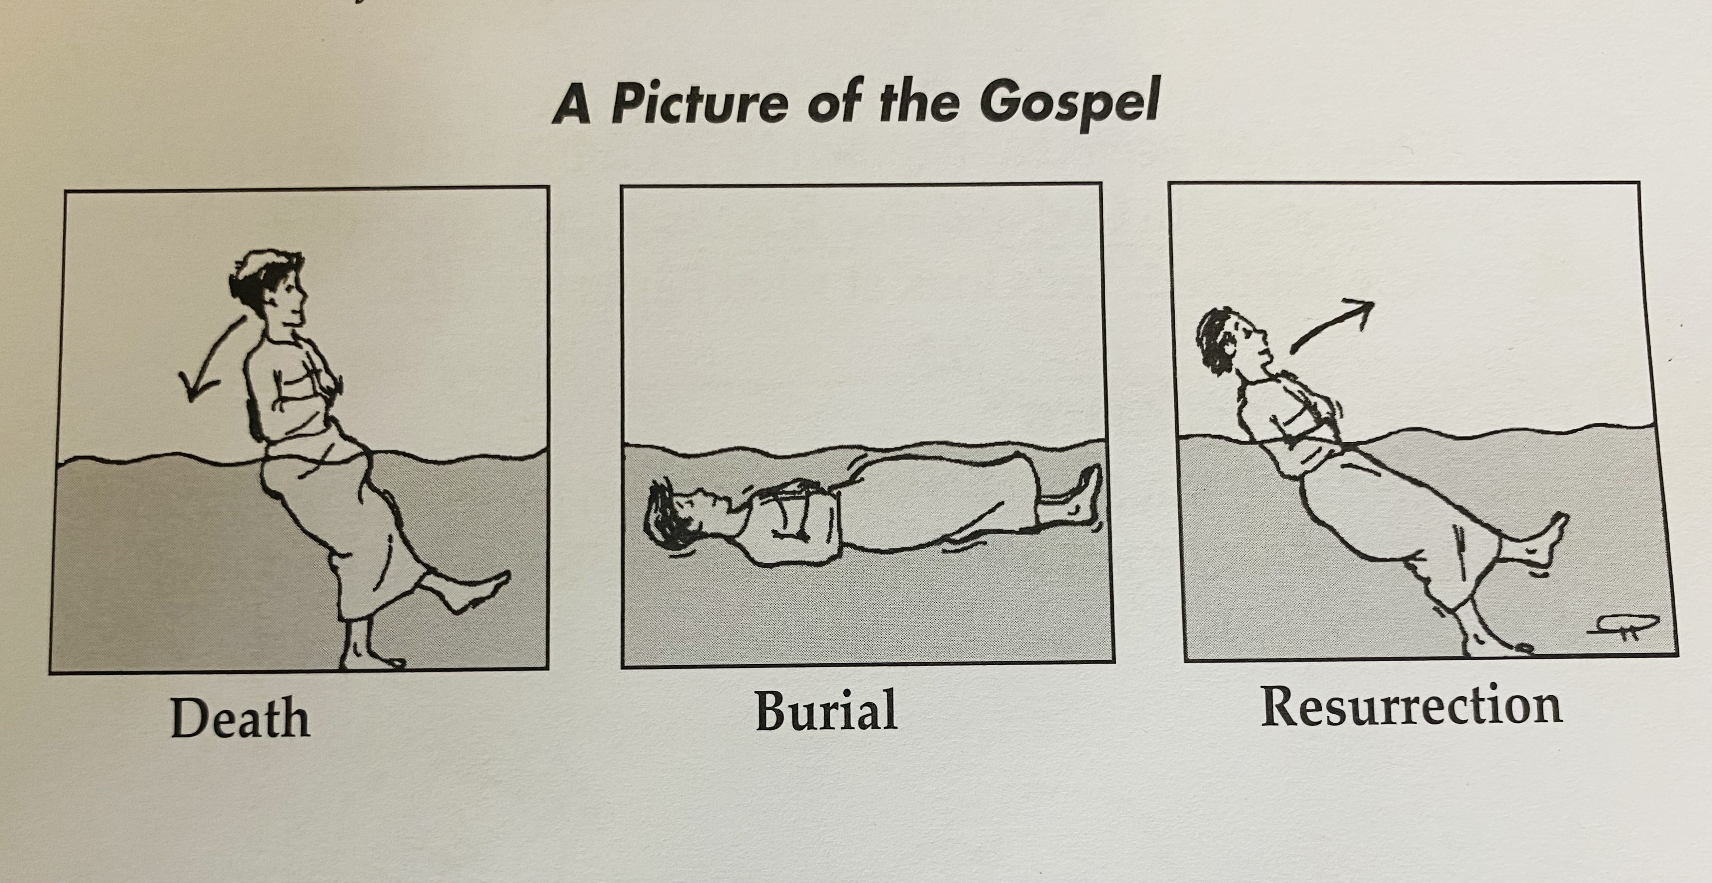
Notes:
Photograph of rbp
Past act with continuing results

Slide 7
Baptism Is Unity With One Another
We – 8 times
Baptism unites us with one another
Who has authority to baptize?

Slide 8
For Christ did not send me to baptize but to preach the gospel.
-1 Corinthians 1:17

Slide 9
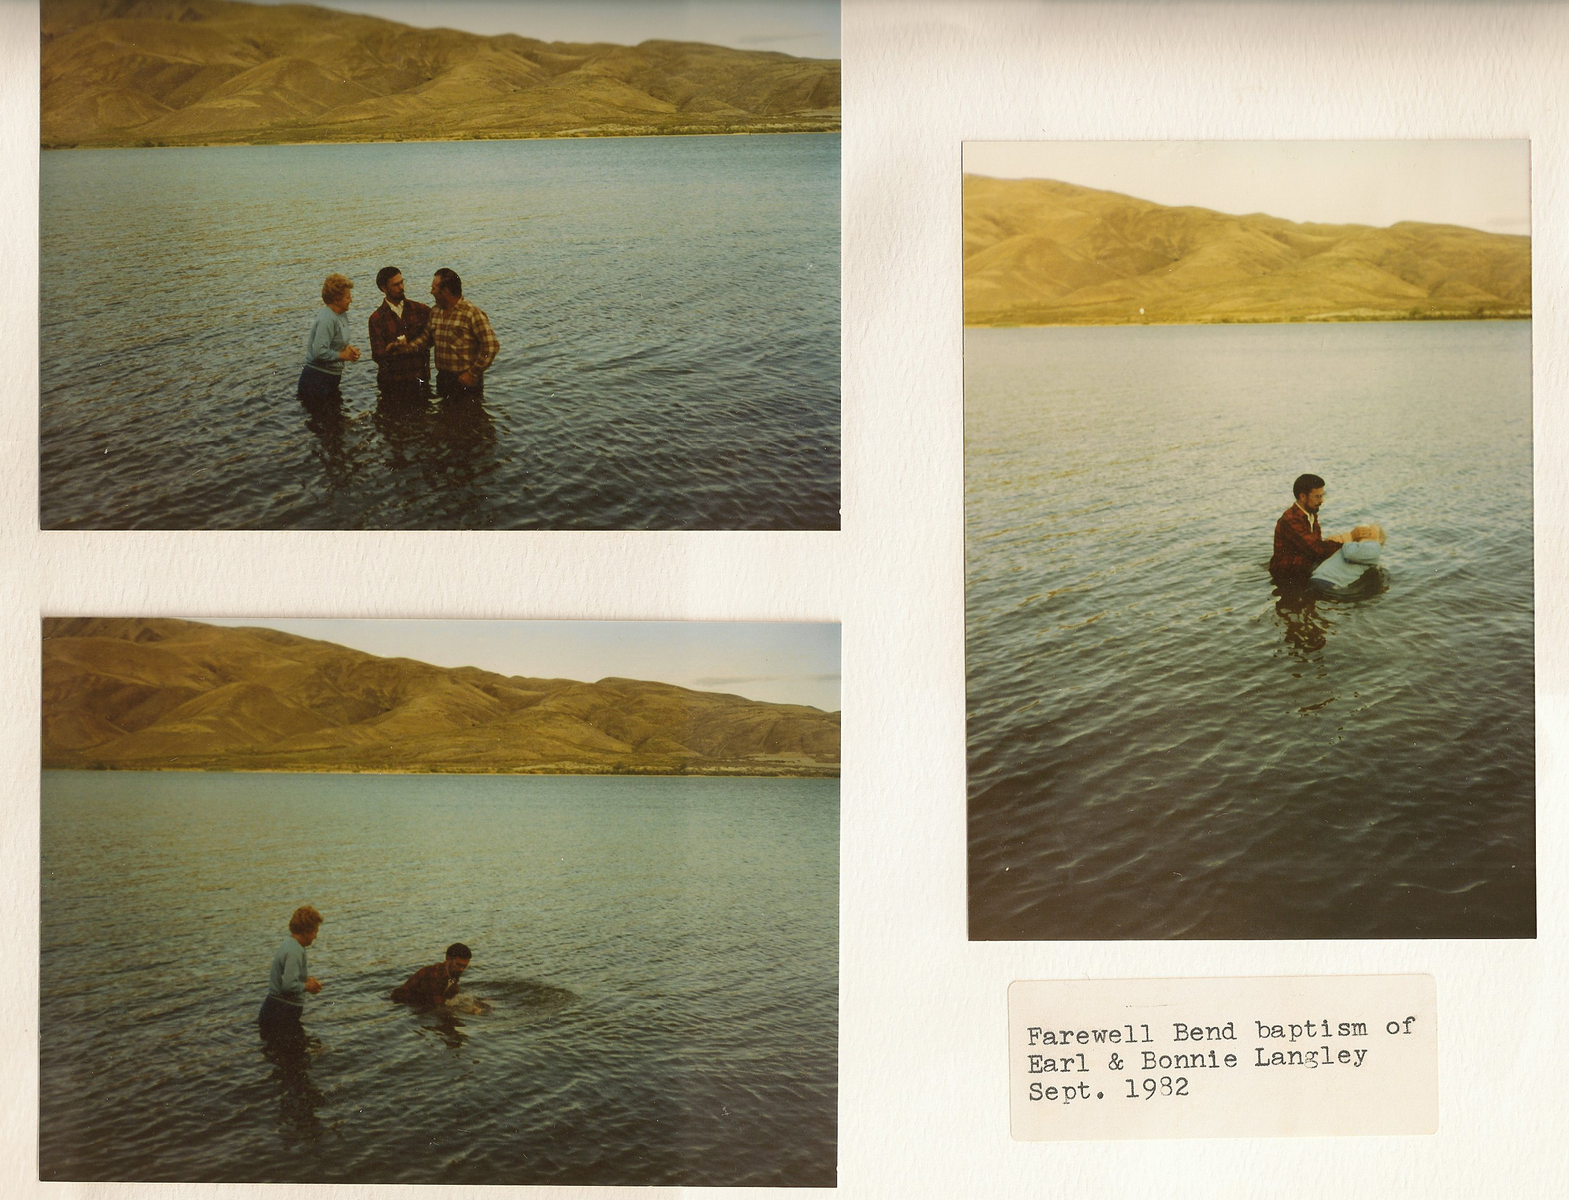
Notes:
Unites us historically
I Corinthians 10 – all were baptized in the cloud and in the sea, same spiritual food and drink, drank from the rock which is christ
Unites us with those who wandered in the wilderness during the exile.

Slide 10
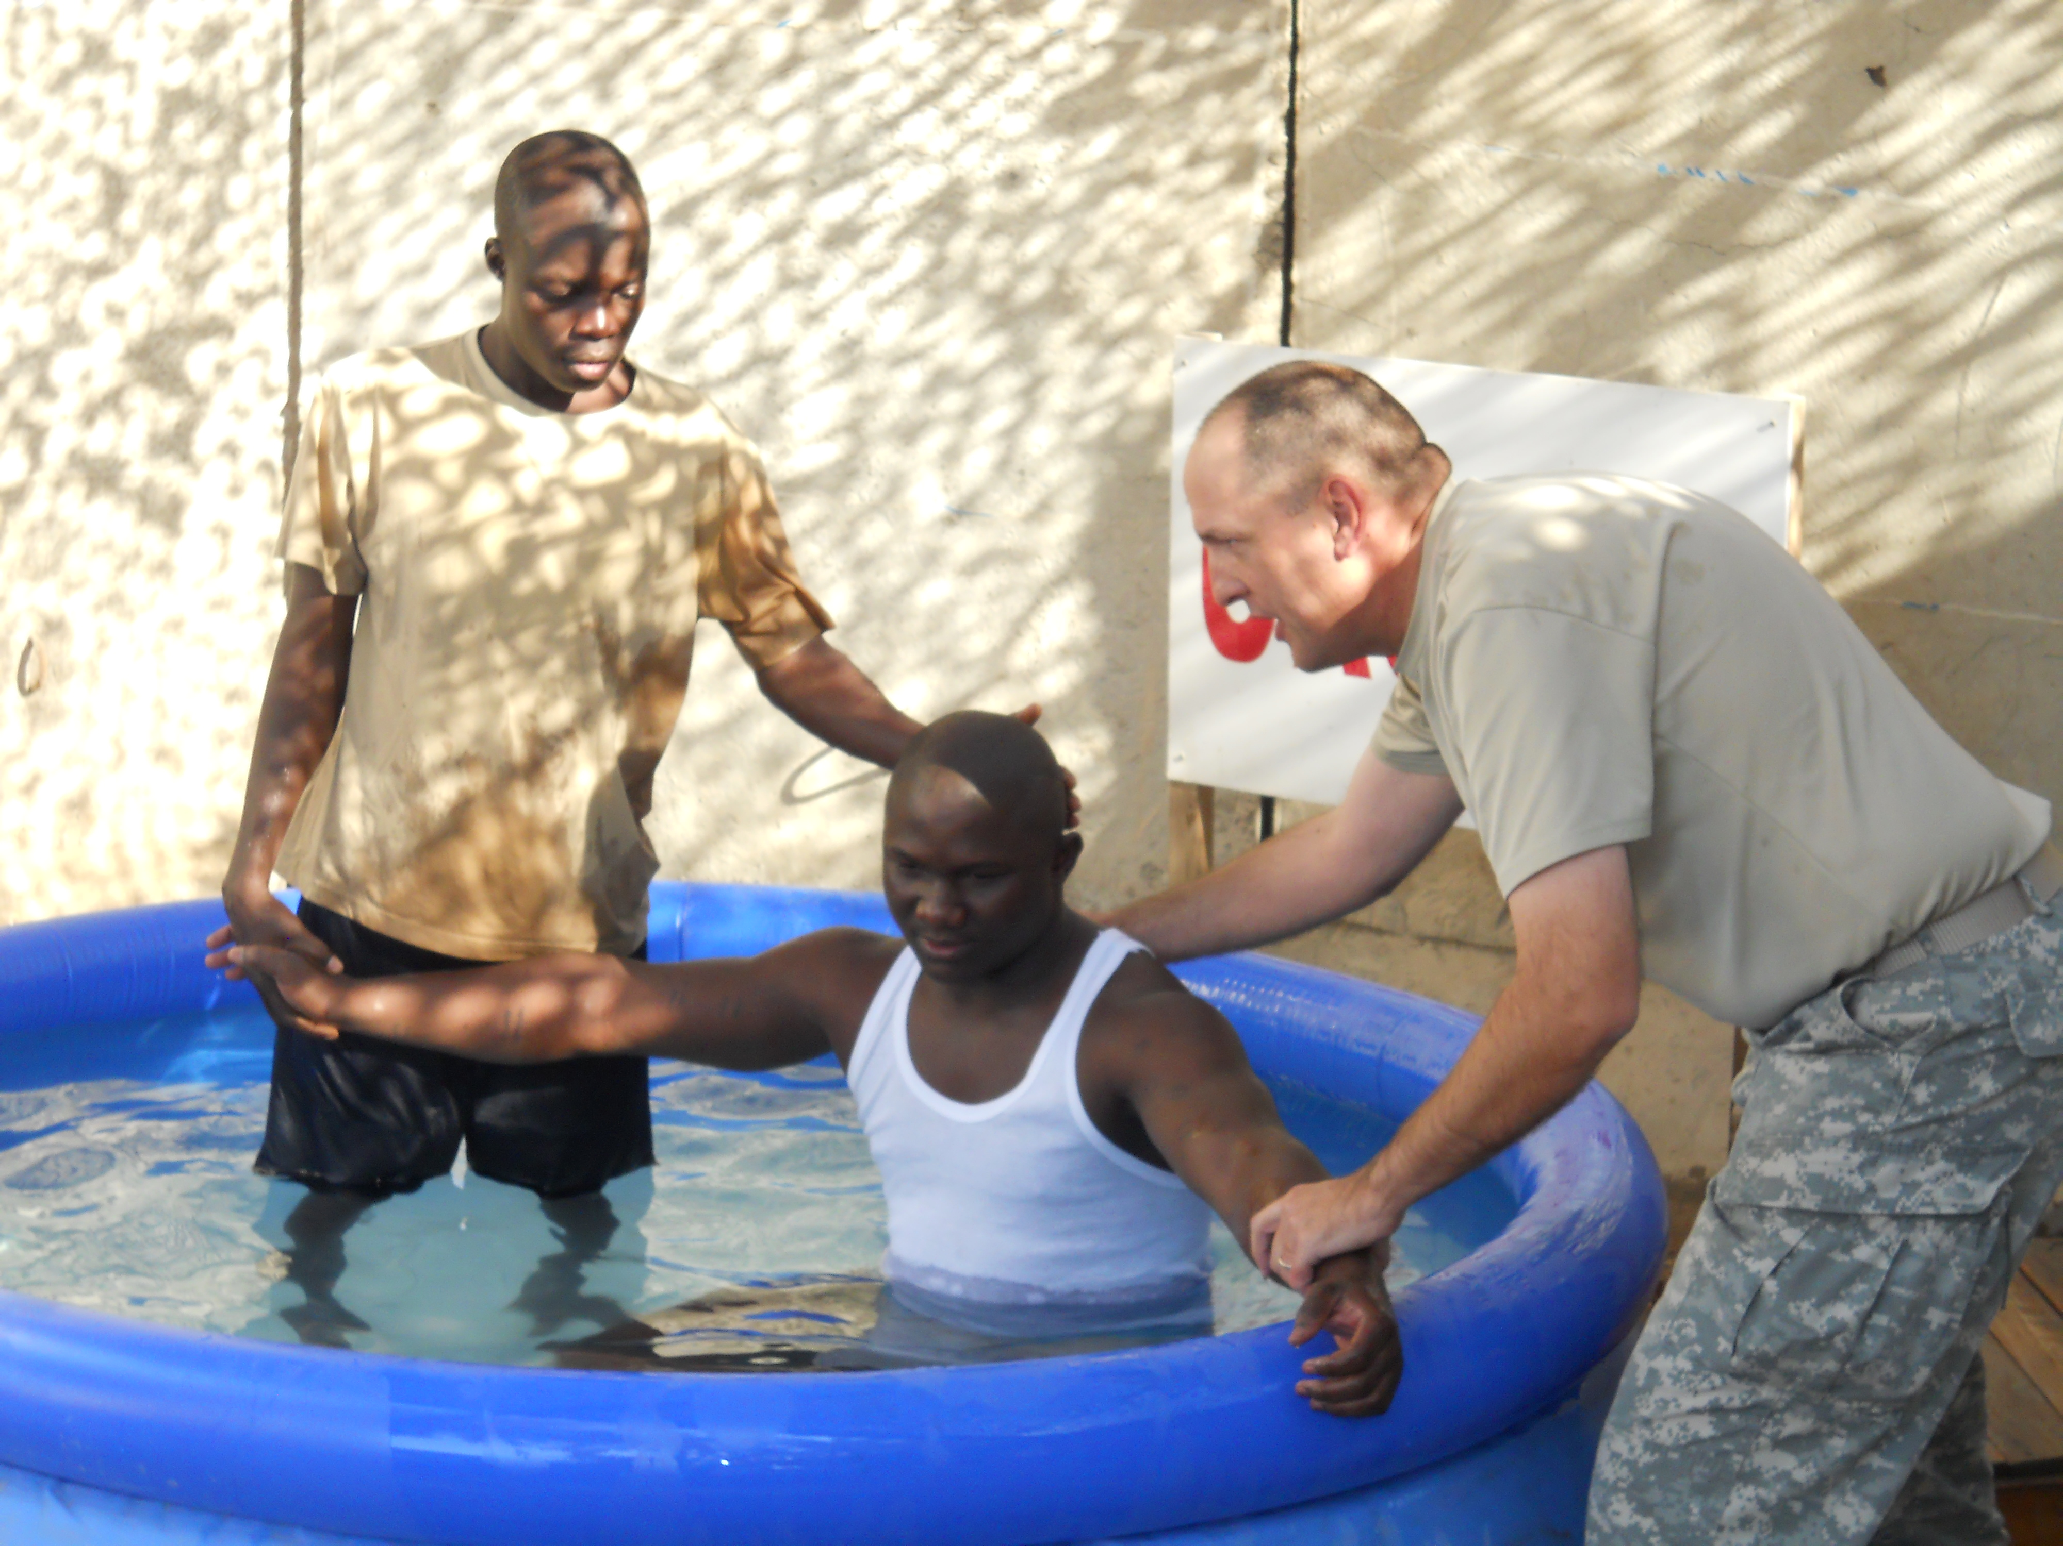
Notes:
Universal church – spiritual, Sierra Leone – pastor – led 50 people to Christ
Practical Application – living in unity and discipleship in a local congregation
Can someone be a Christian and not be an active part of a local congregation.

Slide 11
Application
Have you followed in obedience in the waters of baptism?
Notes:
Matt and Ann Millar
Why am I so excited when

