Slide 1
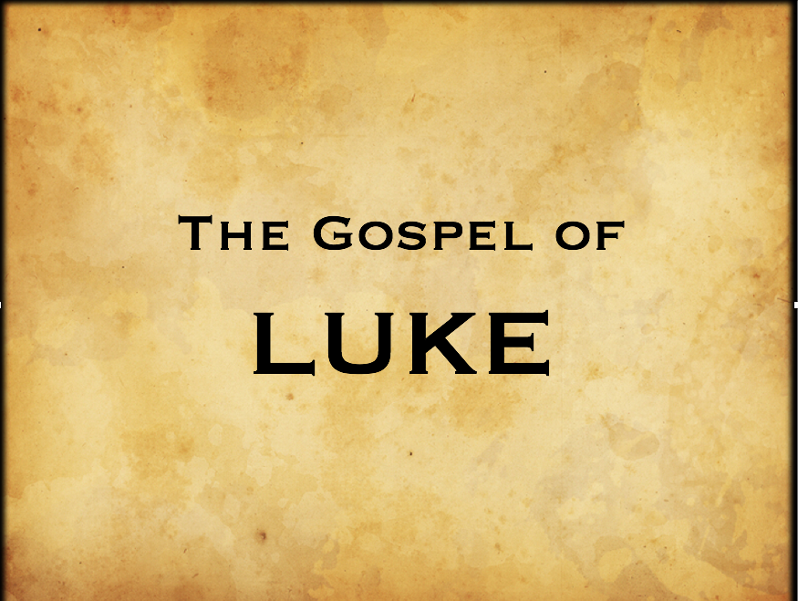
God’s Unalterable Plans
Luke 13:31-35

Slide 2
“God’s Unalterable Plan”
Luke 13:31-35
Intro: In this section we have five questions that need to be answered:
1. Why are Pharisees warning Jesus about a death threat from Herod?
2. Was Jesus breaking an OT Law in calling Herod a fox?
3. What does the phrase, “and the third day I finish my course mean?
4. Were all prophets killed in Jerusalem?
5. What does it mean to have your house made desolate?

Slide 3
“God’s Unalterable Plan”
Luke 13:31-35
I. Confidence in God’s Sovereignty
In His answer to the Pharisees Jesus shows disdain and contempt for Herod.
In calling Herod a fox, Jesus was using descriptive terminology, not baseless sarcasm.
To an Israelite, a fox was noted as unclean and insignificant.

Slide 4
“God’s Unalterable Plan”
Luke 13:31-35
I. Confidence in God’s Sovereignty
In the phrase, “I finish my course”, Jesus was referring to the finished work of redemption that His death on the cross accomplished.
The Bible is clear, the death of Christ was determined by God’s sovereign will, not by man’s evil design.

Slide 5
“God’s Unalterable Plan”
Luke 13:31-35
II. Unmerited Compassion
In the illustration of a hen and her brood we see Jesus offering compassion to a city known for killing God’s prophets.
He longed to gather the people of Jerusalem into His kingdom.
Scripture tells us that God takes no pleasure in the death of the wicked, Ezek. 33:11. He paid for ALL of us to enter! Rom. 5:8

Slide 6
“God’s Unalterable Plan”
Luke 13:31-35
III. Condemnation
The sovereignty of God and man’s responsibility to accept His offer of salvation is a mystery.
Rev. 22:7.
As with the consequences that Jerusalem suffered for their refusal, we, too will see our house made desolate, not just in the future, but in the present as well.
To be without God is to be without hope in the world. Eph. 2:12.

Slide 7
“God’s Unalterable Plan”
Luke 13:31-35
IV. Conversion
Though condemned for their disobedience now, God’s plan for Israel will be fulfilled in the future, Rom. 11:29-31, Ezek 12:10.
As long as the narrow door remains open, we, too can experience God’s amazing grace and mercy, regardless of our past, John 3:16.

