Slide 1
Perseverance of the Saints
Romans 8:32-35
Notes:
The truth about man is that we are forgetful, distracted, wishy washy, wandering, and sinful people
You may not believe this but I am somewhat of an airhead and I tend to loose things
Jr High – I was always loosing my jacket. I would go to school and take it off and forget to bring it home. Recess I would be running around and get hot and set it down somewhere and forget where I put it.
When I got a wallet I would often loose my wallet. When I got a set of keys I would often loose my keys.
Have you ever lost something?
If salvation is up to us we will loose it but it is not up to us it is up to God who keeps us.

Slide 2
The Doctrines of Grace
Oct 24 – Unconditional Election – Ephesians 1:4-6
Oct 31 – Definite Atonement – John 10:11-29
Nov 7 – Total Inability – Romans 3:9-12
Nov 14 – Effectual Call – 1 Corinthians 2:9-13
Nov 21 – Perseverance – Romans 8:32-35

Slide 3
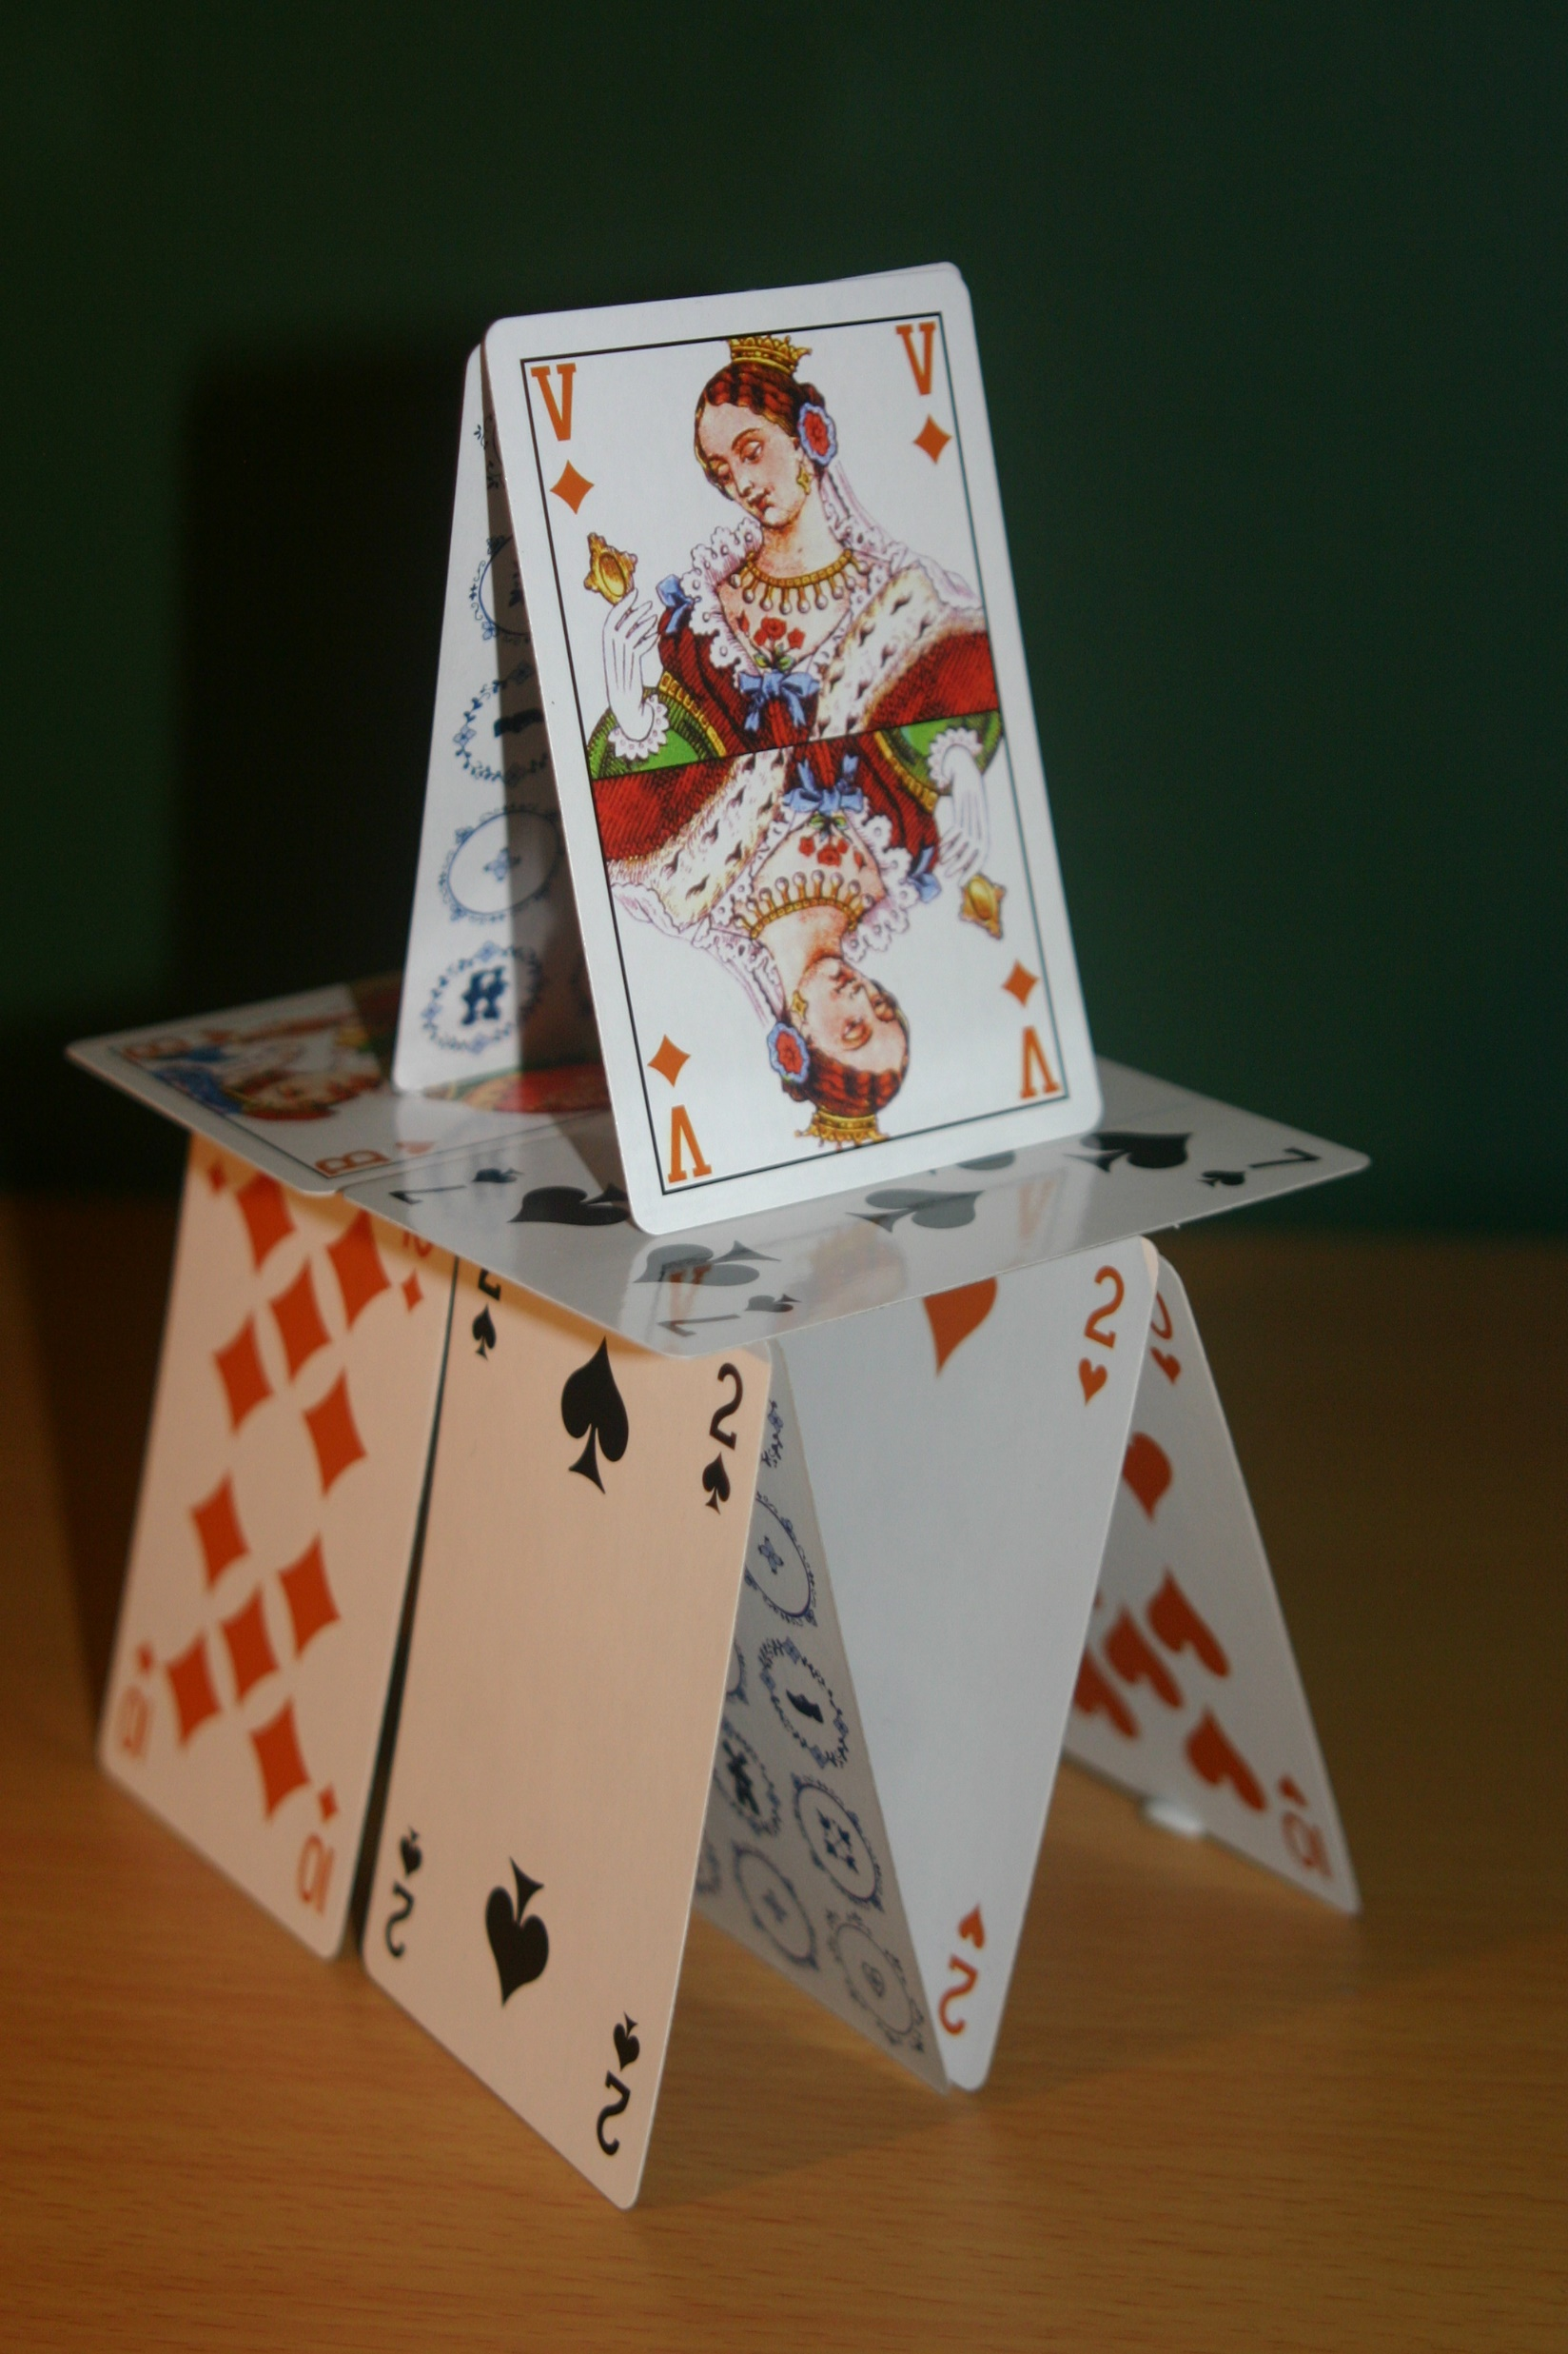
Notes:
Each one of these doctrines are a whole – they are essential to each other,
These are one of our favorite

Slide 4
Eternal Security or Perseverance of the Saints?
Notes:
Eternal Security – emphasize in a decision, walking the aisle, saying a prayer – mechanistic view of salvation
Salvation isn’t just the beginning but a continual lifestyle of following Christ as
Judge a persons heart or relationship with God – Foreign concept that a person can walk an aisle or say a prayer and then deny Christ and live a live to self
Sinners prayer is my ticket to heaven
Not based on Christ’s work but his continual work in your life

Slide 5
Salvation Is Guaranteed!
Foundation: Christ’s Atonement
Result #1: No Accusation
Result #2: No Condemnation
Result #3: No Separation
Notes:
From start to finish it is guaranteed by Christ

Slide 6
Foundation: Christ’s Atonement
Sovereignly Given By The Father
Christ Died For Us “All”
Forgive Us All Things – Past, Present, and Future
Sanctification and Providence

Slide 7
And when you, who were dead in your trespasses and the uncircumcision of your flesh, God made alive together with Him, having forgiven us all our trespasses.
  -Colossians 2:13

Slide 8
I am sure of this, that he who began a good work in you will bring it to completion at the day of Jesus Christ.
-Philippians 1:6
Notes:
Perseverance is not eternal security
Puritan writer John Flavel – Did Christ finish his work for us? Then there can be no doubt, but he will finish his work in us!

Slide 9
“Forgiveness of sins will never be taken back. If you’ve been born again, you can’t be unborn.”
-Medders
“We persevere in grace because God perseveres in his love toward us.”
-Sproul
Notes:
Medders – book Humble Calvinism
Couple of great illustrations that reminded me of stories
Story of Toby – took him everywhere, stuffing came out, his eyes fell off, he got dirty and washed multiple times
Sean’s cherished toy dog
We are Christ’s cherished church – he will never let us go

Slide 10
Result #1: No Accusation
v33 “Charge” Summons to Court
Against the Elect
God is the one who is the Judge

Slide 11
Now the salvation, and the power, and the authority of His Christ have come, for the accuser of our brethren has been thrown down, he who accuses them before our God day and night
  -Revelation 12:10

Slide 12
These will wage war against the Lamb and the Lamb will overcome them, because He is Lord of lords and Kings of kings, and those who are with Him are the called and chosen and faithful
  -Revelation 17:14
Notes:
Beast – who haughty and blasphemes and insults God and His people
Slandered and criticized and accused – happen in this World
What do I do?
Think about the Lamb of God who defeats Satan and the world
Jesus on the cross, slandered, mocked, and reviled
Did not revile in return – Lamb led to slaughter – he did not open his mouth
Kept entrusting Himself – God the Father, the righteous judge.

Slide 13
Result #2: No Condemnation
v34 Who condemns?
Christ died!
For US
Right hand of God – Christ is the judge
Interceding
Notes:
While we were still sinners

Slide 14
There is therefore now no condemnation for those who are in Christ Jesus, For the law of the Spirit of life has set you free form the law of sin and death
-Romans 8:1-2

Slide 15
Therefore He is able to save forever those who draw near to God through Him, since He always lives to make intercession for them.
  -Hebrews 7:25
Notes:
Revelation – Great White Throne Judgment
Judgment – all the things we have done wrong, man it’s a pretty long list, both before we came to Christ and after
Am I worthy
Great White Throne Judgement
Throne Room of Grace – Christ’s Judgment
Incarnation – next week, our salvation is not based on our goodness it is based on Christ’s goodness

Slide 16
Result #3: No Separation
v35 Tribulation – Press (suffering)
Distress – squeezed
Persecution
Famine, nakedness, danger, or the sword
v37 No we are more than conquerers
Notes:
Perseverance of the Saints – question is salvation Man’s Free Will or By God’s Sovereign Grace
NOTHING Can Separate Us – not because of our free will but because of God’s grace
Impossible Things – Only be sustained by God’s grace

Slide 17
I give them eternal life, and they will never perish, and no one will snatch them out of my hand. My Father, who has given them to me, is greater than all, and no one is able to snatch them out of my Father’s hand.
  -John 10:28-29

Slide 18
You will live in a constant state of fear if you think salvation can be lost. You will worry whether you are reading your Bible enough, whether you are praying enough, or whether you might just sin too many times and salvation is going to slip through your fingers. God wants to lift that burden off of you. It’s not yours to carry.
-Medders
Notes:
Lost story

Slide 19
Application #1: Beyond Panic or Pride
Panic – “I’m a failure”
Pride – “I don’t understand why people struggle so much.”
Remember you are united with Christ

Slide 20
Application #2: Confidence Not Complacency
Perseverance of the Saints
We are called to be disciples not decision makers.

Slide 21
Humble Calvinism rests and rejoices in the hands of God. No panic. No arrogant pride. No complacency, either. And we do so confidently and humbly, for from womb to tomb—from the Lamb’s book of life to the marriage supper of the Lamb—we are in God’s hands. And he never lets go.
  -Medders

Slide 22
Give Thanks!
Notes:
We live in a culture that feels entitled – that we are owed something
Increasingly a culture that is less and less grateful – we fail to give thanks
God doesn’t owe us anything
Our depravity and God’s grace – We are affirming that God doesn’t owe us anything but freely gives

