Slide 1

“Be Careful WhoYou Follow”
Luke 6:39-45

Slide 2
“Be Careful Who You Follow”
Luke 6:39-45
Intro: We’ve learned that in our relationships with others, judgments are sometimes necessary.
In dealing with sin or issues of immorality, there is no such thing as remaining neutral. To do so is always to side with evil.
A mark of a true disciple of Jesus is one who:
1. Embraces what the world despises,
2. Resists what the world Cherishes, and,
3. Loves those the world casts aside.
A true disciple travels a different path than the world.

Slide 3
“Be Careful Who You Follow”
Luke 6:39-45
Intro:
A true disciple is one who:
1. Is overwhelmed with his own sense of sin,
2. One who loves his enemies with a
supernatural love,
3. One who submits to the lordship of Jesus
Christ.

Slide 4
“Be Careful Who You Follow”
Luke 6:39-45
I. Four Discerning Questions
A. Does the teacher teach scripture?
1. He should draw a conclusion from the text,
not use the text to support his conclusions.
B. Do they use scripture appropriately?
1. Be a Berean. Check out what is said.
C. Does he give the whole council of God?
1. Are the sermons just topical?
D. What do his students look like?
1. Are they Biblically solid, or judgmental?

Slide 5
“Be Careful Who You Follow”
Luke 6:39-45
II. Four Characteristics of False Teachers
A. They Are Blind Guides, vs. 39
Being blind is used metaphorically in the Bible
for not having any spiritual sight or insight.
B. They Are Worldly, vs. 40
They teach worldly principals, & philosophies, and produce worldly students.

Slide 6
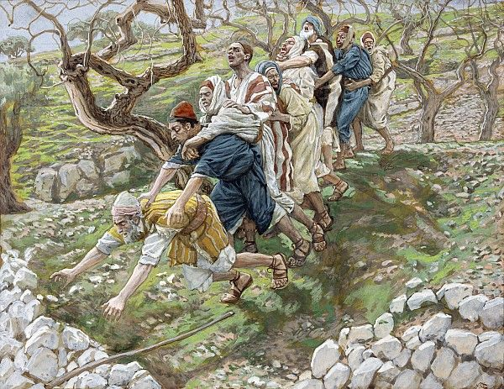

Slide 7
“Be Careful Who You Follow”
Luke 6:39-45
II. Four Characteristics of False Teachers
A. They Are Blind Guides, vs. 39
Being blind is used metaphorically in the Bible
for not having any spiritual sight or insight.
B. They Are Worldly, vs. 40
They teach worldly principals, & philosophies, and produce worldly students.

Slide 8
“Be Careful Who You Follow”
Luke 6:39-45
II. Four Characteristics of False Teachers
C. They Are Hypocrites, Vss. 41-42
They are self deceived in believing their self righteous state. No one who thinks he’s righteous can help a sinner.
D. They Are Evil, Vss. 43-45
They are without piety. They can only produce what is their nature, Matt. 12:33-34.

Slide 9
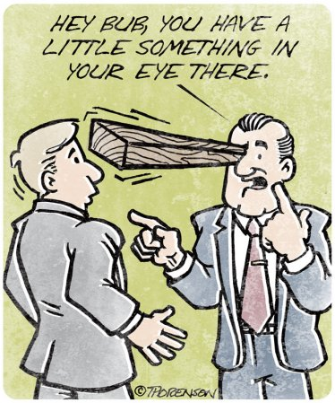

Slide 10
“Be Careful Who You Follow”
Luke 6:39-45
II. Four Characteristics of False Teachers
C. They Are Hypocrites, Vss. 41-42
They are self deceived in believing their self righteous state. No one who thinks he’s righteous can help a sinner.
D. They Are Evil, Vss. 43-45
They are without piety. They can only produce what is their nature, Matt. 12:33-34.

