Slide 1
Matthew 2:16-23
Notes:
WE WANT TO BE PERFECT
THERE ARE TIMES WHEN WE FEEL LIKE A FAILURE
PERFECT CHRISTMAS
PINTEREST FAILS – ORNAMENTS, CUPCAKES, COOKIES
FIRST ONE
ORNAMENT FAIL – BALLOON AND STRING

Slide 2

Notes:
BEATIFUL STRING BALL ORNAMENT
POPPED THE BALLOON – COLLAPSED
NEXT – CUPCAKES PUT TOGETHER FESTIVE ARRANGEMENT

Slide 3
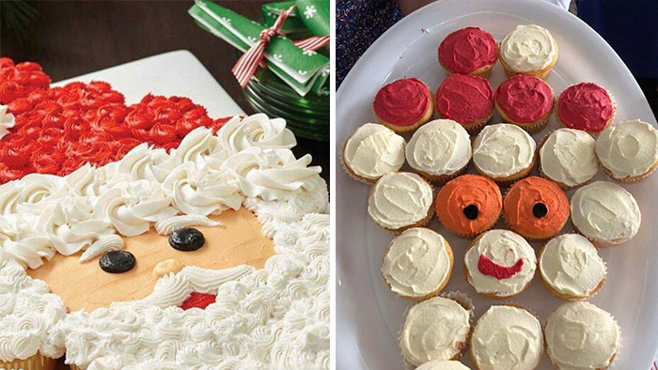
Notes:
SANTA – CANT EVEN SEE THEY ARE CUPCAKES
MONKEY
NEXT – COOKIE ORNAMENTS

Slide 4
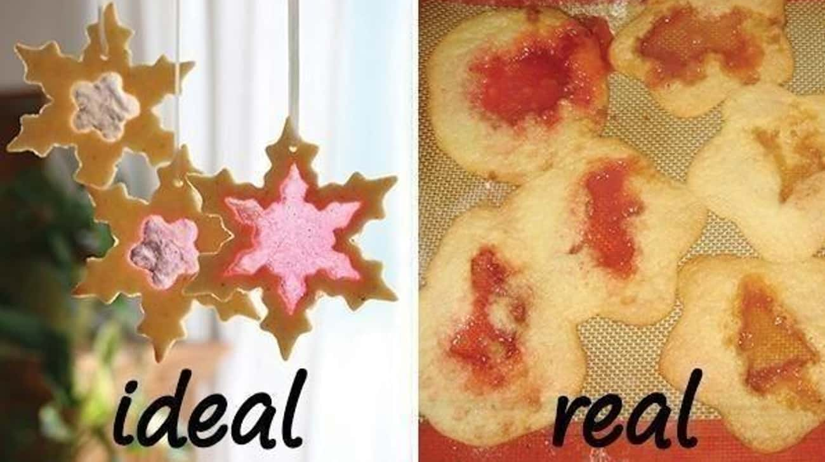
Notes:
IDEAL
REALITY
NEXT - COOKIES

Slide 5
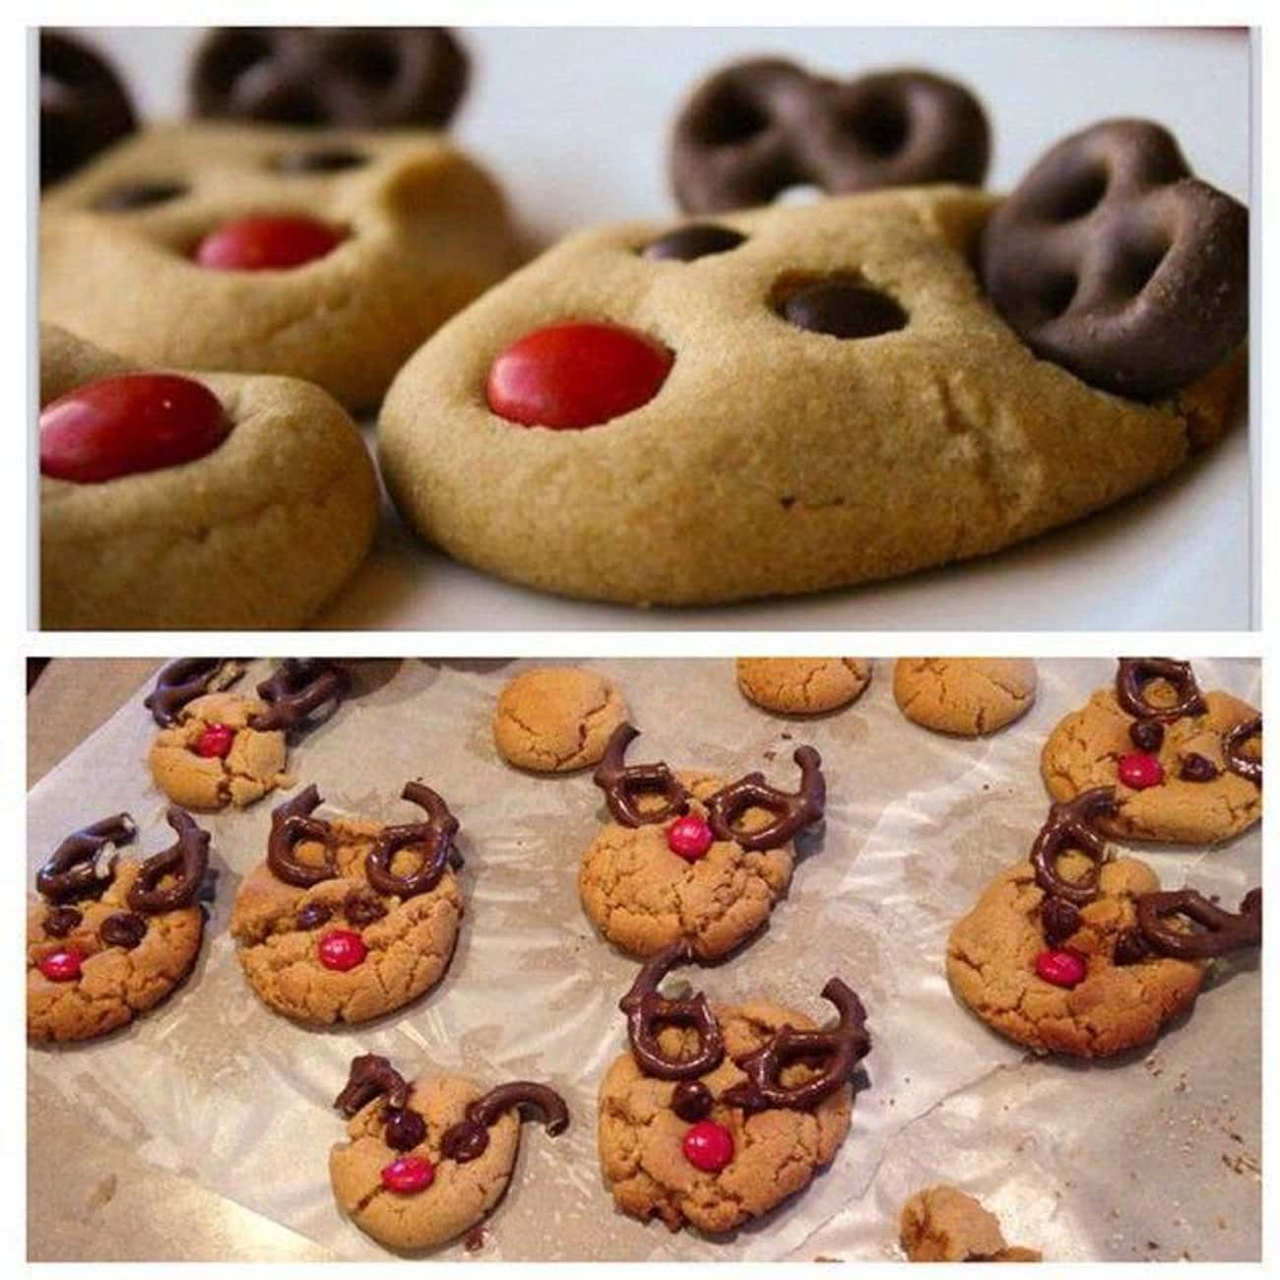
Notes:
REINDEER COOKIES – PRETZEL EARS
TURNED OUT LIKE JUNIOR BIRDMEN GLASSES

Slide 6
Matthew 2:16-23

Slide 7
Jesus Is Man’s Second Chance
Notes:
TITLE – HOW DID YOU GET THIS OUT OF THIS PASSAGE
KNOW THE FULL BIBLE – STUDENT – CROSS REFERENCES
BE A STUDENT OF THE BIBLE
LAZY OR OPINIONATED – DILIGENT AND HUMBLE
DISCERN TRUTH FROM ERROR – EXPOSITORY PREACHING
GOD MADE PROMISES ISRAEL – ISRAEL BE A BLESSING TO THE NATIONS – FAILED
JESUS SUCCEEDED WHERE ISRAEL FAILED

Slide 8
Jesus Lived The Life You
Should Have Lived
Notes:
IMPUTED RIGHTEOUSNESS – NOT MINE IT IS GIVEN
ABRAHAM BELIEVED – COUNTED AS RIGHTEOUSNESS

Slide 9
MATTHEW 2:14–15 ESV
And he rose and took the child and his mother by night and departed to Egypt and remained there until the death of Herod. This was to fulfill what the Lord had spoken by the prophet, “Out of Egypt I called my son.”
Notes:
FULFILL –
TYPOLOGY – ISRAEL IS A TUPE OF CHRIST
HISTORICAL STORIES – CONNECTED TO FUTURE STORIES
ISRAEL AND CHRIST – COMPARED AND CONTRASTED
BOTH CALLED

Slide 10
HOSEA 11:1–3 ESV
When Israel was a child, I loved him, and out of Egypt I called my son. The more they were called, the more they went away; they kept sacrificing to the Baals and burning offerings to idols. Yet it was I who taught Ephraim to walk; I took them up by their arms, but they did not know that I healed them.
Notes:
WHERE ISRAEL FAILED JESUS SUCCEEDED
I DID NOT COME TO ABOLISH THE LAW BUT FULFILL IT

Slide 11
In Matthew’s view, God restarted Israel in her Messiah, Jesus. Jesus relived the history of Israel.
-Alexander
Notes:
JESUS – SECOND ISREAL
DO OVER
GOLFING CHARLIE, BOB, RANDY
MULLIGAN – GRACE – ONE
SECOND SHOT

Slide 12
Why twelve disciples?
Why did Jesus undergo 40 days of temptation in the wilderness?
Why did Jesus need to be
baptized when he was sinless?
Notes:
JESUS RECONSTITUTES THE TWELVE TRIBES WITH ALLEGIANCE TO HIMSELF
JESUS – TESTED AND OVERCAME – ISRAEL REBELLED
IDENTIFYING WITH ISRAEL – RED SEA
MATTHEWS GOSPEL – RETELLING THE STORY OF ISRAEL THROUGH JESUS
JESUS SUCCEEDS WHERE ISRAEL FAILED

Slide 13
Jesus Took Upon Himself
Your Suffering
Notes:
SUFFERING – HOLIDAYS
JESUS – UNITED WITH HIS SUFFERING

Slide 14
MATTHEW 2:17 ESV
Then was fulfilled what was spoken by the prophet Jeremiah: “
Notes:
JEREMIAH – TWICE ISRAEL IS GOD’S SON
WEEPING – CONTEXT DEPORTATION TO BABYLON, EXILED

Slide 15
MATTHEW 2:17 ESV
A voice was heard in Ramah, weeping and loud lamentation, Rachel weeping for her children; she refused to be comforted, because they are no more.
Notes:
WEEPING – TURN TO JOY AND RESTORATION
JESUS EXILED, SUFFER – RESTORATION AND HEALING PROPHESIED

Slide 16
ISAIAH 53:3, 5 ESV
He was despised and rejected by men, a man of sorrows and acquainted with grief; upon him was the chastisement that brought us peace, and with his wounds we are healed.

Slide 17

Notes:
GRIEF – SORROW
LLOYD, BOB BELL, KEN WEBB, NANDO
THERE IS HOPE FOR THOSE WHO SORROW IN CHRIST

Slide 18
Jesus Is The Faithful King

Slide 19
MATTHEW 2:23 ESV
And he went and lived in a city called Nazareth, so that what was spoken by the prophets might be fulfilled, that he would be called a Nazarene.
Notes:
SMALLNESS
NAZARE – BRANCH
BRANCHVILLE

Slide 20
ISAIAH 11:1, 5 ESV
There shall come forth a shoot from the stump of Jesse, and a branch from his roots shall bear fruit. Righteousness shall be the belt of his waist, and faithfulness the belt of his loins.

Slide 21
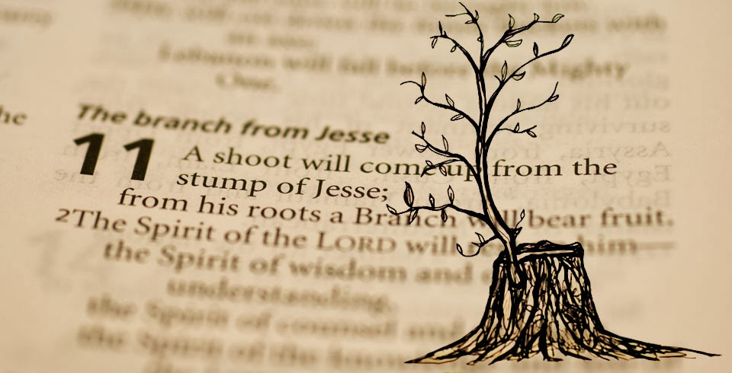
Notes:
ISRAELS KINGS HAVE FAILED
JUST LIKE ALL HUMAN KINGS – NO HOPE IN HUMAN KINGS
HOPE IS IN THE BRANCH
ALMIGHTY GOD, EVERLASTING FATHER, PRINCE OF PEACE

Slide 22

Saved, but only as through fire?
1 Corinthians 3
Notes:
MAYBE YOUR FEELING LIKE A FAILURE
MOST MISUNDERSTOOD VERSE IN THE BIBLE
TRUSTING MAN MADE GOOD WORKS
FOUNDATION OF SALVATION IS JESUS
YOUR PUTTING YOUR FAITH IN THE WRONG PLACE
THE LIFE OF CHRIST IS THE ONLY BASIS FOR OUR JUSTIFICATION

Slide 23
Instead of failing to mediate God’s blessings to the nations, Jesus succeeded in his sinless life and atoning death.
-Alexander
Notes:
SINNER – REPENT AND BELIEVE
SUCCESS IN HIS SINLESS LIFE

Slide 24
APPLICATION
Do you believe that God is the God of the second chance?
Notes:
STORY OF GRACE AND MERCY – NO ONE HEAR HASN’T FAILED
COMPANY OF GRACE
JOYS OF BAPTISM
DON AND MATT AND ANN

