Slide 1
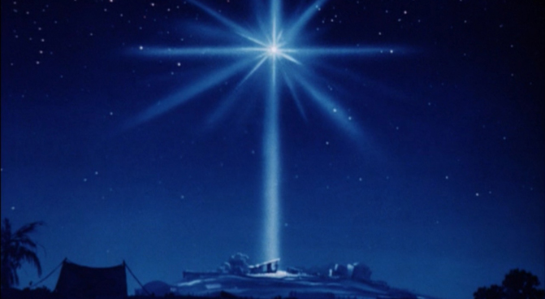
The Best News in the World
Luke 2:1-20

Slide 2
“The Best News in the World”
Luke 2:1-20
Intro:
The birth of Christ is the most profound event in all of human history.
Not everyone sees the birth of Christ as the Best News for a couple of reasons:
1. Familiarity,
2. Lack of understanding.

Slide 3
“The Best News in the World”
Luke 2:1-20
I. The Birth of Christ is Historically True:
Most people are satisfied with the legends of Christmas, rather than the objective facts it presents:
1. It proves the existence of God,
2. It shows people are alienated from God and in need of a Savior.

Slide 4
“The Best News in the World”
Luke 2:1-20
II. The Good News is Based on His Unique Person
1. He is fully Man,
2. He is Fully God, Lk. 2:9,11,23,
3. He is the Christ, Ps. 110
4. He is the Savior, Romans 4:12

Slide 5
“The Best News in the World”
Luke 2:1-20
III. The Good News About Christ is for Everyone
The first witnesses of this profound event were shepherds because:
1. They represented the disenfranchised,
2. Seeing the Lamb of God resonated with these men,
3. It shows Jesus as the Good Shepherd, John 10:11.

Slide 6
“The Best News in the World”
Luke 2:1-20
IV. The Good News about the Savior brings Light, Fear and Joy.
The image of Shepherds sitting in darkness speaks to the darkness of the human heart without the Savior.
The glory of the Lord illuminated the darkness around these men, as the Holy Spirit illumines the darkened heart with the Gospel.

Slide 7
“The Best News in the World”
Luke 2:1-20
V. The Good News about Christ Requires a Personal Response
1. A response of faith, vs. 15,
2. A response of proclamation, vs. 17,
3. A response of praise, vs. 20b,
4. A response of endurance, vs. 20.

