Slide 1
John 10:9-11
Notes:
SANCTITY OF HUMAN LIFE SUNDAY
STILL BROKENNESS
STILL SIN
STILL SPIRITUAL BATTLE

Slide 2

Notes:
HUMAN LIFE IS SACRED – EVEN IN THE WOMB
MAN IS CREATED IN THE IMAGE OF GOD
INHERENT LIFE AND DIGNITY
SIN – WOMEN AND CHILDREN – JESUS IS THE REDEEMER AND HEALER

Slide 3
Be Pro Abundant Life
Notes:
MESSAGE TITLE
CONTRAST BETWEEN THEIVES
GOOD SHEPHERD
LOTS OF FALSE SHEPHERDS
ONLY GOOD SHEPHERD GIVE’S ETERNAL LIFE
SATAN HATES BABIES – PLANNED PREGNANCY SPREADS LIE TO FUEL THE BUSINESS OF ABORTION

Slide 4
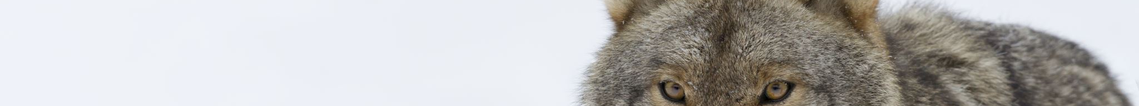
Identify Theives
Notes:
LAST DAYS – MANY FALSE TEACHERS
SAY THE RIGHT THINGS
WE BOTH LOVE THE SAME JESUS
WE BOTH BELIEVE THAT JESUS IS THE WAY TO THE FATHER
DOCTRINE WE SEE CLEARLY THERE IS A COMPLETELY DIFFERENT JESUS AND A COMPLETELY DIFFERENT FATHER

Slide 5
JOHN 10:10 ESV
The thief comes only to steal and kill and destroy.
Notes:
PEOPLE THAT ARE AGAINST LIFE
PEOPLE THAT ARE FOR LIFE BUT THEY ARE NOT FOR THE TRUE DOCTRINE OF JESUS CHRIST
SAY THE RIGHT THING
END GOAL IS TO DESTROY SPIRITUAL LIFE

Slide 6
1 JOHN 4:2-3 ESV
By this you know the Spirit of God; every spirit that confesses that Jesus Christ has come in the flesh is from God, and every spirit that does not confess Jesus is not from God. This is the spirit of the antichrist, which you heard was coming and now is in the world already.
Notes:
ETERNAL GOD – ALWAYS ETERNAL – BECAME FLESH
SPIRIT OF ANTICHRIST
DOCTRINE REALLY DOES MATTER TO GOD

Slide 7
I JOHN 2:22 ESV
Who is the liar but he who denies that Jesus is the Christ? This is the antichrist, he who denies the Father and the Son.
Notes:
FALSE CHRISTS SAY THE RIGHT THING
THEY HAVE A DIFFERENT FATHER AND A DIFFERENT SON

Slide 8
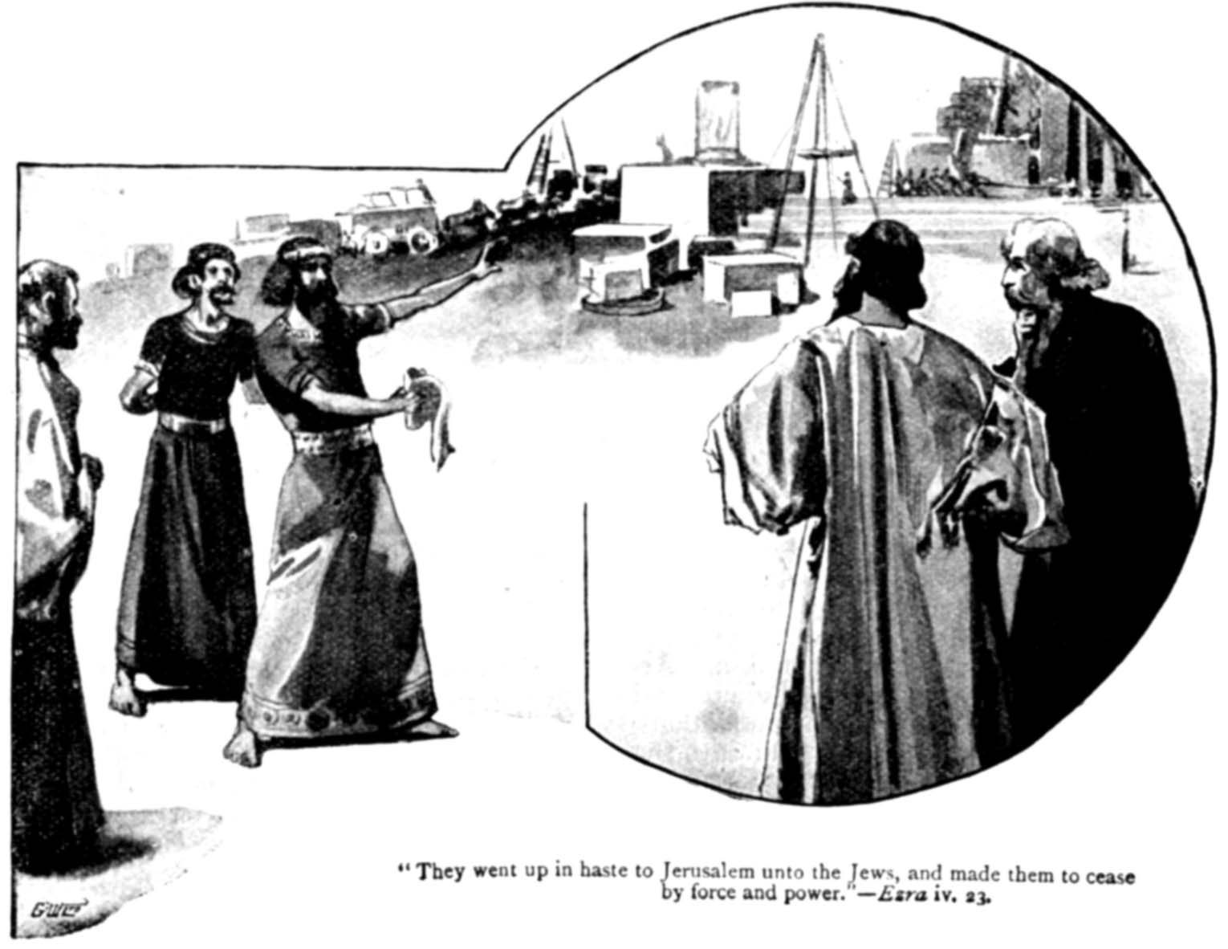
Notes:
ETS – OT SURVEY
EZRA – ENEMIES OF ISRAEL
WE WORSHIP THE SAME GOD YOU DO
LET ME HELP YOU
MANY PRO LIFE MINISTRIES THAT ARE NOT PRO ABUNDANT LIFE
PEOPLE WHO ARE NOT BORN AGAIN – FALSE TEACHERS WANT TO SUPPORT
GIVE MONEY AND TIME

Slide 9
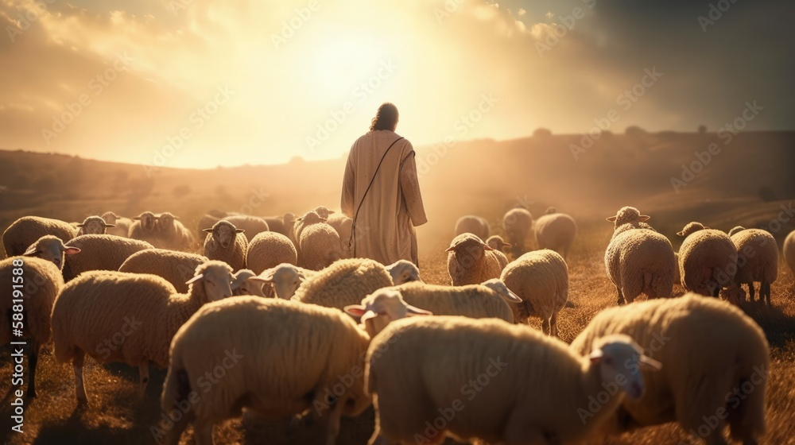
Christ Alone Gives Abundant Life
Notes:
CHRIST ALONE – THE ONE TRUE JESUS CHRIST OF THE SCRIPTURES AND SOUND DOCTRINE
ABUNDANT – SPIRITUAL LIFE
JESUS IS THE ONLY ONE WHO CAN GIVE JOY, VICTORY AND MEANING TO LIFE

Slide 10
JOHN 10:10B–11A ESV
I came that they may have life and have it abundantly. I am the good shepherd.
Notes:
GOOD SHEPHERD

Slide 11
JOHN 10:9 ESV
I am the door. If anyone enters by me, he will be saved and will go in and out and find pasture.

Slide 12
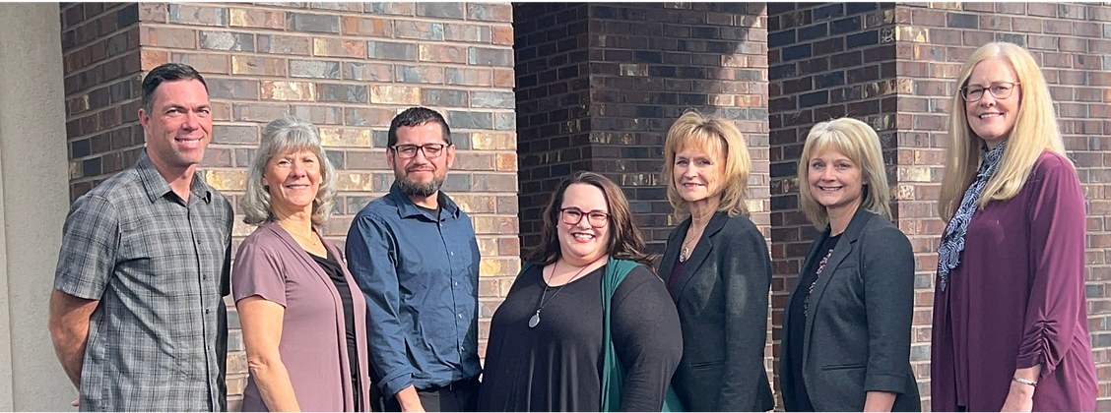
HOPE PREGNACY CENTER, ONTARIO
Notes:
NOT ULTRASOUNDS
NOT SUPPORT AND EDUCATION
NOT BECAUSE OUR VERY OWN DEB NYBERG
NOT BELIEVE IN THE SANCTITY OF HUMAN LIFE
NOT BECAUSE THEY ARE SAVING BABIES
PRO ABUNDANT LIFE – CHRIST CENTERED – PREACH THE GOSPEL – TRANSFORM LIVES
WE EXIST TO GLORIFY GOD BY MAKING DISCIPLES

Slide 13
We realize the foundation of our ministry is the truth of the gospel of Jesus Christ. Christ alone is the source of the love, forgiveness, and salvation that every client and her family needs. We are committed to graciously
Notes:
If your pregnancy center doesn’t
Growth Group – move beyond pulling babies out of the river
Transformational ministry – making disciples through the gospel of jesus christ

Slide 14
Christ Alone Atones For Our Guilt and Shame

Slide 15
JOHN 10:11 ESV
I am the good shepherd. The good shepherd lays down his life for the sheep.

Slide 16
ISAIAH 53:6 ESV
All we like sheep have gone astray; we have turned—every one—to his own way; and the LORD has laid on him the iniquity of us all.

Slide 17
1 PETER 2:24–25 ESV
He himself bore our sins in his body on the tree, that we might die to sin and live to righteousness. By his wounds you have been healed. For you were straying like sheep, but have now returned to the Shepherd and Overseer of your souls.

Slide 18


Slide 19
Application
Notes:
CHRIST CENTERED – MAKE DISCIPLES

Slide 20

Notes:
FEBRUARY 28TH
BULLETIN INSERT

