Slide 1

The Gospel of Luke
“The Kingdom Conundrum”
Luke 17:20-37

Slide 2
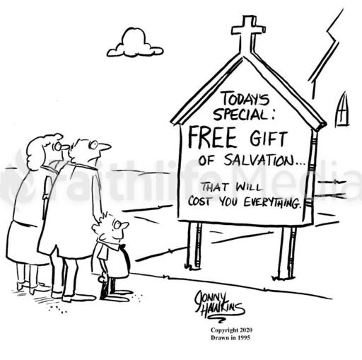

Slide 3
“The Kingdom Conundrum”
Luke 17:20-37
Intro: A conundrum is a paradoxical event or statement that appears, on the surface to be contradictory.
Jesus’ teaching contains several seemingly paradoxical or contradictory statements, such as Lk.22:26, and Jn. 11:25-26.
Our scripture this morning contains the Already Hear/Not Yet conundrum of the Kingdom of God.

Slide 4
“The Kingdom Conundrum”
Luke 17:20-37
I. A Present Kingdom Unnoticed:
The term, “kingdom” as used by Jesus is the Greek word, “Basileia”, and generally refers to reign rather than realm.
Jesus spoke of a spiritual kingdom in His teaching. The Jews were looking for an external, political kingdom.
Because they refused to believe Isaiah 53 regarding the Suffering Servant, they missed the present reality of this spiritual kingdom.

Slide 5
“The Kingdom Conundrum”
Luke 17:20-37
II. A Future Kingdom, Visible and Desired:
In this section Jesus was warning His disciples that tough times were ahead, that trials and persecutions would follow His death and resurrection.
Jesus warns that times will come when our ability to gather to worship and to fellowship will cease and we will long for the days when we could.
In Vss. 23-24 Jesus says His 2nd coming will not just be noticeable, but that all will see it, whether they’re looking for it or not!

Slide 6
“The Kingdom Conundrum”
Luke 17:20-37
III. Conditions At His Coming:
Most would agree that the times of Noah and that of Sodom and Gomorrah were evil times.
Jesus doesn’t refer to the evil, but to common events of everyday life. But they were living with little to no thought about the consequences of the evil among them.

Slide 7
“The Kingdom Conundrum”
Luke 17:20-37
IV. The Suddenness of His Coming:
We know from scripture that the Rapture, or Parousia of the church will be sudden; “in the twinkling of the eye”, 1 Cor. 15:52.
The main point of Jesus is; at His return there will be sheep and goats; those who lived faithful lives and looked for His coming, and those who didn’t.
Being close to one who escapes God’s wrath doesn’t spare you from it. It’s a personal decision.

