Slide 1
Matthew 1:1-17
Christ, The Promised King
Notes:
It seems like a long time until Christmas if you are a child
As adults it seems like it goes rather quickly
It seems like a long time that people wait for God to fulfill his promises

Slide 2
God Is Faithful To Keep His Promises, No Matter How Long It Takes

Slide 3
Matthew 1:1 - Christ
Genesis 3:15
“I will put enmity between you and the woman,
and between your offspring and her offspring;
he shall bruise your head, and you shall bruise his heel.”
Notes:
Promise to Satan – future chosen one

Slide 4
Matthew 1:2
Genesis 22:18
“and in your offspring shall all the nations of the earth be blessed, because you have obeyed my voice.”
Notes:
Abraham
Land
Son – galatinas 3:16
Blessing – all nations

Slide 5
Matthew 1:6
2 Samuel 7:12-13
“I will raise up your offspring after you, who shall come from your body, and I will establish his kingdom. He shall build a house for my name, and I will establish the throne of his kingdom forever.”

Slide 6
Psalm 89:46
[46] How long, O LORD? Will you hide yourself forever?
How long will your wrath burn like fire?

Slide 7

Notes:
Spanky – little rascals

Slide 8
We can trust God to keep His promises!
- To work for our good in all things (Rom 8:28)
To never leave us or forsake us (Heb 13:5)
To be with us by the Spirit (John 14:26)
- To take us home to glory (2 Tim 4:18)
Notes:
All the promises of God find their yes in Christ 2 cor 1:20
To him we answer the amen
Let it be – make it so
Not my will but his be done

Slide 9
God Is Faithful To Keep His Promises, No Matter How Great Your Sin

Slide 10
Matthew 1:3 Tamar
Genesis 38:24
About three months later Judah was told, “Tamar your daughter-in-law has been immoral. Moreover, she is pregnant by immorality.” And Judah said, “Bring her out, and let her be burned.”
Notes:
Judah – went to the Caananites
Oldest Son – Er married to Tamar
Onan – died
Shelah
Tamar – acted as a temple prostitute
Idolatry and immorality
Gave – staff and ring
Boaz and Perez

Slide 11
Matthew 1:5
Joshua 6:25 But Rahab the prostitute and her father’s household and all who belonged to her, Joshua saved alive. And she has lived in Israel to this day, because she hid the messengers whom Joshua sent to spy out Jericho.

Slide 12
Matthew 1:6
2 Samuel 12:10 Now therefore the sword shall never depart from your house, because you have despised me and have taken the wife of Uriah the Hittite to be your wife.’ David said to Nathan, ”I have sinned against the LORD.” And Nathan said, ”The LORD has put away your sin.”

Slide 13
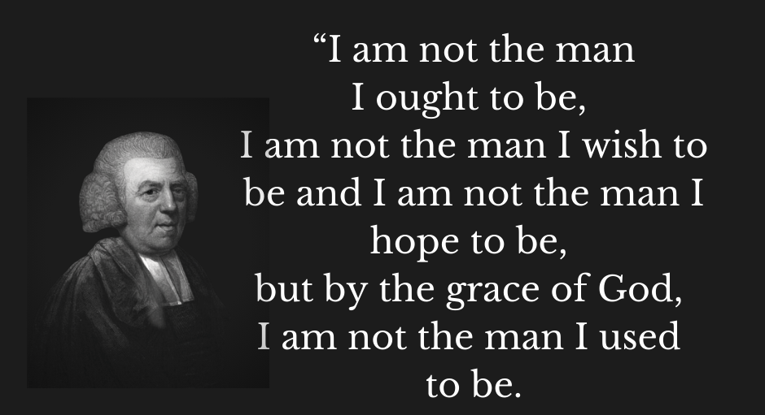

Slide 14
Christ, The New King Is Here!

Slide 15
Matthew 1:17
So all the generations from Abraham to David were fourteen generations, and from David to the deportation to Babylon fourteen generations, and from the deportation to Babylon to the Christ fourteen generations.

Slide 16
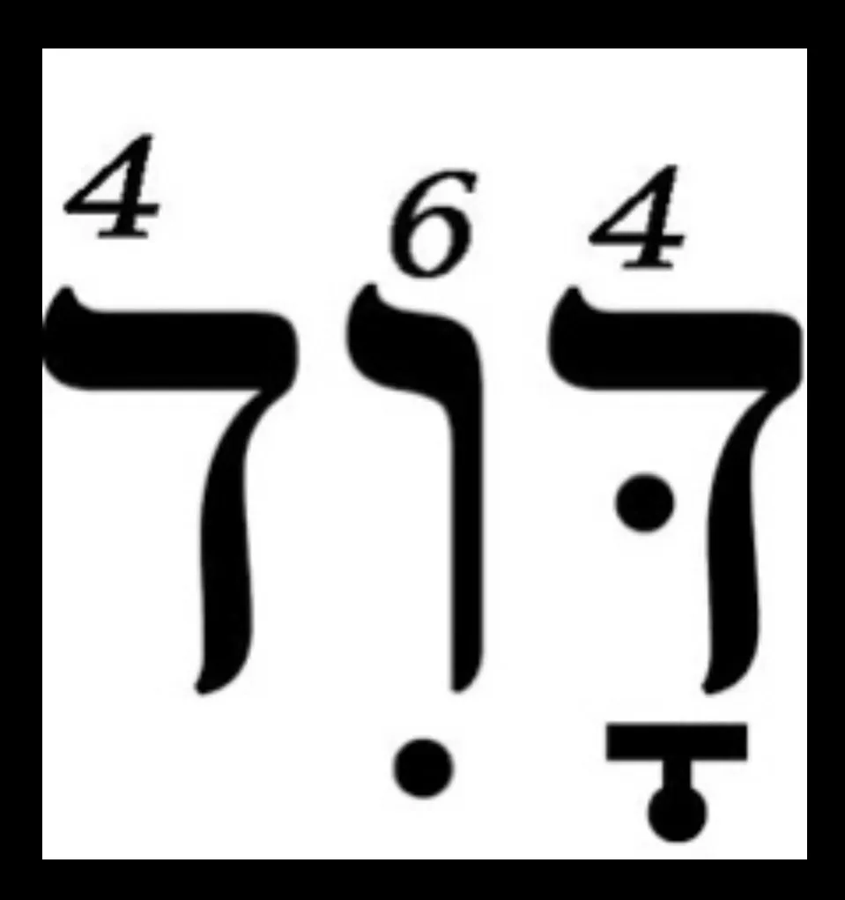

Slide 17
“We sometimes get lost; but God is never lost. We are often confused by our circumstances; God never is. We have doubts about his purposes; God knows what he is doing. His promises never fail. God may seem slow to us, but he is always moving his purposes on at exactly the right speed. God is never late. He is always on time. And his timing is perfect.”
Ferguson, Sinclair B “The Dawn of Redeeming Grace”

Slide 18
Application
Jesus Is King, Put Your Hope In Him!
Jesus Is King, Find Your Assurance In Him!

