Slide 1
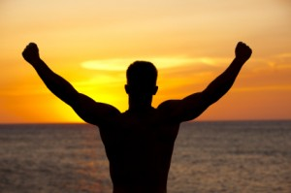
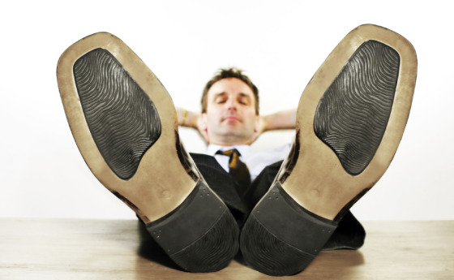

Slide 2
Galatians 6:1-2

Slide 3
Building A Grace Community

Slide 4
Transparent Relationships
Caught in a sin
Contrast: Legalists and Spirit-filled People
Spiritual? = Those full of grace and truth

Slide 5
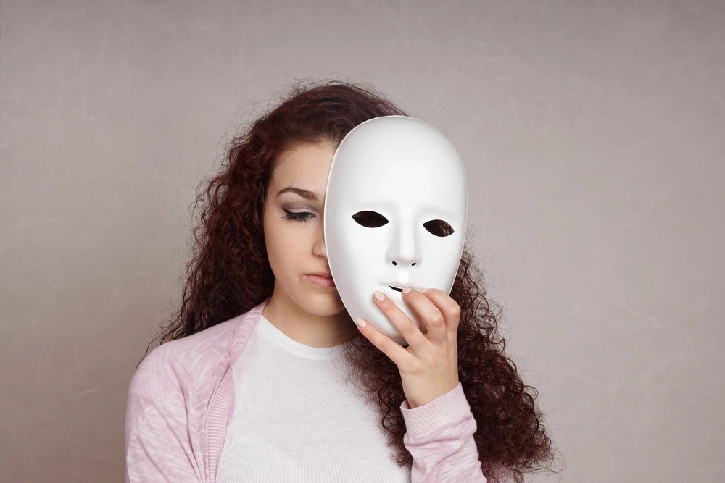

Slide 6
Restore To Health
Restore
Christ is the Great Physician
Spirit of Gentleness

Slide 7


Slide 8
Bear Burdens
Bear each others burdens
v5 Is this a contradiction
Fulfill the law of Christ

Slide 9
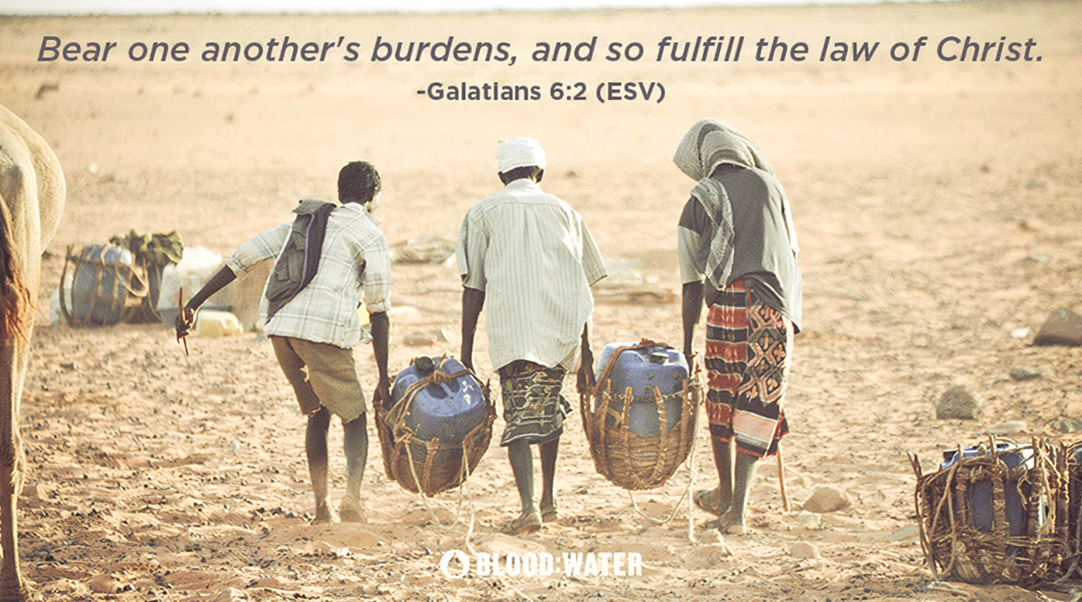

Slide 10
Application
Help Prisoners Find Hope
Do you need healing today?
Is Riverside a Grace Community?

