Slide 1
HOW TO BE CULTURALLY RELEVANT TO YOUR CULTURE WITHOUT SACRIFICING YOUR CHRISTIAN CONVICTIONS
ACTS 16:1-5
Chinese Christian Church of Thousand Oaks
1/8/2017
“One Goal, One Mind: Committed to Church, Committed to Each Other”

Slide 2

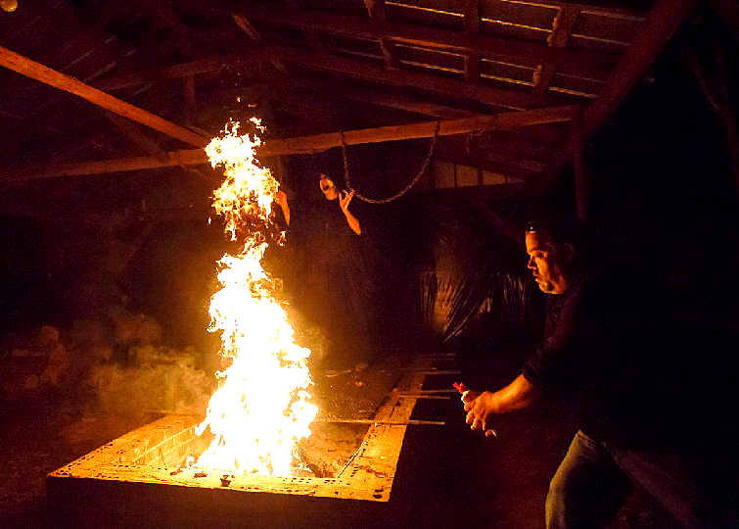
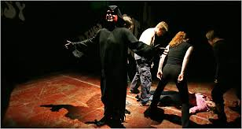
HELL HOUSE EVANGELISM

Slide 3
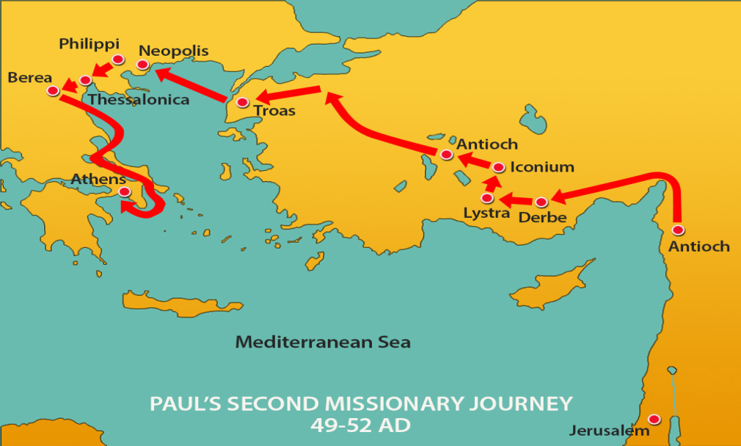
ACTS 16:1-5
¹ He [Paul] came to Derbe and then to Lystra, where a disciple named Timothy lived, whose mother was a Jewess and a believer, but whose father was a Greek. ² The brothers at Lystra and Iconium spoke well of him. ³ Paul wanted to take him along on the journey, so he circumcised him because of the Jews who lived in that area, for they all knew that his father was a Greek.
⁴ As they traveled from town to town, they delivered the decisions reached by the apostles and elders in Jerusalem for the people to obey.
⁵ So the churches were strengthened in the faith and grew daily in numbers

Slide 4
WHAT IS ACTS 16:1-5 TRYING TO TEACH US?
If We Want to Effectively Reach a Certain Group for Christ, it is Often Helpful to Accommodate to Their Culture, as Long as it is Not an Accommodation to Sin.

Slide 5
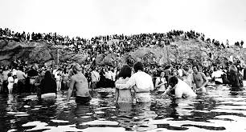
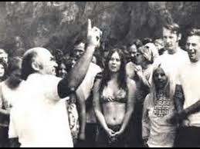
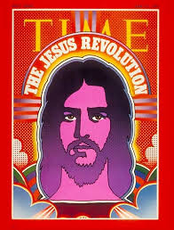

THE CALVARY CHAPEL MOVEMENT

Slide 6
APPLICATIONS
It would be appropriate for us to continually think about what we can do as a church, a fellowship group, or individually; here, at school, or work; to leverage the culture of the people we are trying to reach, in order to more effectively bring them to Christ.
It would also be appropriate for us to think about what we are doing that might be hindering people from coming to know Christ. The challenge is this: Are we willing to give up some of the comforts we enjoy in order to reach out to groups not like us.

Slide 7

REFLECTION PRAYER TIME
What can you do culturally to relate to people you want to reach for Christ?

