Slide 1

Saturday, Sept. 12th, 5 – 8:30pm

Slide 2

“Fight for Truth”
Women’s Seminar
Saturday, October 3rd, 8:30 am – 4:30 pm.

Slide 3
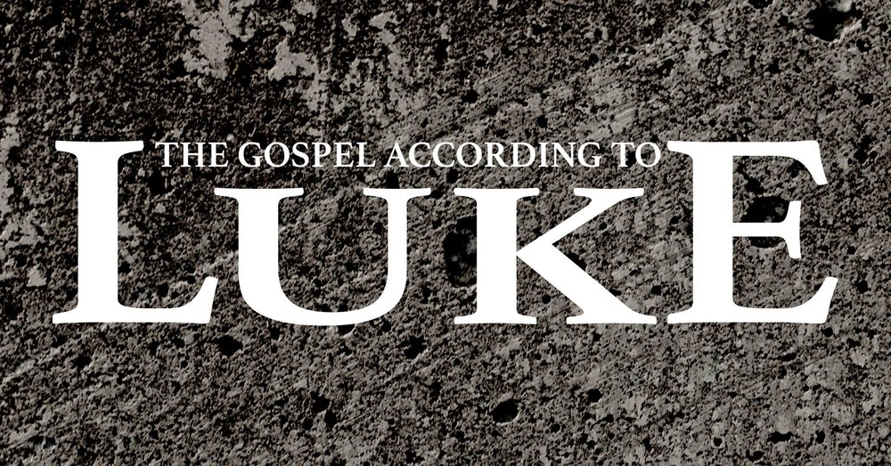
“The Message of John the Baptist”
Part II
Luke 3:7-17

Slide 4
“The Message of John The Baptist”
Part II
Luke 3:7-17
Intro:
The Hebrew word for repentance, shüt, means to turn from or turn away from something.
2 Chron. 7:14.
The issue of judgment often accompanied calls for repentance.
Pending judgment or wrath often is the precursor to repentance.

Slide 5
“The Message of John The Baptist”
Part II
Luke 3:7-17
Intro: Repentance is a work of God. It’s not something we can initiate on our own. Ez. 36:26.
The Gospel isn’t about us accepting Christ, rather it’s us asking Christ to accept us. He is ready to render a verdict on sinners.
Technically, repentance, metanoia, is not so much a turning from sin, but a change of mind.
The result from a change of mind about sin is good deeds. Lk. 19:8.

Slide 6
“The Message of John The Baptist”
Part II
Luke 3:7-17
V. True Repentance Demonstrates Spiritual Transformation
If repentance is genuine it will show up in changed behavior and changed conduct.
Acts 26:19.
As it is the work of God, it is consistent with regeneration. 2 Tim. 2:25.
Repentance is appealing to God for a new heart.
It is not an outward show of piety but results in observable fruit.

Slide 7
“The Message of John The Baptist”
Part II
Luke 3:7-17
V. True Repentance Facilitates Receiving the Messiah
John attests to the fact that Jesus is, indeed God. Vs. 16.
The Jews understood only God could baptize with the Holy Spirit and bring judgment on people. Those were supernatural activities.
John’s stated purpose was to call people to prepare their hearts to receive the Messiah. He did this through his call to baptism and repentance.

