Slide 1

“Overcoming Obstacles”
Luke 5:17-26

Slide 2
“Overcoming Obstacles”
Luke 5:17-26
Intro: All three Evangelists give an account of this incident.
As we’ll see, the purpose of the miracle was to show that Jesus has the authority to forgive sins.
The paralytic didn’t have the social or religious stigma of the Leper. But his life was one of;
1. Dependency,
2. Humiliation,
3. Confinement,
4. Loneliness,
5. Frustration and despair.

Slide 3
“Overcoming Obstacles”
Luke 5:17-26
Intro: The Pharisees and Sadducees came out of the Babylonian captivity. They intended to preserve the Law by adhering to a stricter code of righteousness.
They succeeded in externalizing their religion, making it one of works as opposed to that of faith.
The paralytic’s friends were dedicated to overcoming any obstacles in getting their friend to Jesus.
Their dedication to task challenges us, asking, How far will we go to gain access to Jesus, for ourselves and our friends?

Slide 4
“Overcoming Obstacles”
Luke 5:17-26
I. Man’s greatest need is his sin
The paralytic came for physical healing, but Jesus knew his real need was to have his sins forgiven.
Our perceived physical needs are there to draw us to God.
II. Forgiveness is our most pressing need
The actions of the friends was one of urgency, sacrifice and persistence. It was for a physical need. Ours should be that and more for the spiritual needs of our family and friends.

Slide 5
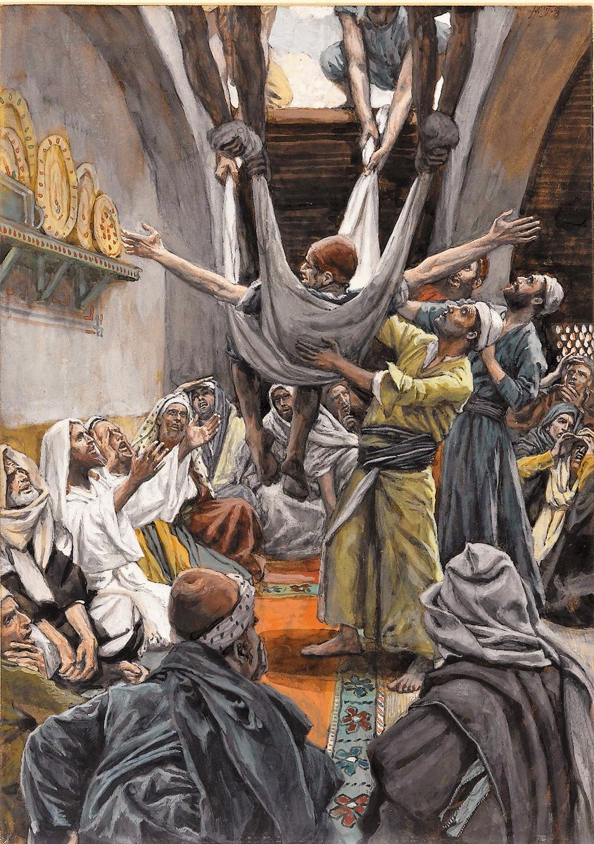

Slide 6
“Overcoming Obstacles”
Luke 5:17-26
III. Only Jesus has authority to forgive sins
It was what Jesus saw that caught His attention. No request was made.
His healing of the paralytic was to show He had authority to forgive sins.
If only God can forgive sins, then Jesus must be God.

Slide 7
“Overcoming Obstacles”
Luke 5:17-26
IV. Our sins are forgiven by God’s grace through faith
Jesus saw the faith of everyone concerned in bringing the paralytic to Him.
Included with the healing was a command to obedience, vs. 24.
Saving faith always issues in obedience.

