Slide 1
ISAIAH 57:13-15
Should a Christian make
New Years resolutions?
Notes:
TIME OF YEAR – RESOLUTIONS – QUESTION
MAKE – ESSENSE IS SELF WILL – WILL POWER
GOD HATES WORKS RELIGION AND SELF-MADE MEN
ONLY OUR PLANS MADE IN THE LORD WILL SUCCEED
INSTEAD OF RESOLUTION WE SHOULD SEEK REVIVAL

Slide 2
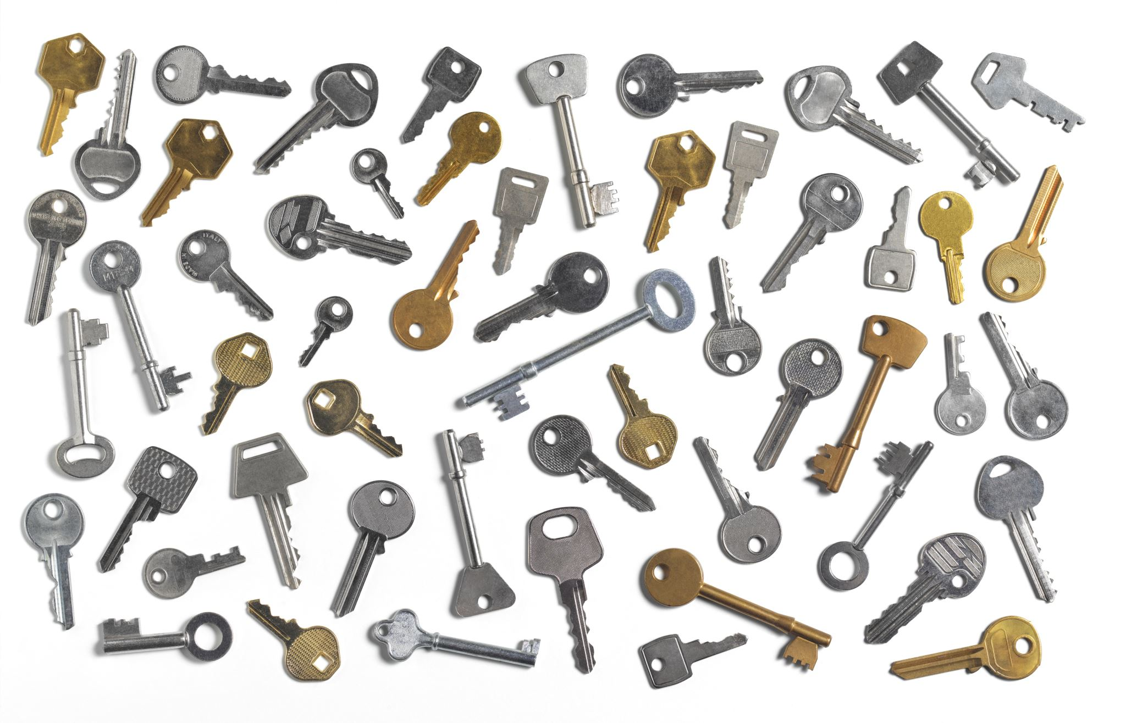
Revival Over Resolution
Four Keys To Revival
Notes:
SENSE SOMETHING DEEPLY WRONG WITH OUR COUNTRY
COMPLAINT ABOUT WHAT OTHERS ARE OR ARENT DOING
FAIL TO LOOK AT OURSELVES – WANT AND NEED REVIVAL
THAT REVIVAL MUST START WITH ME
I CANT PREACH A MESSAGE OF REVIVAL UNLESS I AM PERSONALLY REVIVED

Slide 3

Revival is the work of God where God’s people, whether individually or corporately, are renewed in their experience of God’s presence and power. This can lead to greater gospel outreach in the world and societal transformation.
Notes:
REVIVAL – TENT MEETING
EVANGLISTIC
GOD’S WORK IN GODS PEOPLE
RENEWED EXPERIENCE
LEADS TO GOSPEL WITNESS – SOCIETAL TRANSFORMATION

Slide 4
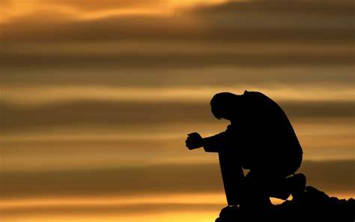
#1 Put Your Trust In The Lord
Notes:
WHAT ARE YOU TRUSTING FOR CHANGE?
SELF
SOMEONE ELSE
WASHINGTON DC
TRUST NOT IN MORTAL MAN – ALMIGHTY GOD

Slide 5

ISAIAH 57:13 ESV
When you cry out, let your collection of idols deliver you! The wind will carry them all off, a breath will take them away.
Notes:
TRUST IN ANYTHING OTHER THAN THE LORD
DISAPPOINT AND FAIL
ISRAEL – WEALTH AND POWER, GODS OF THE STORM AND FERTILITY
BONDAGE IN BABYLON

Slide 6
Trusted Bad Leaders
Trusted Political Alliances
Trusted Own Strength
Notes:
GOD SAID THEY WOULD BE GIVEN BAD LEADERS
AHAZ – DIDN’T SEEK GOD
HEZEKIAH – PRAYED FOR HEALTH, 15 YEARS
BROUGHT AMBASSADORS FROM BABYLON WEALTH OF THE TEMPLE
TRUSTED – EGYPT WOULD SAVE THEM
TRUSTED THEIR OWN STRENGTH

Slide 7
ISAIAH 57:13 ESV
But he who takes refuge in me shall possess the land and shall inherit my holy mountain.
Notes:
TAKE REFUGE
TRUST IN GOD’S POWER
POSSESS THE LAND
I WILL BUILD MY CHURCH
FUTURE FULFILLMENT

Slide 8

#2 Revival Is The Work of God
Notes:
REVIVAL IS THE WORK OF GOD
MANUFACTURE IT OURSELVES
ASBURY KENTUCKY REVIVAL – STOPPED
MORE THAN PEOPLE PRAYING AT A COLLEGE CHAPEL

Slide 9

Isaiah 57:14 ESV
And it shall be said, “Build up, build up, prepare the way, remove every obstruction from my people’s way.”
Notes:
GOD – PUNISHED ISRAEL
FUTURE WOULD BRING REVIVAL
HIS WORD SPEAKS IT – BUILD UP, PREPARE, GOD REMOVES OBSTRUCTIONS
INSTEAD OF TRYING TO EFFORT CHANGE OR REVIVAL
HOW CAN I REMOVE THE THINGS BLOCKING REVIVAL IN MY LIFE
JOHN THE BAPTIST

Slide 10
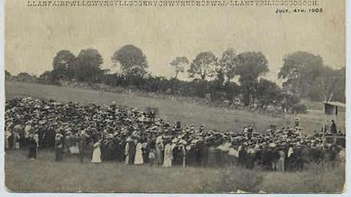
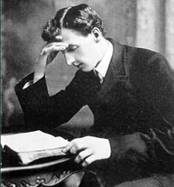
Notes:
NOVEMBER OF 1904 – HS STIRRING IN WALES
EVAN ROBERTS – 26 YEAR OLD – COAL MINER – LITTLE EDUCATION
MARKED – PRESENCE OF GOD
CHURCHES FULL – NOT BY PROMOTION – SPIRIT OF GOD

Slide 11

#3 See God For Who He Is

Slide 12

ISAIAH 57:15 ESV
For thus says the One who is high and lifted up, who inhabits eternity, whose name is Holy: “I dwell in the high and holy place,

Slide 13

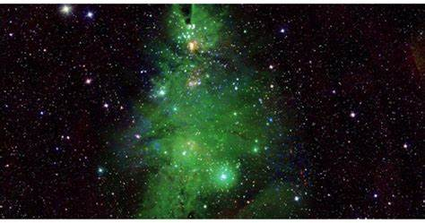
His Power
His Presence

Slide 14
#4 Humble Yourself

Slide 15

ISAIAH 57:15 ESV
and also with him who is of a contrite and lowly spirit, to revive the spirit of the lowly, and to revive the heart of the contrite.

Slide 16
Robert’s Four Points
Confess all known sin
Put away all doubtful things and forgive everyone
Obey the promptings of the HS
Publicly confess Christ as Savior

Slide 17
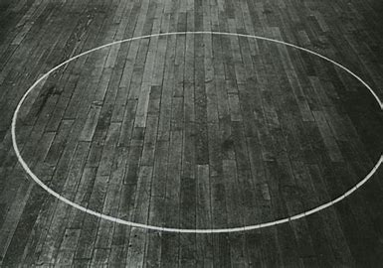
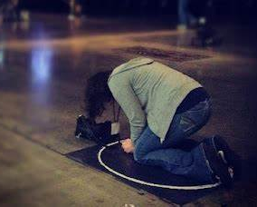
Notes:
Gypsy Smith

Slide 18
Application
Put yourself in the circle
Devote yourself to prayer

