Slide 1
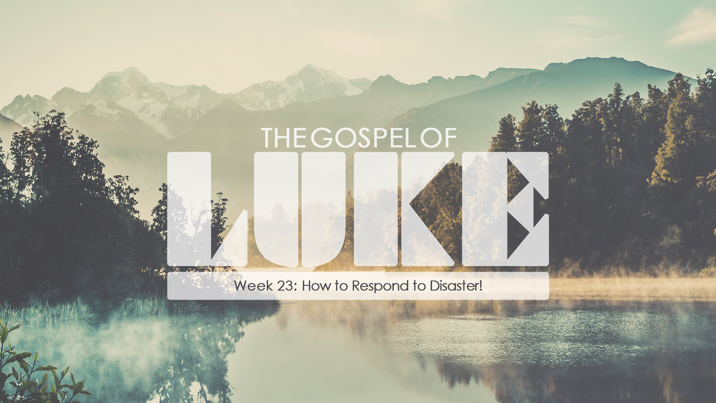
“A Merciful God”
Luke 13:1-9

Slide 2
“A Merciful God”
Luke 13:1-9
Intro:
Jesus talked about sin, repentance and judgment to show people the only way to be reconciled to God.
This is a lengthy, evangelistic discourse where Jesus is calling Israel to come to Him and be saved. It runs from 12:1 through 13:9
The three interruptions in this section, 12:13, 41, and 13:1 show that the Lord is always available to honest inquires.

Slide 3
“A Merciful God”
Luke 13:1-9
I. “A Bad Theology”
Going back to the Patriarchal period the Jews developed a mistaken theology that said, “If you do good you were blessed. But if you had bad things happen to you it was because you were evil, and God cursed your life.
Their theology came out of their being a special people of the covenant, favorites of God.
Job is a prime example of this sort of theology. When his life began to fall apart his “comforters” told him it was because he was an evil, wicked person.

Slide 4
“A Merciful God”
Luke 13:1-9
I. “A Bad Theology”
A. The Temple Calamity, Vss. 1-2.
As the victims, Galileans were offering their sacrifices themselves it was probably the Passover celebration.
There is no noted sin; they were worshipping God.
You don’t live because you deserve to live. You live because, though you deserve to die, God is merciful.

Slide 5
“A Merciful God”
Luke 13:1-9
I. “A Bad Theology”
B. The Tower Calamity, Vs. 4.
Jerusalem Jews looked down on Galileans. Here Jesus uses a similar illustration involving Jerusalem Jews.
Jesus points out our relative morality, or our particular standing with God has nothing to do regarding our experiencing a calamity.
God does not use calamity to single out evil or bad people.

Slide 6
“A Merciful God”
Luke 13:1-9
I. “A Bad Theology”
C. The True Calamity, Vss. 6-9.
The issue isn’t how, when or by what means people die. Everyone dies, Hebrews 9:27. The issue is, If you don’t repent when death comes, you will perish! Lk. 12:58-59; 13:3,5.

Slide 7
“A Merciful God”
Luke 13:1-9
II. “A Merciful God”
1. God expects His followers to bear fruit in keeping with their repentance, Lk. 3:8, 13:7.
2. He is patient, giving us time to repent, 2 Peter3:9.
3. His patience will not endure forever, Rom. 2:4-5.
4. God can use calamity in our sanctification, James 1:2-4.

