Slide 1
Faith Facts To Live By

Slide 2
Why do this study?
1. Faith is the Modus Operandi of the Christian’s life!
• The Christian life begins by faith — Ephesians 2:8-9;
Galatians 2:16
• The Christian’s life is to be lived by Faith — Romans 1:17; Gal. 2:20
2. Faith is necessary to please God!
Hebrews 11:6
See also Colossians 1:9

Slide 3
3. To help us understand the purpose of trials that come into our lives!
James 1:2-4
God brings trials to “test” our faith so we can become strong and mature in our relationship with Him!
4. So we can appreciate the value of God’s Word in our lives!
Romans 10:17
Faith comes by hearing and hearing by the word about Christ!

Slide 4
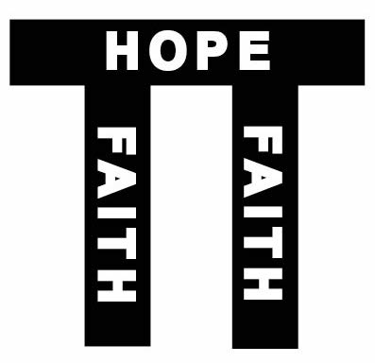
5. To remind us that a life of faith brings great rewards!
Hebrews 11:1-2
• The word “assurance” hypostasis, means a “support, foundation, or guarantee” Think of faith in the same way that you would view a support beam of a massive structure. It is the support beam of our hope.

Slide 5
• The word “conviction” elenchos, is evidence that make someone fully agree, understand and realize the truth or validity of something. Even though things are unseen faith provides the evidence, and understanding to realize the validity that the things are true.
• The word “approval” martyreo, means a testimony, or a witness. (cf. verse 4, 5 & 39)
6. To enable us to stand against the subtle attacks of Satan!
Ephesians 6:16
“take up the shield of faith with which you will be able to
extinguish all the flaming missiles of the evil one.”

Slide 6
What is FATIH?
Let’s blast before we build!
What we DO NOT mean by “faith”:
1. Faith is NOT an identification with a religious denomination or system!
“I’m a person of faith.”
2. Faith is NOT the magic “key” to get what you want from God!
FAITH is NOT the magic wand to health, wealth, and prosperity as is taught by the “Word-of-faith” teachers!

Slide 7
Hank Hanegraaff — The Bible Answer Man
“. . . for the word-faith teachers, healing and prosperity became so important that they had to find some way to guarantee them, and they did this by exalting man’s faith at the expense of God’s sovereignty. Thus, they developed the doctrine that God created the world out of nothing by faith, and that He created men as “little gods” to exercise the same kind of faith. Faith therefore becomes a powerful force that gets results, whether in the hands of a believer or a nonbeliever.
On the basis of this virtual deification of human faith, the purveyors of the word-faith message promise health and wealth to those who exercise faith in their faith rather than faith in their God. As has been well said elsewhere, faith is only as good as the object on which it is placed.”

Slide 8
What is FATIH?
Let’s BUILD!
What we DO mean by “faith”:
Romans 4:18-21
“Faith is a deep immovable TRUST in God that He will FULFILL what He has PROMISED, and responds in OBEDIENCE to what He commands.”

