Slide 1
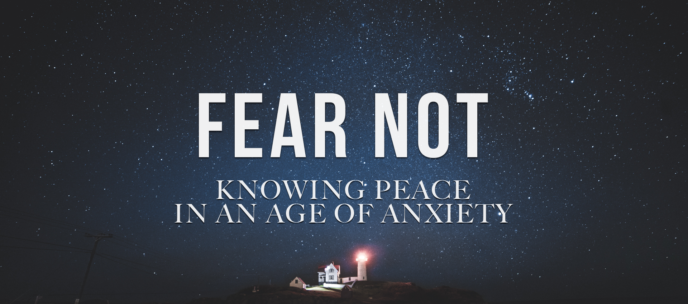
Intro:
Isaiah 41:10

Slide 2
“Fear Not”
Isaiah 41:10
Intro: Everyone is fearful about something sometime.
The Bible admonishes us more than 360 times to Not be fearful, anxious or dismayed. Gen. 15:1, Ex. 14, 1 Chron. 22
Satan targets our fears anxieties and distress, telling us God is powerless and indifferent towards or fears.
Almost every book in the Bible has an admonishment not to be fearful.
All the promises God gave the Israelites are for us as Gentile Christians today as well. Gen. 12:1-3, Gal. 3:7-29.

Slide 3
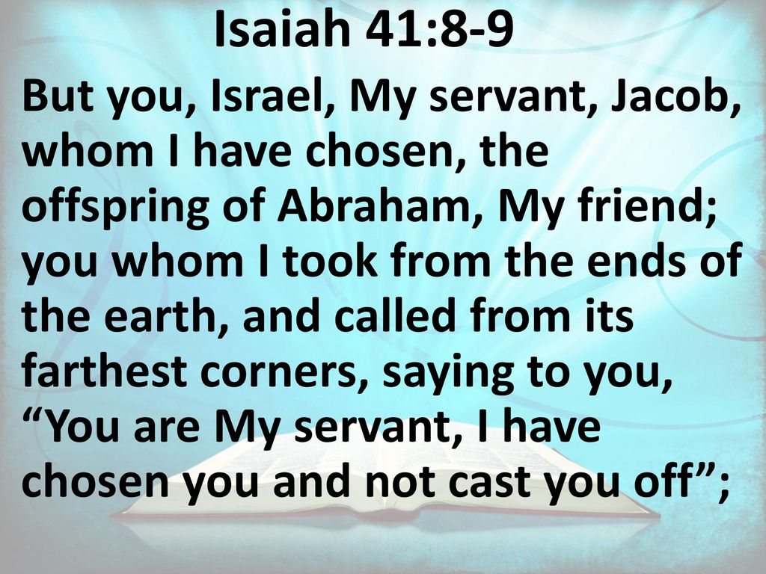
“Fear Not”
Isaiah 41:10

Slide 4
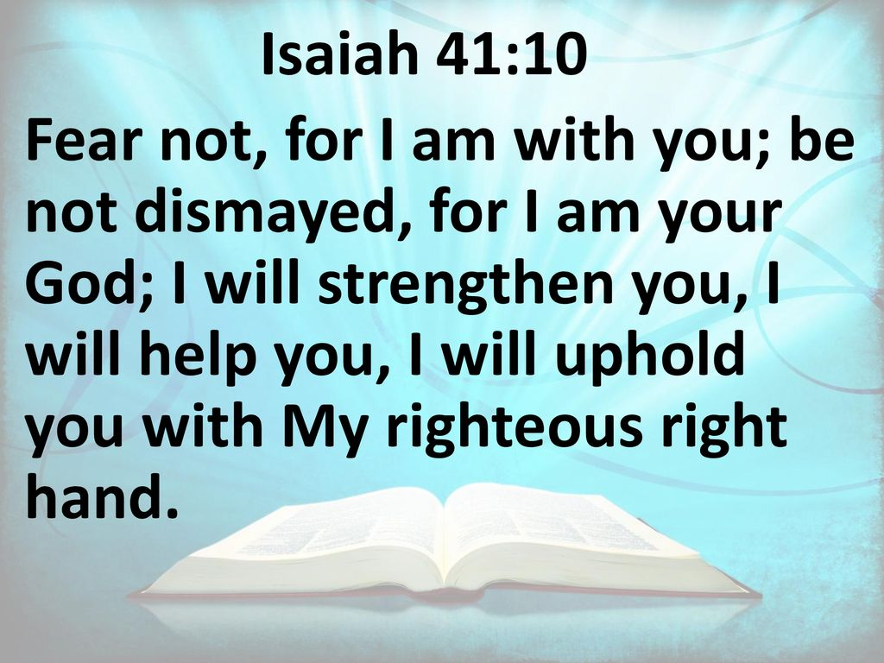
“Fear Not”
Isaiah 41:10

Slide 5
“Fear Not”
Isaiah 41:10
I. Two Commands
Fear Not: Fear in Hebrew is, “yare’. It means to be terrified, afraid.
We are to fear God but not be fearful about anything else.
Fear of God is a reverential fear or awe of Him. The fear of God keeps us from sin, while the fear of man leads us to sin.

Slide 6
“Fear Not”
Isaiah 41:10
I. Two Commands
Don’t be Dismayed:
The Hebrew is, sha`ah. It means to gaze about, looking to be anxious about something.
An accurate translation would be; “Do not anxiously look about you.”

Slide 7
“Fear Not”
Isaiah 41:10
II. Five Reasons
God gives us divine support with the requirement to be fearless.
1. God is with us, vs. 10 a.
2. God is our God, vs. 10b,
3. God will strengthen us, vs. 10c,
4. God will help us, vs. 10c,
5. God will uphold me, vs. 10d.
To uphold is “tamak” in Hebrew. It means to secure from underneath.

Slide 8
“Fear Not”
Isaiah 41:10
III. Four Insights to God’s Greatness
Isaiah 41:1-9
1. The judge of all the earth, Vs. 1,
2. The ruler of all rulers, Vss. 2-3,
3. The uncreated first, YAHWEH, Vs. 4
4. The God Who chose His own people, Vss. 8-9.
(The same God has done the same for His church);
A. He chose us before the foundation of the world, Eph. 1:4,
B. He called us out of Darkness and Death, 1 Peter 2:9,
C. He took us for Himself, to be His, to make Himself our God.
1 Peter 2:10; Titus 2:14.

Slide 9
“Fear Not”
Isaiah 41:10
IV. Five Practical Steps
1. Live without fear because God is with me,
Ex. 33:14; Ps. 23:4; Matt. 28:20.
2. Don’t be dismayed because God is my God,
1 Samuel 30:6; Isaiah 40:10, 15.
3. Lean on God to strengthen me,
Ps. 29:11; Isaiah 42:3; Matt. 12:20.
4. Trust God to help me,
Hebrews 13:5-6.
5. Believe God will uphold me with His right hand.
Ps. 145:13-14.

Slide 10
“Fear Not”
Isaiah 41:10

