Slide 1

1 Corinthians 1:10-17
What Is Baptism?
Notes:
Annual Baptism and Membership sermon
Do not use GUILT
We do not use SHAME
Our intent – our this is not just my emphasis but also the heart of Biblical men called the deacons
Teaching of the WORD
Guidance of the HOLY SPIRIT
The love of the glory of Christ produced internally
Weigh the application of this teaching not by human reasoning but by the Word of God
1 COR 1:10-17 Insight from a passage we don’t usually go to

Slide 2

Baptism Publicly Identifies Us with Christ and His Church
Notes:
SALVATION
SUPERSTITIOUS

Slide 3
Baptism Identifies Us With Christ

Slide 4
1 CORINTHIANS 1:11-12 ESV
For it has been reported to me by Chloe’s people that there is quarreling among you, my brothers. What I mean is that each one of you says, “I follow Paul,” or “I follow Apollos,” or “I follow Cephas,” or “I follow Christ.”
Notes:
STRUCTURE – Book of Christions
Addressing Problems
DIVISIONS IN THE CHURCH

Slide 5
1 CORINTHIANS 1:10 ESV
I appeal to you, brothers, by the name of our Lord Jesus Christ, that all of you agree, and that there be no divisions among you, but that you be united in the same mind and the same judgment.
Notes:
UNITY
SAME OPINION OR THINKING
UNITY IN SOUND DOCTRINE
DOCTRINE DOESN’T DIVIDE BUT IT UNITES
UNITY IN THE ESSENTIALS OF THE FAITH

Slide 6
1 CORINTHIANS 1:13 ESV
Is Christ divided? Was Paul crucified for you? Or were you baptized in the name of Paul?
Notes:
BAPTISM – NAME OF CHRIST
UNITES US WITH CHRIST – FOLLOWING HIM NOT A MAN
ALLEGIANCE IS NOT TO WHO BAPTISM – BELONG TO CHRIST
DOWN – DEATH, BURIED, COMING UP - RESURECTION

Slide 7
MATTHEW 28:19 ESV
Go therefore and make disciples of all nations, baptizing them in the name of the Father and of the Son and of the Holy Spirit,
Notes:
David Shrock
Baptism is the way Jesus gave His future disciples to publically identify with him.
He could have said build an ark, move to Israel, stop cutting your hair
Baptism is the initiatory rite of every follower of Christ

Slide 8
ACTS 18:8 ESV
And many of the Corinthians hearing Paul believed and were baptized.
Notes:
Phillipian jailer believed and was baptized
NOT ESSENTIAL FOR SALVATION
IMPORTANT AS A FIRST ACT OF OBEDIENCE

Slide 9
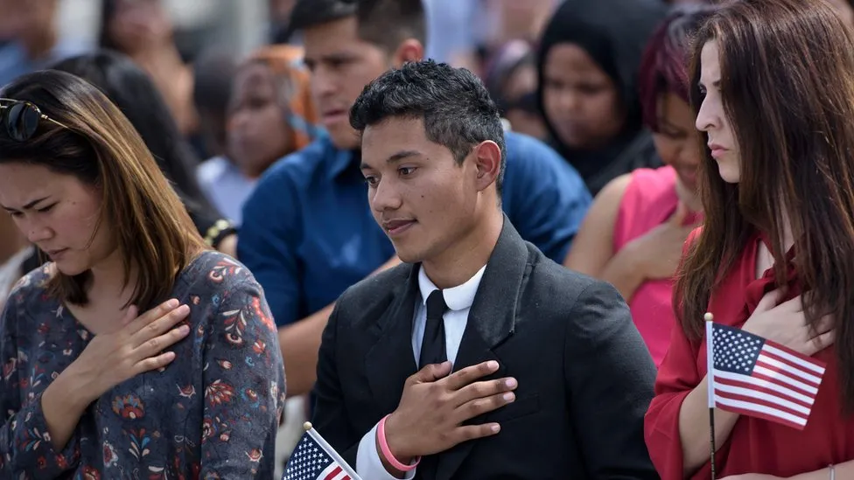
Notes:
NATIONAL ANTHEM
Honors our country and shows solidarity with our fellow citizens
It doesn’t make us A CITIZEN
OATH – CONSTITUTION, PAY TAXES, BEAR ARMS, NON-COMBAT SUPPORT
GLORIFIES CHRIST
DEMONSTRATES OUR UNITY WITH A LOCAL CHURCH

Slide 10
Baptism Identifies Us With A Local Church

Slide 11
1 CORINTHIANS 1:14–15 ESV
I thank God that I baptized none of you except Crispus and Gaius, so that no one may say that you were baptized in my name.
Notes:
BAPTISM DOESN’T SAVE
Philosophy of ministry and doctrine and distinctives
Political agenda or a social agenda or a different doctrinal agenda and create disunity

Slide 12
1 CORINTHIANS 1:17 ESV
For Christ did not send me to baptize but to preach the gospel, and not with words of eloquent wisdom, lest the cross of Christ be emptied of its power.

Slide 13
GALATIANS 3:27–28 ESV
For as many of you as were baptized into Christ have put on Christ. [28] There is neither Jew nor Greek, there is neither slave nor free, there is no male and female, for you are all one in Christ Jesus.

Slide 14
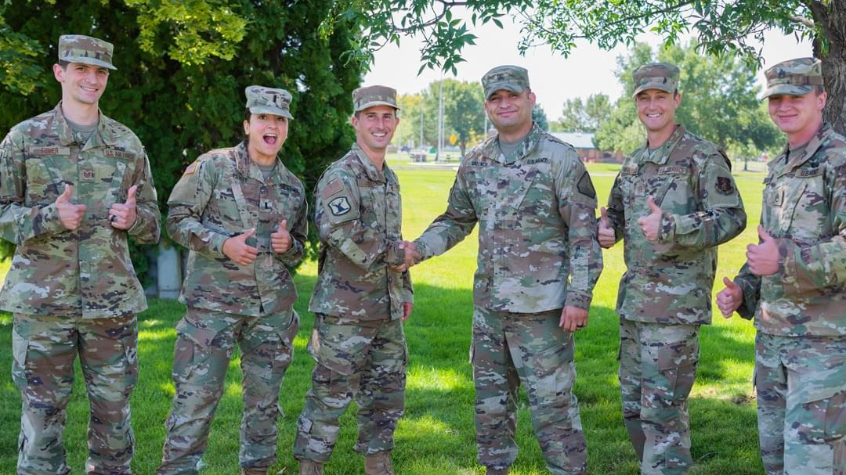
Notes:
STF COFFEE GROUP – SHAVE HEAD
STRIP YOU OF YOUR CIVILIAN IDENTITY
I AM NOW A SOLDIER – UNIFORM AND HAIR STANDARDS – OUTWARD EXPRESSION OF THAT REALITY
ESPRIT DE CORPS – LOYALTY AND TOGETHERNESS
NOW I AM NO LONGER A SOLDIER I AM A CIVILIAN
BRAD ASKED ME GROW A PONY TAIL

Slide 15
Membership Identifies Previously Baptized as part of a local church
Membership Identifies Someone As A Member of A Particular Congregation

Slide 16
Membership expresses true Christian unity
Membership best expresses true Christian governance

Slide 17
Baptism at Riverside
Talk to Pastor
Book on Baptism

Slide 18
Membership at Riverside
Talk to a Deacon
Evidence of salvation and Baptism
General agreement on doctrine and covenant
Church affirmation

