Slide 1

“In Plain Sight”
Luke 4:14-30

Slide 2
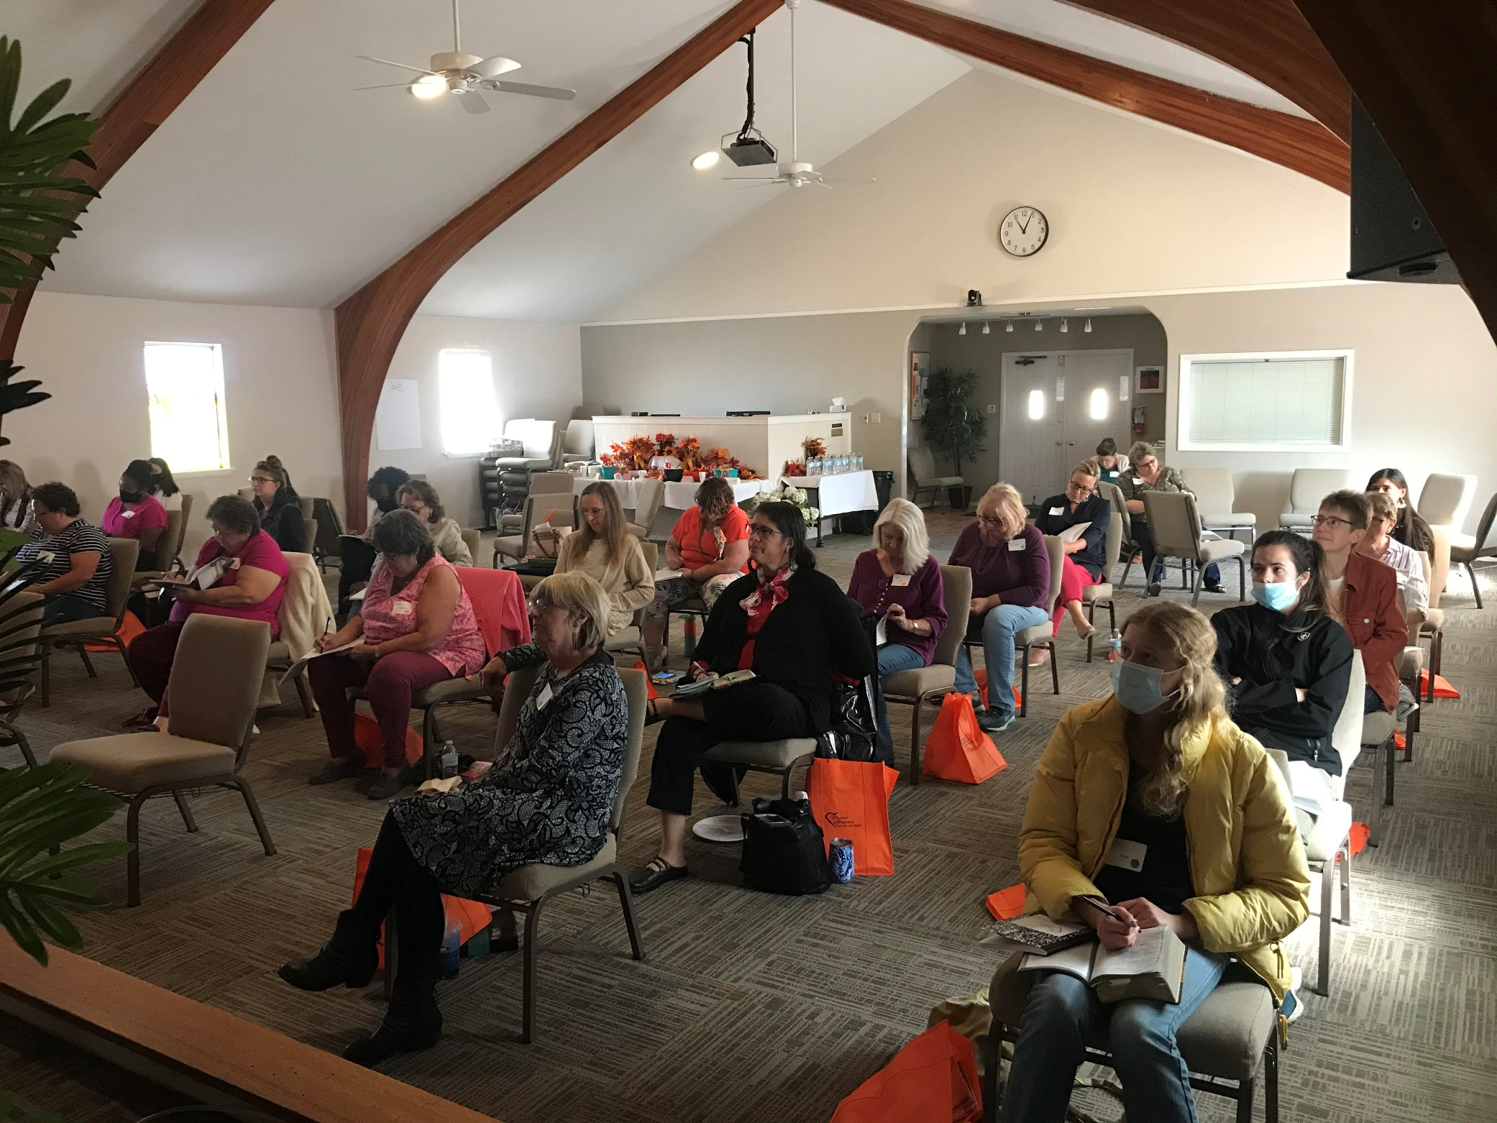

Slide 3
“In Plain Sight”
Luke 4:14-30
Intro:
Luke follows his style of taking events out of chronological order.
Luke doesn’t change the facts, he merely changes their order of appearance in the record.
This event doesn’t take place till Ch. 13 in Matthew, and not till Ch. 6 in Mark, well after a considerable time being in ministry.

Slide 4
“In Plain Sight”
Luke 4:14-30
The Manner of His Return
A. In the power of the Spirit;
1. He never acted on His own,
a. He was subject to the Father, Jn. 5:30
b. He came to do the Father’s will, Lk. 22:42,
c. He does nothing of His own initiative, Jn. 8:28
2. He never acted independently of God
a. He performed miracles by the power of God,
b. He taught what was given Him by God,
c. He was always led by the Spirit of God.

Slide 5
“In Plain Sight”
Luke 4:14-30
The Manner of His Return
B. As was His custom;
1. Being in worship was the discipline of the Lord’s life,
2. Worshipping corporately was not an option with Jesus,
3. There’s a bid difference between being an admirer of God, and a true worshipper of God.

Slide 6
“In Plain Sight”
Luke 4:14-30
II. The Place of His Return
We’re told Jesus returned to Galilee which is in the Northern part of Palestine.
Luke focuses on the Lord’s Galilean ministry.
He worshipped in the Synagogue, a strictly NT place of worship established during the Babylonian captivity.

Slide 7
“In Plain Sight”
Luke 4:14-30
III. The Reception at His Return
Initially, positive. All who heard Him were praising Him.
But there was no repentance, or turning to God in faith.
The Jews saw no need to change.

Slide 8
“In Plain Sight”
Luke 4:14-30
IV. The Proclamation of the Word
He read Isaiah 62:1-2, and translated it into Aramaic as the Jews of the day could not understand Hebrew.
They failed to recognize Jesus had already fulfilled that Messianic prophecy, Matt. 11:4-5.
He only read the first part of Vs. 2, as He did not come this time to judge the world, Jn. 3:17.

Slide 9
“In Plain Sight”
Luke 4:14-30
V. The Reaction to His Message
1. One of wonderment, Liked His style, not taken to heart.
2. One of doubt, Familiarity breeds contempt.
3. Complete rejection. Their arrogance and pride were assaulted.

