Slide 1

“Two Sinners and a Savior”
Luke 7:36-50

Slide 2
“Two Sinners and a Savior”
Luke 7:36-50
Intro: Luke’s concern in his gospel is to reveal just who this Man, Jesus is.
Luke has already shown:
1. That Christ is compassionate and
powerful,
2. That He heals bodies and souls,
3. He has dominion over both physical and
spiritual realms.
The account in Luke is NOT the same account found in;
Matt. 26:6-13; Mk. 14:3-9, or Jn. 12:1-8.

Slide 3
“Two Sinners and a Savior”
Luke 7:36-50
I. Background
A. The Pharisee:
Name was Simon. Was a typical Jewish religious leader and opposed to Jesus.
(Lk. 6:11; Matt. 12:14)
Saw himself in NO need for redemption.
He relied on his own self- righteousness which treats Christ’s sacrifice with disdain, seeing it as unnecessary and foolish.
An unredeemable position/attitude.

Slide 4
“Two Sinners and a Savior”
Luke 7:36-50
I. Background
B. The Prostitute:
Name unknown. She was NOT Mary Magdalene.
She apparently received forgiveness for her sins prior to this meeting with Jesus. Vss. 48 and 50 are words of assurance, not words of declarations.
She unashamedly served and worshipped Jesus for the love and acceptance she had received from Him.

Slide 5
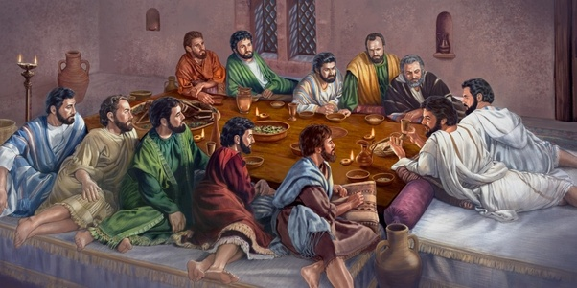

Slide 6
“Two Sinners and a Savior”
Luke 7:36-50
I. Background
C. The Savior:
He endured mistreatment in order to be able to confront the Pharisee regarding his salvation.
By forgiving sins Jesus showed that He was divine.
He answered Simon’s thoughts showing He was a prophet.

Slide 7
“Two Sinners and a Savior”
Luke 7:36-50
II. The Rebuke
The parable of the two debtors was to show Simon his view of the prostitute as being the larger sinner and he the lesser sinner was wrong. They both were indebted to God.
Jesus pointed to the actions of the prostitute in contrast to the actions of Simon to show his lack of love for Him.
We are like Simon in that we often see our sin problem is a minor ailment.

Slide 8
“Two Sinners and a Savior”
Luke 7:36-50
Grace Extended
The expressed love of the prostitute is the evidence of her prior redemption, NOT the cause of it. Vs. 50.
Forgiveness precedes and results in love, not the opposite.
If we want to develop a fervent love for Christ, we must:
1. Realize our great debt,
2. Understand our inability to pay it back,
3. Trust in God’s grace to completely forgive it.

