Slide 1
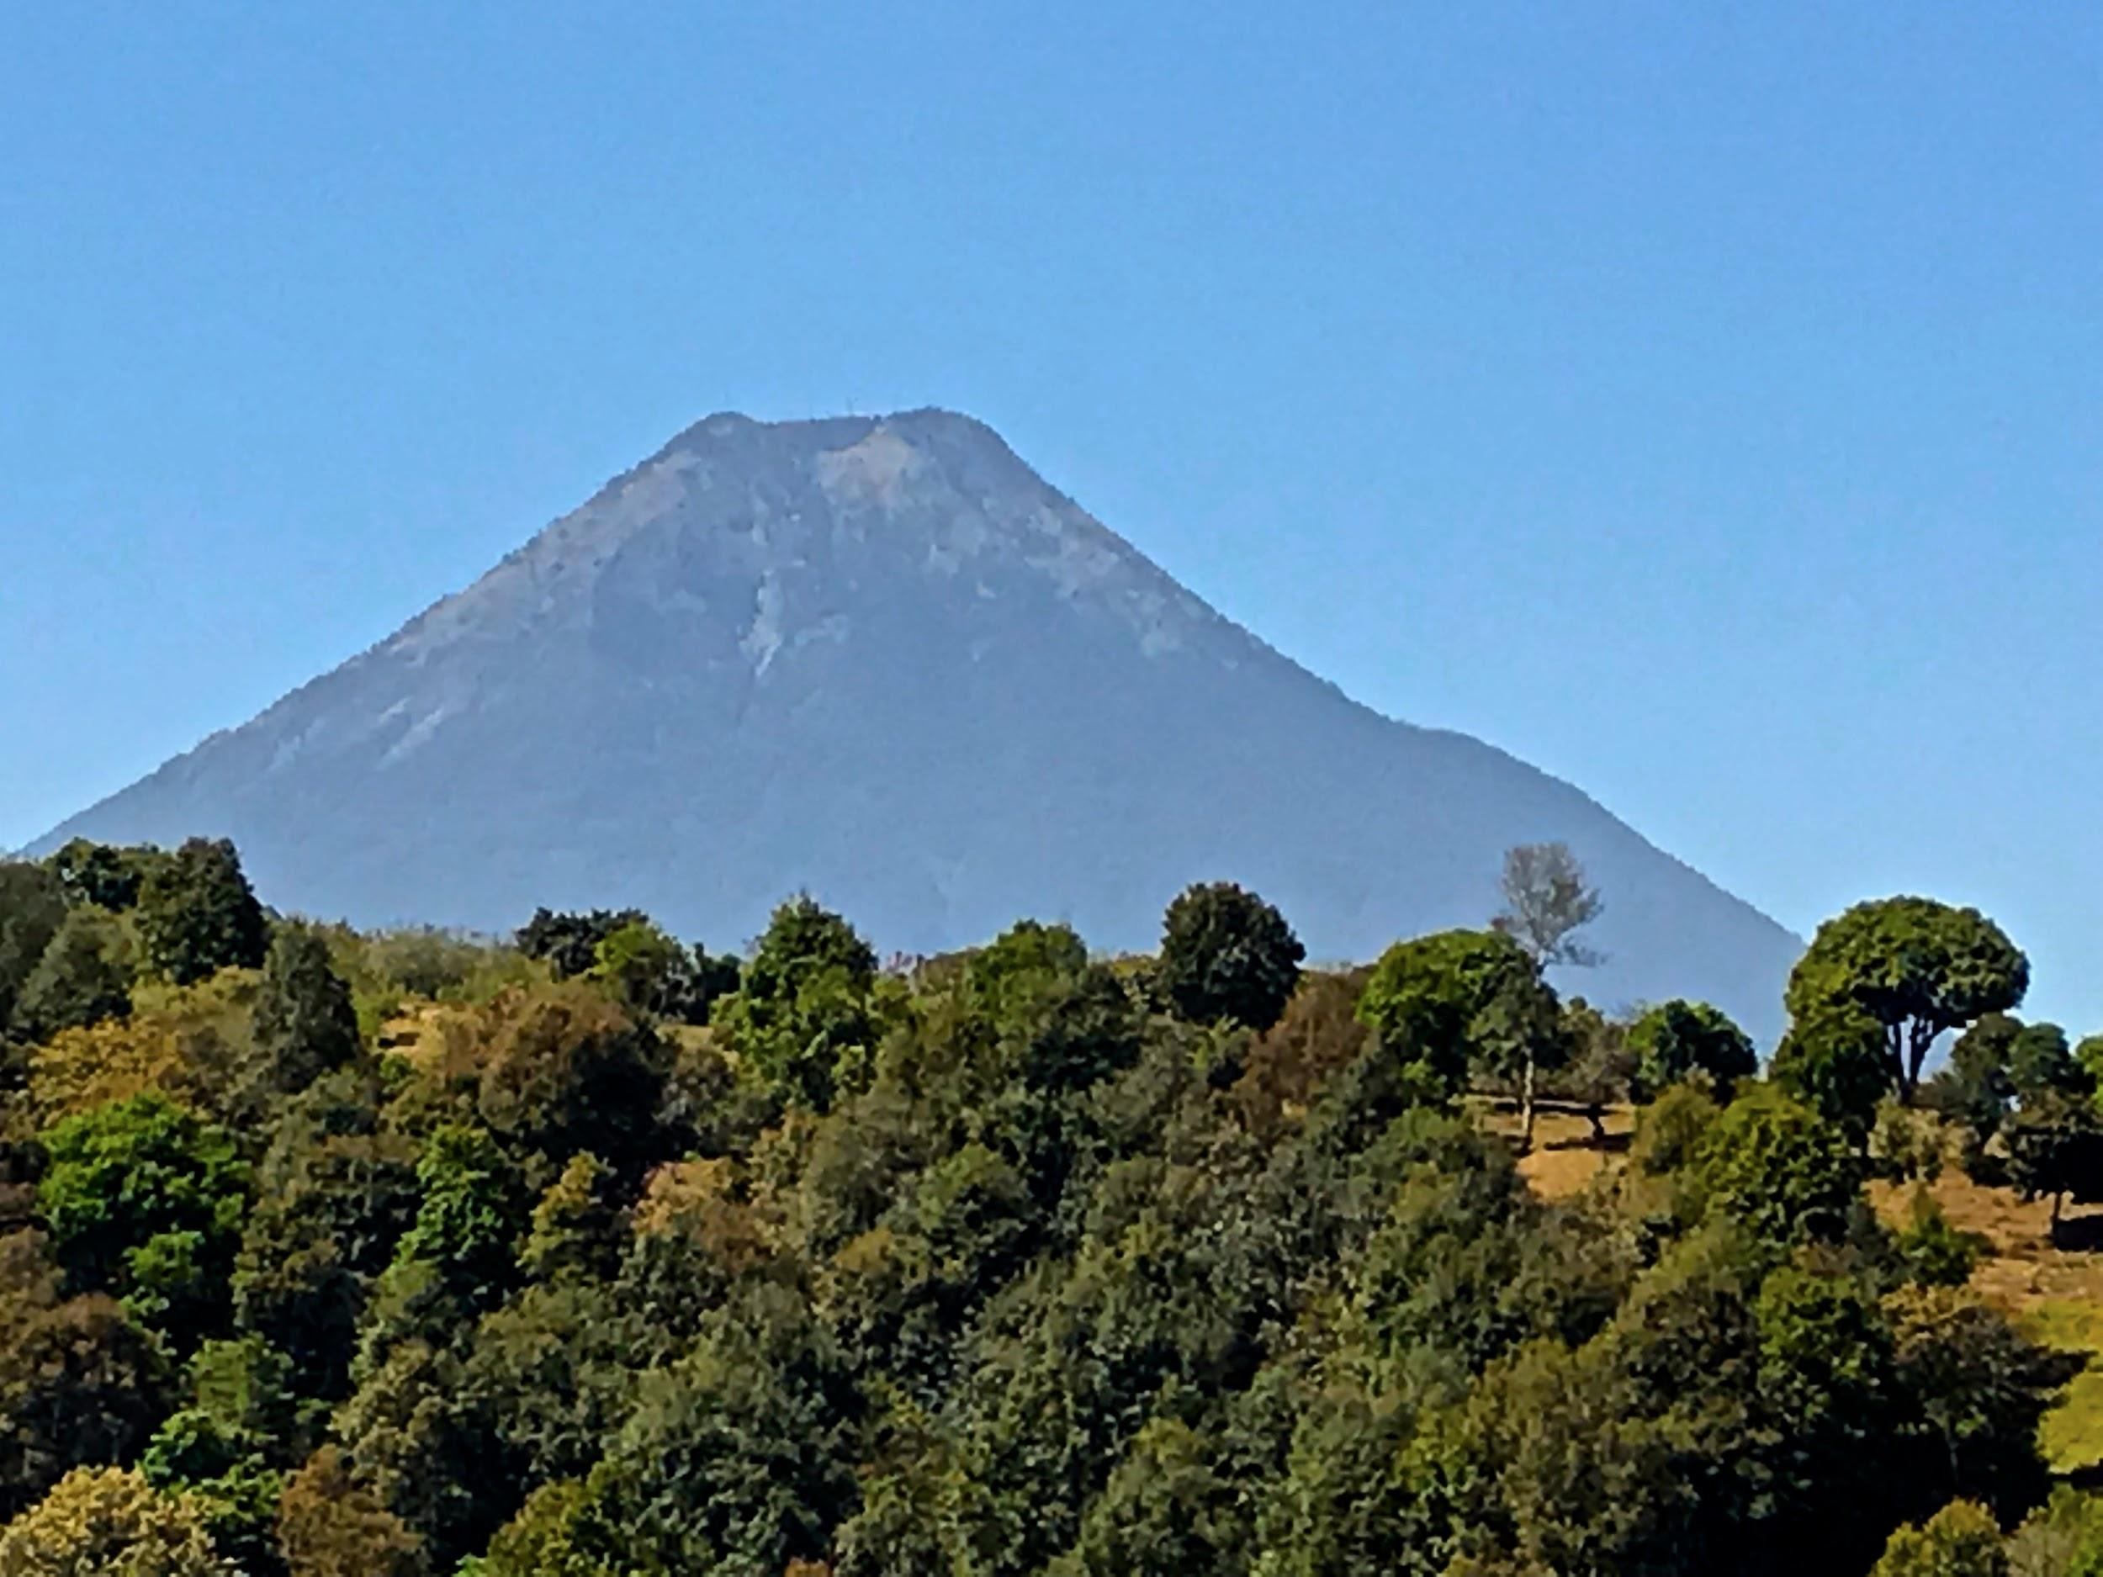

Guatemala Mission Trip
March 22-29, 2019
Seniors
Joel Barrett
Ben Comfort
Chaperones
John Barrett
Kim Comfort
GHAF
4-6-19

Slide 2
How to do mission trips…
(click icon to play video)

Slide 3
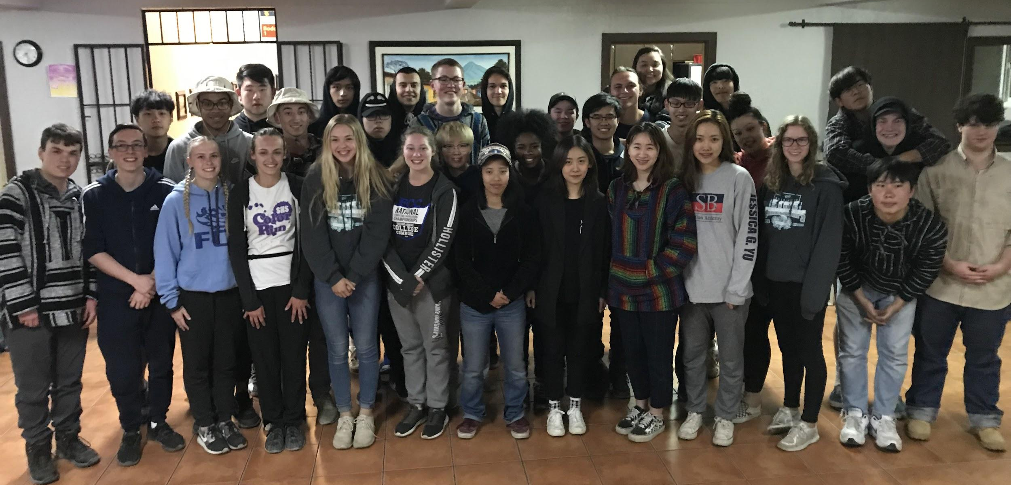
Mission Trip Team
34 LCA senior class members
8 adults (5 LCA staff, 3 parents)

Slide 4
Thank you, GHAF!
GHAF 2018 Christmas offering
$4,269.63 donated to LCA specifically for the mission trip
Due to late change of venue, GHAF’s donation covered the shortage between the money charged students and the cost of the trip

Slide 5

Who is Students International?
Mission - Bringing students and the poor together cross-culturally to encounter God, share the Good News, disciple, and serve others in occupational ministries
Vision - Seeing students and the poor transformed into the likeness of Christ and discover their true calling

Slide 6
Who is Students International?
Philosophy
Community development, long-term relationships, loving, caring, serving people’s physical and spiritual needs
Example Programs
Social work, special needs, tutoring, micro-finance, sports, appropriate technology, creative arts, etc.

Slide 7
Who is Students International?
Participant spiritual growth
1-1/2 hours each morning for singing, personal devotions and prayer time, group devotions
Participant service
6+ hours daily “in the field” working in assigned program

Slide 8
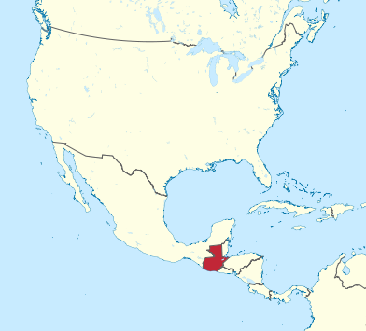
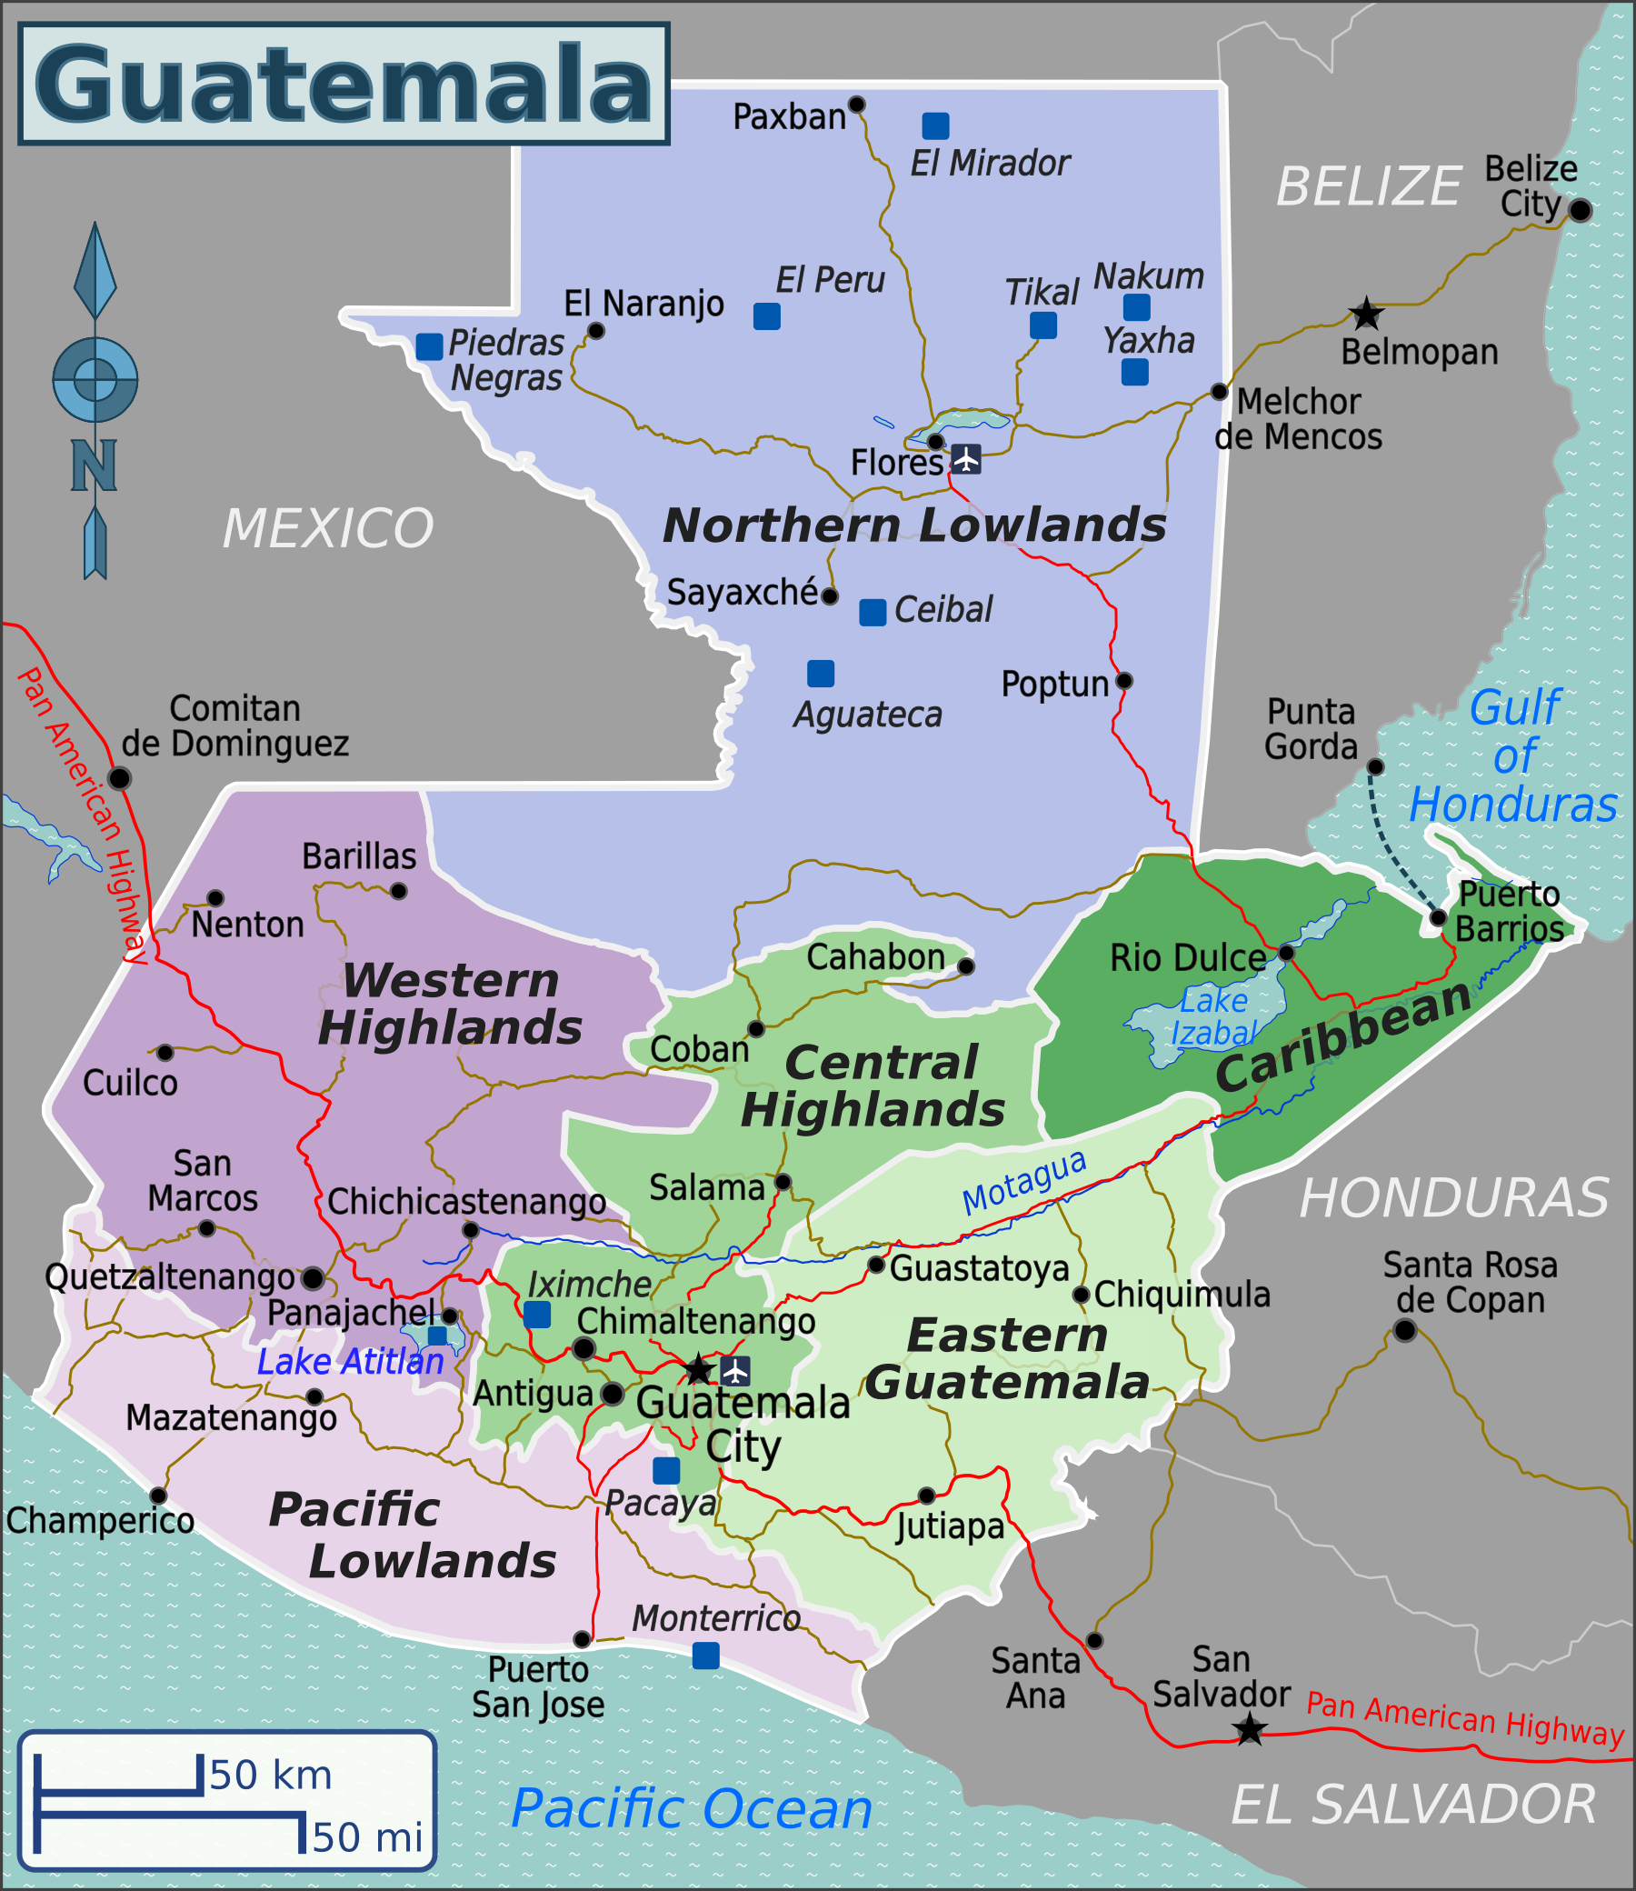
Where were we?

Slide 9
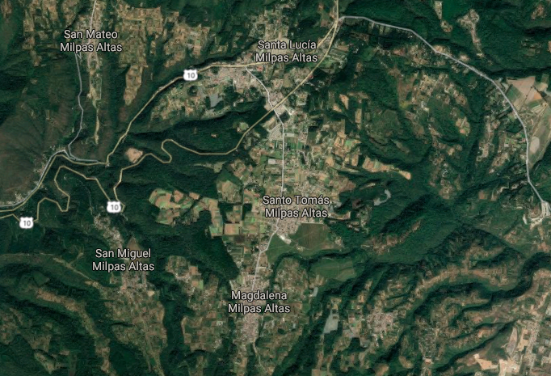
Range of Ministry Sites
Santa Lucia
Santo Tomas
El Gorrion
Buena
Vista
Magdalena
El
Tablon

Slide 10
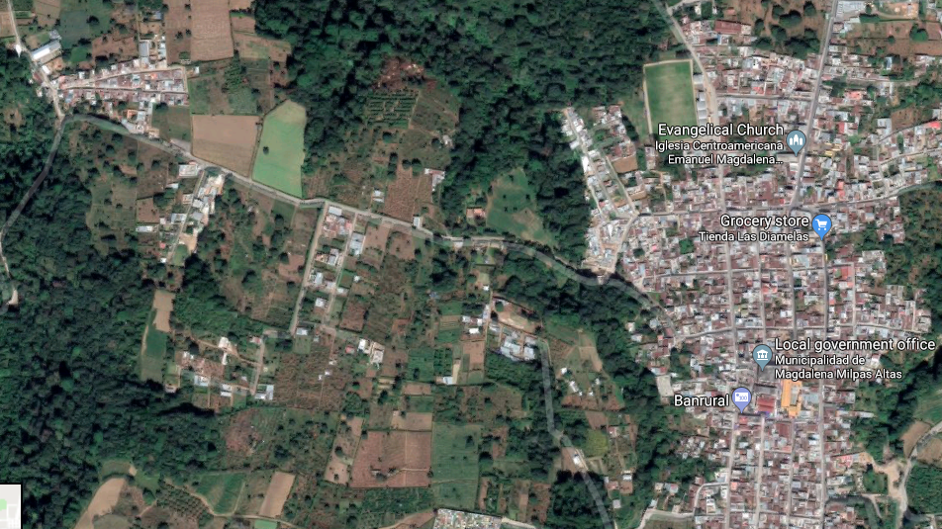
Main Ministry Sites
El Gorrion
Magdalena
Students Int’l Community Center

Slide 11
What we did...

Slide 12
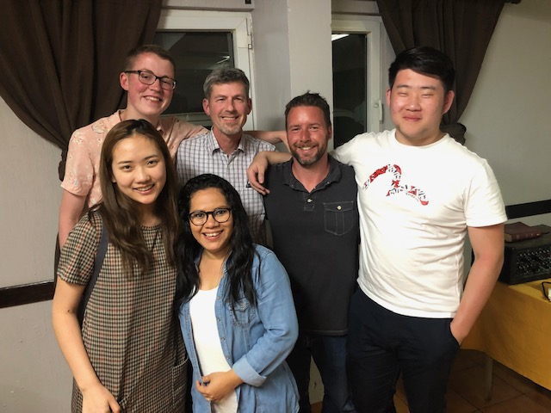
Sponsorship
Sponsorship
Back: Ben, Kim, Steven, Andrew
Front: Jessica, Raquel

Slide 13
What Ben and Kim did...
Sponsorship:
Sponsors 135 students helping with private school tuition/uniforms (both public/private)
Builds relationships with the families of the students
Helps with other areas such as sports and tutoring

Slide 14
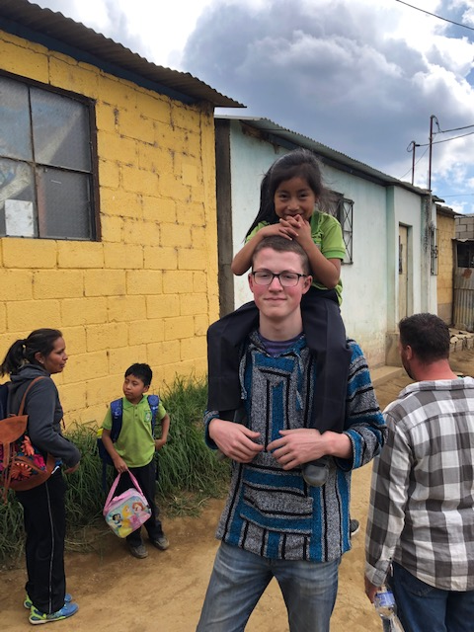
Visiting at El Gorrion

Slide 15
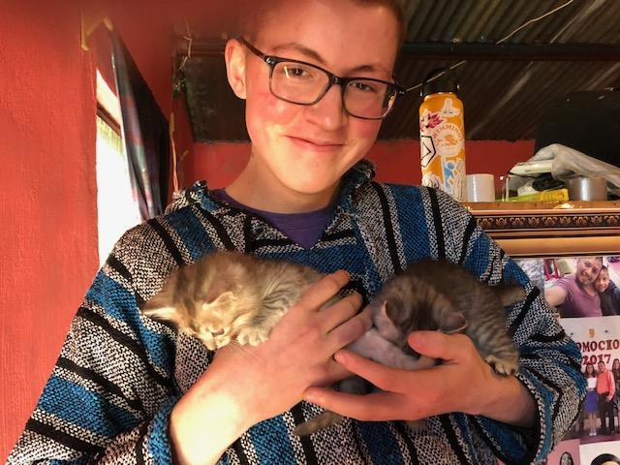
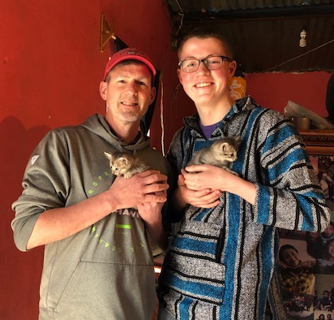

Slide 16
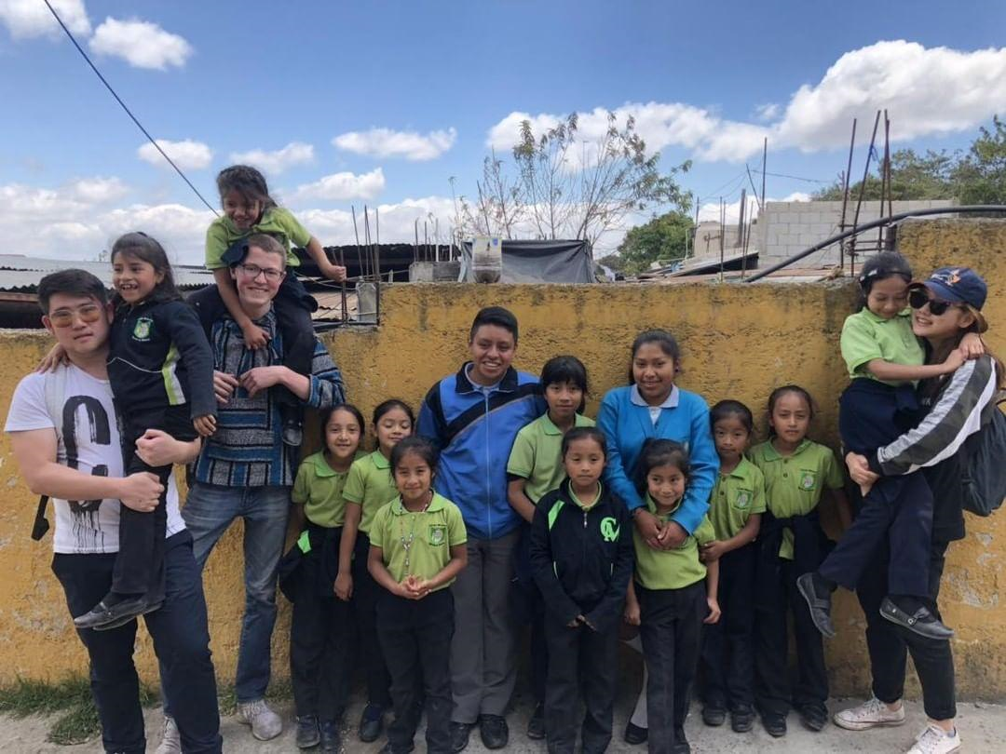
Visit to a private school

Slide 17
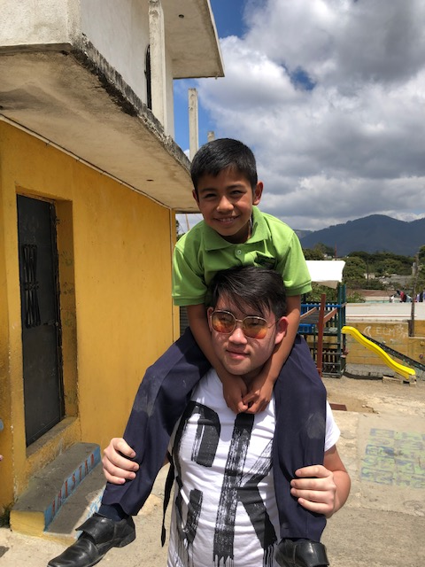

Slide 18
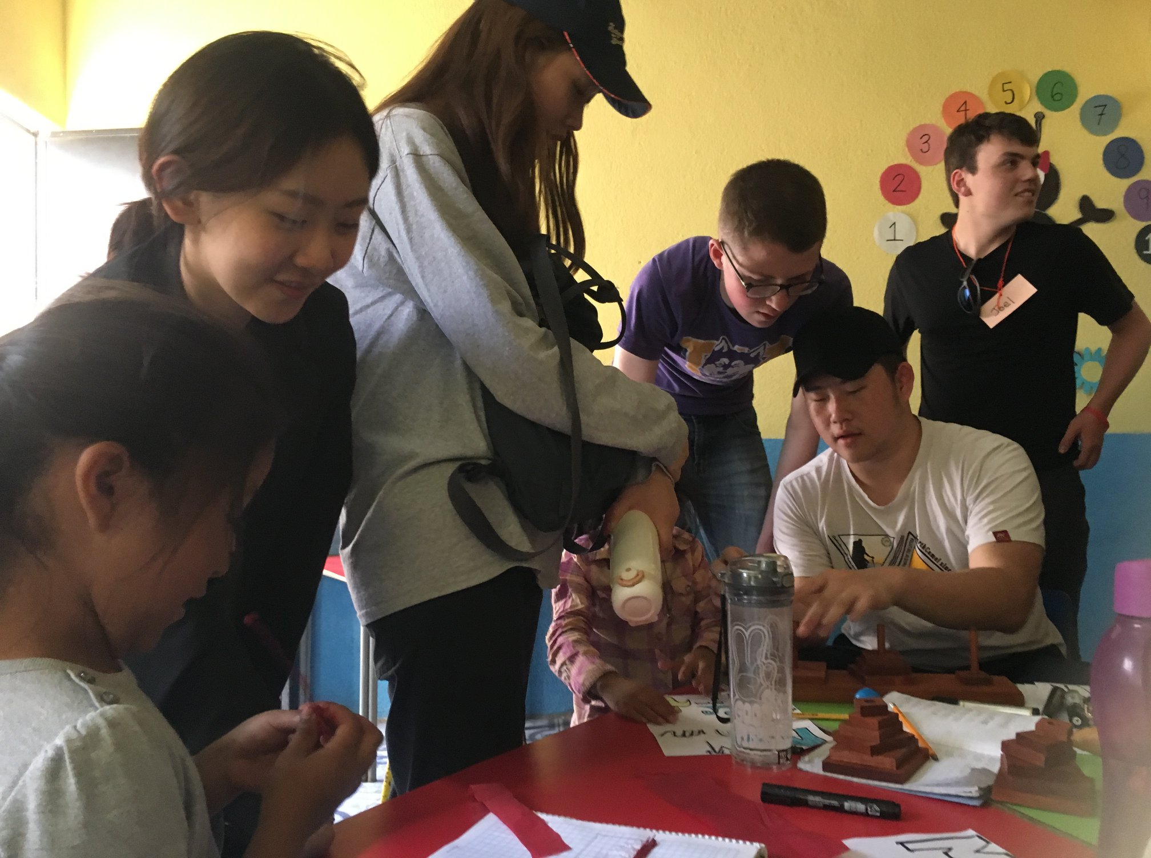

Slide 19
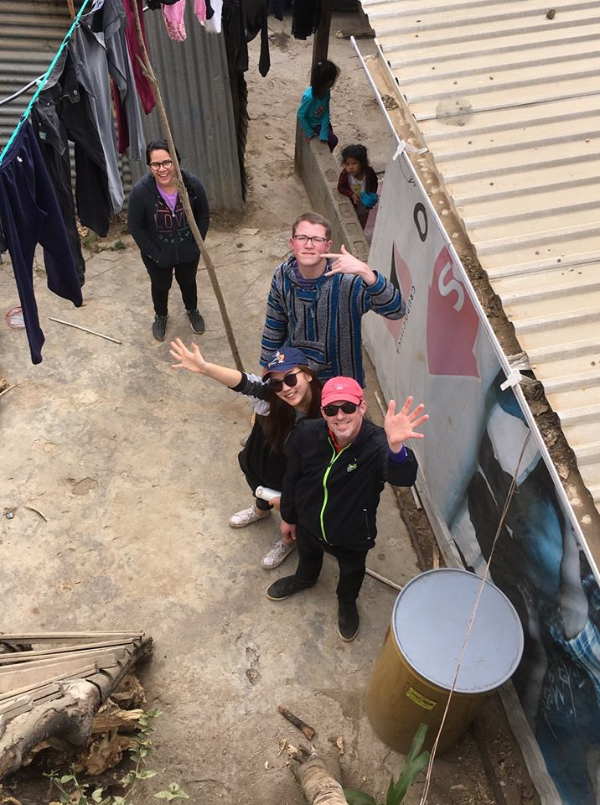
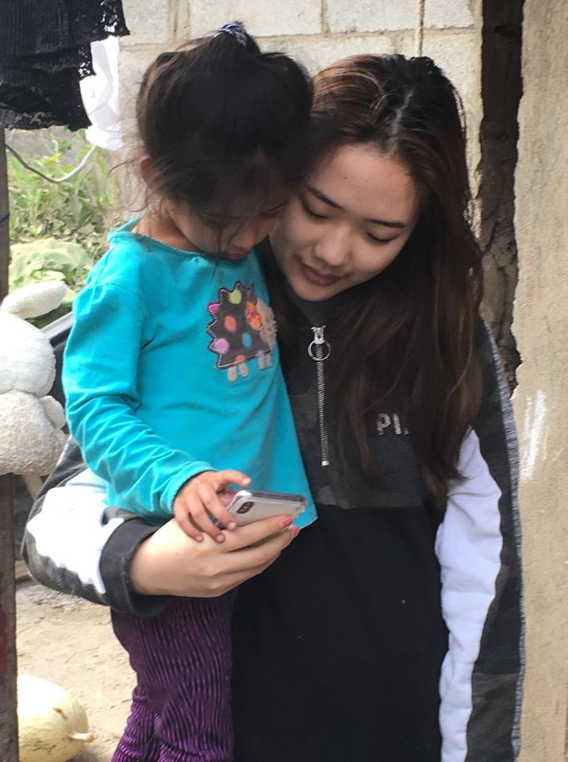

Slide 20
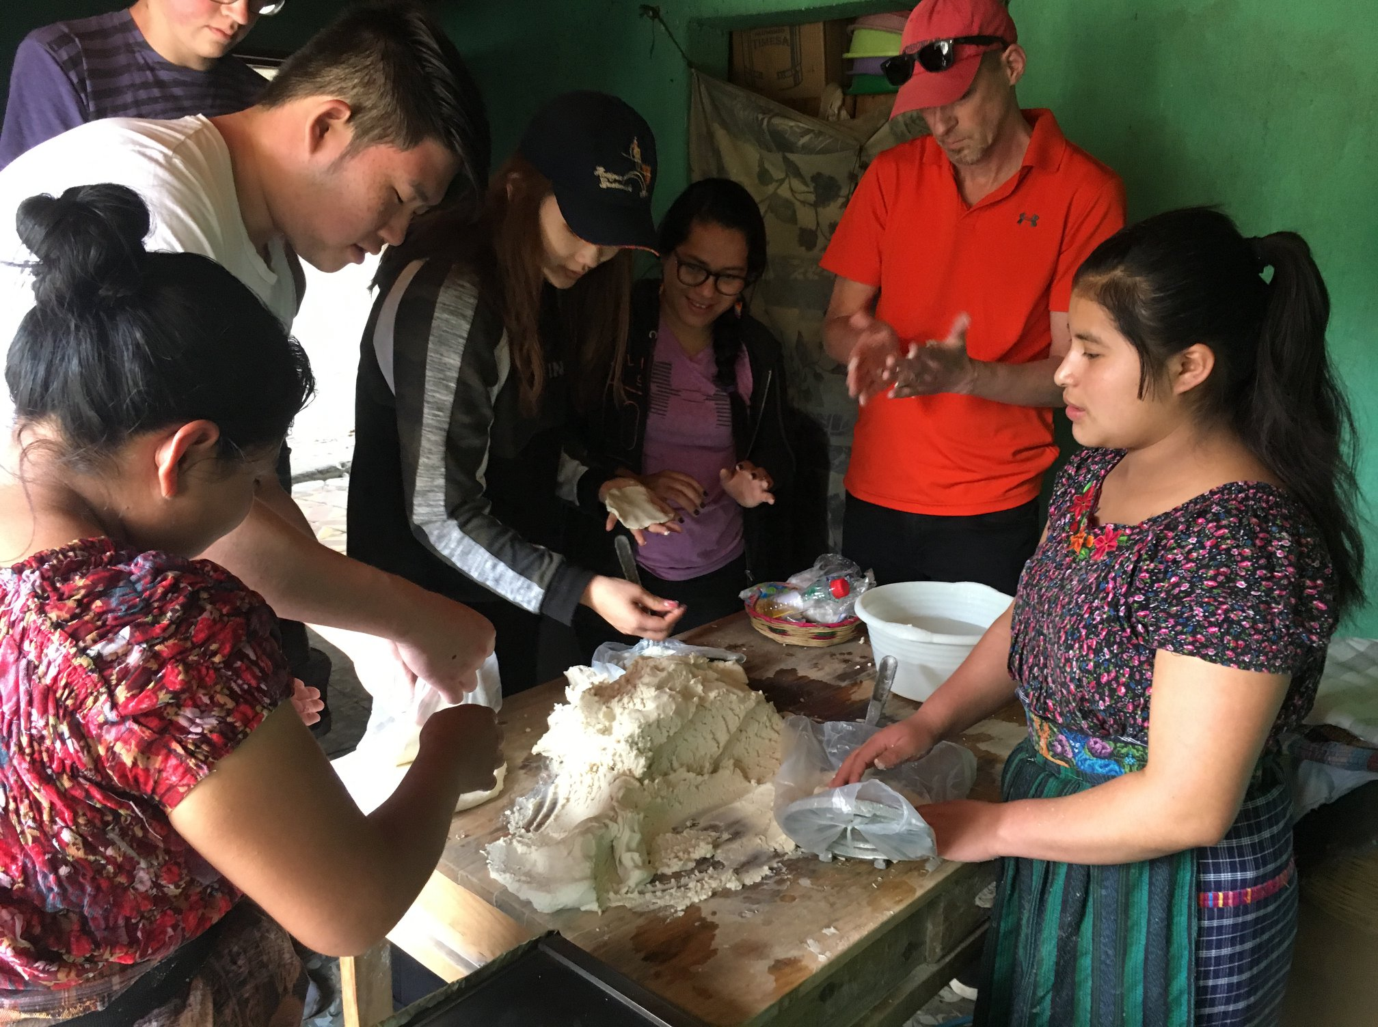

Slide 21
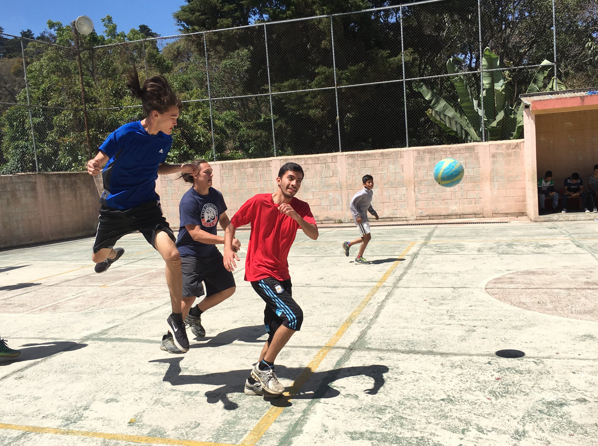
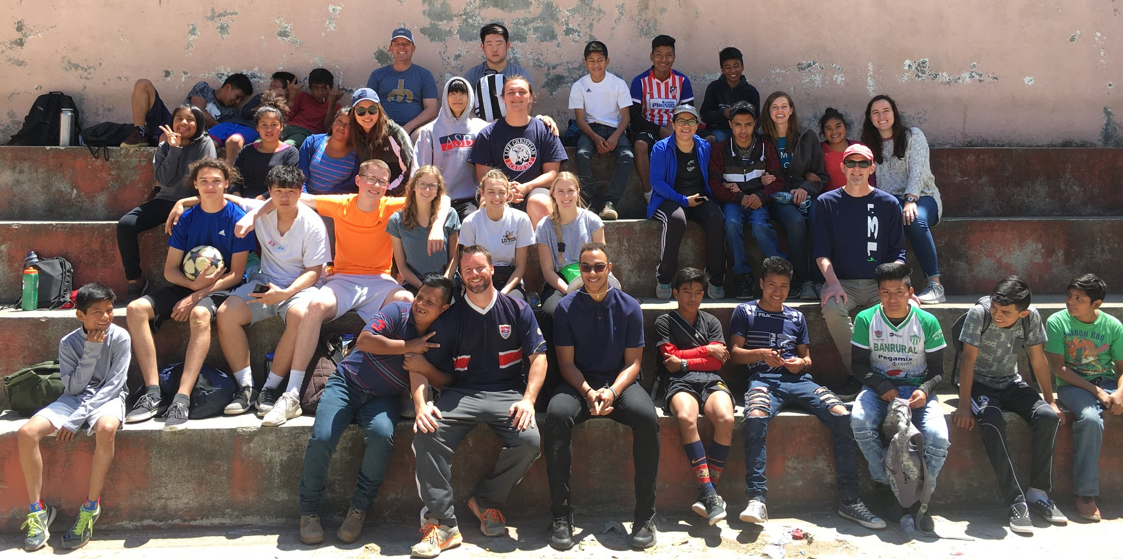
Sports!

Slide 22
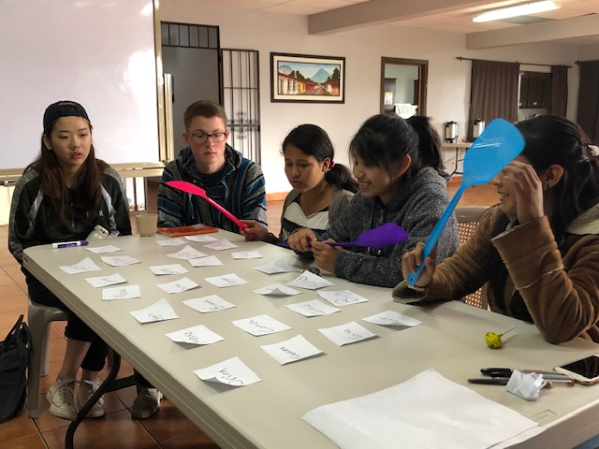
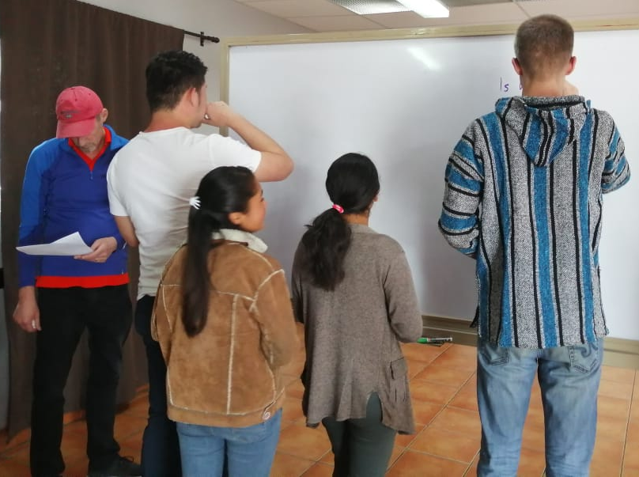
Tutoring at the Community Center

Slide 23
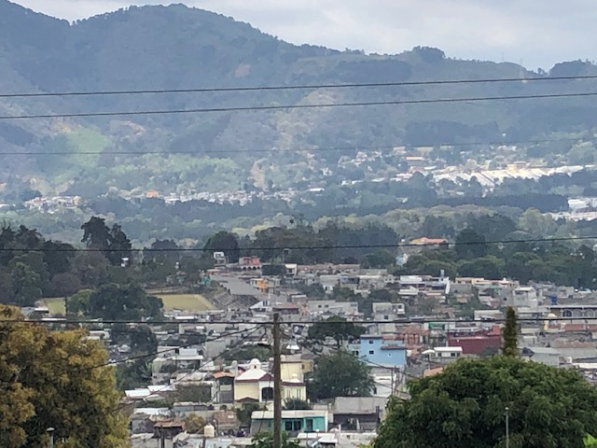
A view of Magdalena

Slide 24
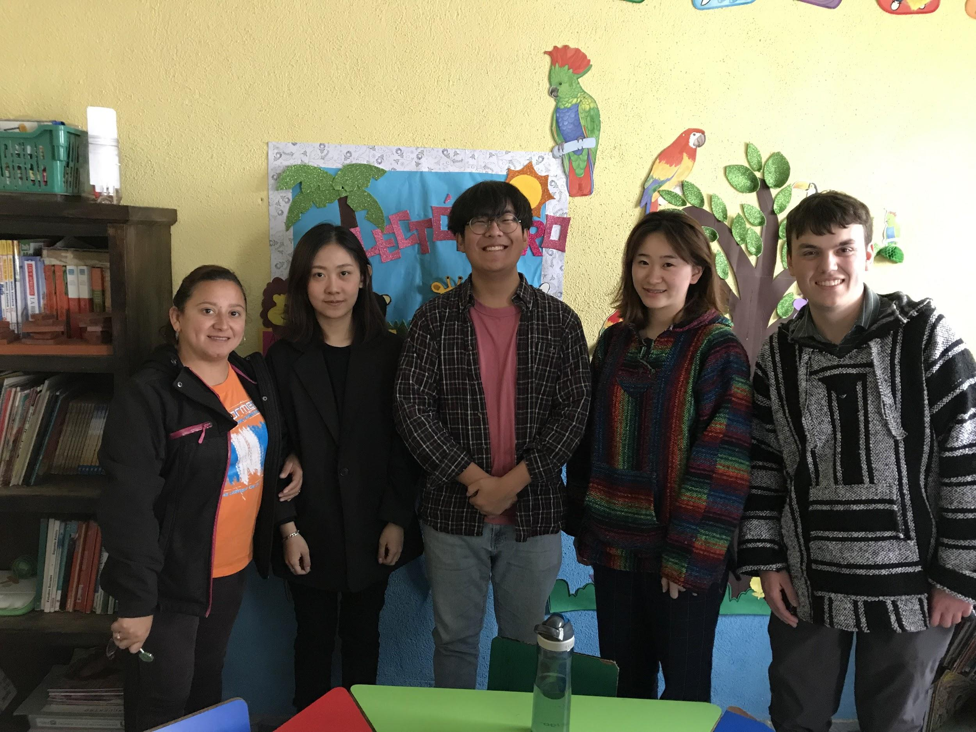
What Joel did...
Raquel, Amber, Isaac, Anna, Joel
Raquel - Tutoring program leader

Slide 25
What Joel did...
Tutoring Program Overview:
Voluntary after-school program
Grades 1-6: Math, Spanish, English
Bible lessons
Building relationships
What I did:
Tutored math and English
Tutored Spanish vocabulary

Slide 26
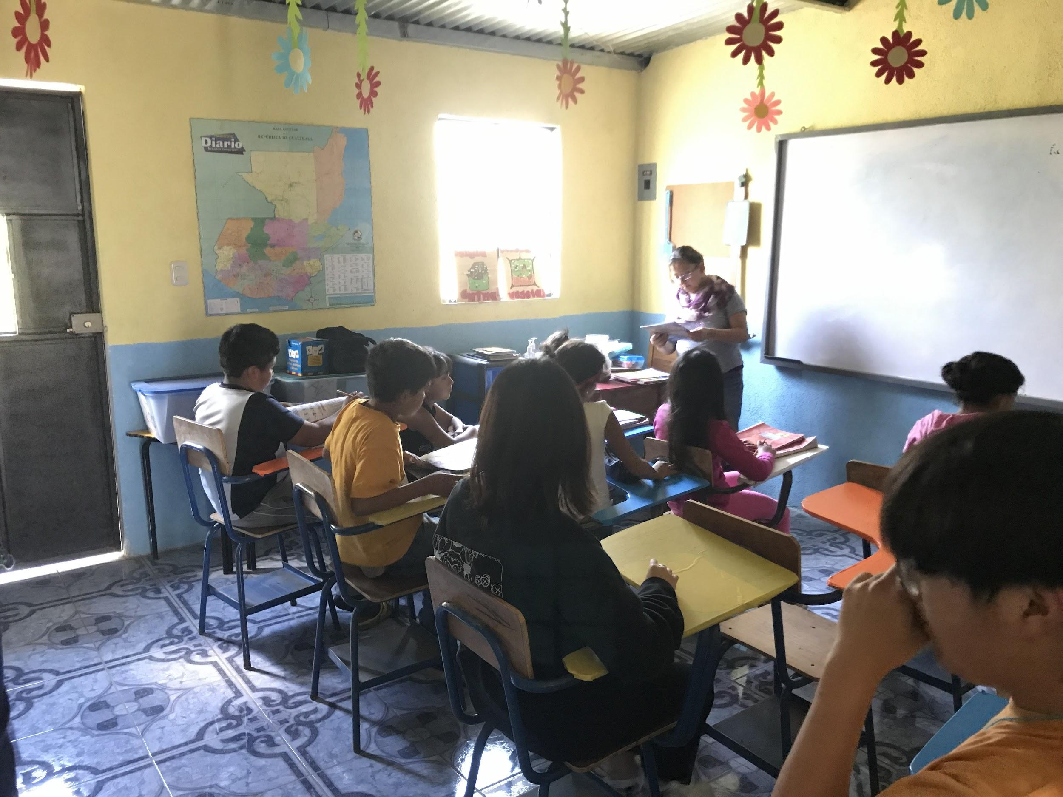
Tutoring

Slide 27
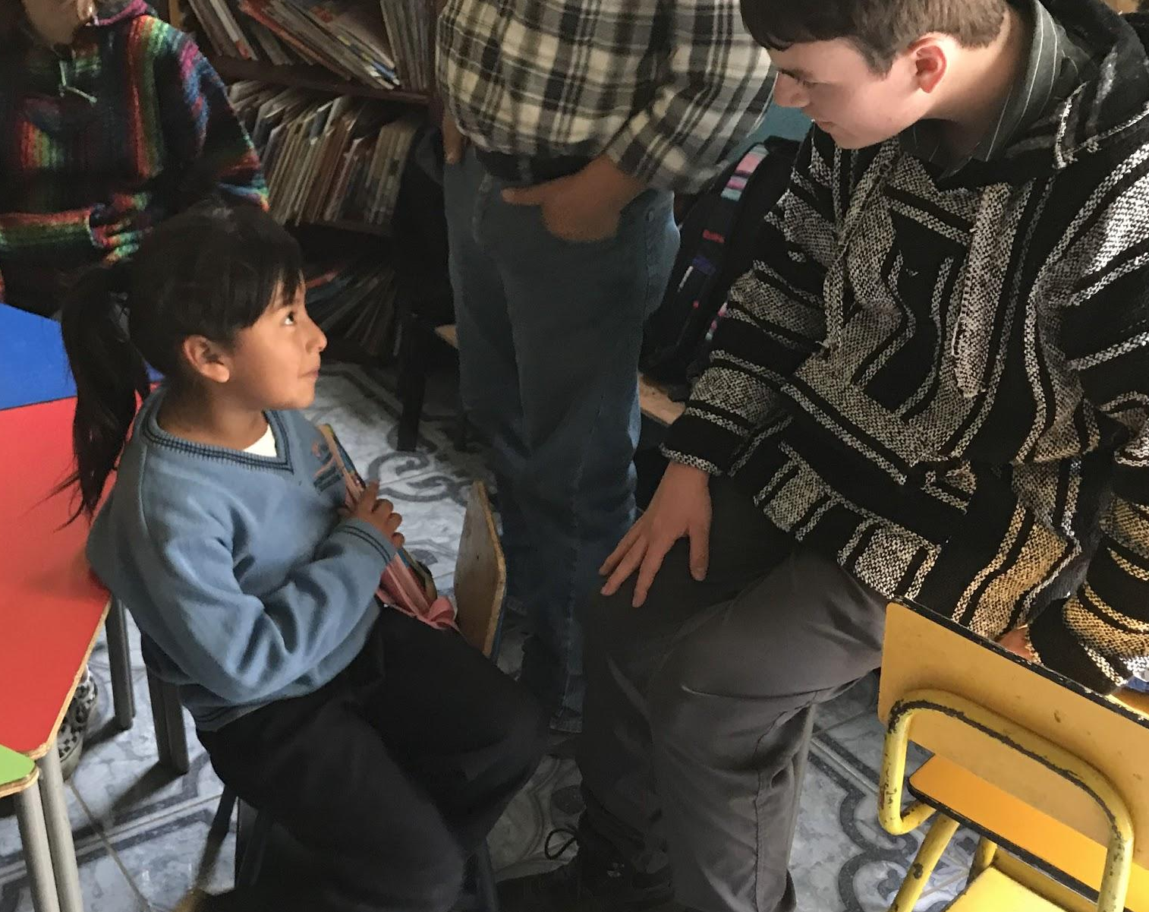
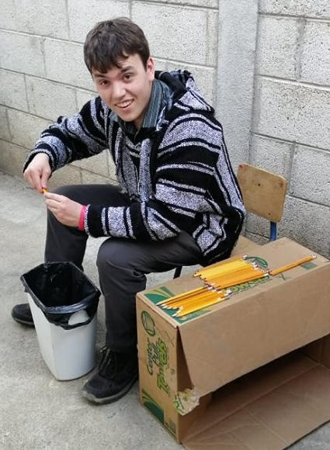
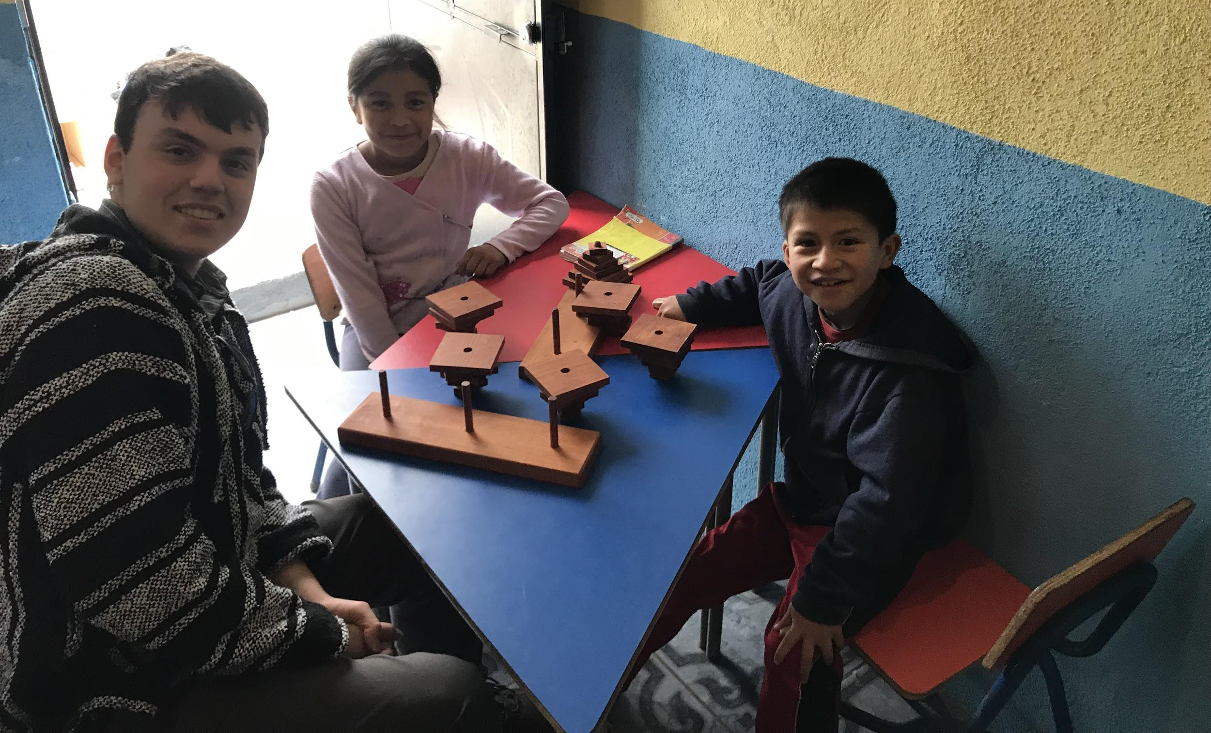
Tutoring

Slide 28
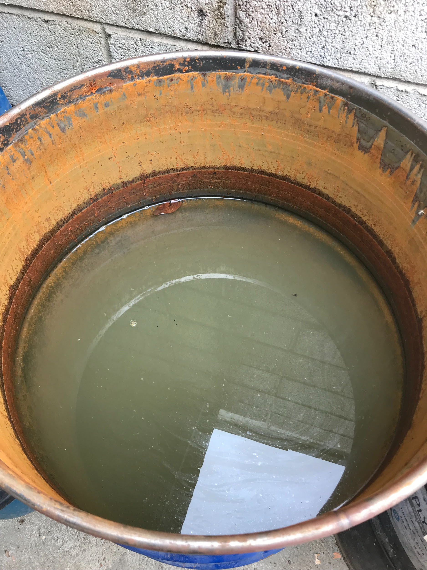
Tutoring
My water source

Slide 29
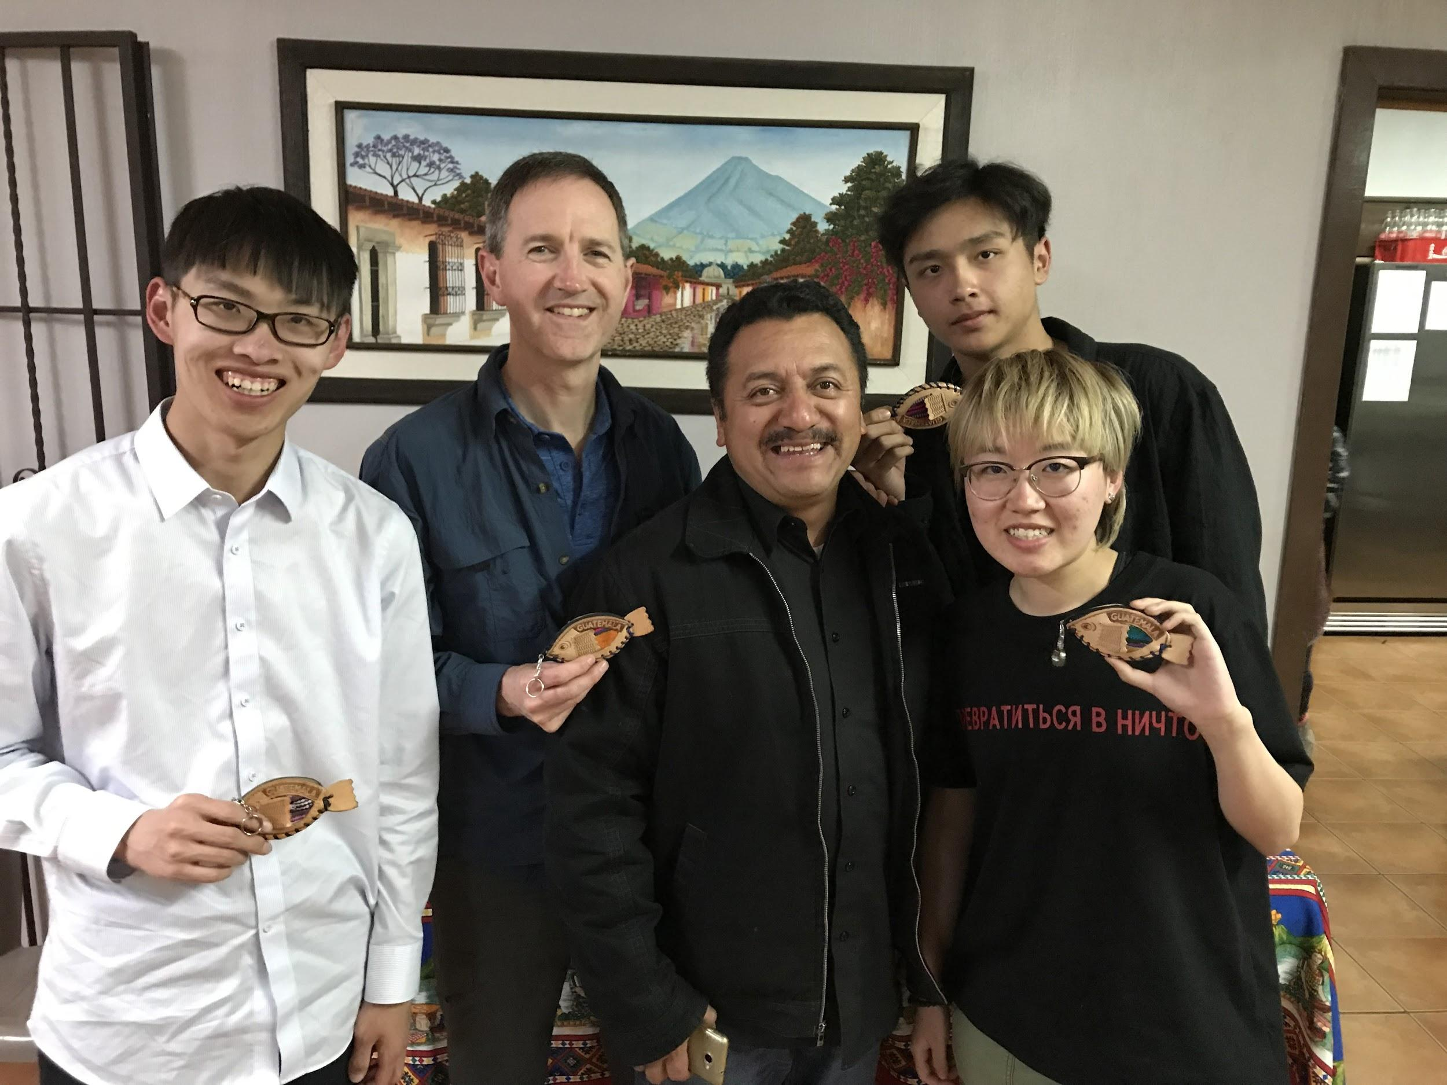
What John did...
Frank, John, Roger, April
Gerber - Micro-finance program leader

Slide 30
What John did...
Micro-finance program overview:
Small business loans
Business training
Relationship, serving, supporting, caring
Bible study, prayer
What we did:
Home/site visits
Discuss their business
Pray with them

Slide 31
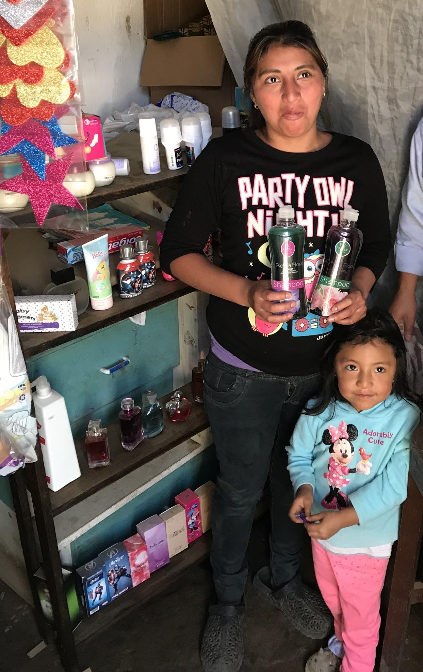
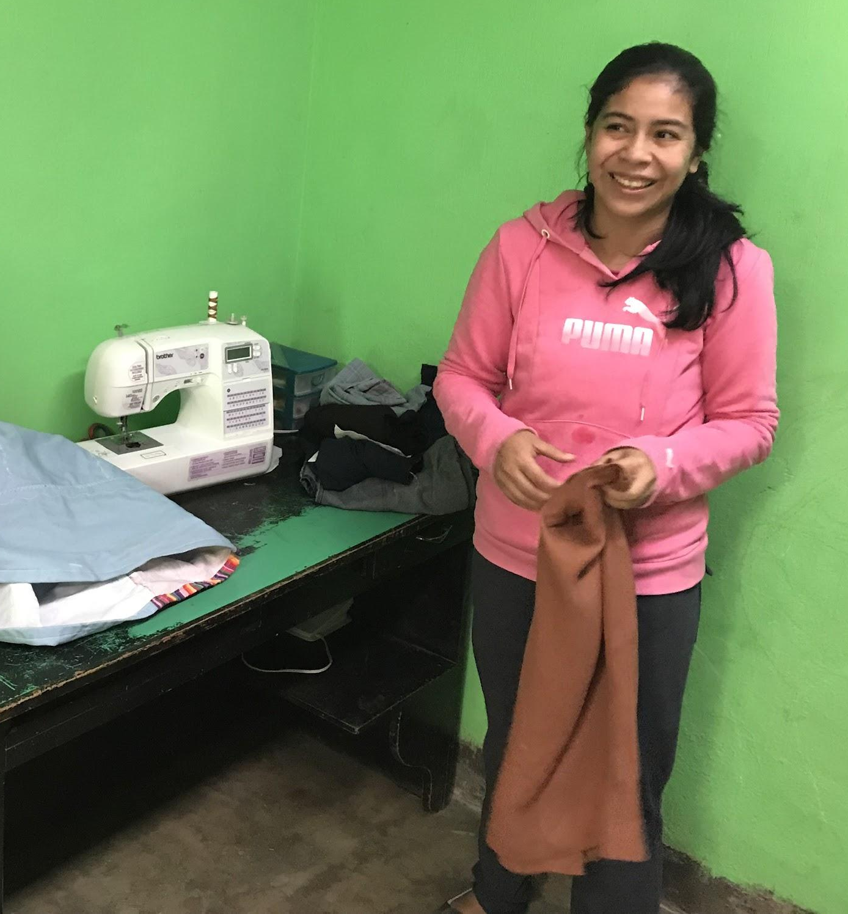
Micro-finance
Wendy: soap,
shampoo, fragrances
Mindi: seamstress

Slide 32
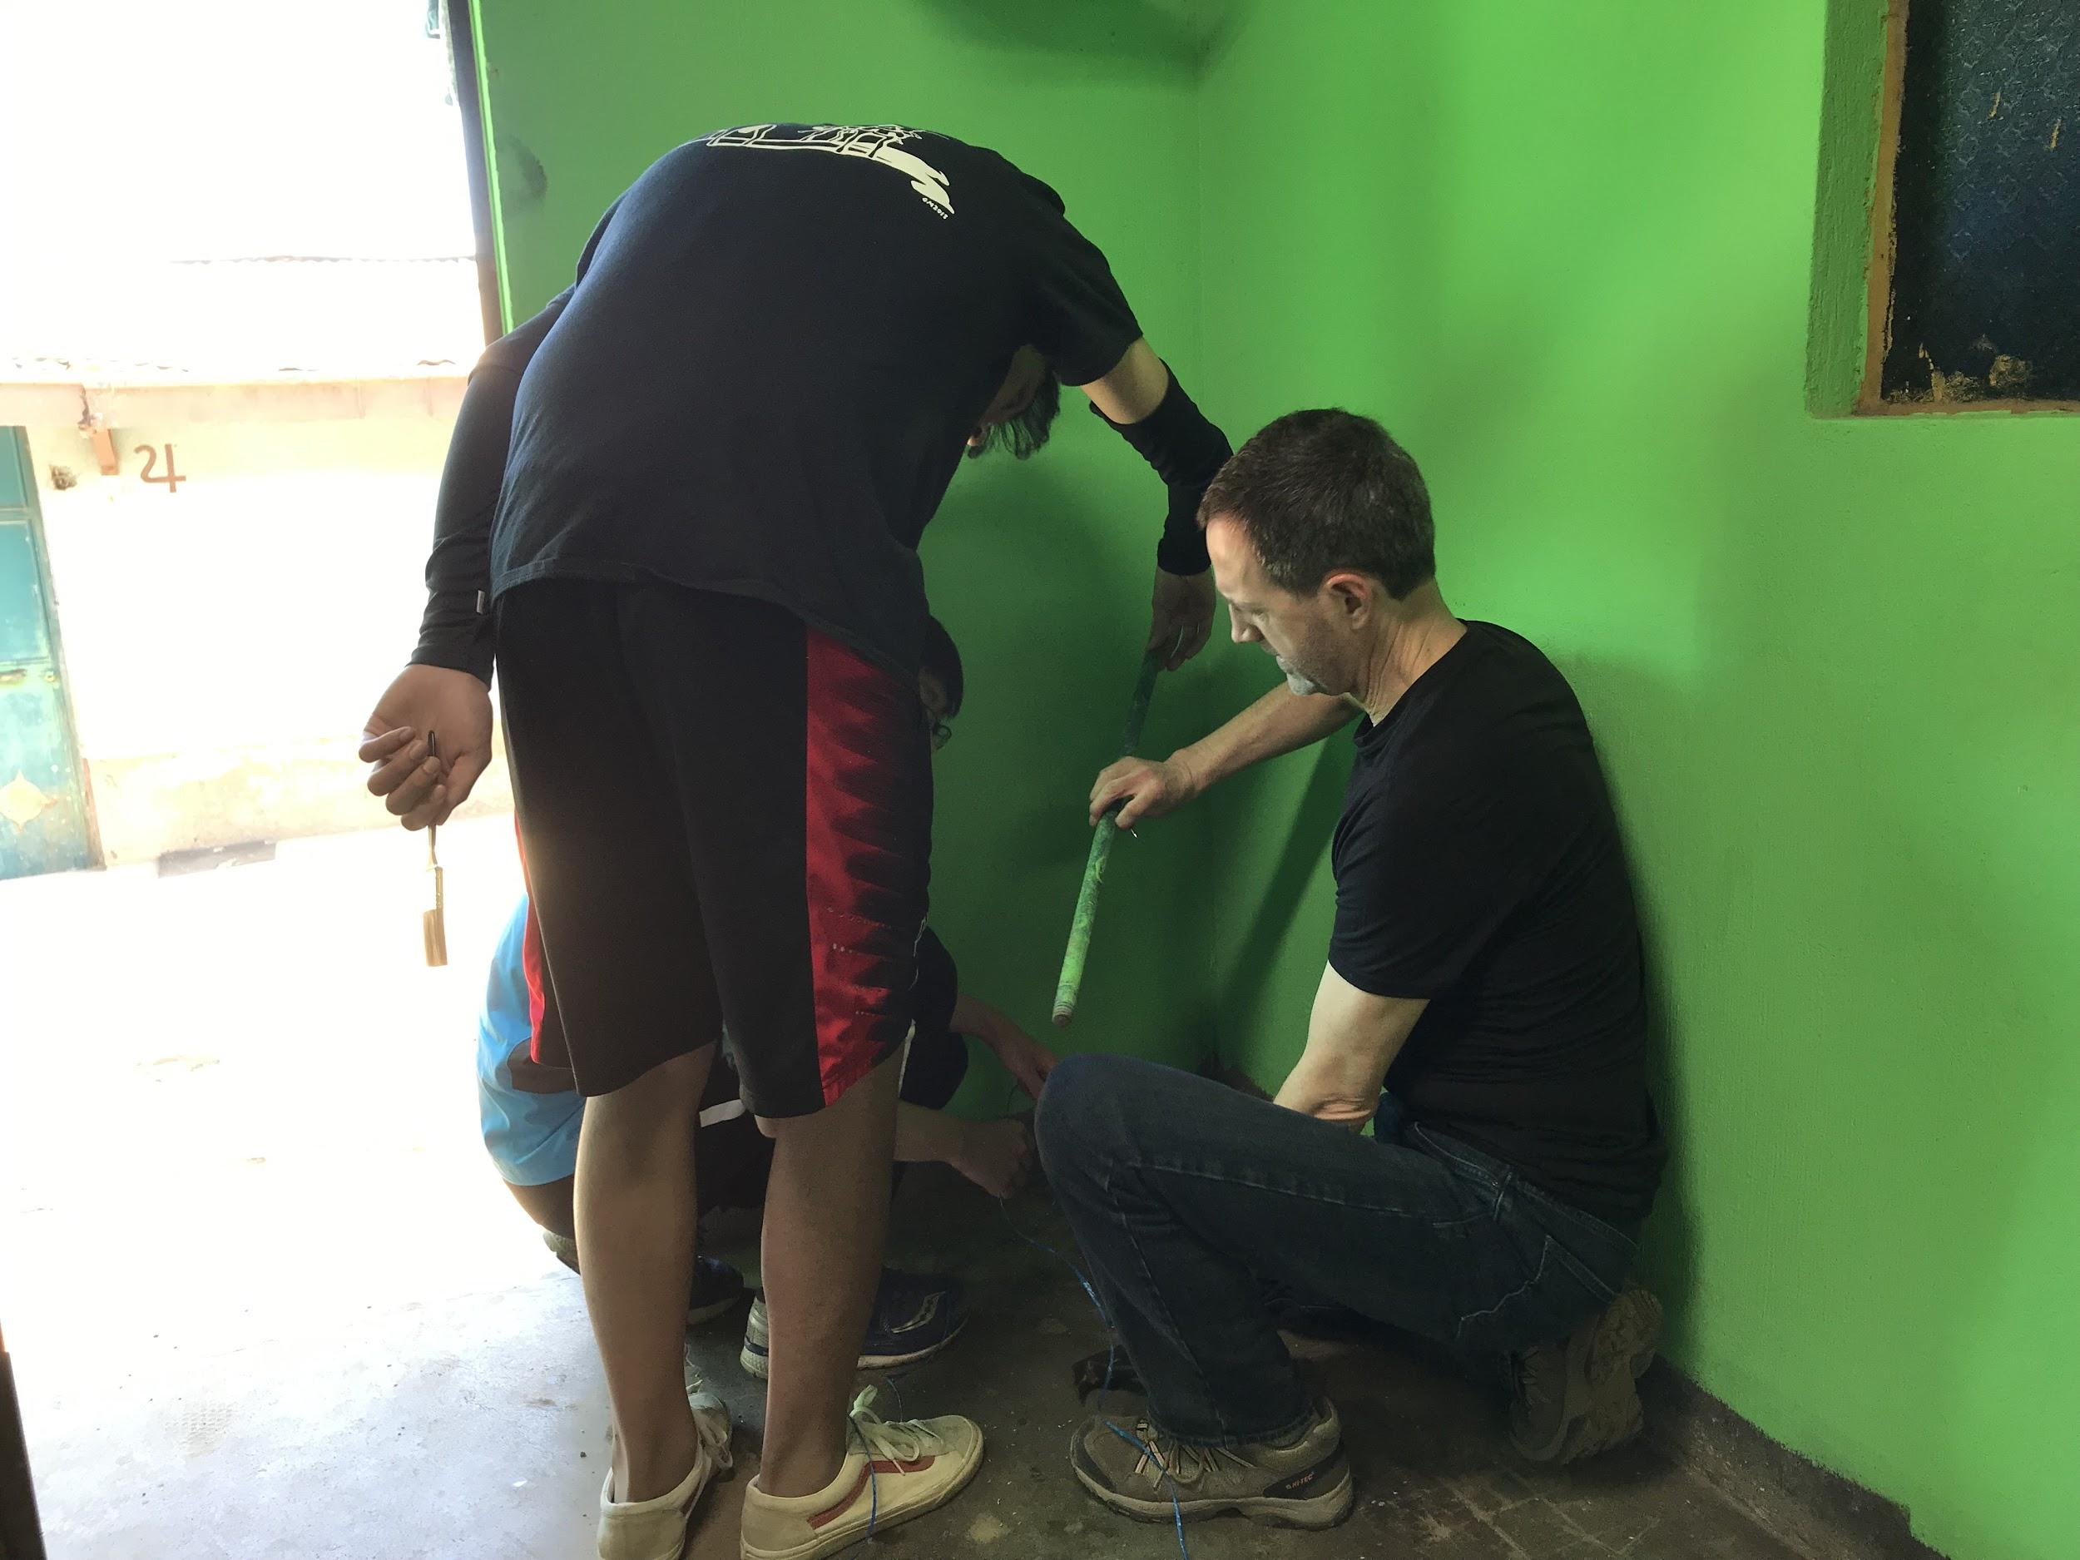
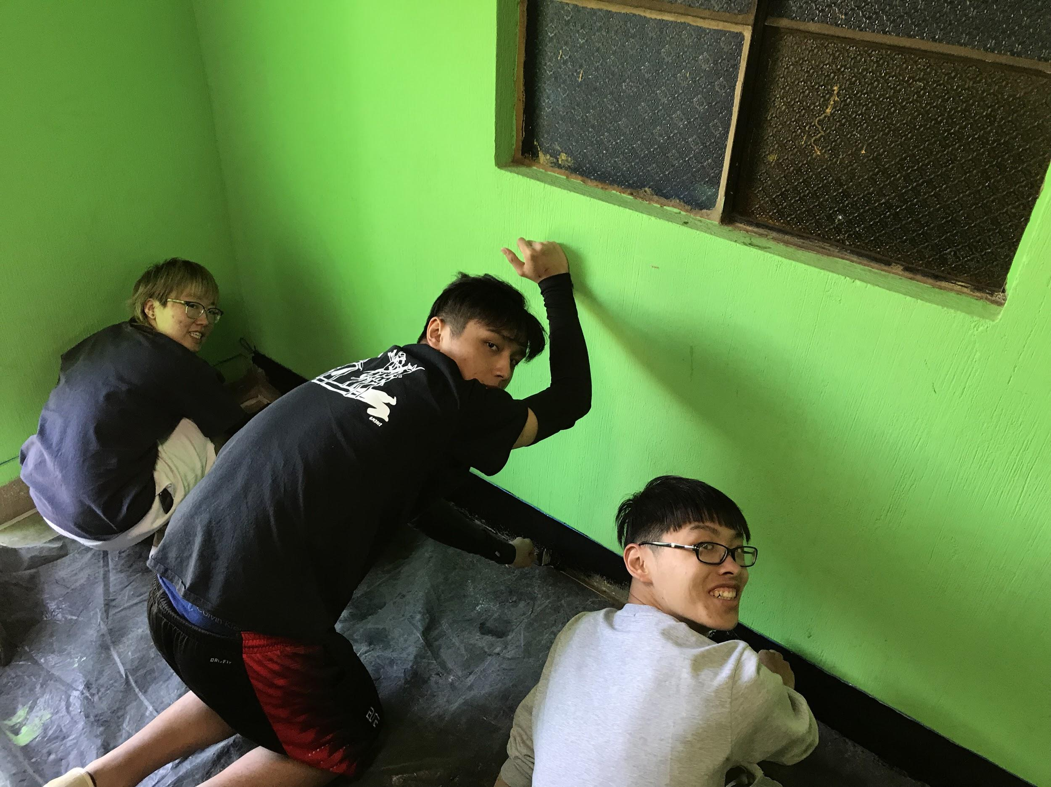
Micro-finance
Painting!

Slide 33
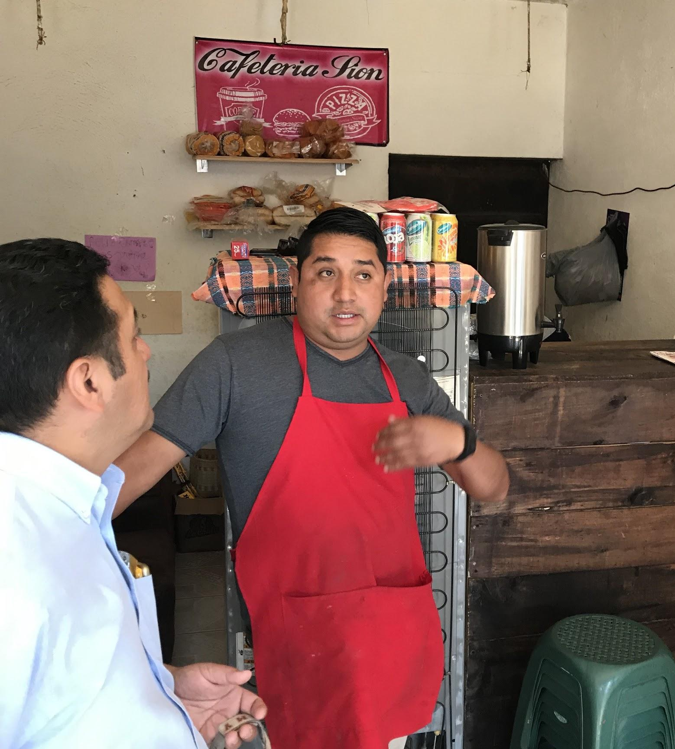
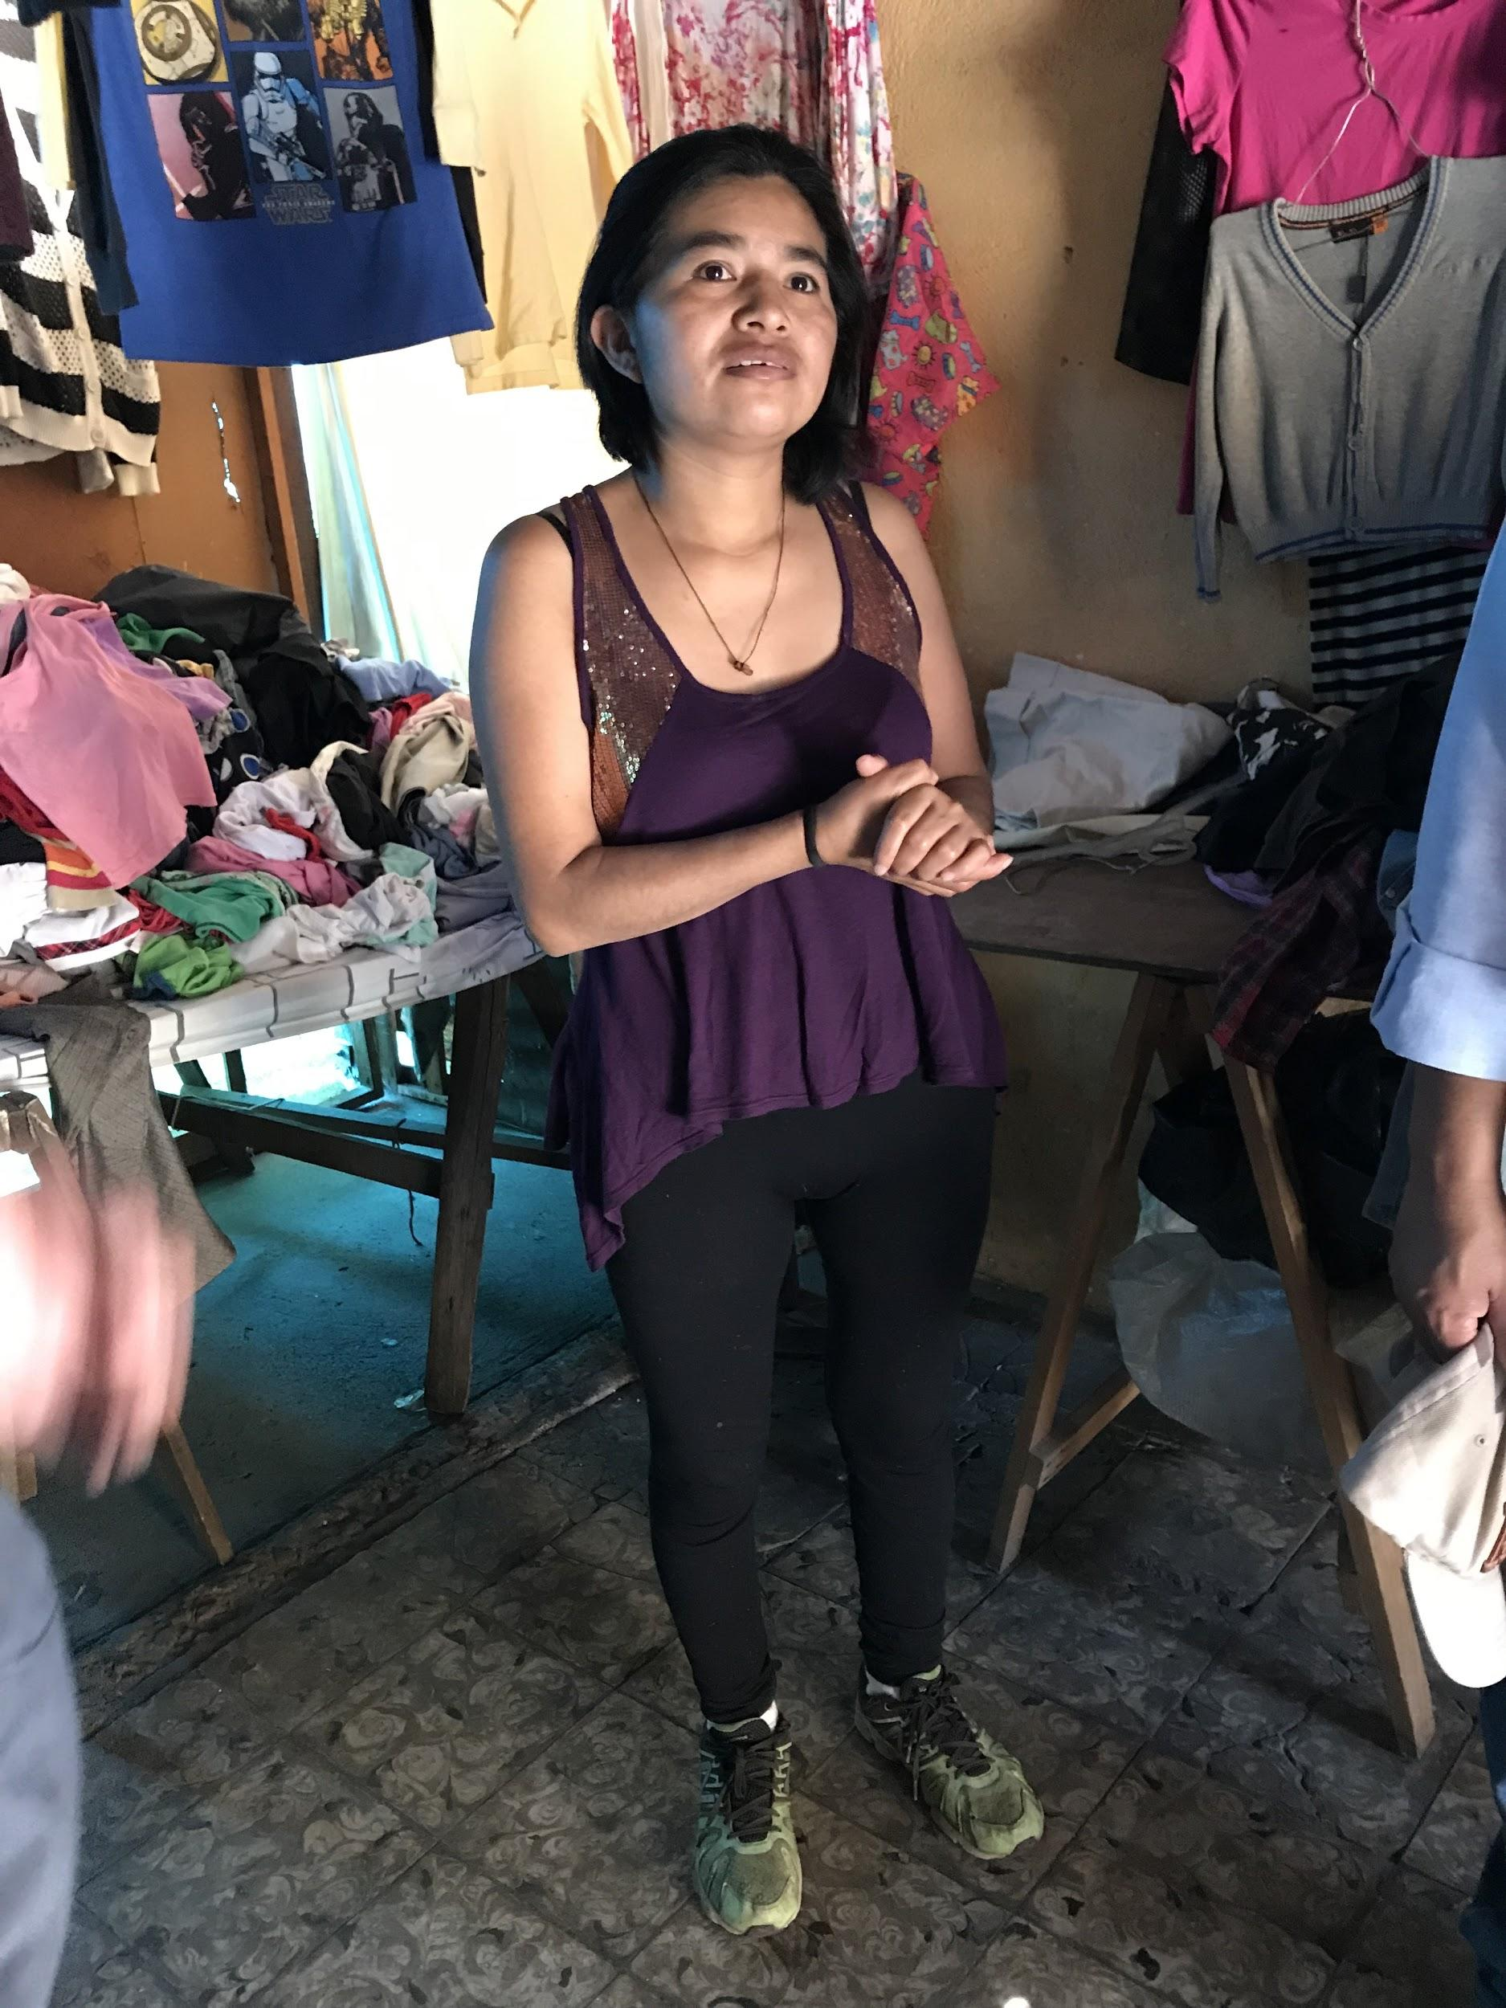
Micro-finance
Melvin: cafe
Annabella: used clothing

Slide 34
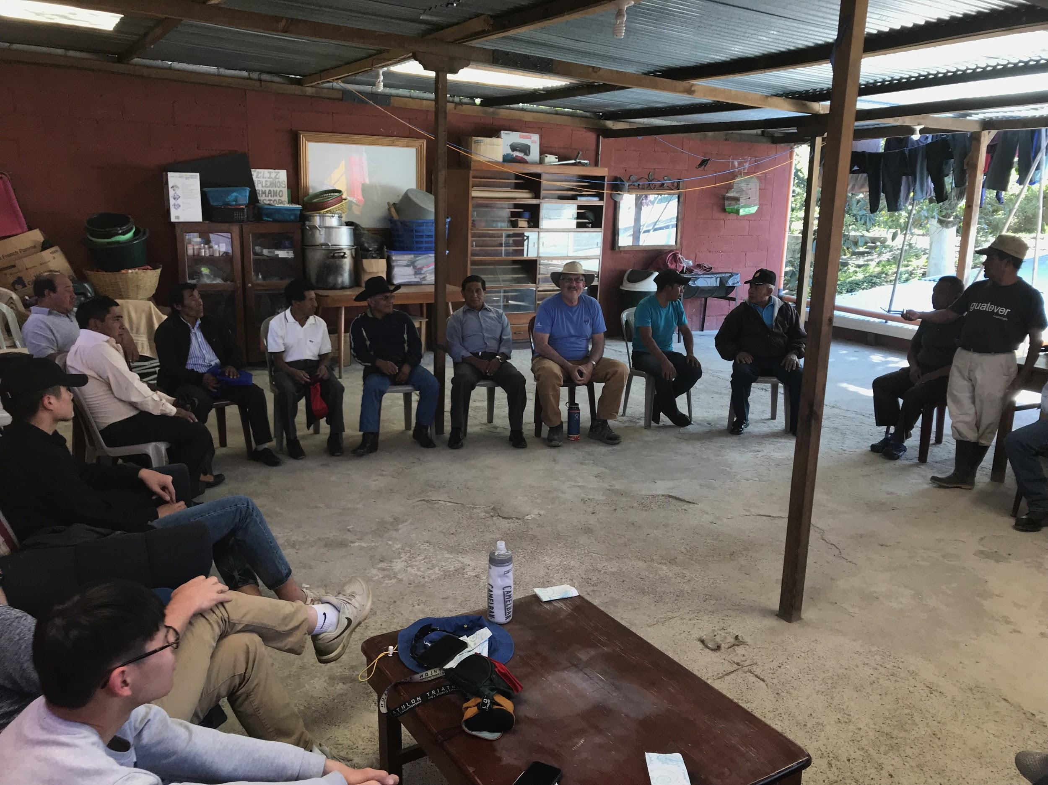
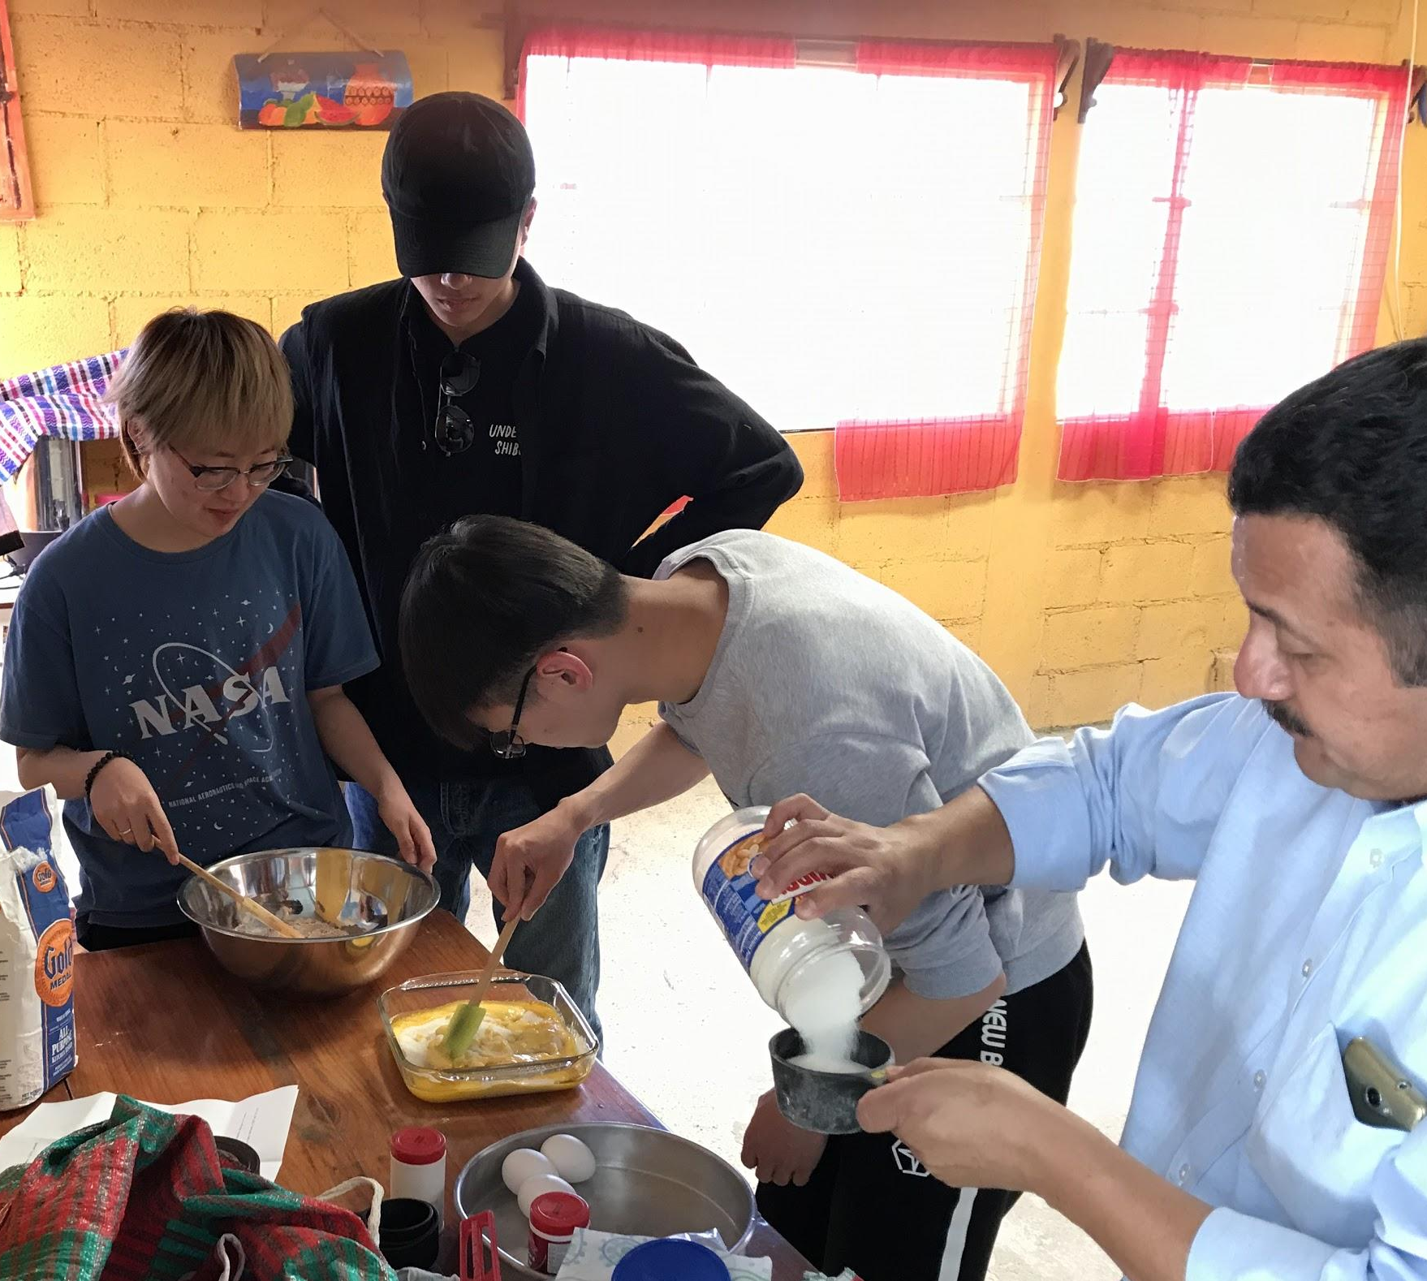
Micro-finance
Brownies!
Bible study with avocado farmers

Slide 35
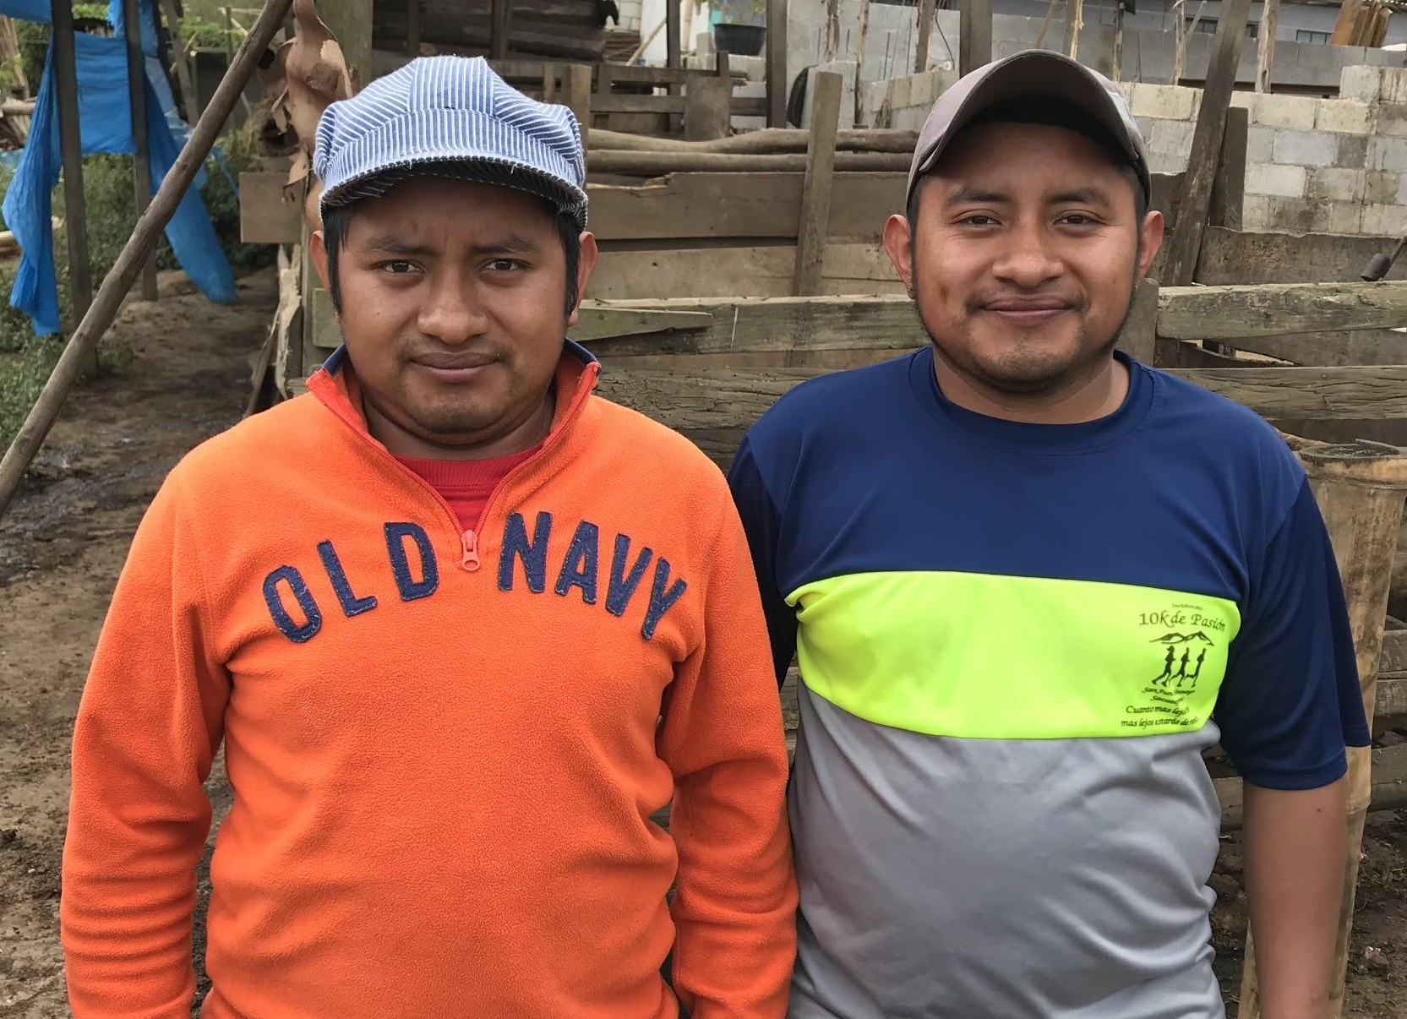
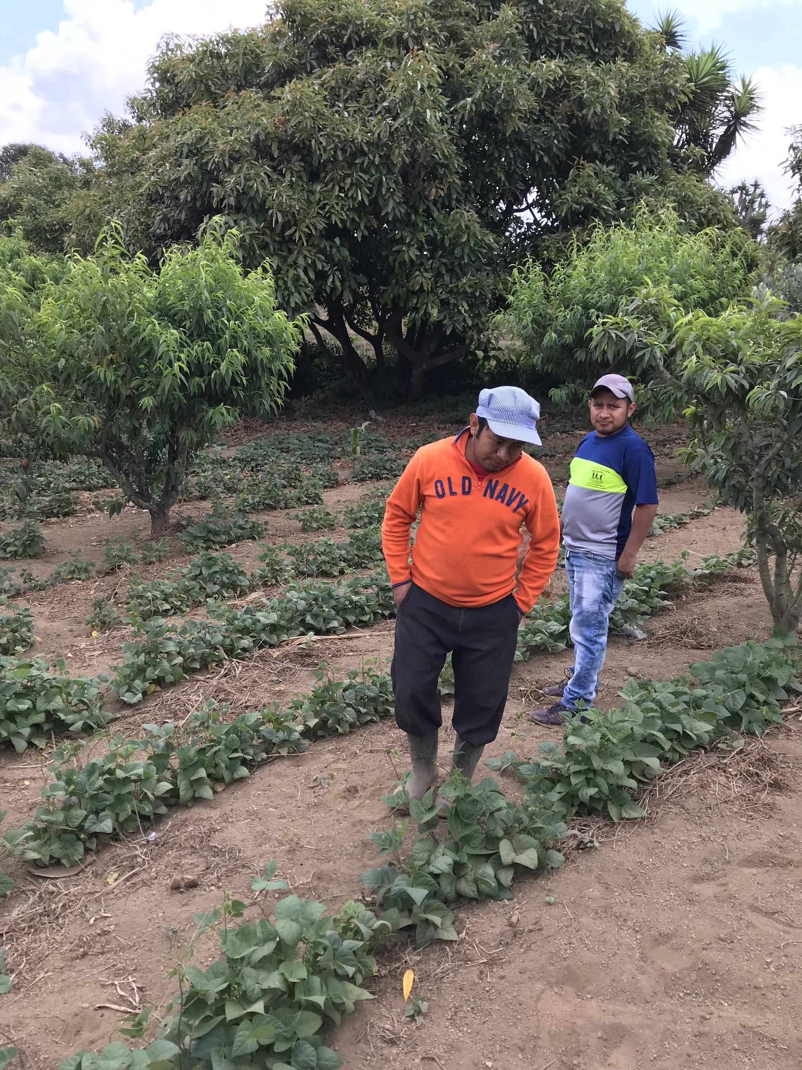
Micro-finance
Ledy and Billy:
pigs, beans, peaches, pears, avocados

Slide 36
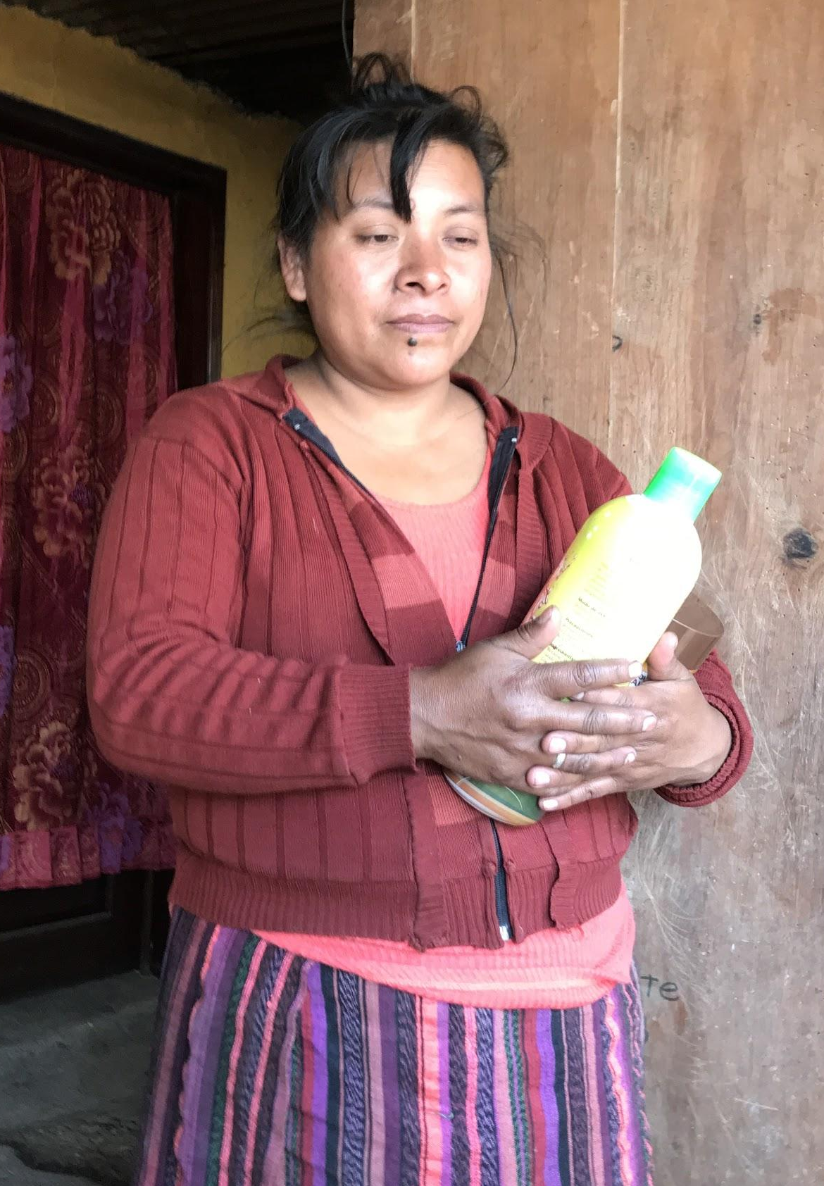
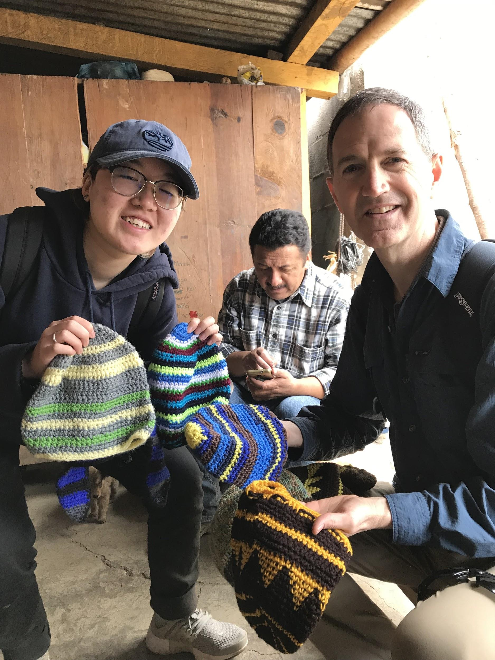
Micro-finance
Roberta: chickens, lotion, crocheting

Slide 37
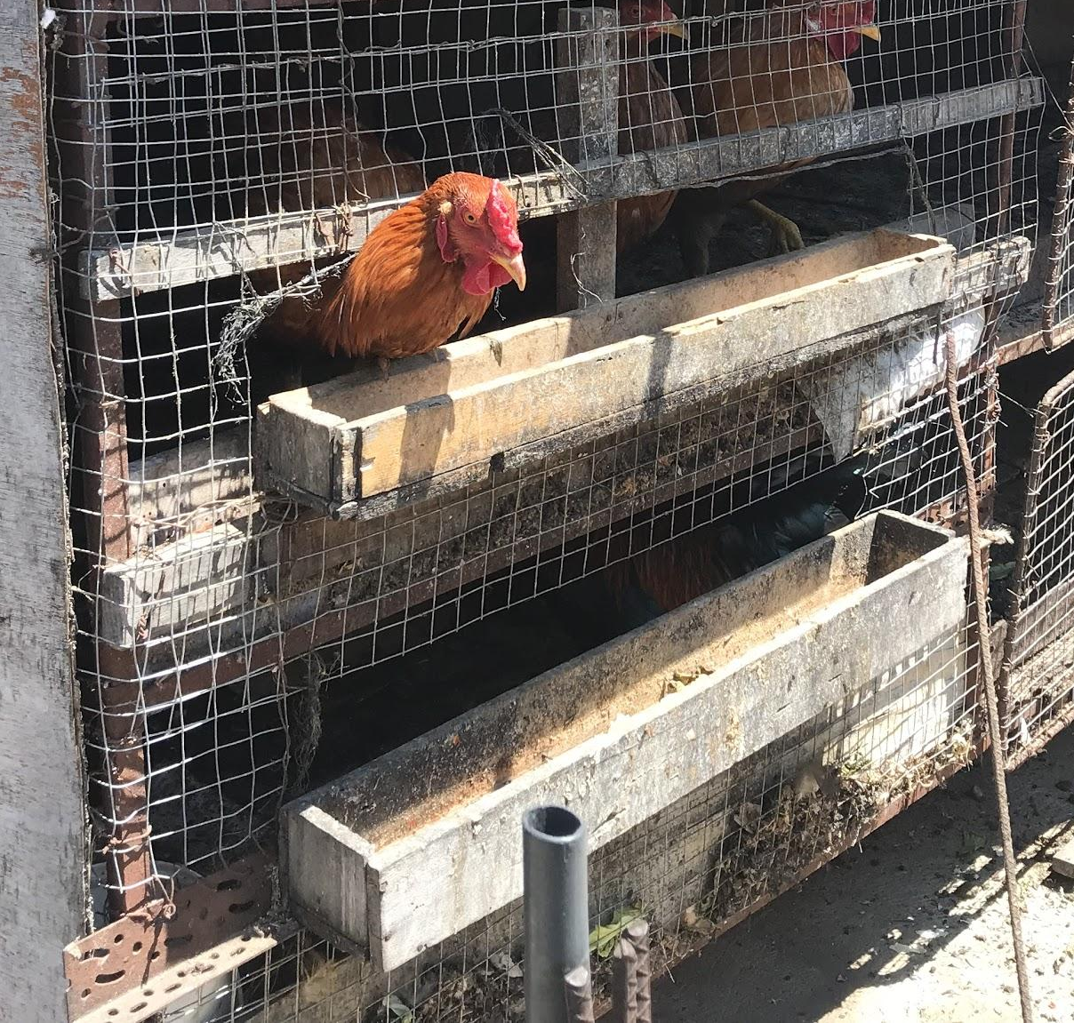
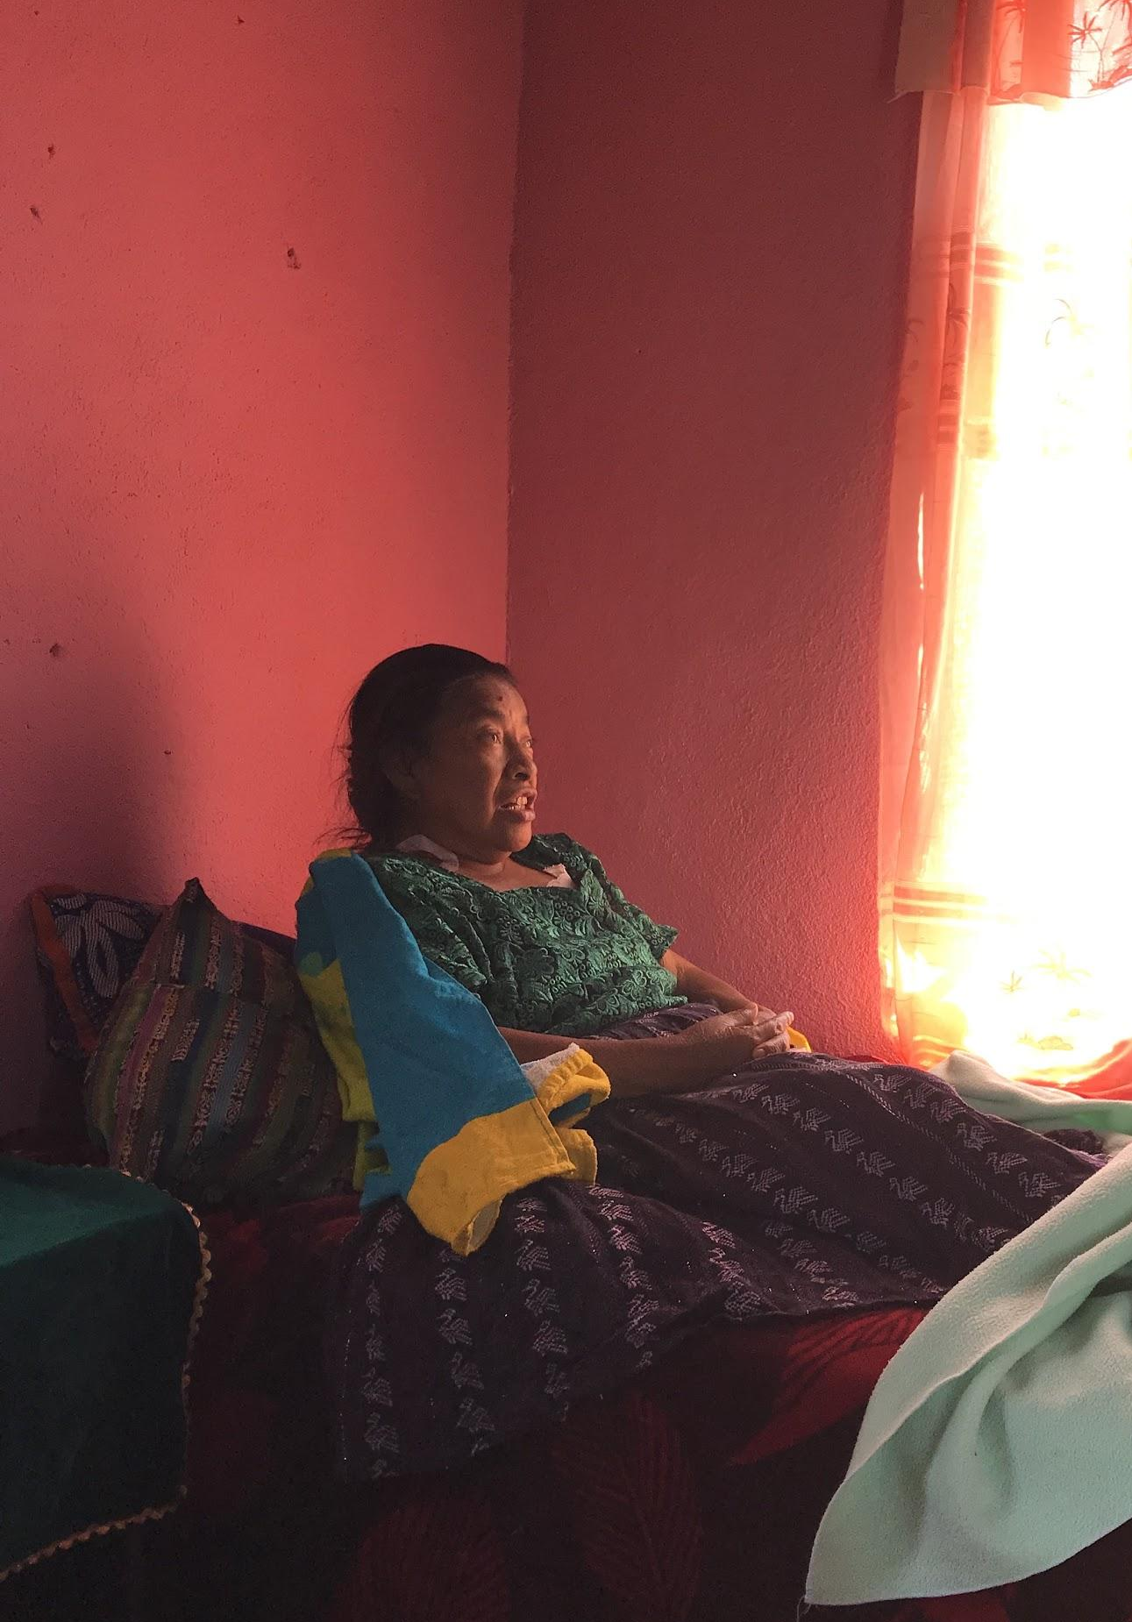
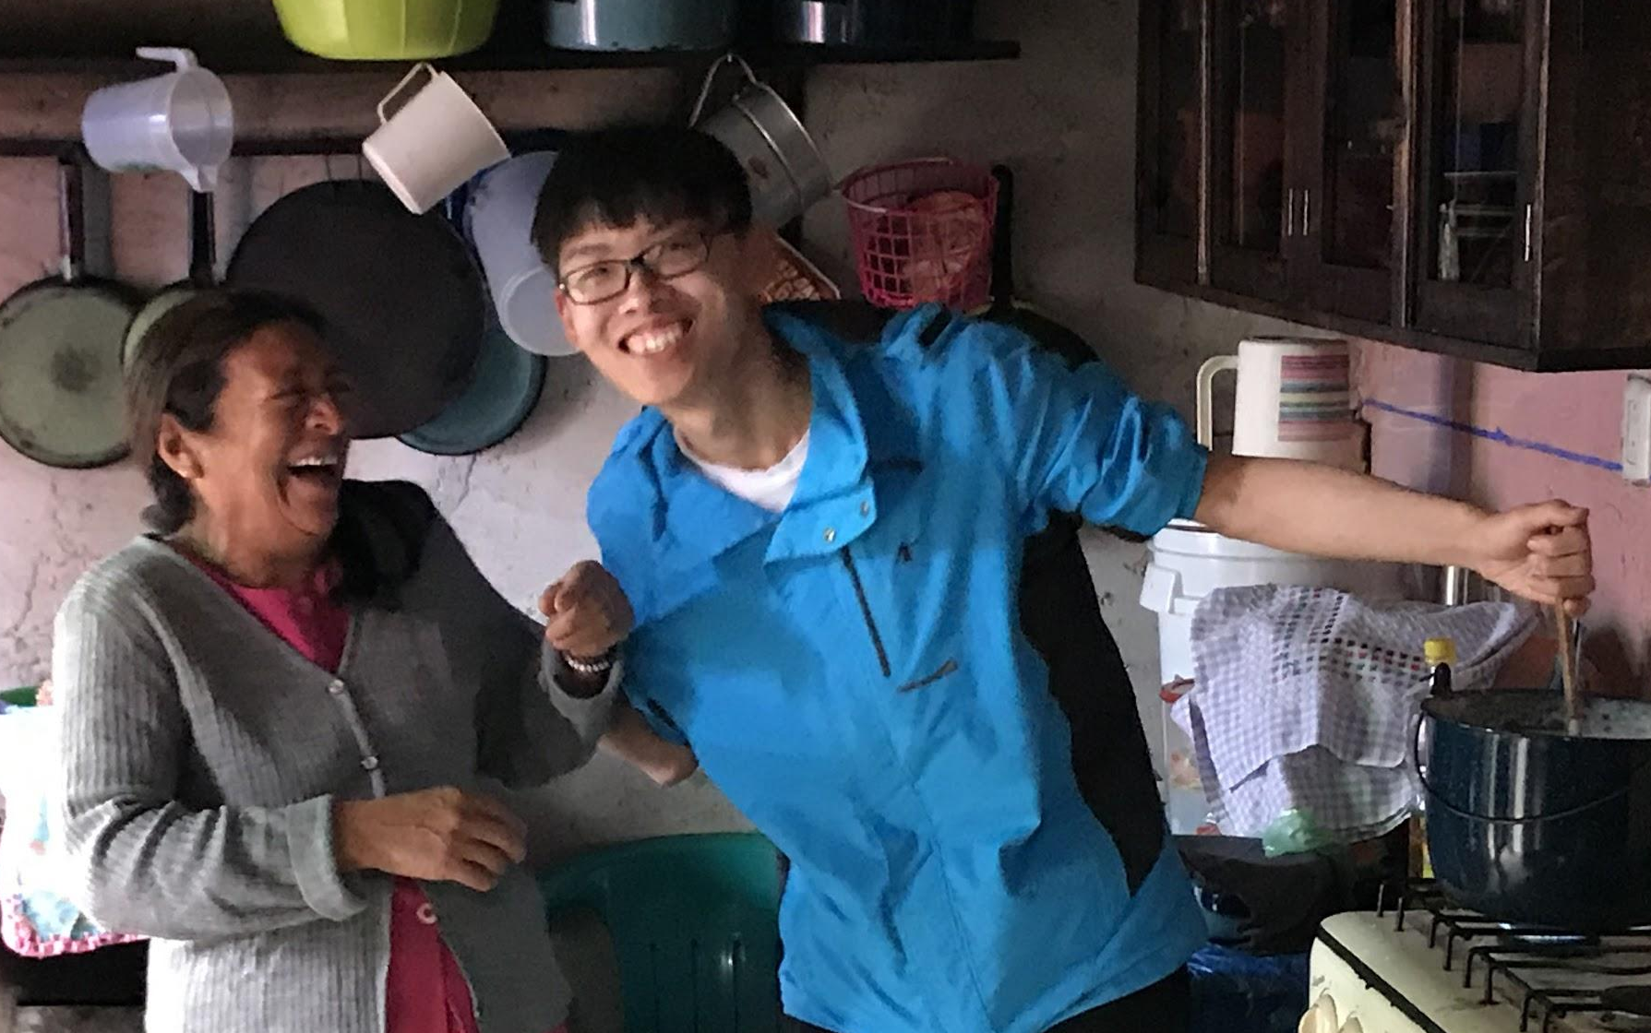
Micro-finance
Felicity, Sonia: raising chickens

Slide 38
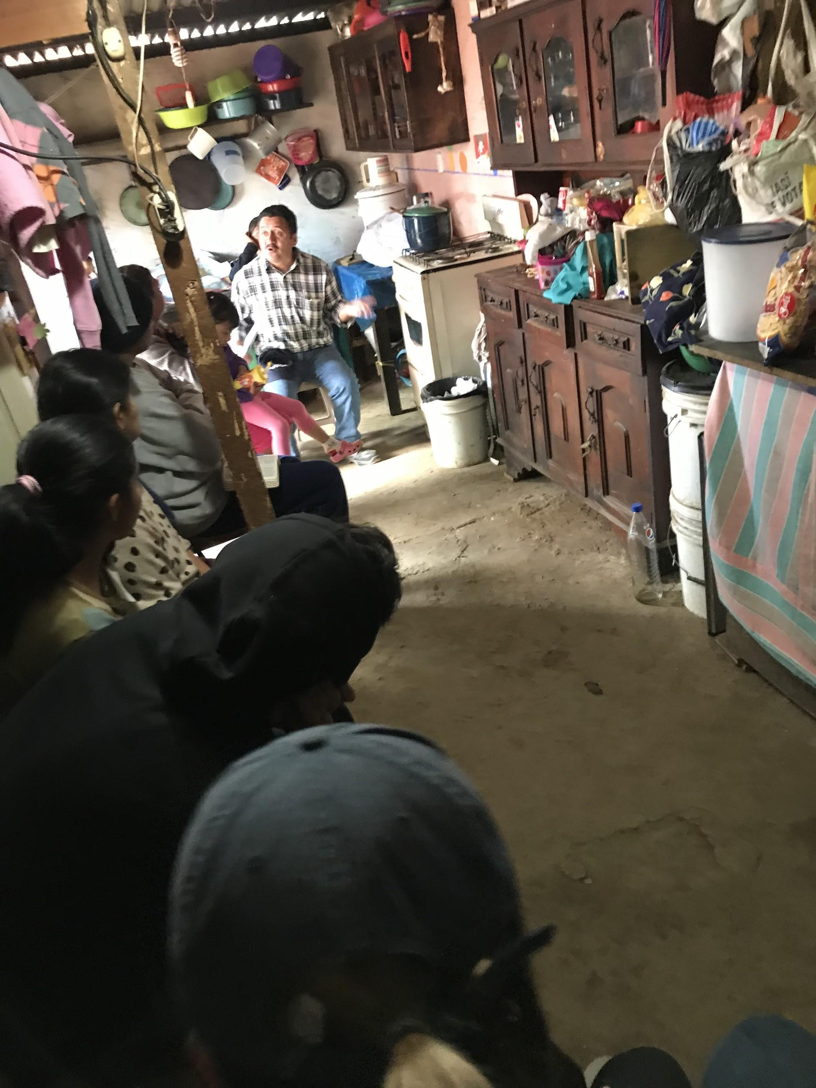
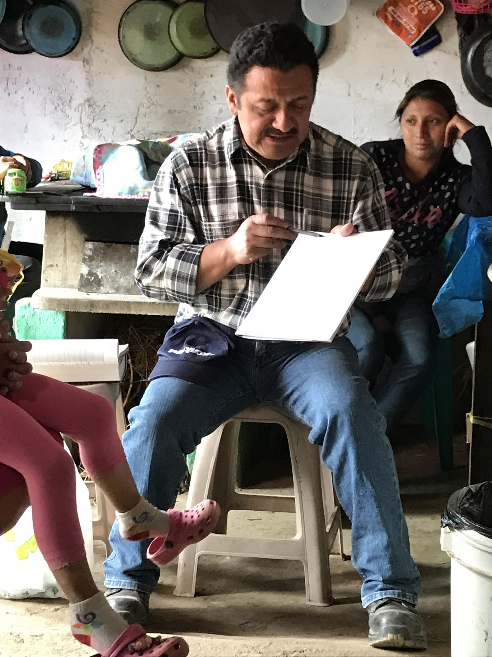
Micro-finance
Learning to
build a budget
training

Slide 39
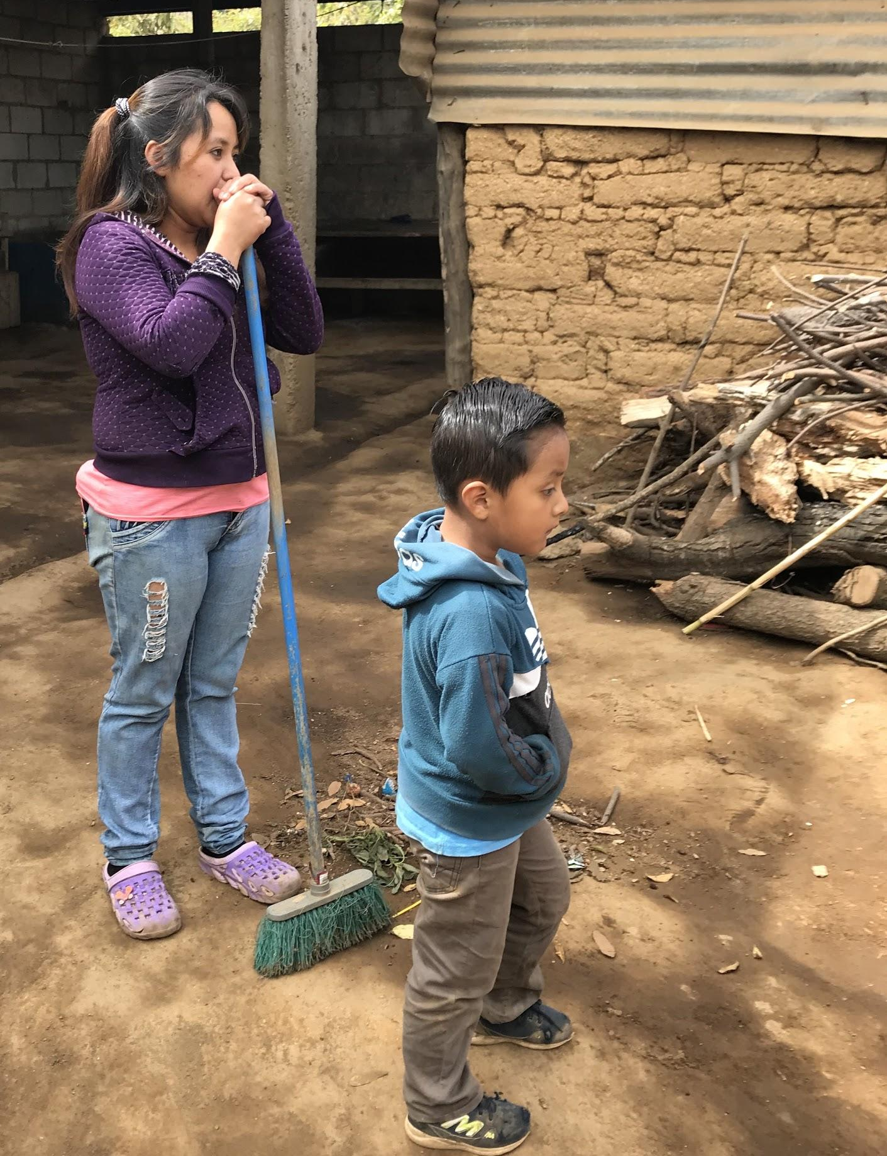
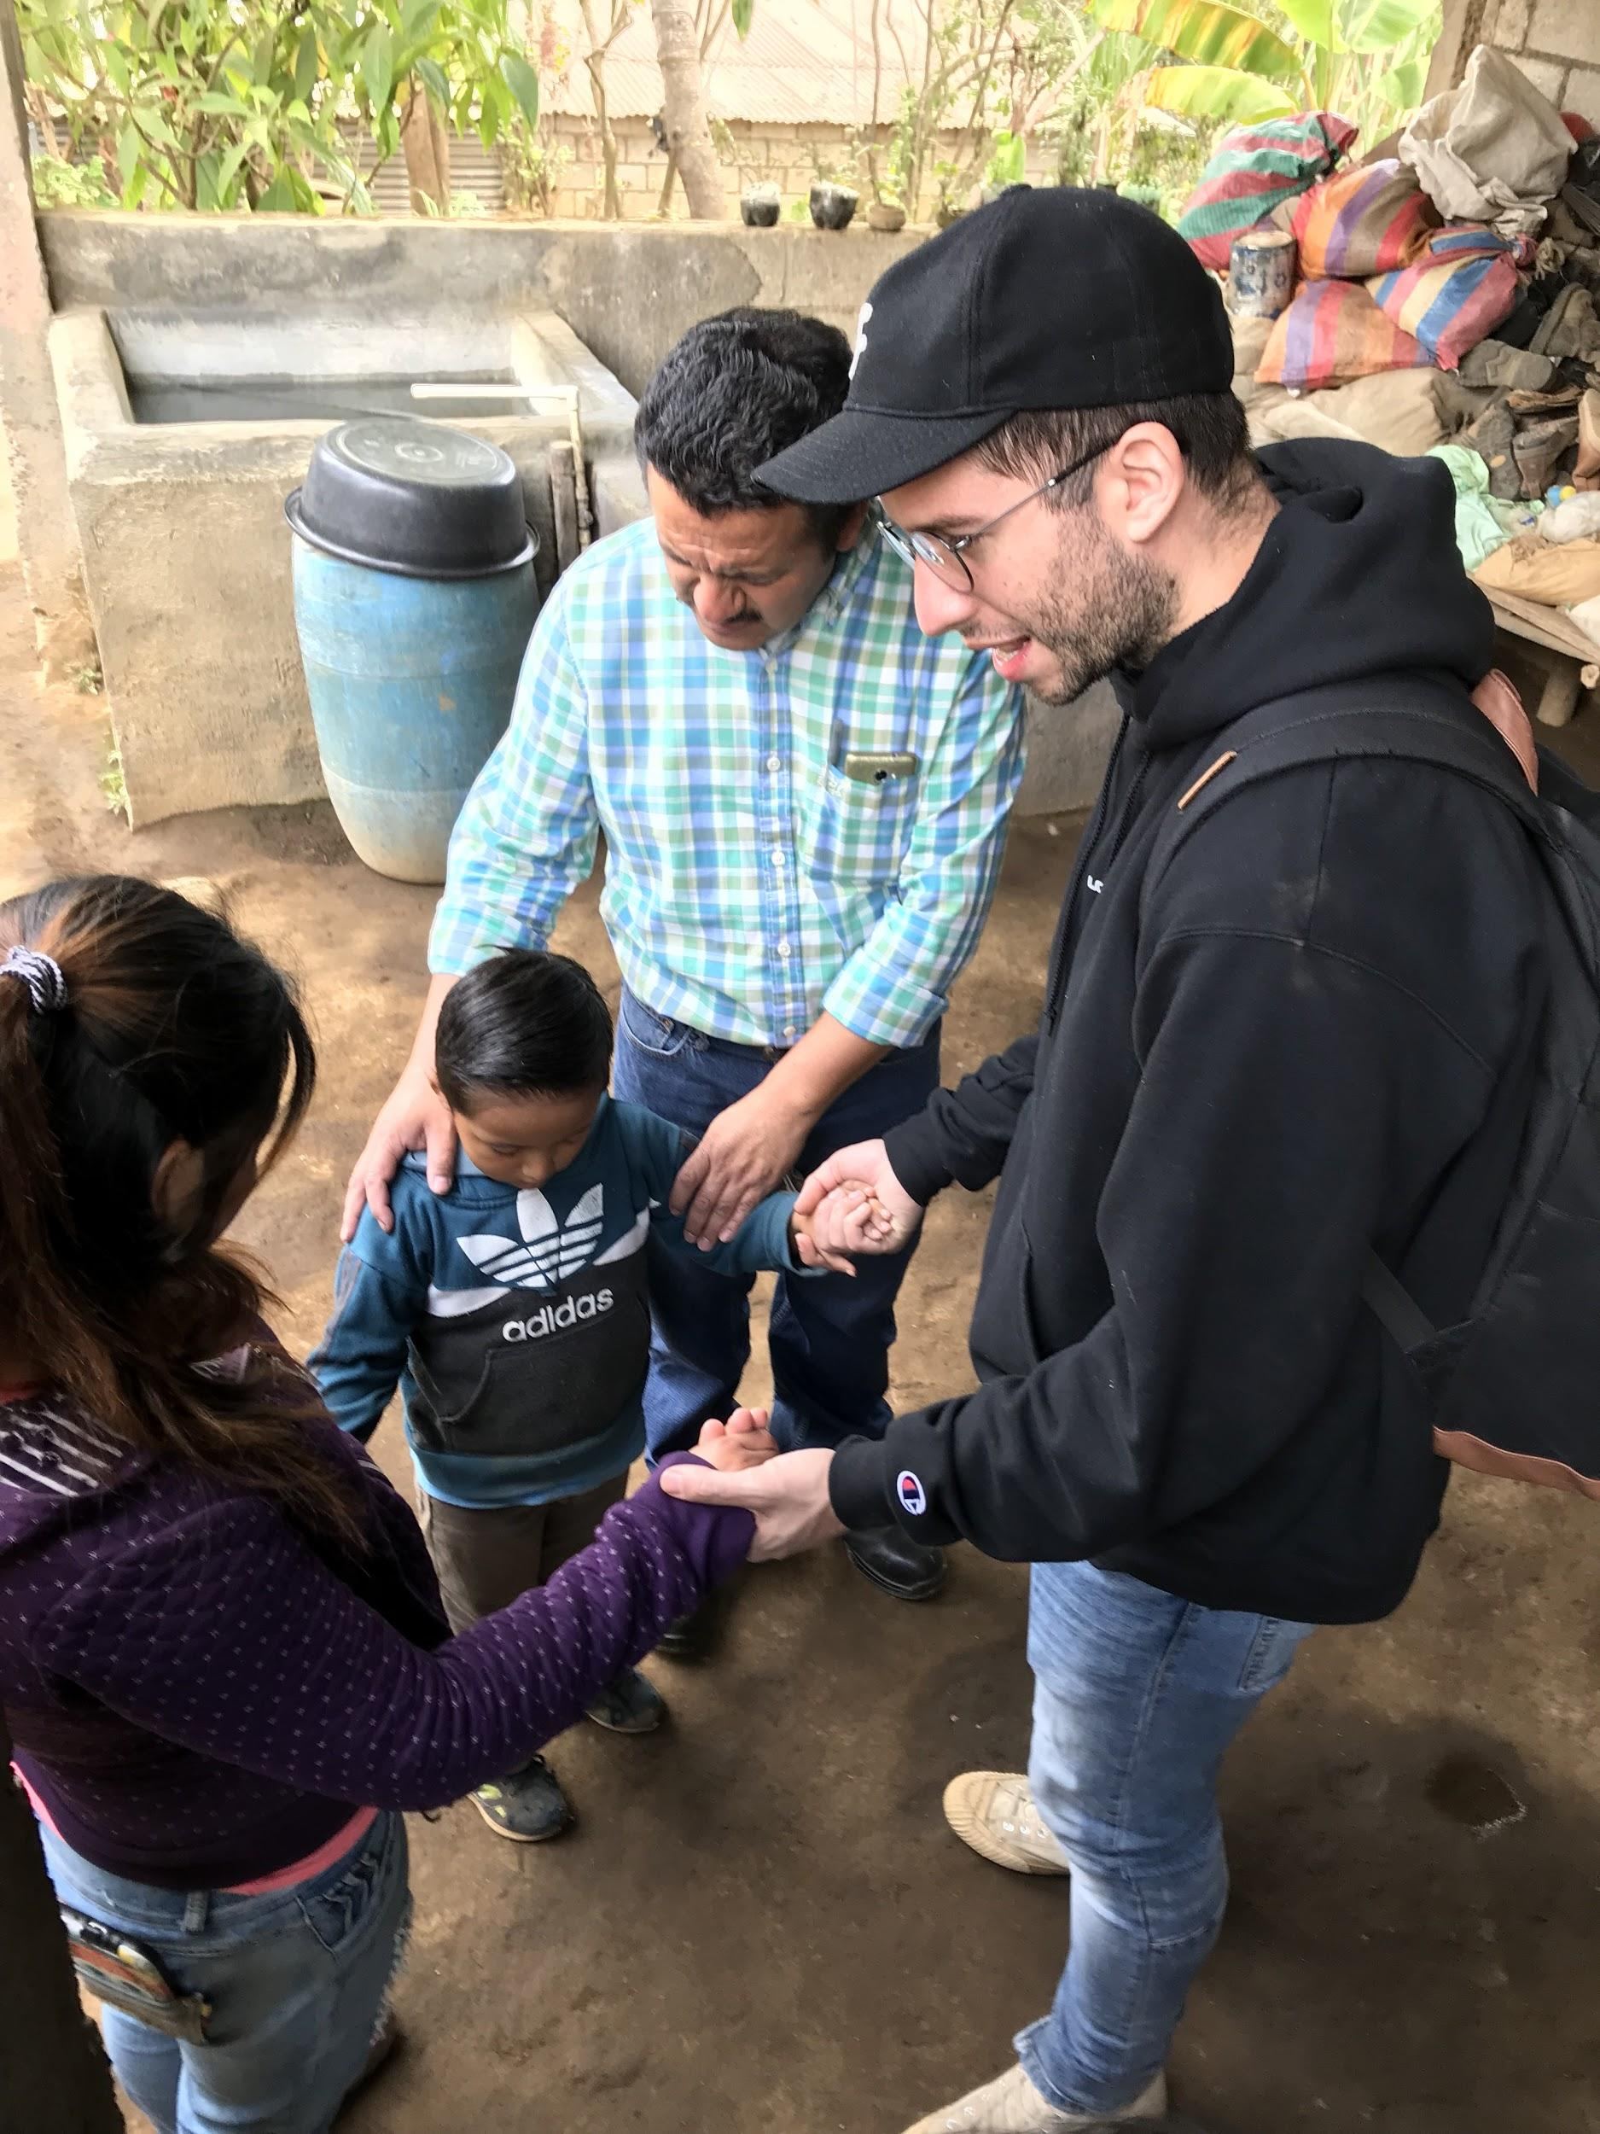
Micro-finance
Lucero: raising pigs

Slide 40
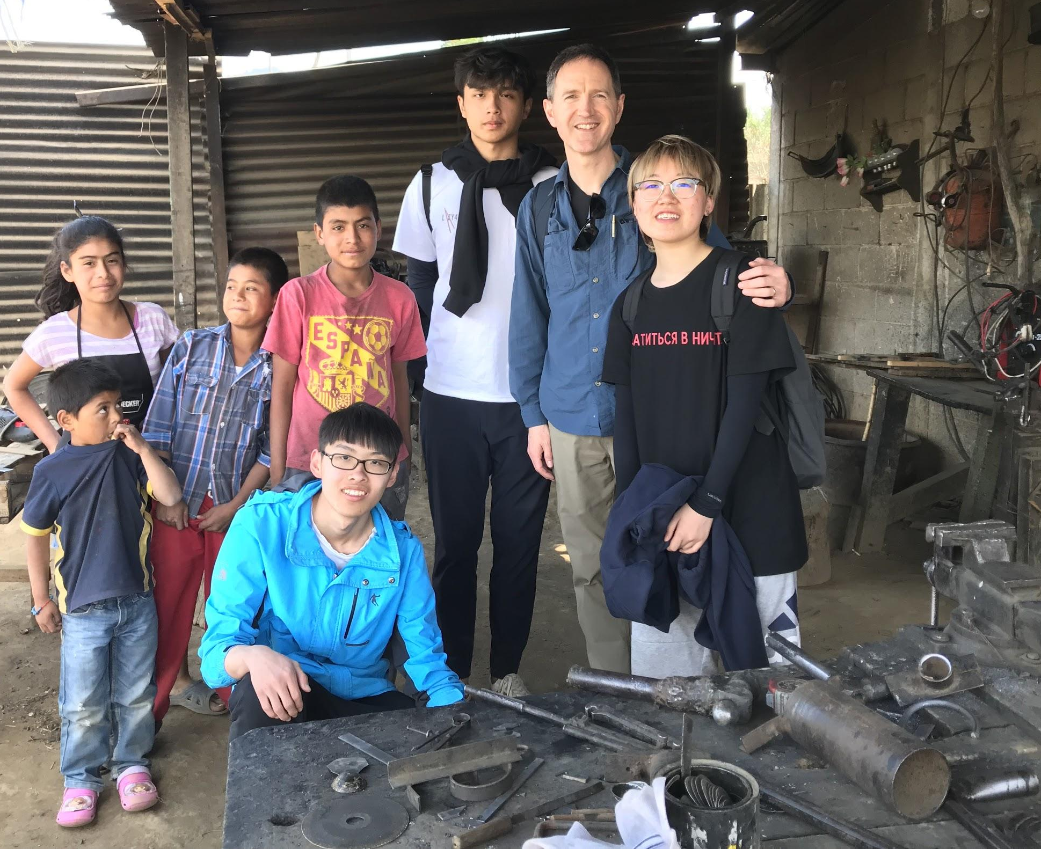
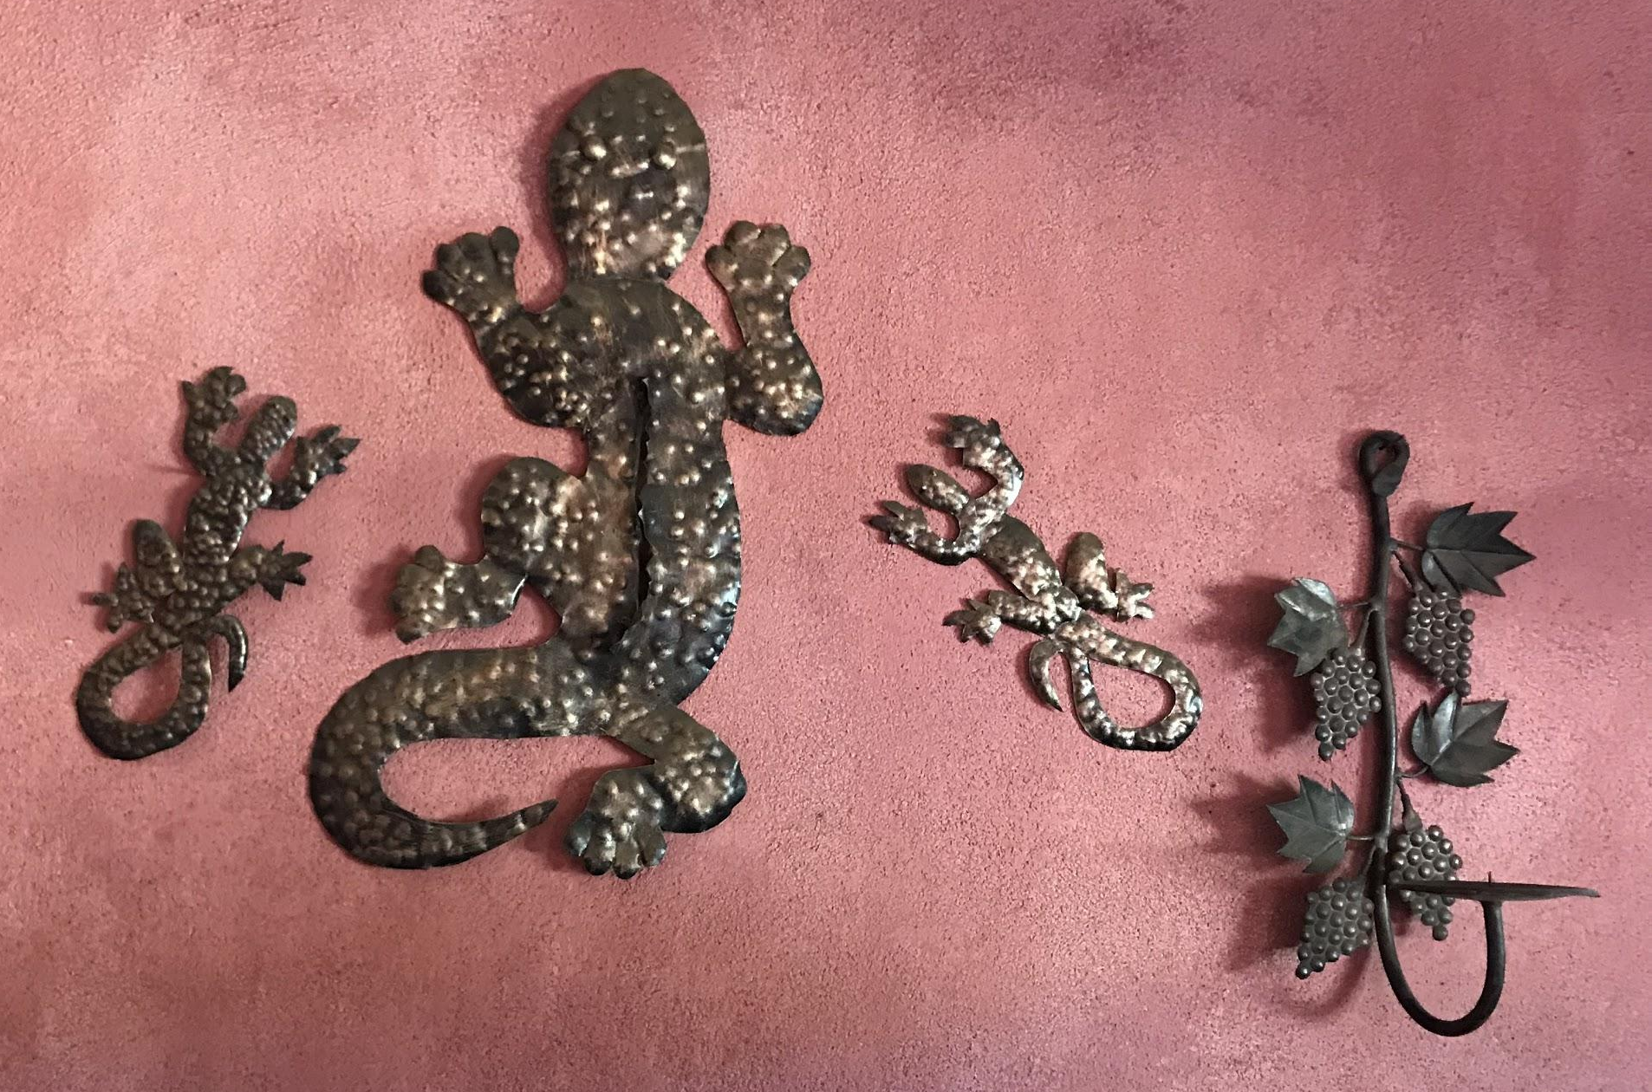
Micro-finance
Vidal: metalworker

Slide 41
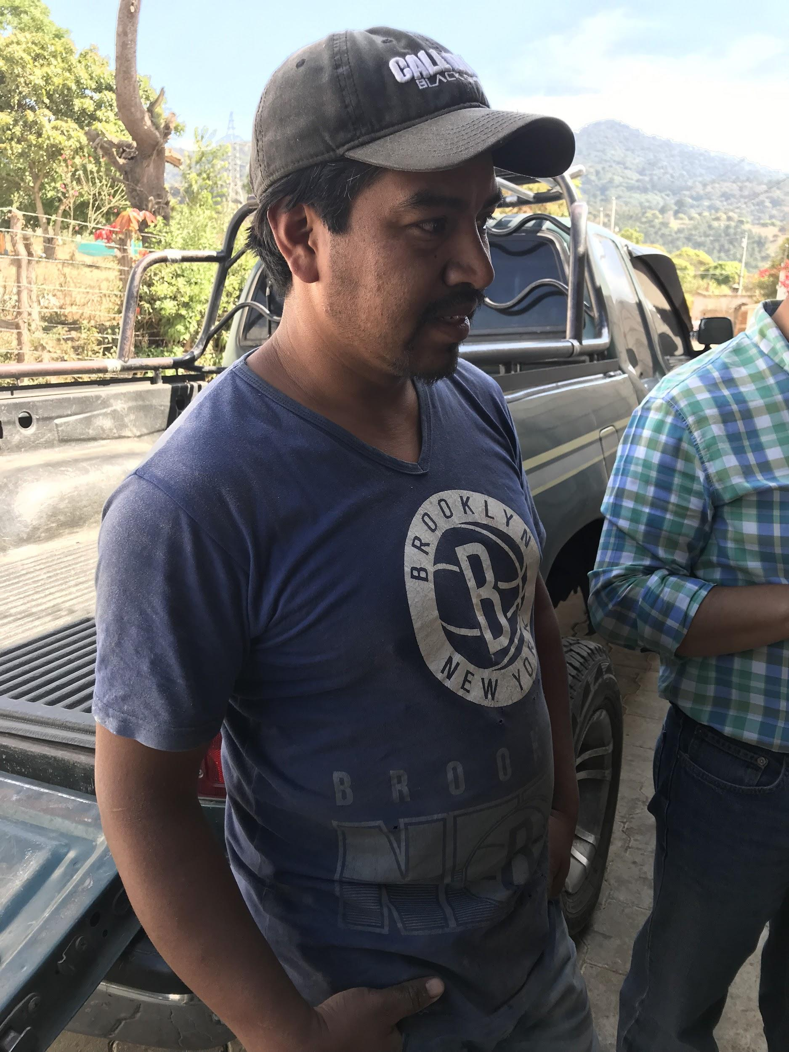

Micro-finance
Esdras: carpentry shop

Slide 42


Micro-finance
Mario: sells paintings

Slide 43




Micro-finance
Hector: nursery

Slide 44
What we learned...

Slide 45

Impacts and Takeaways

Slide 46
Application for GHAF?
Reflecting on Students International’s principles
Long-term, relational, service, physical and spiritual, love, prayer, presence, etc.
How do these apply to GHAF in GH?

Slide 47
Students International Video
(click icon to play video)

Slide 48

Application for GHAF?
Would you go on a mission trip for learning, bonding, generating vision and momentum back at home?

Slide 49
A few more pictures...

Slide 50



Slide 51


Slide 53


Slide 63


Slide 65


Slide 71


Slide 72



Slide 75


Slide 80
¡Adiós mis amigos!

