Slide 1
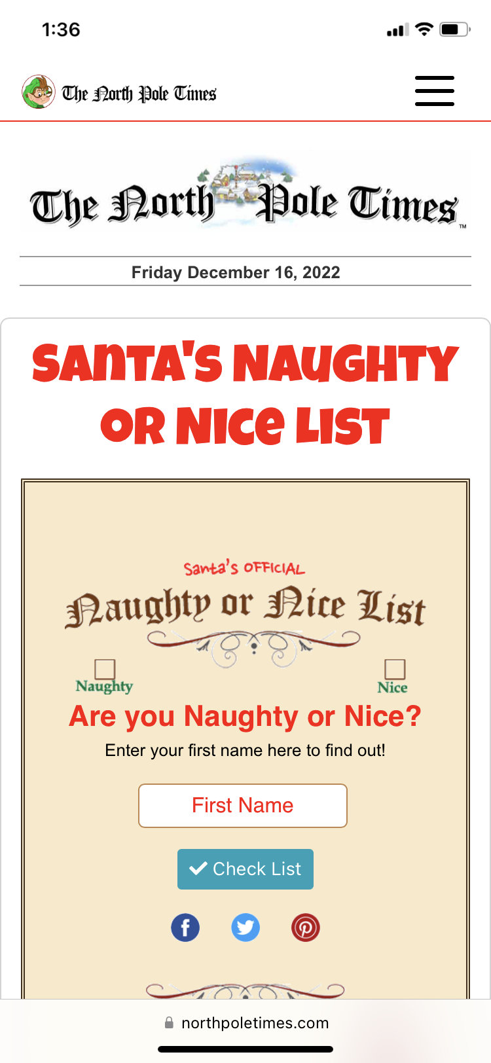
Notes:
Are you on the naughty or nice list?
Deacon’s Names –
My name – Behavior needs improvement at times. But has been pretty nice for the most part
Rick – Nice most of the time but needs to work on listening to grown ups
Glenn – Very nice a few days ago Needs to listen to grown ups too Could share more often too
Richard – Needs to brush his teeth better just wetting the tooth brush is not enough.
Websites judgment is totally arbitrary and not tied to anyone.
Funny but how many base their self evaluation on internet surveys

Slide 2
Mark 2:1-11

Slide 3
Only Jesus Has
The Authority To Forgive
Notes:
Weight of sin

Slide 4
The Problem of Moralism
The Story of The “Four Friends”
The Context – The Story of the Authority of Jesus
The Rise of American Moralism
Notes:
1) Discussion in Sunday School – Expository Preaching – it is Christ centered
Often teaching today is we teach moralism instead of Christ – Gave an example
Another example – Sunday School version that I was taught – moral of this story is help your friend
These friends were trying to get this paralyzed men and they did the right thing by taking him to Jesus
Went the extra mile even destroying a house to accomplish their mission
Virtues of the paralyzed mans friends – friend was paralyzed they helped him get healed
Context – 12 verses for this story and only 2 just 1/6th of the story is devouted to the friends bringing him
We are more drawn to moralism than grace
2) Mark is establishing Jesus credentials as the Christ the Son of God who is both fully God and fully man and has such is able to save people from their sins to the uttermost – Christs power to forgive
3) Our society has become very judgmental – modern morality based on our own relative right and wrong
Censored or absolved in - The court of social media and public opinion.
Majority people believe that going to heaven is based on my good works will outweigh my sins
52 percent – evangelical Christians – believe person get to heaven by doing good
34 percent of pastors
Replaced grace with self righteousness – we have given in to the worlds view that everyone is on the nice list

Slide 5
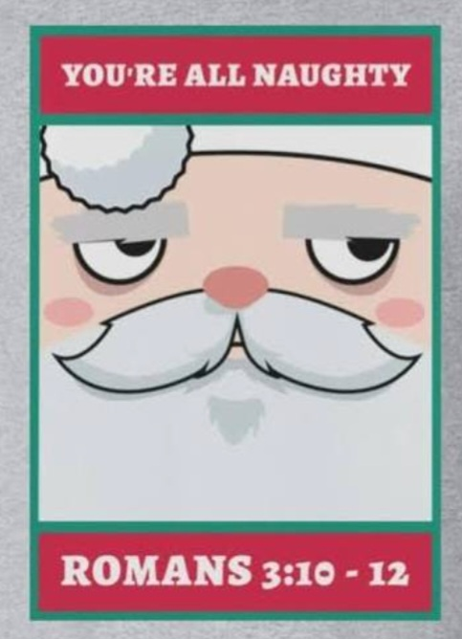
Notes:
Who determines if someone has been good enough – Who establishes justice
God’s Word – not from ourselves, not from others but from God and his word – God says you are all naughty
None is righteous no not one, no one understands, no one seeks for God. All have turned aside; together they have become worthless, no one does good not even one!
V21 The righteousness of God has been manifested apart from the law – the righteousness of God through faith in Jesus Christ for all who believe!
Glenn and I got a chance to enjoy a chili dog at Weiser Classic Candy
I was confessing to Glenn that I can at times be very judgmental – people who lack common sense or who are deceived in my opinion or who are inconsiderate of others
Reminder - God’s got this – This is his job - God is the gatekeeper of judgment and not me
O by the way – none are righteous no not one that includes me in all of my self righteousness
Once again – persist in my own judging I am putting myself in the place of God

Slide 6
The Power of Grace Through Faith
v4 Paralysis is a picture of sin
Your sins are forgiven!
Jesus saw their faith
Notes:
Looked down at the paralyzed man – he saw a person in bondage to sin, greater need than physical healing
Everyone who sins is a slave to sin, we create prisons of our own choosing
Sin is so controlling and overpowering that it puts us inbondage
2) Your sins are forgiven – total grace, makes this pronouncement
Good news – no conditions
If the son sets you free you are free indeed
3) Parable of the authority of Jesus – the only thing that these people bring to this story is their faith
Faith is only as strong as the object of your faith

Slide 7
Is it really that simple?
Notes:
It is a simple act of faith with
A deal to good to be true – fill out this survey and you will get a $500 gift certificate from Amazon
Emails – just pass them buy because nothing in this world is too

Slide 8
Jesus’ Authority To Forgive Sins
v7 Who can forgive sins?
No man has authority to forgive someone’s sins, not your or anyone else
v10 The Son of Man has authority
Notes:
I have authority – not only to forgive but also to judge
Life and death are in his hands
2) You need to forgive yourself – don’t be to hard for yourself
Our self opinion is subjective – we tend to be too easy
Others? People will go to a priest or a friend
Other person is not aware of the utter depravity in our soul – do they understand us
3) The Son of Man authority – Lamb of Revelation who is worthy to open the scrolls – worthy to judge
Worthy to forgive – lamb of God, shepherd who lays down his life for the sheep

Slide 9
v11 Proven By Physical Healing
Arise and walk!
Notes:
How do we know Jesus is God, He has the authority, just like God speaks and it happens Jesus says the word
Now are released from the bondage of sin to walk in newness of life –
Go and sin no more

Slide 10
The incarnation is the open mystery that the Divine Son, the Second Person of the Trinity, took on human flesh being born of a virgin.
Notes:
Do the synoptic gospels teach this?
There is no Christmas story in Mark – Mark is clearly building a case through story that Jesus is God
Open – it is clear
Mystery – difficult for our minds to process
Jesus – has always been and will always be
Took on flesh
Appearances as a man – Jesus revealing himself as a man but not having taken on flesh and blood
Jesus is fully God and fully Man
Story of a bird

Slide 11
Mark 1:2 Behold I send my messenger before your face, who will prepare your way, the voice of one crying in the wilderness; Prepare the way of the Lord, makes his paths straight.
Notes:
John the Baptist – v4 Wilderness preaching a baptism for repentance for the forgiveness of sins
V15 John is arrested – Jesus arrives in Galilee proclaiming the gospel of God – repent and believe – same message

Slide 12
A voice cries: “In the wilderness prepare the way of the LORD; make straight in the desert a highway for our God.” –Isaiah 40:3
Notes:
Jesus
The New Testam

Slide 13
Mal 3:1 Behold, I send my messenger, and he will prepare the way before me. And the Lord whom you seek will suddenly come to his temple.
Notes:
The Lord will come to the temple to bring righteousness and justice – restore his presence among his people
Messaih – anointed one
The Lord will come to his temple – his temple because He is God
Take both together – Jesus is presented by Mark from the very beginning as Israel’s returning God
Why is this important? Jesus purpose is to save us for our sins, providing himself as a sacrifice, we might have forgiveness of our sins

Slide 14
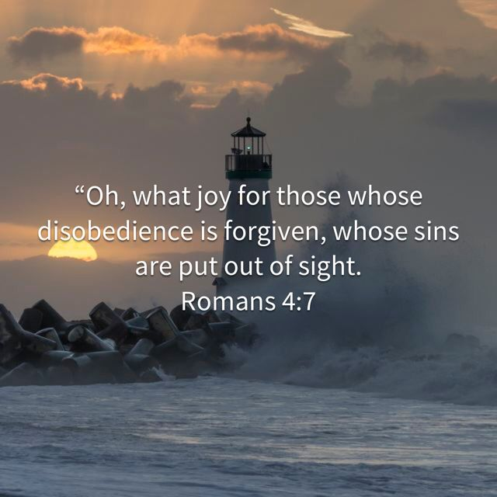
Notes:
Mary Magdalene – Luke 7

Slide 15
Application
Forsake Man’s Righteousness
Rejoice In Christ’s Forgiveness
Notes:
Innate built in sin of the flesh to base our forgiveness on our own opinion and thinking
People feel oppressed by this overwhelming burden of guilt and self condemnation
I don’t believe that God could forgive me for that
Or to base it on the opinion of man – Your own opinion or other’s opinion will never justify you
FORSAKE – Deny Yourself – Repent of Pride and self justification
Do you believe that Christ did it? Completely or is it a deal that is too good to be true
2) Embrace the justification, delight yourself in it, let the love of Christ sweep over your body like a giant ocean wave of grace.
Observation – Christians that are filled with criticism and contempt for others
Speech is biting and caustic – poor witness to the good news of Jesus
Heart Issue - Missed the grace of God and a root of bitterness – fail to let Christ’s forgiveness seep down into their soul’s
How often do you thank Christ and remember how much you have been forgiven? REJOICE
Joy to the World the Lord is come let us receive our KING – embrace him rejoice in him
Parable of the man – to the one has been forgiven much

