Slide 1

Saturday, Sept. 12th, 5 – 8:30pm

Slide 2
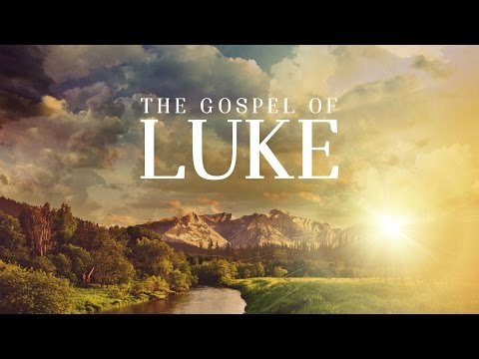
2:39-52
The Business of God

Slide 3
“The Business of God”
Luke 2:39-52
Intro: In Luke’s account there are a few events that he doesn’t record;
1. The visit of the Magi,
2. The slaughter of the Hebrew babies,
3. The flight into Egypt.
These are all recorded in Matthew’s Gospel record,
Matt. 2:1-23

Slide 4
“The Business of God”
Luke 2:39-52
Intro: We know the Magi came between Jesus’ first and second return to Nazareth because:
1. Matt. Tells us the came to a house,
2. They gave Mary and Joseph a lot of wealth.
There are three reasons this record of the account of Jesus’ youth is significant;
1. It’s the only inspired record of His Youthful years,
2. It records the first words of the Lord,
3. It’s the last time we hear of Joseph in the entire Biblical record.

Slide 5
“The Business of God”
Luke 2:39-52
I. His Humanity
A. He Grew physically, Vs. 40.
He developed as any other child would,
B. He grew mentally, Vs. 40b
He demonstrated His mental acuity regarding the scriptures, Vs. 47.
C. He grew spiritually,
He increased in the grace of the Spirit, Vs. 40c, Gal. 5:22.

Slide 6
“The Business of God”
Luke 2:39-52
II. His Expressed Deity
Vs. 49 is the most profound testimony of Jesus as to His own identity.
Our response to God’s sovereignty is the same as Mary’s. When He brings us adversity we also want Him to tell us “WHY”.
That Mary didn’t “get” what Jesus’ reply meant, (Vs. 50), it was a clear indication that the authority in His life had changed.

Slide 7
“The Business of God”
Luke 2:39-52
III. His Preparation for Ministry
As a sovereign His authority trumped that of Mary.
Yet, He was born under the Law which required Him to honor His parents.
His preparation consisted of Him submitting to the authority which God had placed over Him, Vs.51.

Slide 8
Application
4 Principals in the Story
I. If God is our Father, then our ultimate Obedience must be to Him and not to any earthly authority when the two are in conflict.
II. Nothing should hinder from access to those things which contribute to our spiritual growth.
III. We must be able to recognize both the divine and human in what God is doing in and through us.
IV. We must be absolutely sure of just Who Jesus is.

