Slide 1
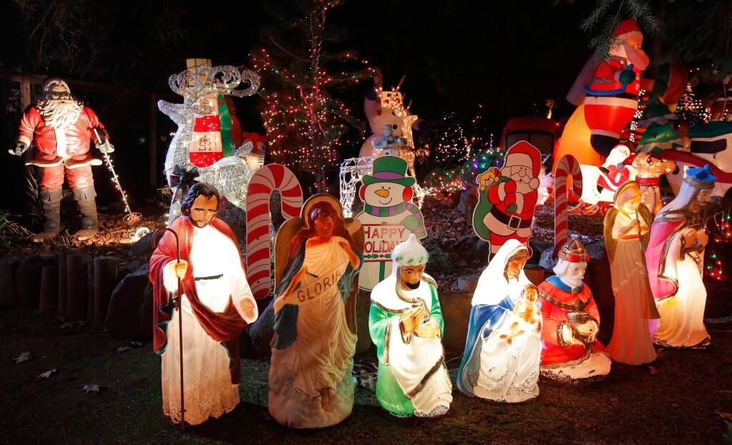
Notes:
Syncretism – combining and unifying of different religions and world views

Slide 2
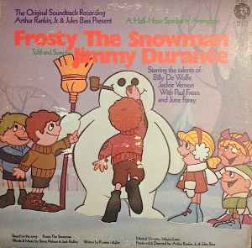

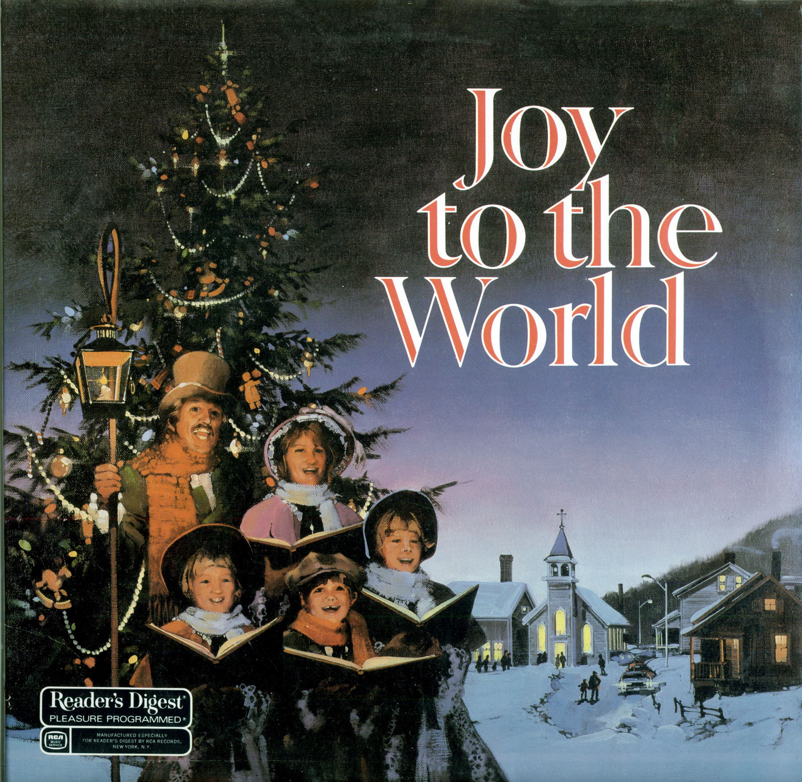
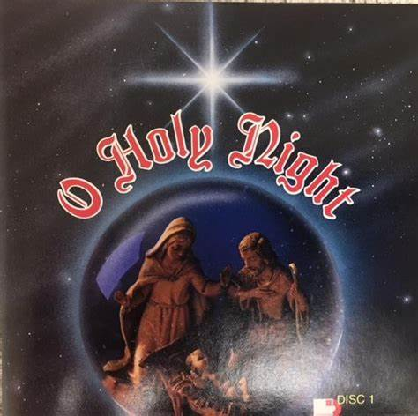

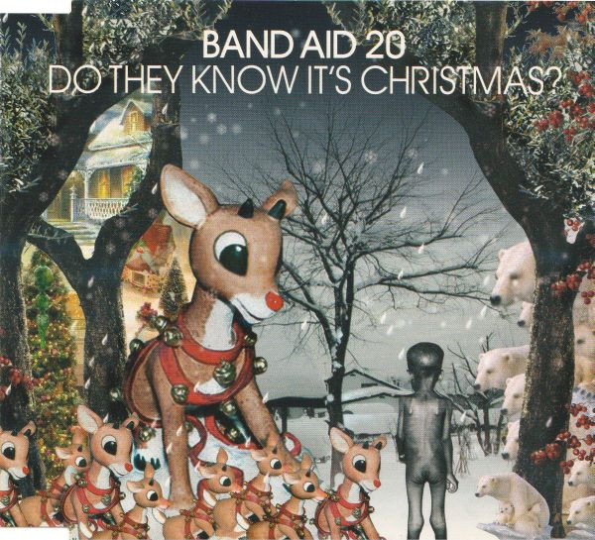
Notes:
Music – secular setting where we might hear carols that would have good Biblical theology
When in a secular setting is the name Jesus ever spoken
Opportunity to ask - Do you understand what you are listening to?

Slide 3
1 Timothy 3:14-16

Slide 4
Confess The Mystery of Christ

Slide 5
Confess!
Early hymn
Confessional vs Pietistism
v14 A Church is a family with a “great” confession
Notes:
2) Confessional – Christian faith are founded upon the objective and declarative realities of Jesus and his work in place of sinners
IDENTITY
Pietistism – Christiain faith – primary question is “What must I do?” Focus – Duty

Slide 6
Confess Christ
He was manifest in the flesh
He was vindicated by the Spirit
He was seen by angels
Notes:
1 Peter - died in the flesh but made alive in the Spirit
Gospel - things into which angels long to look

Slide 7
Confess The Mystery
Jesus is fully God and fully man
Jesus took on flesh
Essential to our salvation

Slide 8
The Mystery of Godliness
The mystery that leads to godliness
The best thing you can do to be godly is to confess Christ

Slide 9
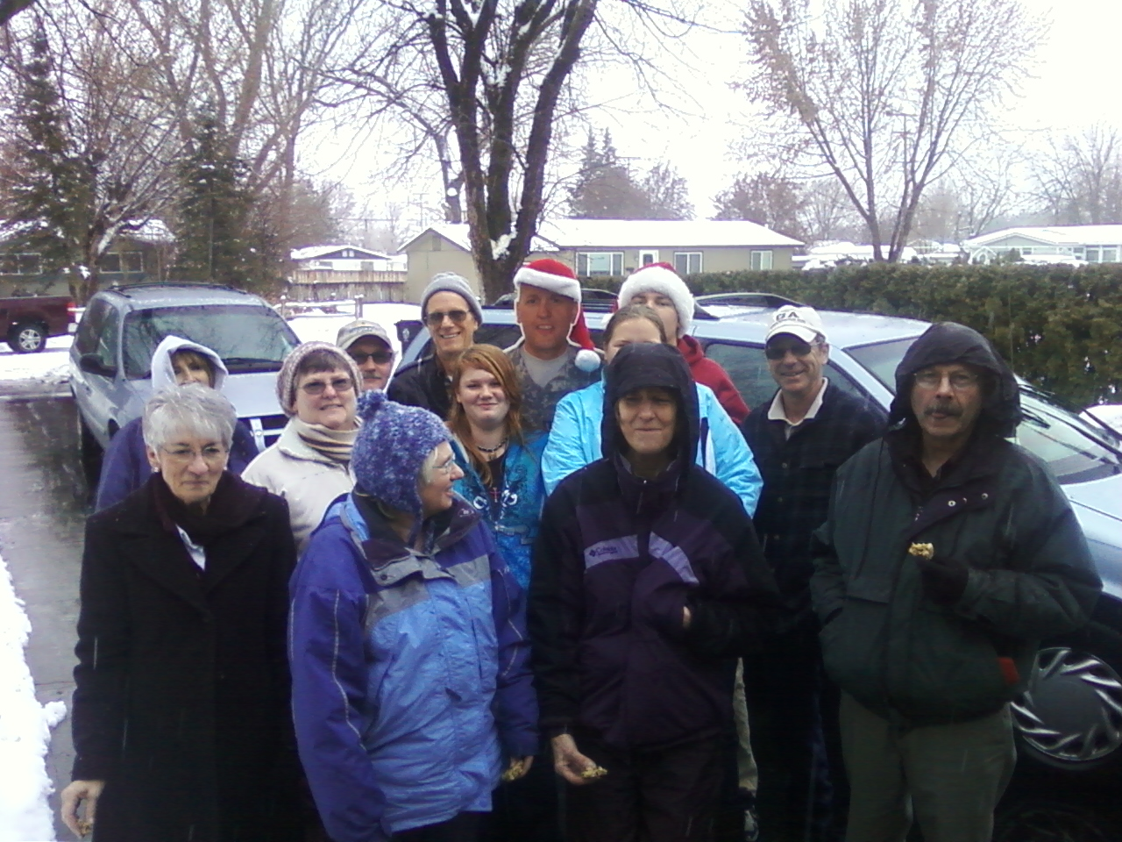

Slide 10
Application
Keep Confessing!
Notes:
Family of God – one of the things that we do is to confess Christ to each other
Confess Christ to the world

