Slide 1
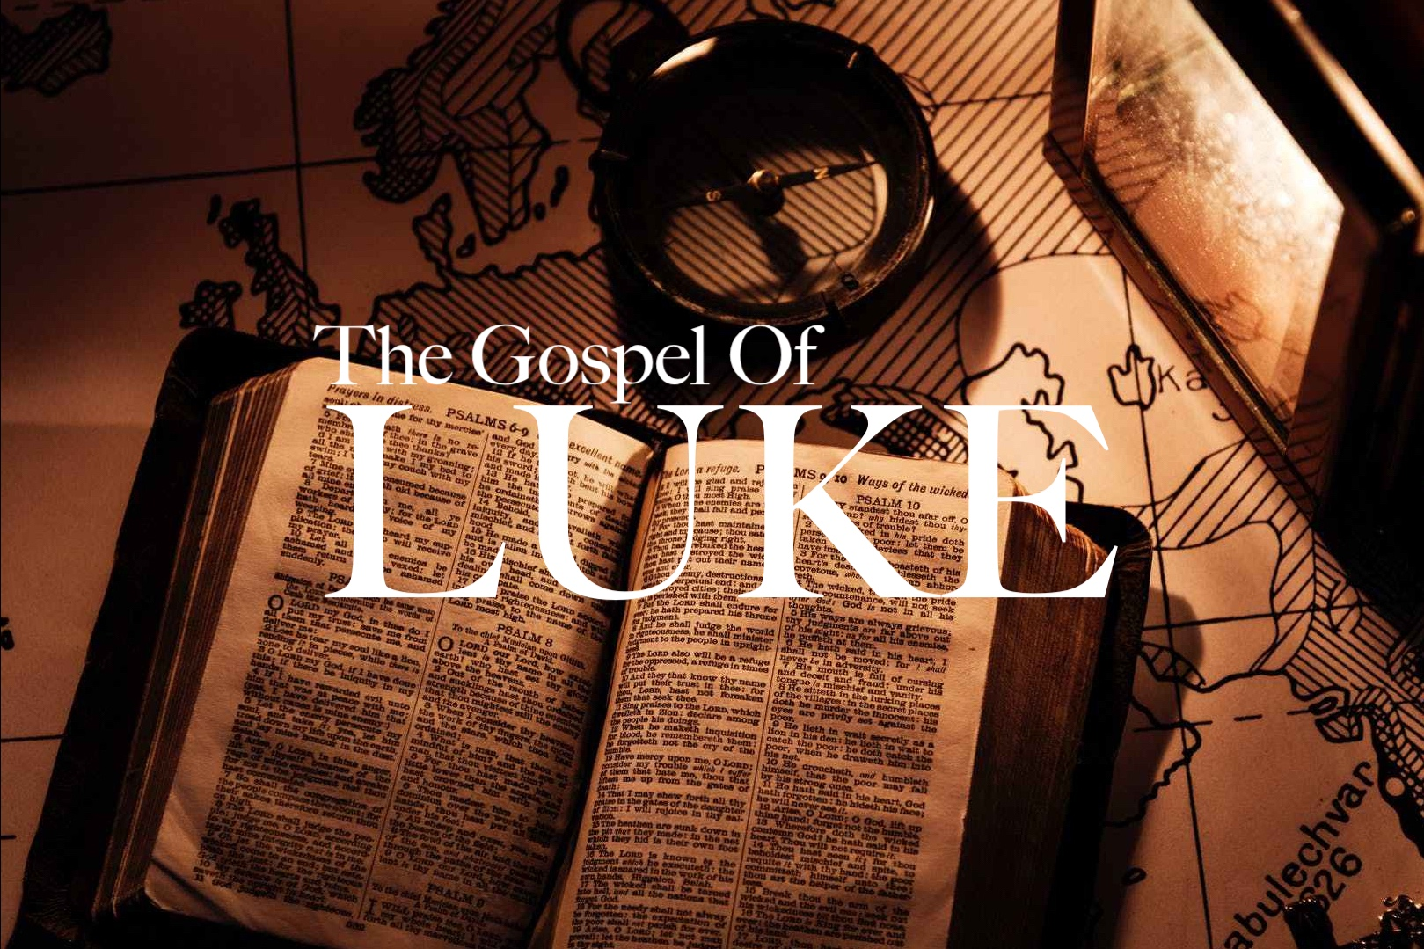
“Going Against the Grain”
Luke 6:1-11

Slide 2
“Going Against the Grain”
Luke 6:1-11
Intro: In this passage Jesus uses the issue of Shabbat in order to deal with the root problem of legalism.
By the time of Jesus the Jewish religion had become a works based religion.
In order for Jesus to show the distinction between the truth, and error of Judaism, He had to get to the heart of the Jewish religion, which was Sabbath observance.

Slide 3
“Going Against the Grain”
Luke 6:1-11
I. They Missed The Point
The Jewish leaders relegated the Sabbath to a series of rules and regulations, making its observance a burden rather than the joy which God intended.
The rules surrounding Sabbath observance in today’s Jewish community is not far removed from the legalism of the first century.
While Sabbath observance is not an issue in today’s Christian community, legalism is.

Slide 4
“Going Against the Grain”
Luke 6:1-11
II. The Old Testament Sabbath
Keeping the Sabbath is the 4th commandment in the original Decalogue given to Moses on Mt. Sinai, Ex. 20.
God saw that to disregard the Sabbath was to disregard Him and it carried the death penalty to do so. Ex. 31.
God blessed the 7th day, and made it holy.
1. He made it a source of blessing, and,
2. He made it to focus on Himself. Gen. 2:2-3.

Slide 5
“Going Against the Grain”
Luke 6:1-11
II. The Old Testament Sabbath
A second word for rest is, nuakh. It means to dwell or settle. God dwells with His people specifically in the Sabbath observance.
With the advent of Christ, the OT Sabbath observance is set aside, as He is the Sabbath rest, Matt. 11:28-30, Colossians 2:16-17.

Slide 6
“Going Against the Grain”
Luke 6:1-11
III. Doing Good on the Sabbath
Jewish law forbid the helping of an individual in any way on the Sabbath, except in the case of immanent death.
God says healing, deeds of mercy, and the expression of compassion is appropriate every day!
God tells the Israelites through Isaiah that keeping religious activities, including the Sabbath, was no litmus test to one’s faithfulness to the Lord, Isaiah 1:11-15.

