Slide 1
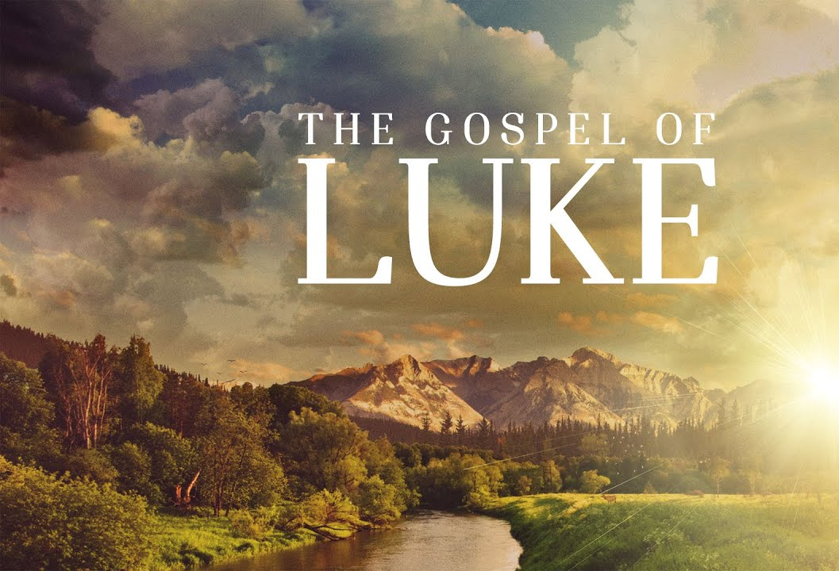
Synagogues and Sabbaths
Luke 13:10-17

Slide 2
“Synagogues and Sabbaths”
Luke 13:10-17
While demons can’t possess a believer, they can and do oppress them when unrepentant sin is present. Eph. 4:26-27.
Synagogues came about during the Babylonian captivity and after the temple was destroyed.
The synagogue was a place of gathering for the teaching of the Tanach. There was no priest, only a lay leader.
There were no sacrifices made and no major feasts were celebrated in a synagogue.

Slide 3
“Synagogues and Sabbaths”
Luke 13:10-17
The Sabbath was commanded by God to be observed by Israel as a day of rest and remembrance, Ex.20:8-13, as well as a sign that they belonged to God, Ex. 31:13.
The NT church is not commanded to keep the Sabbath. It is not subject to the Mosaic Law. It is under the New Covenant established by the death and resurrection of Christ. Romans 6:14;
John 1:17.

Slide 4
“Synagogues and Sabbaths”
Luke 13:10-17
I. He Takes the Initiative
According to Jewish skewed theology, this woman had a physical impairment due to sin in her life, John. 9; Job.
Jesus “saw”, horaō her with knowledge of her emotional and spiritual pain and called her to come. There was no indication of faith on her part.
The woman was a picture of the sovereign work of the Lord in salvation.

Slide 5
“Synagogues and Sabbaths”
Luke 13:10-17
II. The Faithfulness of the Woman
Though she has been bound for 18 years, she still worshipped God regularly.
She didn’t allow her circumstances to keep her from worshipping God. She believed God knew her best!

Slide 6
“Synagogues and Sabbaths”
Luke 13:10-17
III. Her Transformation
A. She was healed physically,
B. She was healed emotionally.
When the inner man is made whole, The outer man shows the fruit of that work! 2 Cor. 10:3-5.

