Slide 1
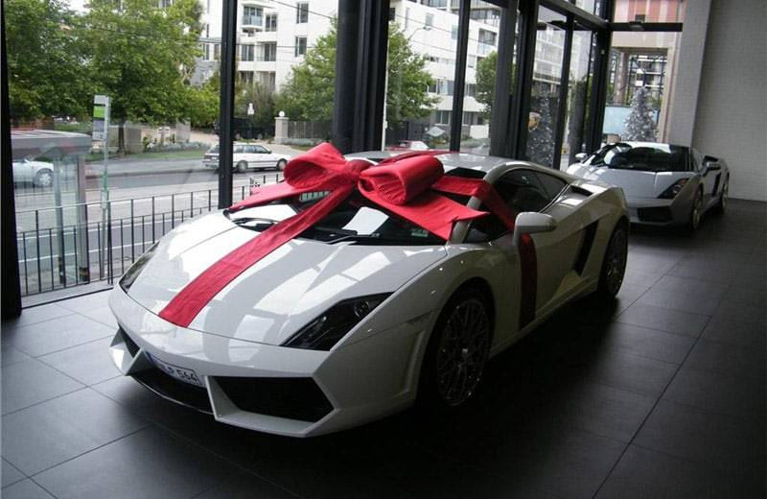
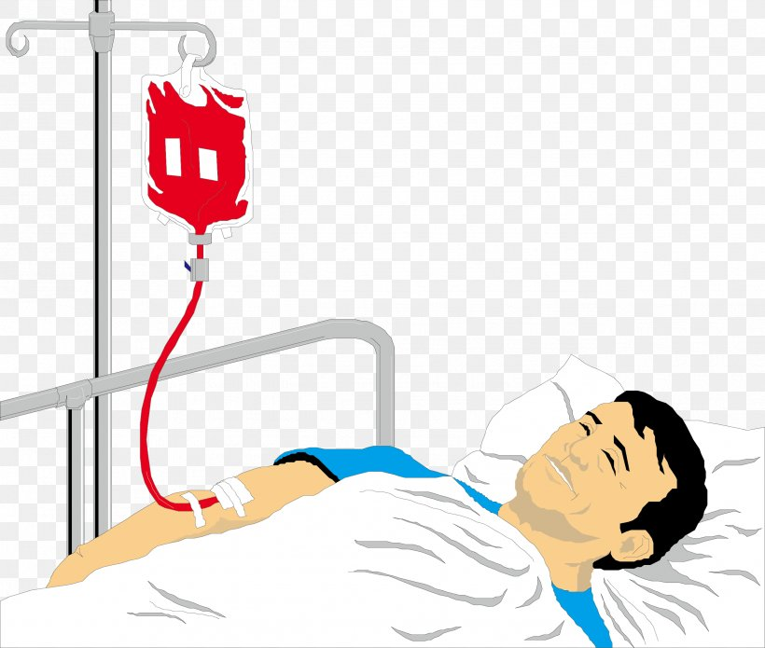
Notes:
McLaren 650s for 200,000 your friend buys it for you
Coma – after being hit by a car, barely alive unable to do or say anything to help yourself or even resist
Blood transfusion

Slide 2
Effectual Call
1 Corinthians 2:9-13

Slide 3
The Doctrines of Grace
Oct 24 – Unconditional Election – Ephesians 1:4-6
Oct 31 – Definite Atonement – John 10:11-29
Nov 7 – Total Inability – Romans 3:9-12
Nov 14 – Effectual Call – 1 Corinthians 2:9-13
Nov 21 – Perseverance – Romans 8:32-35

Slide 4
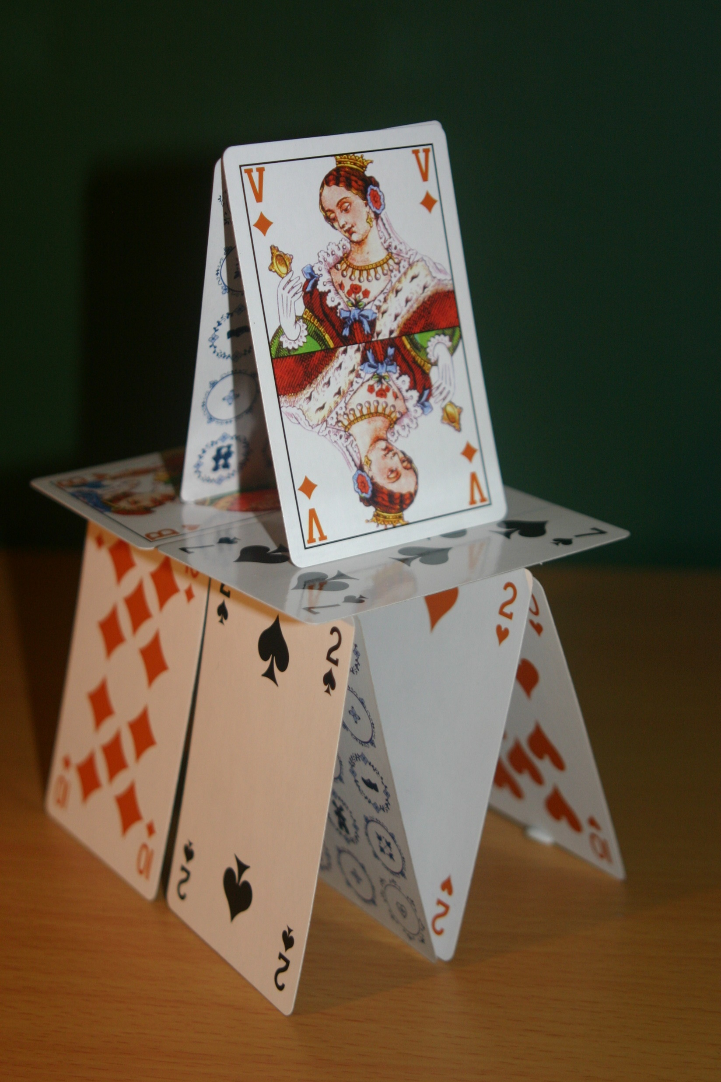
Notes:
Each one of these doctrines are a whole – they are essential to each other,

Slide 5
Is saving faith a gift that we can accept or deny, or is it a new principle worked in us by God’s sovereign and unfailing effectual will?

Slide 6
No one believes except by the effectual work of the Holy Spirit!
Revealed By The Spirit
Received Through The Spirit
Regenerated By The Spirit
Notes:
Define %100 it is effective in producing the desired result
Total Inability – Blind and Deaf cannot Understand
Heart that is diseased and a heart of stone – given a new heart
Regenerated – dead and need to be born again

Slide 7
Revealed Through The Spirit
Context 1:18 and 2:14, 16
Paul’s Preaching – 2:1-6
Secret and Hidden Wisdom of God 2:7
v9 Eyes, Ears, and Heart Alienated
v10 Revealed To “US” Through The Spirit

Slide 8
For God, who said, “Let light shine out of darkness,” has shone in our hearts to give the light of the knowledge of Jesus Christ.
  -2 Corinthians 4:6

Slide 9
Received Through The Spirit of God
2:11 No One Comprehends God except the Spirit of God
v12 We have the Spirit of God in order to understand
v12 Freely Graced = Bestowed
v13 Imparting truths by the Spirit

Slide 10
And I will give you a new heart, and a new spirit I will put within you. And I will remove the heart of stone from your flesh and give you a heart of flesh. –Ezekiel 36:26

Slide 11
One who heard was a woman named Lydia…The Lord opened her heart to pay attentions to what was said by Paul.
-Acts 16:14
Notes:
Preaching – A P T A T

Slide 12
God took our deaf, blind, and stubborn hearts and made them hear, see, and respond to the gospel call. We didn’t become Christian’s on our own, Christians are Christians because of God.
  -Medders

Slide 13
Regenerated By The Spirit
Interpreting spiritual truths
Spiritual People
Natural Person does not understand

Slide 14
The wind blows where it wishes, and you hear its sound, but you do not know where it comes from or where it goes. So it is with everyone who is born of the Spirit.
  -John 3:8
Notes:
How does this work? Mystery
Evidence – repent and believe but we are not aware of the work of God
Deny that he does any work
The process of speaking – don’t realize all that goes into your body to speak a word

Slide 15
no prophecy (of Scripture) was ever produced by the will of man, but men spoke from God, as they were carried along by the Holy Spirit. -2 Peter 1:21
no one can say “Jesus is Lord” except in the Holy Spirit. –1 Corinthians 12:3
Notes:
Praying about how to make this concept understandable
Scripture and Salvation – similar in their process and product
Process – moved along by the Holy Spirit
Product – from God, salvation from God, praise of his glory
Scripture – human opinion or will it is from the Holy Spirit
Salvation – your own opinion or will but it is from the Holy Spirit
How this works in the process
God breathed – Conscious powerful breath, word breathe unconsciously, word breathe softly
Conscious and powerfully –
Carried along by the Holy Spirit – so influenced as to cause them to follow, lead or directed. Rom 8:14 all that are lead by the Spirit, sons of God
Biblical writers – not automons not robots, not dictated,
Superintended – God used the personality and background of the writer, communicate exactly what he wanted.
Process of our salvation -

Slide 16
who WERE born, not of blood or the will of man, but of God. -John 1:13

Slide 17
And “I will put my Spirit within you, and you shall live, and I will place you in your own land. Then you shall know that I am the Lord; I have spoken, and I will do it, declares the Lord.” –Ezekiel 37:14

Slide 18
Application #1: Give Thanks!
According to his great mercy he has caused us to be born again…Blessed be the God and Father of our Lord Jesus Christ! -1 Peter 1:3 (emphasis mine)
Thanks be to God for his inexpressible gift! -2 Cor 9:15
Notes:
Praising God – God doesn’t owe me anything but judgment
Didn’t do anything
Blind to the word of God – given the miracle of sight
Ears were deaf – HS unstopped my ears
Opened my mind to understand the word of God
Heart – heart of stone
God made it a heart of the spiritual
He did it – eternally thankful and have a Spirit filled attitude of gratefulness

Slide 19
Application #2: Confidently Evangelize!

