Slide 1
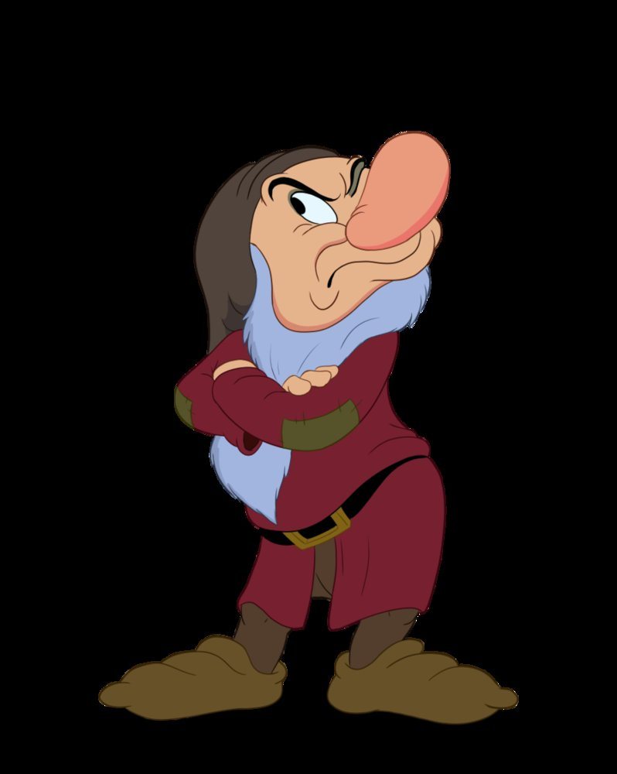
Notes:
What things make you grumpy?
Inflation
Price of Turkey is 1.15 a pound up 8 percent from last year which was up 8 percent from the year before
Politics
Contentious political season and midterms
Decline of morals in America
Remember myself as a teenager at Redwood Valley Community Church
Work day with a bunch of old timers
Coffee break
Complain about – inflation, politics, declining morality
Know I am that grumpy old man

Slide 2
I Thessalonians 5:16-18

Slide 3
Be Grateful Not Grumpy
Rejoice, Pray, Be Thankful
Notes:
It is really easy to be grumpy, it takes the power of God by faith through the Holy Spirit
Impossible Commands – flow from being converted to Christ

Slide 4
Conversion Before Commands
A Miraculous Conversion
Acts 17:1-10, I Thess 1:4-5, 9-10
A Blessed Hope
1 Thess 4:17-18
Notes:
1) Conversion – birth of the church was by the power of God to the glory of God – Before you get to chapter 5, chapters 1-4, BORN AGAIN
2) Story of Acts – Jesus is King, Ceasar King – Provincial capital under control of Rome
-Chosen – proven by their faith in adversity, no worldly reason for a church to be here
Report from Timothy was wow – turned from serving idols to the living God
Power for keeping the commands – obey God on your own, BORN AGAIN
3) Second Coming Epistles – looking forward to the second coming NEAR
-controversy is some had died and Christ had not returned so what about those folks
4) King are Distinguished Visitor – Visit the town, and the great in the town would go out to great HIM
King Jesus is returning and we will be caught up to meet him in the air
Dead are going to go first – so instead of the least they are the best

Slide 5
1 Thessalonians 5:23-24
Impossible commands are accomplished by the faithfulness of God.
Notes:
Sanctified – process of being made Christlike, holy or to be set apart. Wholly find our delight in Him
God who through Christ has reconciled us to himself
2) Prayer – key verse for this passage

Slide 6
Always Rejoicing
Spirit Produced Command
Be Joyful – Be Glad, Take Delight In
At All Times
Notes:
Spirit gives us joy bubbling up in our soul – more of the Spirit – be joyful – I can’t do that by the flesh unless I’m joyful in fleshly things
Be Joyful – Be Glad, to Be Excited, Take Delight In, Object of our Joy Is The Triune God of the Scriptures
In Good Times and In Bad Times
COVID – lethargic, elephant sitting on my chest, feeling depressed
Health – Hoggs have COVID, cancer, other ailments
How do we have joy at all times?

Slide 7
1:6 You received the word in much affliction with the joy of the Holy Spirit.
Acts 5:41 Rejoicing that they were counted worthy to suffer
Notes:
Received The Word – means of grace was to accept the Word as authoritative, Words of Life. Joy in the Word
Given by the Holy Spirit – Spirit mediates to us the presence of God
2) Peter and the apostles – put into prison, put on trial for the gospel unjustly
Told to stop preaching the gospel – We must obey God rather than men. Then they were beaten
Persecution Christians face today - Make us angry and make us grumpy
Response was JOY that they were counted worthy to suffer

Slide 8
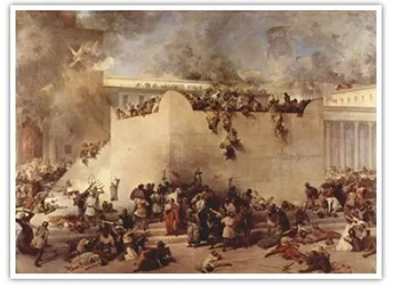
Notes:
605 BC Habbakkuk prophesied during the destruction of Jerusalem
Great bloodshed and death and destruction
Economy would fall apart and there is a scarcity of food
Habakuk 3:17-18 I will rejoice in the Lord – God is still on the throne and is working out His divine purposes for His people
Fight of Faith

Slide 9
Constantly Praying
Prayer connects us to the presence of Christ
Lament and dependance
Prayer is the one thing you can do to be more joyful and thankful - Constantly
Notes:
Joy comes from the presence
Cast our cares upon Him for he cares for you
Joy in his presence, thanks in all things, Prayer that is constant every moment of every day.

Slide 10
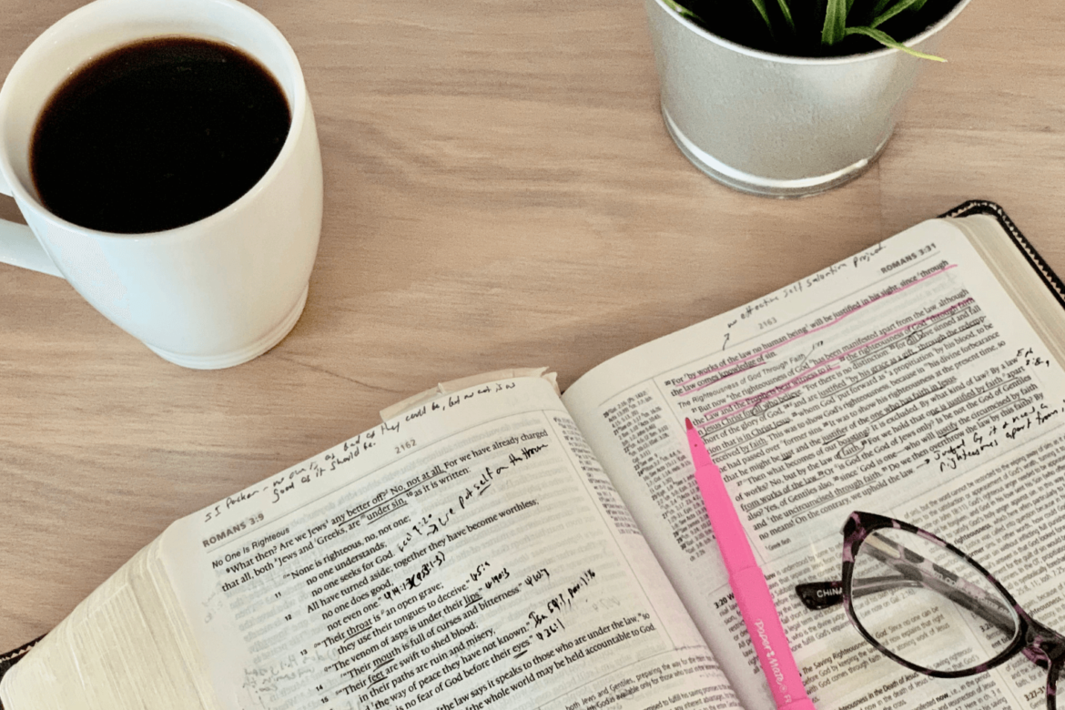
Notes:
Greatest joys in ministry is to get away and pray – pastor prayer retreats
Quiet time – remove all distractions and just spend time fellowshipping with Christ
Young moms – Katrina: probably the one person that has an excuse
John Piper – one discipline leads to knowing the presence of Christ throughout the day – primes the pump
Meditating and mindful of the presence of Christ all throughout the day.

Slide 11
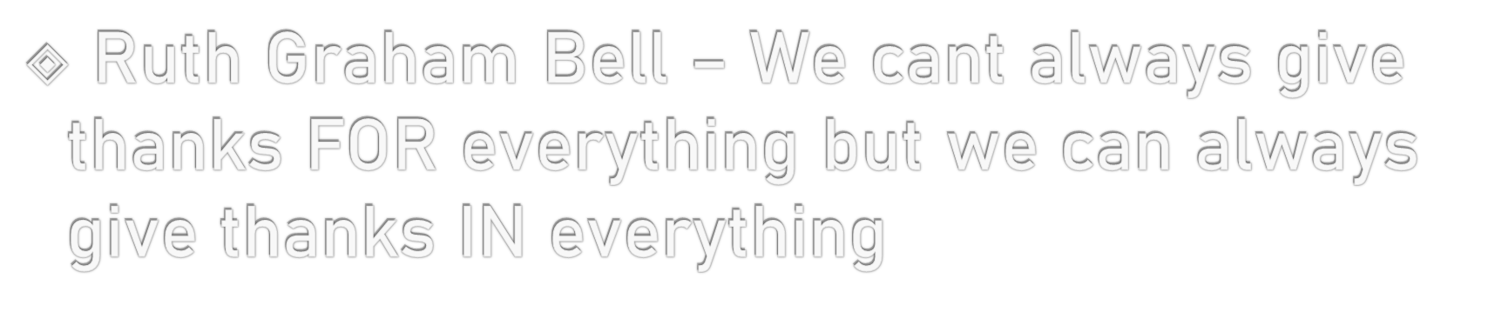
In All Things Grateful
Grateful comes from the root word for grace
In All Things or Circumstances
Notes:
Recipients of God’s grace in salvation are gratefual
In All Circumstances – all things, bad health, difficult circumstances, bad economy
For everything – IN
God is producing in us Christ likeness, God is bringing glory to himself through us, testifying to the truth of the gospel
Grateful people

Slide 12
Therefore let us be grateful for receiving a kingdom that cannot be shaken, and thus let us offer to God acceptable worship, with reverence and awe, for our God is a consuming fire. –Hebrews 12:28-29
Notes:
Hebrews context – Mount Sinai – judgment upon the earth
Mount Zion – assembly of the firstborn, enrolled in heaven, heavenly Jerusalem, Jesus – mediator of a new covenant
Kingdom that cannot be shaken
Thanks for the Lord, thanks for God’s people
Thanks – festal meal, Jewish New Year, Day of Atonement, Passover, Tabernacles
God’s people gathered in the presence of God – feast
Thanksgiving – become really that festal meal – Halloween right to Christmas

Slide 13
V18 For this is the will of God for you in Christ Jesus
Notes:
What is God’s will?
FOR – Joy, Prayer, Thanks
Will – what will I do? Career, Live, Marry, Decision
Will – what kind of person will you be
He is much more concerned with your character than with your activiity

Slide 14
Now thank we all our God
Oh, may this bounteous God through all our life be near us
With ever joyful hearts and blessed peace to cheer us;
And keep us in His grace, and guide us when perplexed;
And guard us through all ills in this world, till the next!
Notes:
Hymn Story – think of this hymn sung in a church before Thanksgiving – bountiful food
Martin Rinkart – table prayer, sung before a meager meal
Pastor – Eilenberg Germany – walled city during the Thirty Year War – 1637
Refugees – famine and plague killed 8,000 – he was the only surviving pastor
Did about 50 funerals a day

Slide 15
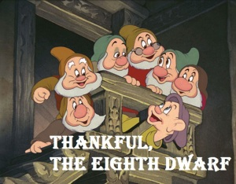
Notes:
Hard economic times – BE THANKFUL
Disney had no Dwarf named Thankful

Slide 16
Application
Give Thanks For Your Salvation
Give Thanks In Your Circumstances
Notes:
Grace – deserve mercy, received grace purchased by the blood of Christ
For - IN

