Slide 1

“Be Careful How We Hear”
Luke 8:16-21

Slide 2
“Be Careful How We Hear”
Luke 8:16-21
Intro:
The parable of the lamp is connected to the parable of the soils in that they both emphasize the importance of listening rightly.
We basically know if someone was listening to us if they did what we had asked.
How we listen determines what our relationship to other people is like.

Slide 3
“Be Careful How We Hear”
Luke 8:16-21
Intro:
We are told in scripture that listening to God’s word is a privilege He has given us, Deut. 4:36.
According to the parable of the soils, the kind of hearer we are indicates our spiritual condition.
Jesus using parables is a way of His rendering judgment on the spiritually insincere, the irreligious and the superficial.

Slide 4
“Be Careful How We Hear”
Luke 8:16-21
I. God’s Truth is Revealed in Jesus’ Teaching
A. The main purpose of God’s light is to illumine our path, Ps. 119:105
1. The Gospel light is to be proclaimed to all.
2. The parable of the Lamp was to show the disciples
that truth in light of Vs. 10.
B. The secondary purpose of light is to expose evil.
1. No one can take a neutral stance on God’s word.
2. We are either obedient to it, or we ignore it and
are self- deceived.

Slide 5
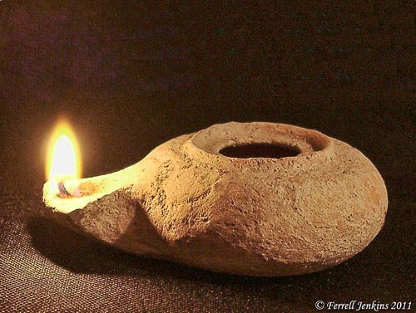

Slide 6
“Be Careful How We Hear”
Luke 8:16-21
II. The Word will Judge our Disobedience
A. If we listen carefully and obediently, we’ll be blessed.
To listen carefully means:
1. Read and meditate on the word continually,
2. Always look for Jesus Christ in the word,
3. Always seek to apply the word to our
hearts.
B. Listening superficially leads to self-deception.
Rev. 3:14-22.

Slide 7
“Be Careful How We Hear”
Luke 8:16-21
III. Careful Listening means Obedient Listening
We are not blood relatives with Jesus, but spiritual relatives.
In the story of His family, Jesus was setting priorities; Allegiance to God’s word comes before our earthly families, Lk. 14:26.
To get close to Jesus, we must hear His word with a view to obedience, Jn. 14:21.

