Slide 1
2 Corinthians 2:5-11
Notes:
Credit to Jonathan Lehman and Mark Dever and the folks at 9Marks
Finished up a Sunday School class from 9Marks
Jonathan Lehman says that if he had 15 seconds to convince you that church membership was biblical he would take you to the passages on removing someone from the body of Christ. Biblical command
More than 15 seconds – essence of affirming and encouraging one another in love

Slide 2
Why Church Membership?
Notes:
Live in culture that is less and less inclined to join and less and less interested in membership
Proposition. Church membership sets the boundaries of who is in the church and who is outside the church.
Who are we to treat as part of the world and who should we treat in love to one another
Two responsibilities of what is the core of being a church member – is accountability and encouragement – discipline and affirmation

Slide 3
Membership Is Mutual Accountabilty
v5 What pain?
Man in adultery of 1 Corinthians 5
Notes:
Church discipline issue that is painful but necessary –
-for the benefit of the one in sin
-for the protection and testimony of the church
What painful situation is Paul talking about
Church Discipline – sexual immorality, divisive or persistently quarrelsome person, fraud or swindling, unresolved church conflict, anything that is major and causes damage to the body of Christ

Slide 4
When you are assembled in the name of the Lord Jesus and my spirit is present, with the power of our Lord Jesus, you are to deliver this man to Satan for the destruction of the flesh, so that his spirit may be saved in the day of the Lord.
1 Corinthians 5:5
Notes:
1 Corinthians 5
Tears and weeping
Assembled in the name of the Lord Jesus
There is nothing worse that someone who thinks he is a Christian when he actually is not

Slide 5
For what have I to do with judging outsiders? Is it not those inside the church whom you are to judge? God judges those outside. “Purge the evil person from among you.”
1 Corinthians 5:12–13
Notes:
Outsiders and insiders – we shouldn’t be judging the sinful behavior of outsiders
We should affirm or remove someones fellowship in the body
Purity of the church – you cannot have outsiders and insiders
Illustration – Church Surveyor – mark out the property lines, neighbor dump snow on our property, another neighbor say they owned about five feet of our property, how do you know its your property
Not responsible for that

Slide 6
2:1 A Painful Visit
v4 A Painful Letter
v5 A Painful Person
v6 Removal By The Majority
Notes:
Visit that involved controversy and contention and discipline
Wrote a painful letter – lost and we do not have it, intended just for the church at Corinth and not a wider audience
Personal and provocative
V5 Identify a painful person, one who had caused pain to Paul specifically
As for a person who stirs up division, after warning him once and then twice, have nothing more to do with him, knowing that such a person is warped and sinful; he is self-condemned.
Titus 3:10-11

Slide 7
And I tell you, you are Peter, and on this rock I will build my church, and the gates of hell shall not prevail against it. I will give you the keys of the kingdom of heaven, and whatever you bind on earth shall be bound in heaven, and whatever you loose on earth shall be loosed in heaven.” Matthew 16:18–19
Notes:
Membership marks out where our property ends
Church discipline – a church is to treat someone as a Gentile
Two ways of taking that – first is that we can shun them
Other way is that they are unbelievers

Slide 8
Membership Is Mutual Encouragement
v7 Comfort = Encouragement
Forgiveness(7) and Obedience(9)
Reaffirmation and Affirmation

Slide 9
Church Covenant
Covenant Commitment and Unity
Love One Another In Mutual Support
Support the Doctrine and Mission
Grow In The Word
Glorify God in our Conduct
Pray For One Another
Reconcile and Forgive
Notes:
Covenant Commitment and Unity
Love One Another In Mutual Support and Accountability
Support the Doctrine and Mission of the Church
Grow in the Word of God
Glorify God Through Our Conduct In The World
Pray for One Another
Reconcile and Forgive One Another
Submit To One Another

Slide 10
Hebrews 13:17 - Obey your leaders and submit to them, for they are keeping watch over your souls, as those who will have to give an account. Let them do this with joy and not with groaning, for that would be of no advantage to you.
Notes:
Terri – Keep my soul

Slide 11
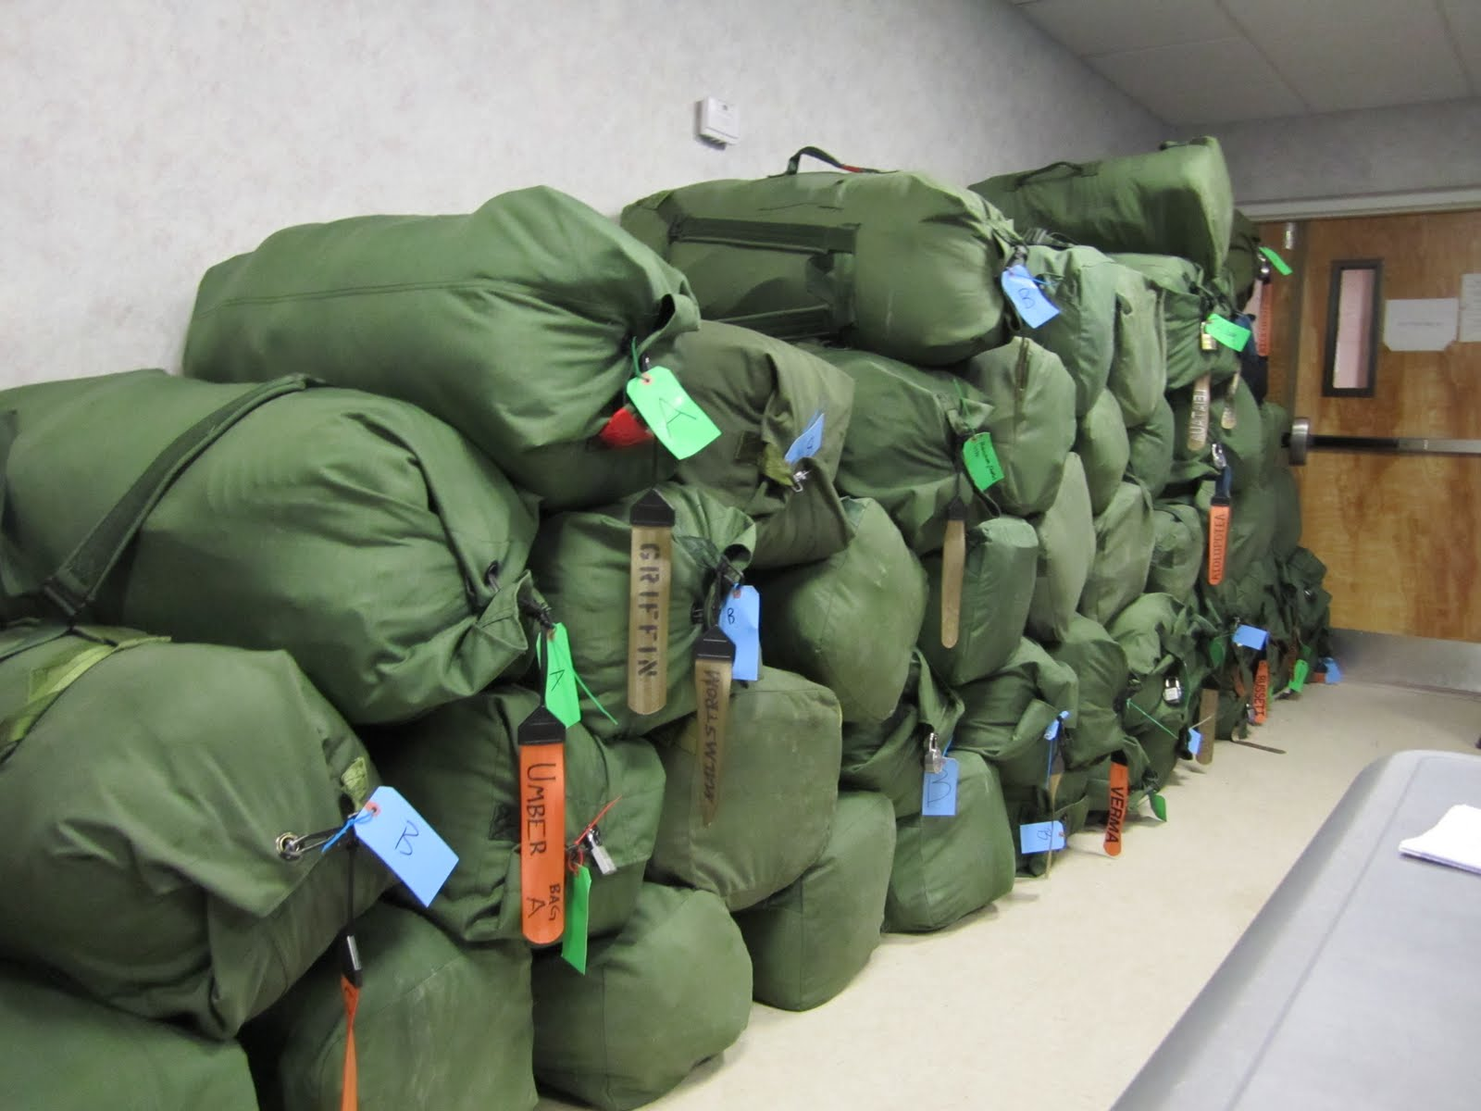

Notes:
Every Soldier has two green duffle bags
Commander – landed in Kuwaitt – sent about 20 of us to go and get your duffle bag
Two most important designators
Name
Unit Designator

Slide 12
Application
If you aren’t a member why aren’t you?
Process – talk to the Deacons
  Meet – Are you a baptized Christian?
  Church Affirmation
If you are a member are you?

