Slide 1


Slide 2


Slide 3


Slide 4


Slide 5


Slide 6


Slide 7


Slide 8
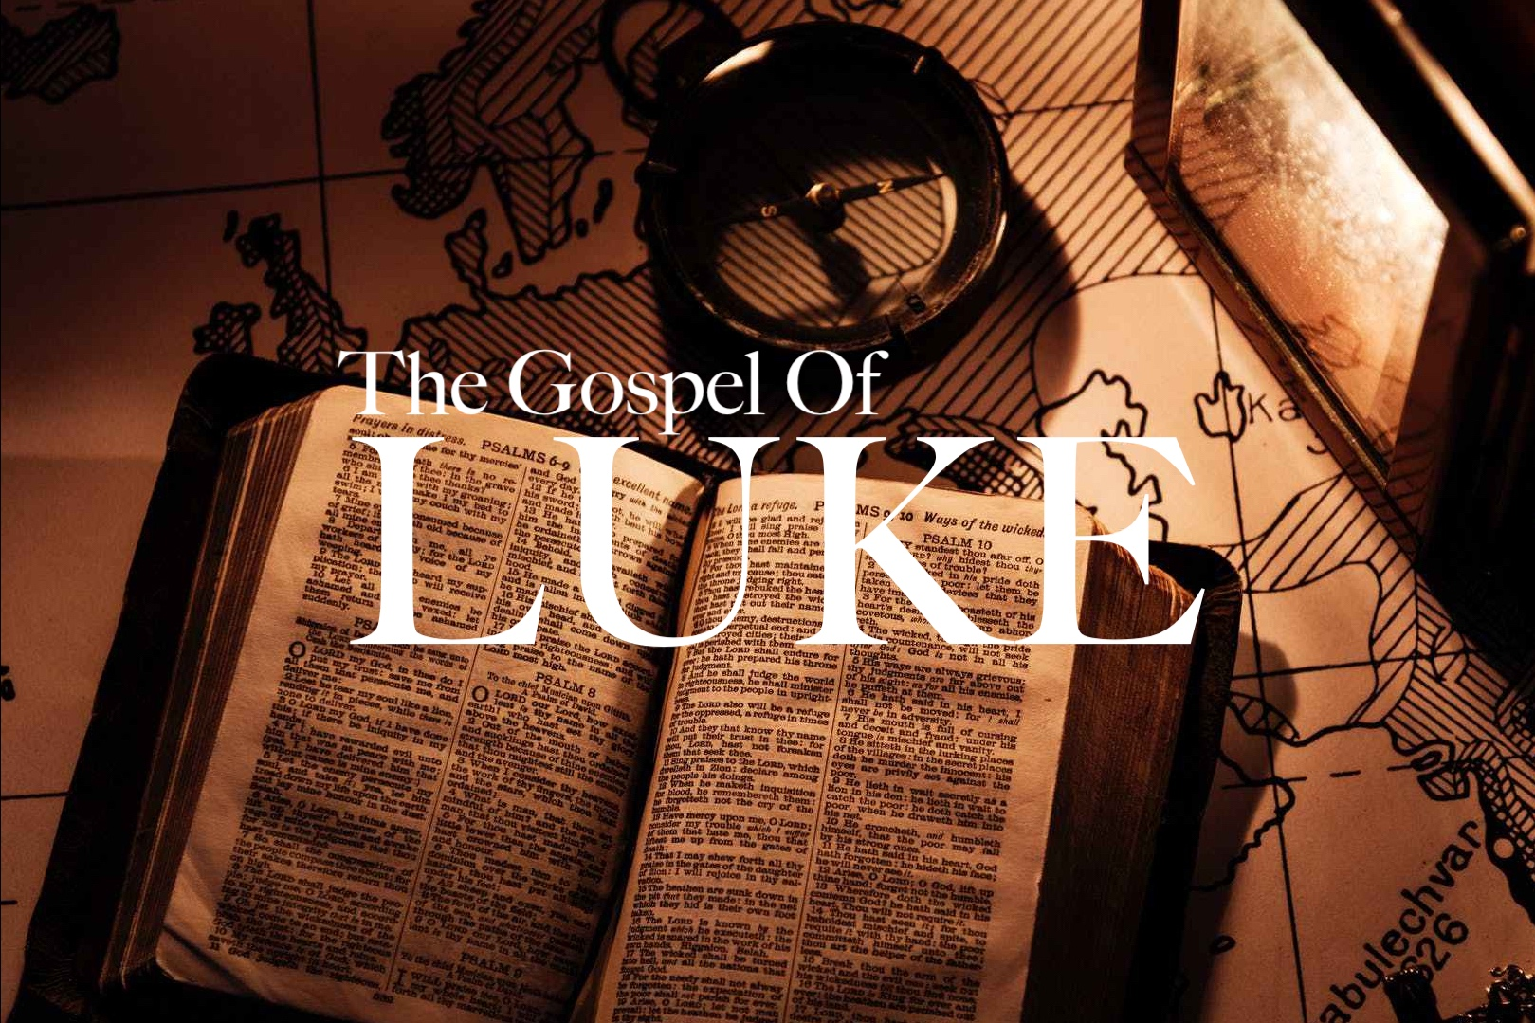
“The Authority of Jesus”
Part 2
Demons, Pigs and Missionaries
Luke 8:26-39

Slide 9
“The Authority of Jesus”
Part 2
Demons, Pigs and Missionaries
Intro: People are fascinated by the supernatural.
They are drawn to the power and the mystery that is beyond their comprehension.
Though most have not personally witnessed an individual possession by a demon doesn’t negate their existence today.
Individual demonic possession is not mentioned in the OT, but there is evidence of demonic activity, Gen. 6:1-4; 1 Sam. 28

Slide 10
“The Authority of Jesus”
Part 2
Demons, Pigs and Missionaries
Intro: The agenda of demons is to oppose the things, people, and purposes of God.
The flurry of demonic activity seen in the NT is unique. After the Gospels there are only two specific instances of it, Acts 16 & 19.
We won’t see such demonic activity again until the tribulation, but meanwhile we will be engaged in constant spiritual battle, Eph. 6; 1 Peter 5:8.
Jesus exercises sovereign authority and power over the demonic forces. They are terrified of Him.

Slide 11
“The Authority of Jesus”
Part 2
Demons, Pigs and Missionaries
I. The Destructive Power of Demons
Demons are created beings cast out of heaven with Satan for their rebellion against God.
Though they have power to destroy a man’s life, they are limited in that power. They are not ubiquitous nor omniscient.

Slide 12
“The Authority of Jesus”
Part 2
Demons, Pigs and Missionaries
II. The Transforming Power of Jesus
This account shows that No One is beyond Jesus’ ability to save!
Jesus came to destroy all the works (erga) of Satan, 1 John 3:8.
The transformation which Jesus gives is complete, 2 Cor. 5:17. The Greek word means metamorphosis, think caterpillar!

Slide 13
“The Authority of Jesus”
Part 2
Demons, Pigs and Missionaries
III. The Damning Power of Sin
The fear of the towns people was not an economic issue involving pigs.
They were comfortable in their status quo, which they thought Jesus was going to change, So they sent Him away.
Unsaved people are just as enslaved to sin as the demoniac.

Slide 14
“The Authority of Jesus”
Part 2
Demons, Pigs and Missionaries
IV. The Missionary
There were two major results of Legion’s Transformation:
1. He worshipped the Lord, vs. 35, and,
2. He was obedient and told his story
to everyone.

