Slide 1


Slide 2

“The Authority of Jesus”
Part 1
Luke 8:22-25

Slide 3
“The Authority of Jesus”
Part 1
Luke 7:18-35
Intro:: As we looked over the past two weeks, we saw a recurring theme of obedience to God’s word.
We noticed in the parable of the Lamp on a lampstand that we weren’t to make a judgment as to who should hear the Gospel message.
In that same parable we noticed an evangelistic challenge as the light, the Gospel was to be seen/heard by everyone.
Jesus tells us that obedience to His word was an indication of our love for Him, Jn. 14:15,21,23.

Slide 4
“The Authority of Jesus”
Part 1
Luke 7:18-35
I. Authority over the Natural World
A. Background:
Luke gives no indication as to the chronology of the event. Mark says It was “On that day…” following His teaching, Mark 4:35.
The Eastern shore of the lake was primarily Gentile territory.
Jesus’ necessity to go there was due to a divine appointment with a demoniac.

Slide 5
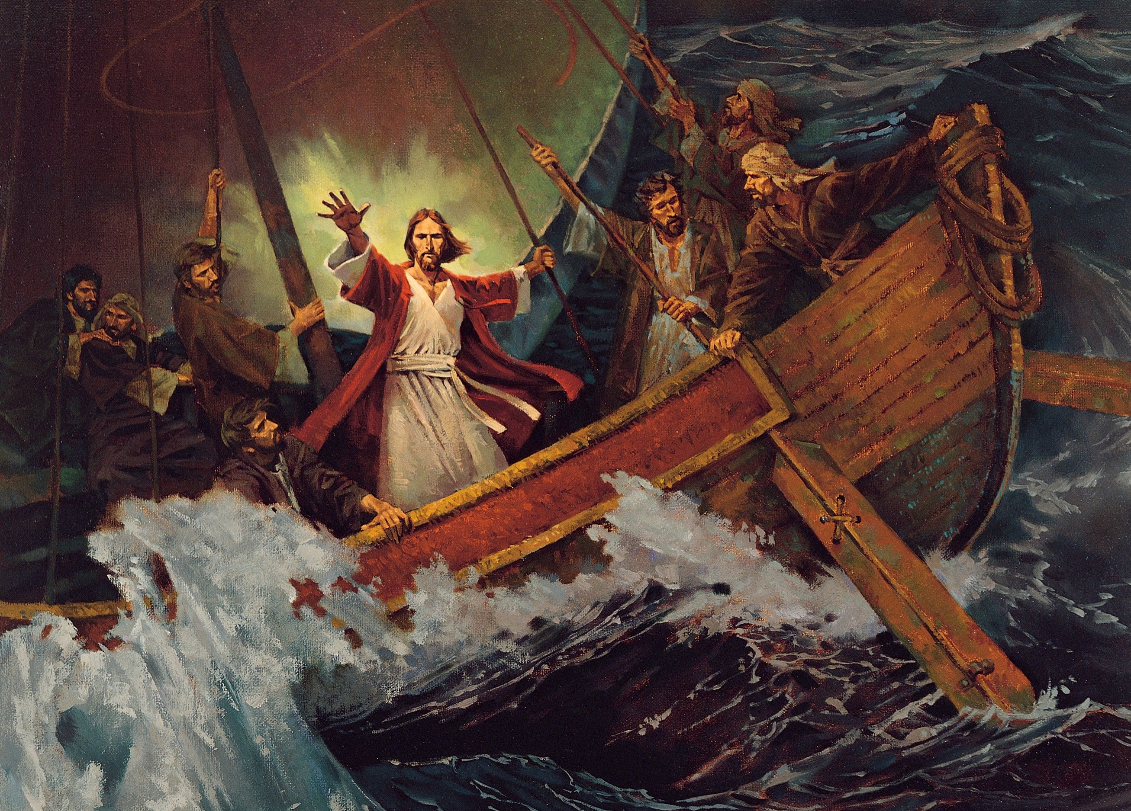

Slide 6
“The Authority of Jesus”
Part 1
Luke 7:18-35
B. The Calm:
The Lord asleep during the pandemonium attests to His:
1. Humanity, He was fatigued!
2. Tranquility, Nothing can rile Him. He is sovereign over all.
The disciples were panicked. It takes peace in one’s heart to be calm in such circumstances.
Peter learned this lesson: When Jesus is in your Boat, there’s no need to worry, Acts 12:6-7.

Slide 7
“The Authority of Jesus”
Part 1
Luke 7:18-35
C. The Rebuke:
1. To the wind and sea, Vs. 24.
The sea immediately became calm. His actions fulfilled OT prophecy, Psalm 107:23-30.
2. To the disciples Vs. 25.
Jesus asked, “Where is your faith?”
They let their circumstances take their focus off of following Jesus.

Slide 8
“The Authority of Jesus”
Part 1
Luke 7:18-35
D. The Response:
A. They were terrified,
B. Their faith was brought to a new
level as they pondered, “Who is this
Jesus?”
Our answer has eternal consequences.

