Slide 1
Matthew 2:1-11

Slide 2
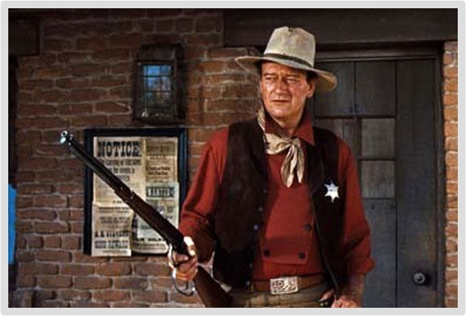
How will you respond to
King Jesus?
Notes:
TITLE - QUESTION
JOHN WAYNE OR CLINT EASTWOOD – FAVORITE WESTERN HERO
CHRISTMAS – NOT DOVES, PEACE, REINDER, AND ELVES AND CANDY CANES
THERE IS A NEW SHERIFF IN TOWN – NOT EVERYONE IS HAPPY
THREE RESPONSES
HEROD – THREAT
CHIEF PRIESTS – APATHY
WISE MEN - WORSHIP

Slide 3
For Herod, Jesus Is A Threat
Notes:
NEW SHERIFF IN TOWN
CURRENT SHERIFF ISNT HAPPY

Slide 4
MATTHEW 2:1 ESV
Now after Jesus was born in Bethlehem of Judea in the days of Herod the king, behold, wise men from the east came to Jerusalem, (ESV)
Notes:
JESUS – LINEAGE OF KING
SON OF GOD – CHRIST THE PROMISED MESSIAH
HEROD THE KING
CONFLICT
HISTORY WORLD – KINGDOM OF MAN AND THE KINGDOM OF GOD
MAN OF LAWLESSNESS AND CHRIST THE KING

Slide 5
MATTHEW 2:3 ESV
When Herod the king heard this, he was troubled, and all Jerusalem with him;
Notes:
JESUS THREATENS PEOPLE WITH HIS AUTHORITY
TROUBLED
ONE OF THE BIGGEST FEARS – MY LIFE WILL CHANGE
I WILL GIVE UP THE RIGHT TO MYSELF
SIN – SELF GOVERNANCE

Slide 6

Notes:
SEASON – PEACE ON EARTH – SUBMIT TO CHRIST - RECONCILES
JOHN 16:2 – DISCIPLES – PEOPLE KILL YOU DOING A SERVICE TO GOD
MATTHEW 10:34 – DO NOT THINK I CAME TO BRING PEACE
REVELATION 11 – CHRISTMAS PARTY BECAUSE GODS WITNESSES ARE KILLED
INCREASE IN HOSTILITY TOWARDS CHRISTIANS AND BIBLICAL IDEAS
WE SHOULD NOT BE SURPRISED

Slide 7
The Chief Priests Are Apathetic
Notes:
PEOPLE OPENLY AGAINST JESUS
RELIGIOUS LOST
PEOPLE WHO CLAIM ALLEGIANCE BUT THEIR HEARTS ARE FAR FROM GOD

Slide 8
MATTHEW 2:4-5 ESV
and assembling all the chief priests and scribes of the people, he inquired of them where the Christ was to be born. They told him, “In Bethlehem of Judea, for so it is written by the prophet:

Slide 9
MATTHEW 2:6 ESV
“And you, O Bethlehem, in the land of Judah, are by no means least among the rulers of Judah; for from you shall come a ruler who will shepherd my people Israel.”
Notes:
MICAH 5:2
ISRAEL AND JUDAH – JUDGMENT
REBELLED
RESTORED – MESSIANIC KING –BORN IN BETHLEHEM – RULE JERUSALEM – RESTORED PEOPLE
KNEW GOD’S WORD – NO LOVE – NO ACTION

Slide 10

Notes:
APATHY – GODS WORD HEAD NOT HEART
PEOPLE – SCRIPTURE KNOWLEDGE – NO HEART
GO TO CHURCH – LIVE FOR THEMSELVES THE REST OF THE WEEK

Slide 11
Wise Men Worship
Notes:
WHAT IS WORSHIP
WORSHIP IS TOTAL LOVE, DEVOTION, OBEDIENCE, AND SERVICE TO CHRIST OUR KING
WORSHIP IS NOT A CONCERT
WISE MEN – NOT KINGS – NOT THREE – NOT ORIENT – BABYLON
DANIEL – SOME KNOWLEDGE OF SCRIPTURE

Slide 12
MATTHEW 2:10
When they saw the star, they rejoiced exceedingly with great joy.
Notes:
STAR – ANGEL OR A LOCALIZED PHENOMENON
WORK OF GOD BY THE HOLY SPIRIT
4 TO 5 MONTHS OF TRAVEL – DROPPED EVERYTHING

Slide 13
MATTHEW 2:11 ESV
And going into the house, they saw the child with Mary his mother, and they fell down and worshiped him. Then, opening their treasures, they offered him gifts, gold and frankincense and myrrh.
Notes:
WORSHIPPED – NO MUSIC
FELL DOWN – TOTAL SUBMISSION TO CHRIST OUR KING
DEVOTION – LOVE – GREAT PERSONAL COST
TIME - TREASURES

Slide 14

Notes:
WORSHIP – LIGHTS, SMOKE MACHINES, INSTRUMENTS, SINGING
WORSHIP – OBJECT, JESUS CHRIST – SPIRIT AND TRUTH
HEART – SERVICE, TIME, TALENTS, AND OUR TREASURE

Slide 15
APPLICATION
What Is Your Response to King Jesus?
Heart Check
Notes:
HAVE YOU SUBMITTED TO KING JESUS FROM THE HEART
JESUS – SON OF GOD
ATONEMENT
HEART – THREAT, APATHY, FILLED WITH WORSHIP

Slide 16
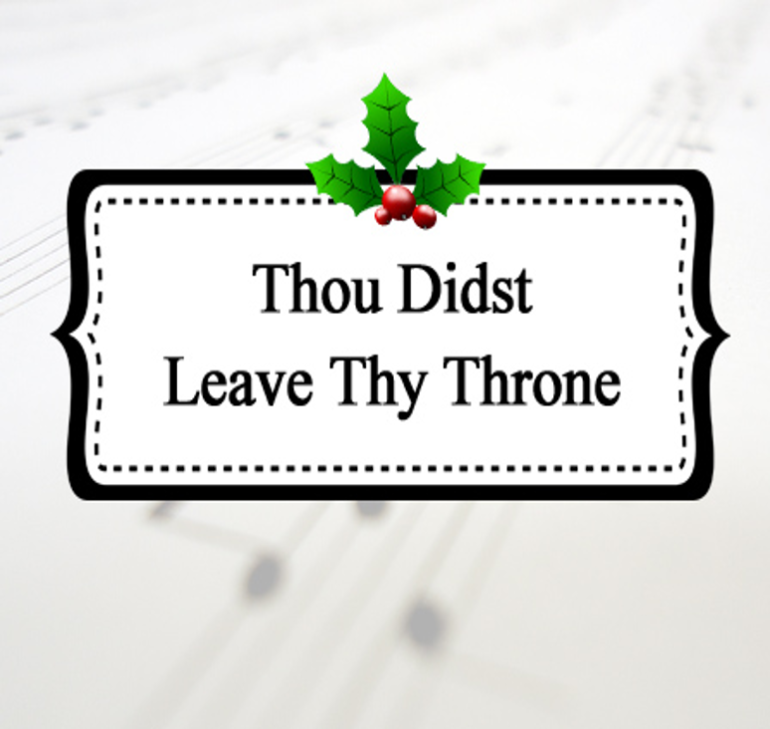
Notes:
THE HYMN “THOU DIDST LEAVE THY THRONE” WAS WRITTEN BY EMILY E. ELLIOTT. IT WAS FIRST USED IN 1864 AT ST. MARK’S CHURCH IN BRIGHT­ON, ENG­LAND WHERE EL­LI­OTT’S FA­THER WAS THE REC­TOR (SIMILAR TO A PASTOR).
Thou didst leave Thy throne and Thy kingly crown,
When Thou camest to earth for me;
But in Bethlehem's home was there found no room
For Thy holy nativity.
O come to my heart, Lord Jesus,
There is room in my heart for Thee.
MAY WE SERVE KING JESUS FROM OUT HEART

