Slide 1

Notes:
119 MILLION PEOPLE WILL TRAVEL FOR THE HOLIDAYS THIS YEAR, BREAKING THE RECORD SET IN 2019. TRIPLE A PREDICTS THAT 107 MILLION PEOPLE WILL TRAVEL BY CAR,
7.85 MILLION BY AIR AND
4.47 MILLION WILL USE OTHER TRANSPORTATION.
THE FAMILY LEFT NAZARETH FOR BETHLEHEM. THAT TRIP WAS 90 MILES AT 2.5MPH ON FOOT. JERUSALEM FOR JESUS’ CIRCUMCISION, 12 MILES.
AGAIN TO JERUSALEM FOR MARY’S PURIFICATION, MEETING ANNA AND SIMEON.
BACK IN BETHLEHEM, THEY SAW THE WISE MEN.
THEN THEY TRAVELED TO EGYPT, ANOTHER 50 MILES.
THEN BACK TO NAZARETH, WHICH WAS 140 MILES.
THE TOTAL NUMBER OF MILES THAT THEY TRAVELED WAS ABOUT 300 MILES ON FOOT.
CHRISTMAS SEASON CAN BE STRESSFUL – TRUE FIRST CHRISTMAS

Slide 2
MATTHEW 2:13-23
JESUS REDEEMS FROM THE BONDAGE OF SIN
Notes:
MAYBE YOU’RE HERE TODAY – GRIEVING A LOSS
MAYBE YOU’RE HERE TODAY – WEIGHT OF GUILT AND SIN
REDEEM – BIBLICAL WORD FOR BEING SET FREE
JESUS CAN SET YOU FREE FROM PAIN AND SIN

Slide 3
THE REALITY OF SPIRITUAL WARFARE AND SUFFERING
Notes:
JESUS IS BORN – CONFRONTED WITH EVIL
PERSON BY THE NAME OF HEROD

Slide 4
MATTHEW 2:13
Notes:
GOD – SOVERIEGNLY KNOWS THE HEARTS OF MAN
KNOWS THE FUTURE
WARNS AND PROTECTS – JOSEPH, MARY AND JESUS
WHERE DO PEOPLE LIKE HEROD, HITLER, MANY EVIL PEOPLE THROUGHOUT HISTORY
SPIRITUAL WARFARE
GOD HAS A PLAN, PROTECTS HIS PEOPLE

Slide 5
GENESIS 3:15
I will put enmity between you and the woman, and between your offspring and her offspring he shall bruise your head and you shall bruise his heel.”
Notes:
SATANS OFFSPRING IS TRYING TO KILL THE CHIRST CHILD
DRAGON AND THE WOMAN OF REVELATION – STORY OF HISTORY

Slide 6
MATTHEW 2:17-18
Notes:
JEREMIAH’S PROPHECY
RACHEAL WEEPING
JERUSALEM DESTROYED – JUDAH IS GOING INTO EXILE TO BABYLON
PASS RAMAH – BURIAL PLACE OF RACHAEL
DIED IN CHILDBIRTH – WOULD NOT SEE HER CHILDREN
EXILE – RACHAEL WOULD NEVER SEE HER CHILDREN
JEREMIAH – WEEPING PROPHET
SIN, DESTRUCTION
IMPRISONED, FAMINE, THROWN IN A WELL, JERUSALEM WAS BEING SACKED
JESUS WAS BORN A MAN OF SORROWS – ACQUAINTED WITH GRIEF

Slide 7
JEREMIAH 20:18
Why did I come out from the womb to see toil and sorrow, and spend my days in shame?
Notes:
JEREMIAHS LAMENT – IN

Slide 8
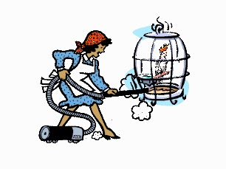
Notes:
MAX LUCADO TELLS OF MRS. SMITH - PARAKEET CHIPPY. HIS SONGS BRIGHTENED HER LONELY DAYS.
ONE DAY WHILE VACUUMING, MRS. SMITH NOTICED CHIPPY”S CAGE WAS DIRTY. OPENING THE LITTLE DOOR, SHE INSERTED HER VACUUM HOSE . . . WHEN THE PHONE RANG. AS SHE TURNED TO PICK UP THE PHONE, THE HOSE SHIFTED SLIGHTLY AND””SLURP!””SUCKED POOR CHIPPY DOWN INTO THE SWEEPER”S BOWELS.
HORRIFIED, MRS. SMITH DROPPED THE PHONE, TORE OPEN THE SWEEPER BAG, AND DUG THROUGH THE DIRT UNTIL SHE FOUND THE NOW-BROWN LITTLE FEATHERED LUMP. CHIPPY WASN”T BREATHING, SO SHE DID THE ONLY THING SHE COULD THINK OF””SHE RUSHED HIM TO THE BATHROOM FAUCET AND SHOVED HIM UNDER THE RUSHING WATER. THE PARAKEET SPUTTERED BACK TO LIFE, BUT NOW FREEZING WET, HER PRECIOUS CHIPPY WAS DRIPPY. AGAIN SHE DID THE ONLY THING THAT CAME TO MIND””SHE GRABBED HER HAIR DRYER AND BLASTED HIM WITH HOT AIR.
POOR CHIPPY HAD NOW BEEN SUCKED UP, WASHED UP, AND BLOWN UP. AT THIS POINT, HE SURELY THOUGHT HE HAD DIED AND, FOR WHATEVER REASON, GONE TO THE LITTLE BIRDIE BAD PLACE
A FEW DAYS LATER, A REPORTER DROPPED BY TO INTERVIEW MRS. SMITH. HE SAW CHIPPY SITTING ON HIS PERCH, STARING VACANTLY INTO SPACE, AND ASKED, “HOW IS CHIPPY DOING?”
MRS. SMITH REPLIED, “WELL, PHYSICALLY HE SEEMS FINE. BUT HE DOESN”T SING MUCH ANYMORE.”
SOMETIMES LIFE HAS A WAY OF STEALING YOUR SONG.

Slide 9
PSALM 6:2-3
Be gracious to me, O LORD, for I am languishing; heal me, O LORD, for my bones are troubled. My soul also is greatly troubled.
But you, O LORD—how long?
Notes:
LAMENT – VOICE OUR GRIEF IN THE PRESENCE OF THE LORD
WE BOTTLE IT ALL UP
PRAYER TIMES WOULD HAVE LAMENT

Slide 10
Christmas is God's answer to our lament. In the person of Jesus, he entered into our suffering, experiencing all the grief and despair and woundedness of being human. The little baby in the manger was God becoming man, signing up for all the pain that life on this planet entails.
-Matt Proctor
Notes:
CHRIST UNDERSTANDS OUR GRIEF
JESUS HAS A PLAN

Slide 11
JESUS FULFILLS THE HOPE OF THE OLD TESTAMENT
Notes:
JESUS REDEEMS ISRAEL OUT OF ALL OF ITS PROBLEMS

Slide 12
MATTHEW 2:14-15
Notes:
FULFILL – NOT HOW WE WOULD USUALLY COME TO PASS - ACCOMPLISH
THAT HIS LIFE FULFILLS A PROMISE – PROMISE GIVEN TO ISRAEL, JEREMAIH, ISAIAH
JESUS IS THE FULFILLMENT OF THOSE PROMISES
EXODUS
MOSES – KILLED ALL THE CHILDREN UNDER TWO YEARS OF AGE
JESUS
MOSES – DELIEVERED GOD’S PEOPLE FROM SLAVERY
JESUS – DELIVERS GOD’S PEOPLE FROM SIN

Slide 13
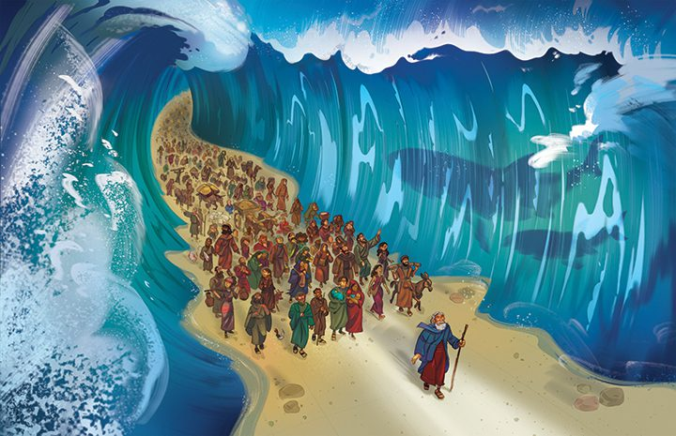
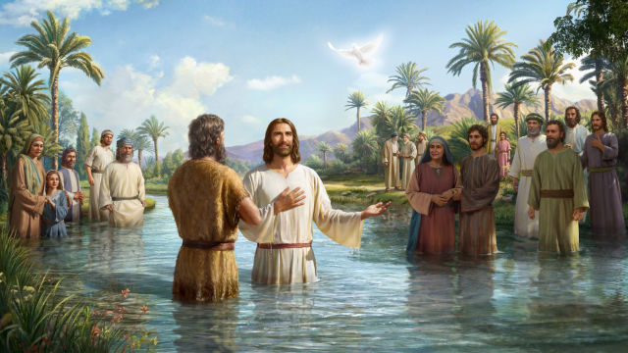
MATTHEW 3:13, 15
Notes:
JESUS BAPTISM
FULFILL ALL RIGHTEOUSNESS
IDENTIFY WITH SINNERS – HE TAKES OUR SIN UPON HIMSELF

Slide 14
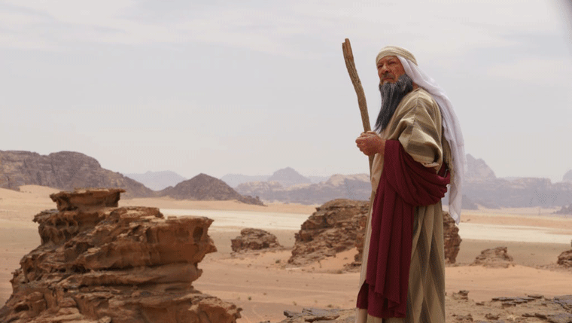
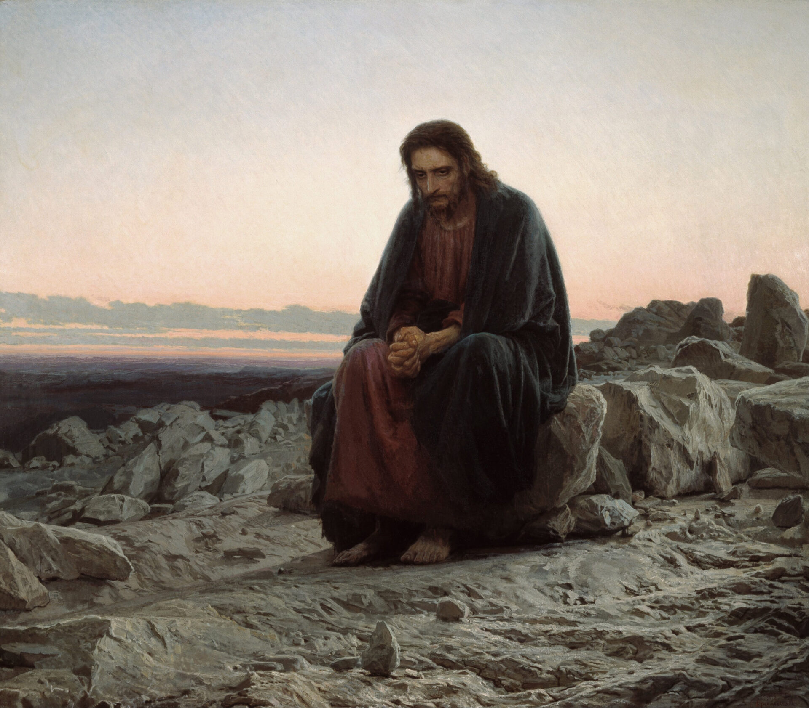
MATTHEW 4:1, 4, 7, 10
Notes:
QUOTED – DEUTERONOMY 6
ISRAEL FAILED IN THE WILDERNESS – JESUS ACCOMPLISHED AND OVERCAME

Slide 15
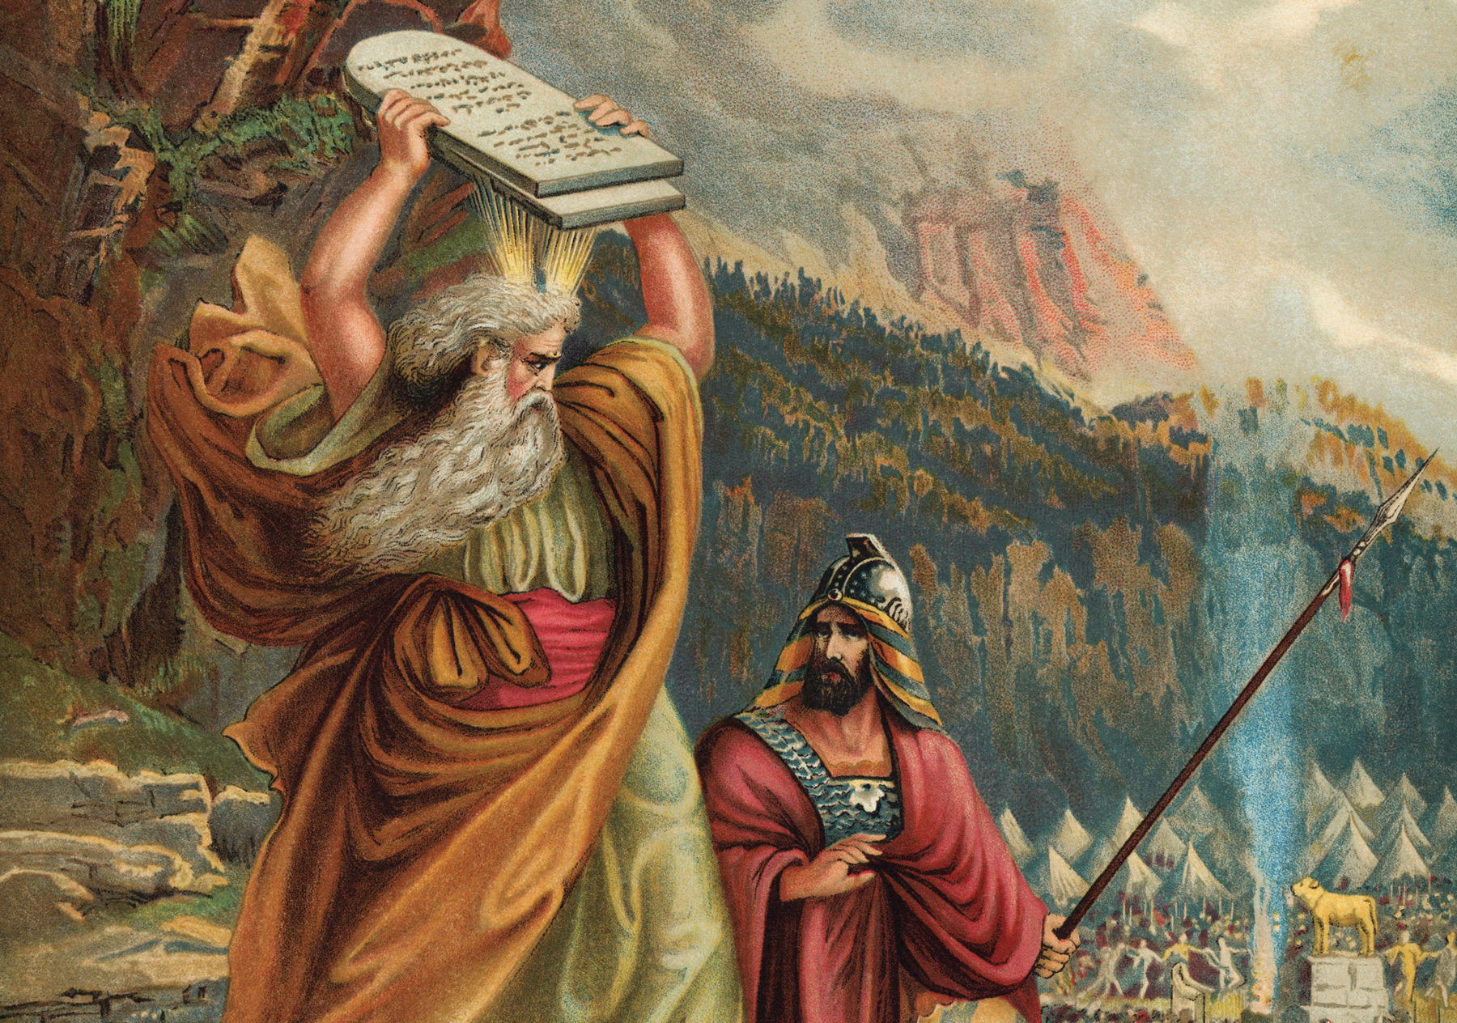
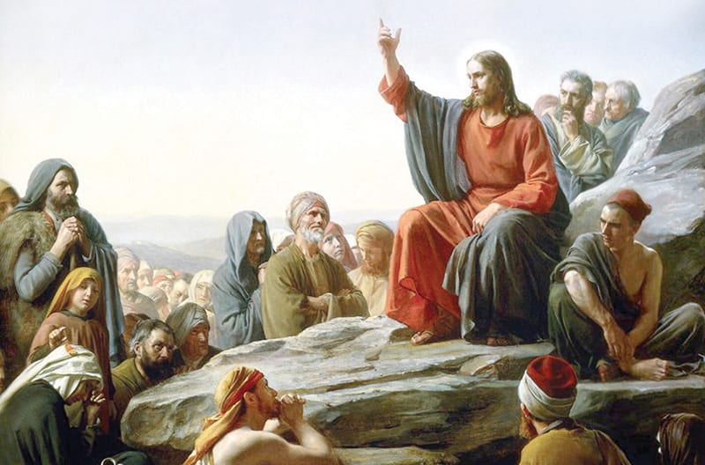
MATTHEW 5:1, 17, 20, 48
Notes:
LAW – FAILED BEFORE IT WAS GIVEN
JESUS – BLESSED ARE THE POOR IN SPIRIT
I SAY TO YOU
FULFILL THE LAW
PERFECT – IMPUTED RIGHTEOUSNESS

Slide 16
JOHN 5:39, 46
“You search the Scriptures because you think that in them you have eternal life; and it is they that bear witness about me. . . . If you believed Moses, you would believe me; for he wrote of me.”
Notes:
OT SPEAKS OF CHRIST
BELIEVE MOSES MUST BELIVE CHRIST

Slide 17
ROMANS 10:4
For Christ is the end of the law for righteousness to everyone who believes.
Notes:
LOOK AT THE LAW – BURDEN OF GUILT
THINK YOU CAN DO IT ON YOUR OWN
CHRIST DID IT FOR YOU

Slide 18
HEBREWS 9:12
he entered once for all into the holy places, not by means of the blood of goats and calves but by means of his own blood, thus securing an eternal redemption.
Notes:
OWN BLOOD
ETERNAL REDEMPTION

Slide 19
LUKE 9:29-31
And behold, two men were talking with him, Moses and Elijah, who appeared in glory and spoke of his departure, which he was about to accomplish at Jerusalem.
Notes:
EXODUS – SET CAPTIVES FREE

Slide 20
This true and final exodus is not a physical deliverance from an earthly pharaoh. Nor is freedom from merely physical servitude. It is deliverance from Satan, and from the guilt, and power, and shame of sin.
-Sinclair Ferguson

Slide 21

Notes:
GUILT AND SHAME OF THE HOLIDAY SEASON

Slide 22
God is sovereign but he does allow trials. The purpose is to make us more aware of our need to depend wholly on him. When many things are going wrong, we must turn and cry “Abba, Father”… everything is possible for you.
Notes:
SUNRISE AND SUNSET
LONG TIME OF INVERSION
LONGING
TRIALS – LOOK FORWARD TO OUR FULL REDEMPTION

Slide 23
APPLICATION
SUFFERING? MEDITATE ON PRESENT GRACE AND FUTURE GRACE
FEELING GUILTY? BELIEVE AND REJOICE THAT CHRIST FORGIVE’S YOUR SINS
Notes:
SUFFER – GOD PROTECTS – CHRIST IS KING – NEW KINGDOM COMING
GUILT – JESUS FULFILLED THE RIGHTEOUS REQUIREMENTS OF THE LAW
FAITH – DO YOU BELIEVE THIS FOR YOU
REJOICE – PRAISE HIM
IN CHRIST - WE HAVE A REASON TO SING

