Slide 1
FINDING CHRIST, THE KING
MATTHEW 2:1-12
Notes:
MANY PEOPLE ARE SEEKING TO FIND JOY THIS CHRISTMAS
FIND IT TO BE ELUSIVE
CHRISTMAS MUSIC AND LIGHTS AND FOOD
NONE OF THESE CAN BRING JOY
THE ONLY WAY TO FIND JOY – FIND CHRIST, THE KING

Slide 2
CHARACTERISTICS OF A FINDER
Notes:
CHURCHES TALK ABOUT SEEKERS
CHURCH OF SEEKERS – SEEKER DRIVEN
MANY PEOPLE ARE CONTINUOUSLY SEEKING AND NEVER FINDING
DRAW GREAT CROWDS AND EVERYONE IS SEEKING BUT NO ONE IS FINDING
PEOPLE WHO NOT ONLY SEARCH FOR JESUS BUT PEOPLE WHO ARE OBEDIENT TO STEP OUT IN FAITH
MANY DO NOT FIND JESUS BECAUSE THEY ARE NOT OBEDIENT

Slide 3
FINDERS ARE GUIDED BY GOD
Notes:
TEXT – HOW DID THESE MAGI FIND JESUS

Slide 4
MATTHEW 1:1-2
Notes:
MAGI – GROUP OF ADVISORS TO KINGS – SORCERERS
FORETOLD THE FUTURE – INTERPRETED DREAMS
EXODUS – PHAROAH MAGI – CONTERFEIT SIGNS
EAST – PERSIA – MOST LIKELY BABYLON
BECAUSE OF EXPOSURE TO SCRIPTURE THROUGH DANIEL
WHY DID THEY GO ON THIS LONG JOURNEY?
PROPHECY OF BALAAM – EAST NEAR THE EUPHRATES RIVER
MAGI – DIVINER – READ SLAUGHTERED ANIMAL ENTRAILS
NUMBERS 24:17 A STAR SHALL COME OUT OF JACOB,
AND A SCEPTER SHALL RISE OUT OF ISRAEL;
WHICH STAR WERE THEY FOLLOWING?
CELESTIAL SIGN – COMET JUPITER AND SATURN,
LOCAL SIGN – CLOUD, BOTH
JERUSALEM TO BETHELEHEM - MOVE
IT WAS A SPECIAL STAR JUST FOR THEM – LOOKING FOR IT
GOD GUIDED THEM AND DIRECTED THEM – GAVE THEM THE MOTIVATION
COME AND WORSHIP

Slide 5
Romans 3:10-11
as it is written: “None is righteous, no, not one;
no one understands; no one seeks for God.
Notes:
MAGI – JOURNEY WASN’T OF THEIR OWN DOING – DIVINE GUIDANCE – INNER MOTIVATION
YOU – GOD DREW YOU TO HIMSELF
WORKED IN YOUR HEART AND CIRCUMSTANCES

Slide 6
The wise men were guided by a “secret instinct of the Spirit.”
-John Calvin
Notes:
NO ONE LEAVES THEIR HOME ON A LONG DANGEROUS JOURNEY TO FOLLOW A STAR BASED SOLEY ON AN OBSCURE ANCIENT PROPHECY.
THEY WERE GUIDED BY GOD
GOD USES CIRCUMSTANCES TO DRAW US TO HIMSELF – STARS OR DREAMS
MOM WAS A BELIEVER – WORDLESS BOOK – ATTENTION SPAN
FIRST DAY OF SUNDAY SCHOOL – FIRST BAPTIST THOUSAND OAKS – HEART STIRRED STUDY THE BIBLE
BIBLE TEACHING PASTOR – REDWOOD VALLEY COMMUNITY CHURCH
HOLIDAY SEASON – RECOUNT YOUR JOURNEY TO CHRIST

Slide 7
FINDERS ARE GUIDED BY
GOD’S WORD
Notes:
CIRCUMSTANCES ARE NEVER ENOUGH ON THEIR OWN – DRAW US TO FIND GOD’S WORD

Slide 8
MATTHEW 2:5-6
Notes:
MICAH 5:2 SCRIBES AND PRIESTS
KNEW CHAPTER AND VERSE, MEMORIZED
NO DESIRE TO FIND CHRIST, TAKE THE EFFORT
JERUSALEM – NOT JOYFUL BUT TROUBLED
SPEAKS TO MANY CHRISTIAANS WHO KNOW A LOT ABOUT THE WORD BUT ARE NOT OBEDIENT TO IT
MAGI – BEFORE THEY WERE GUIDED BY CIRCUMSTANCES
NOW THEY WERE GUIDED BY THE WORD
CIRCUMSTANCES CAN BRING US TO CHRIST BUT IT IS THE WORD OF GOD THAT CLOSES THE DEAL

Slide 9
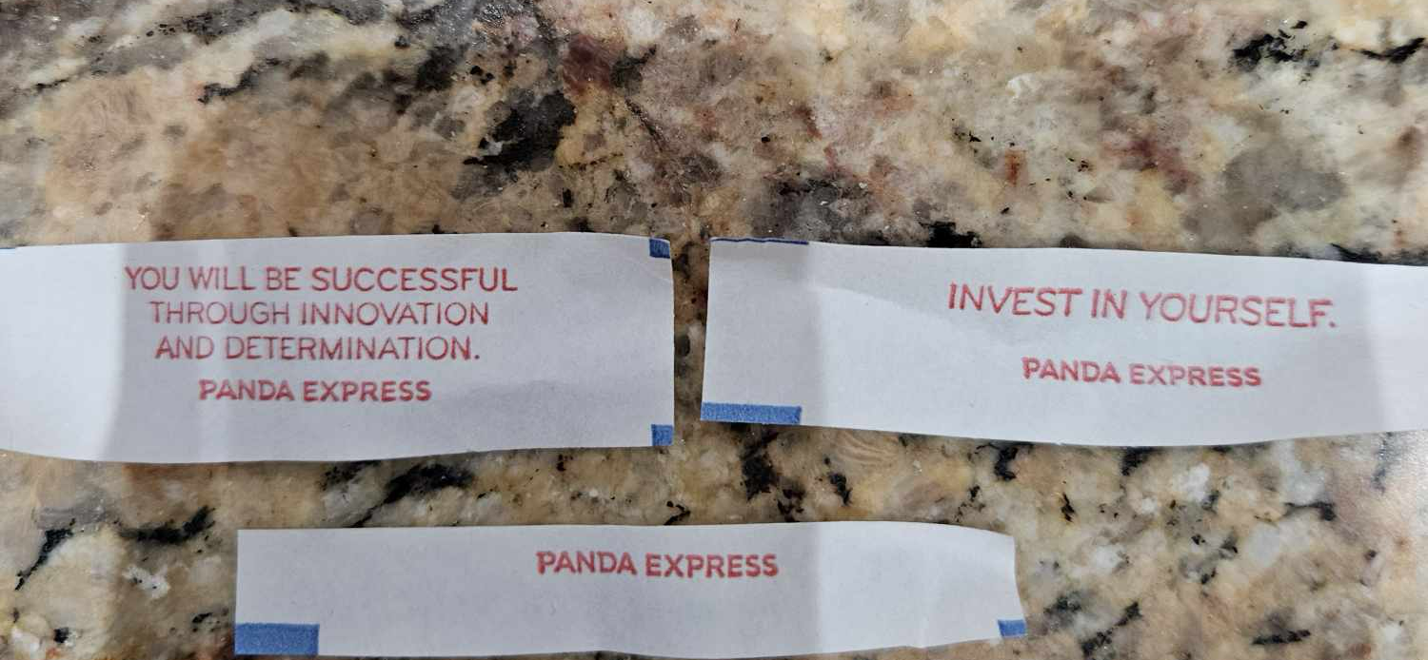
Notes:
PANDA EXPRESS GAME
PEOPLE ACTUALLY BELIEVE IN FORTUNE COOKIES
PEOPLE COMMONLY PREDICT THE FUTURE THROUGH METHODS LIKE: ASTROLOGY, TAROT CARD READINGS, PALM READING (CHIROMANCY), TEA LEAF READING (TASSEOGRAPHY), NUMEROLOGY, CRYSTAL GAZING, INTERPRETING DREAMS, ANALYZING TRENDS, STATISTICAL MODELING BASED ON HISTORICAL DATA, AND OBSERVING EMERGING TECHNOLOGIES; WITH THE FIRST FEW CONSIDERED MORE MYSTICAL AND THE LATTER LEANING TOWARDS DATA-DRIVEN APPROACHES.
CIRCUMSTANCES, INNER FEELING, BIBLE FLIPPING
PASSAGE ABOUT ONAN – JUDAH AND TAMAR
GUIDED BY PRAYER AND THE HOLY SPIRIT SOLID TEACHING OF GOD’S WORD

Slide 10
FINDERS SUBMIT TO GOD’S UNEXPECTED WAYS
Notes:
GOD’S WAY ARE NOT HOW WE USUALLY THINK – UNEXPECTED
THERE IS A LOT I DO NOT UNDERSTAND ABOUT GOD

Slide 11
MATTHEW 2:11
Notes:
HUMAN REASONING
JESUS WOULD BE BORN IN A BIG CITY NOT A LITTLE TOWN LIKE BETHLEHEM
JESUS WOULD BE BORN IN A PALACE – NOT AN ORDINARY HOUSE
GOD GUIDES THEM – BETHELEHEM AND AN ORDINARY HOUSE
QUESTIONS – NATIVITY SCENES
NOT A CAVE OR AN INN AND A MANGER – A YEAR OR TWO LATER
STAR – HEROD APPEARED TWO YEARS EARLIER

Slide 12
1 CORINTHIANS 1:27-29
But God chose what is foolish in the world to shame the wise; God chose what is weak in the world to shame the strong; God chose what is low and despised in the world, even things that are not, to bring to nothing things that are, so that no human being might boast in the presence of God.
Notes:
WHY – DOES GOD DO THIS – HUMBLE US
GODS WAYS ARE NOT OUR WAYS AND GODS THOUGHTS ARE NOT OUR THOUGHTS
PEOPLE THAT FIND GOD – SUBMIT THEIR REASONING TO GOD’S REASONING
HONEST – MULTIPLE THINGS I DO NOT UNDERSTAND ABOUT GODS WAYS
HE IS GOD AND I AM NOT – I JUST SAY - YES LORD
MAGI DID

Slide 13
FINDERS BECOME OBEDIENT WORSHIPPERS
Notes:
WORSHIP IS NOT JUST SINGING

Slide 14
MATTHEW 2:11-12
Notes:
WORSHIPPED – PROSTRATED
KNEELING BENCHES
ALL THE WAY DOWN ON THE FLOOR
SIGN OF SUBMISSION
GAVE GIFTS – FIT FOR A KING
SIGNIFICANCE – THESE GENTILES, OTHER NATIONS, ISRAEL WAS APATHETIC
MAGI – PROCLAINED THE DIETY AND SOVEREIGNTY OF THE LORD JESUS CHRIST

Slide 15
Isaiah 60:1-6
Notes:
BECAME A FINDER
JESUS NOT ONLY THE KING OF THE JEWS
HE BECAME THEIR KING
ISRAEL – SUPPOSED TO BE GLAD BUT THEY WERE DISTRESSED
DIDN’T WANT JESUS TO BE THEIR KING
MISSED OUT ON THEIR JOY

Slide 16

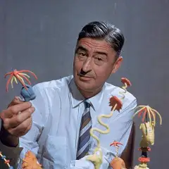
Notes:
THERE WAS ANOTHER MAN WHO MISSED OUT ON THE JOY OF CHRIST
ONE OF MY FAVORITE CHRISTMAS MOVIES TO WATCH ON CHRISTMAS EVE – THE GRINCH
STEALS ALL THEIR FOOD AND PRESENTS WAITS FOR THE BOOHOO – INSTEAD CHRISTMAS SONG
IT CAME WITHOUT RIBBONS OR TAGS, IT CAME WITHOUT BOXES OR BAGS. CHRISTMAS DOESN’T COME FROM A STORE MAYBE CHRISTMAS MEANS A LITTLE BIT MORE.
THOUGHT IT WAS CHRISTIAN – TGC – DAN OLSON
DR SUESS LEFT CHRIST OUT OF CHRISTMAS
DR SUESS – TED GEISEL
GRINCH – 1957 LOOKING IN THE MIRROR
SAW A GRINCHISH COUNTENANCE – LOST THE JOY OF CHRISTMAS – WROTE TO FIND IT
DON’T KNOW WHEN GEISEL HAD LOST INTEREST IN THE CHRIST OF CHRISTMAS
HE WAS RAISED IN A MISSOURI SYNOD LUTHERAN FAMILY

Slide 17
APPLICATION
REMEMBER YOUR JOURNEY
FIND CHRIST THE KING –
HE ALONE BRINGS THE JOY OF CHRISTMAS
Notes:
JOURNAL – WRITE DOWN THE CIRCUMSTANCES THAT GOD USED TO BRING YOU TO CHRIST - PURPOSE OF PRAISE
Maybe you have lost the christ of Christmas JUST LIKE DR SUESS
PRAY – INSTEAD OF A SEEKER THAT YOU WOULD BE A FINDER

Slide 18
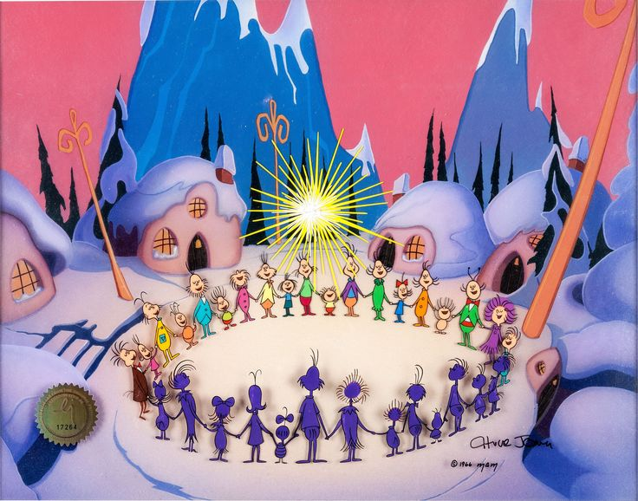
Notes:
THE STAR IN THE GRINCH COMES FROM ME AND. IT STARTS IN THE CIRCLE ON THE GROUND AND GOES UP INTO THE HEAVENS, SONG CHRISTMAS TIMES IS HERE AT LAST AS LONG AS WE HAVE HANDS TO GRASP.
GRINCH OFFER A SECULAR HOPE—THE HOPE OF “ME” AND “WE.” BUT GOD OFFERS A BETTER HOPE—ONE NOT ACHIEVED BY US, BUT RECEIVED FROM HIM: “
THE STAR IN MATTHEW 2 COMES FROM GOD AND DIRECTS US AWAY FROM ME AND WE TO WORSHIP HIM.

