Slide 2


Slide 3
Gospel – Greek “euangélion”
Old English “God spell” became “Gospel”
“Good Tidings” or “Good News”
Related word “evangelism” basically means “bringing or sharing good news”
In the NT: 77x noun, 54x verb

Slide 4
Street Preachers

Slide 5
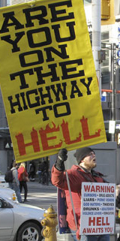
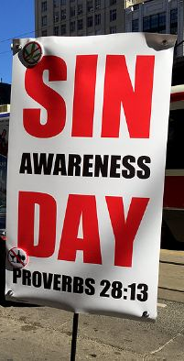
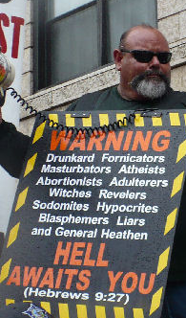

Slide 6
The Gospel?
“Accept God or you’re going to Hell!”

Slide 7
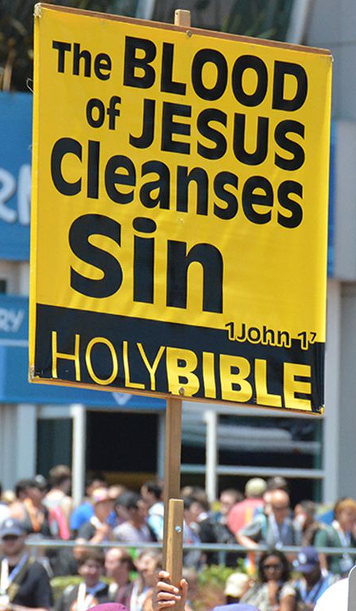
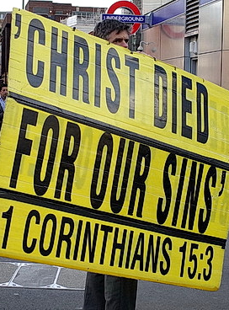

Slide 8
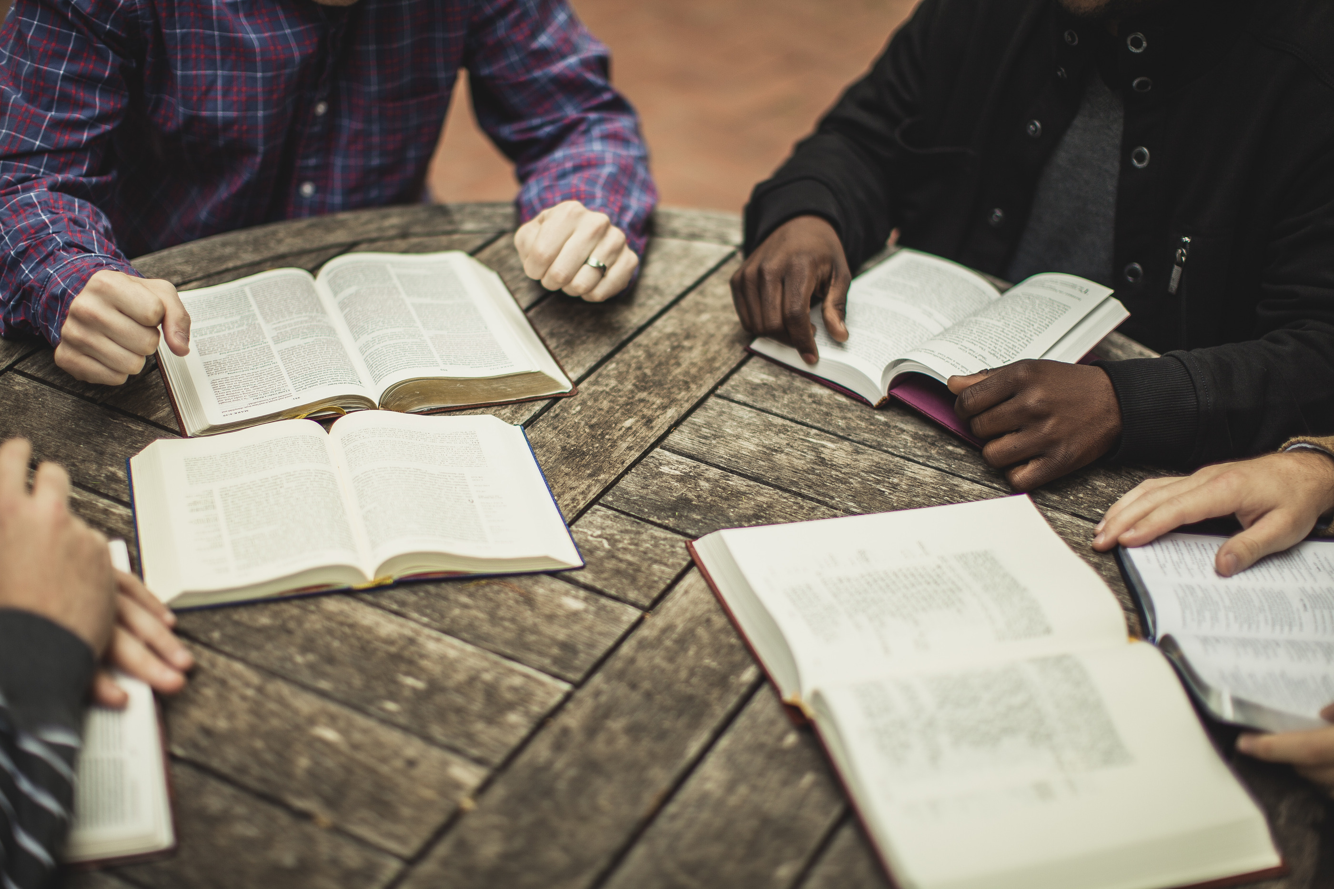

Slide 9
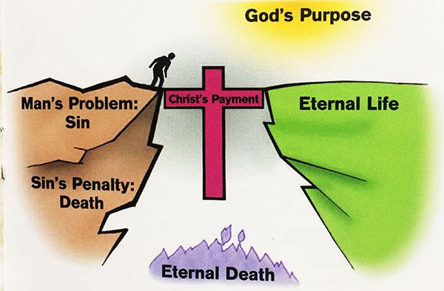
The Gospel

Slide 10
The Gospel?
“Believe in what Jesus did to save you,
and get a reward. You’re going to heaven!”

Slide 11
Caricature
Exaggerating characteristics to
create a comic or grotesque effect

Slide 12
Let’s be fair…

Slide 13
“Is that all there is?”

Slide 14
An Incomplete Gospel
“We are sinners destined for eternal death.
Jesus provided a way of redemption.
If we believe and accept it, we have eternal life.”
(not wrong, but not the complete good news)

Slide 15
“A More Complete Gospel”

Slide 16
“Blessed are the...”

Slide 17
“You have heard, but I say...”

Slide 18
“Your kingdom come, Your will be done,
on earth, as it is in heaven.”

Slide 19
Reclaiming the Kingdom

Slide 20
“This gospel of the kingdom shall be
preached in the whole world...
make disciples of all the nations...
teaching them to observe all
that I commanded you...”
Matt 24.14, 28.19-20

Slide 21
Justin Martyr, Christian theologian, approx.155-157 AD:
“We formerly rejoiced in uncleanness of life, but now love only chastity; before we used the magic arts, but now dedicate ourselves to the true and unbegotten God; before we loved money and possessions more than anything, but now we share what we have

Slide 22
and to everyone who is in need; before we hated one another and killed one another and would not eat with those of another race, but now since the manifestation of Christ, we have come to a common life and pray for our enemies and try to win over those who hate us without just cause.”
“First Apology” to Roman Emperor Antoninus Pius

Slide 23
Good News:
A transformed life, starting now!

Slide 24
But wait, there’s more!

Slide 25
Good News:
Power! Grace! Holy Spirit!

Slide 26
A mystery revealed…

Slide 27
Good News:
The mystery of Christ in me!

Slide 28
Incomplete Gospel
“We are sinners destined for eternal death.
Jesus provided a way of redemption.
If we believe and accept it, we have eternal life.”
A more complete Gospel
Above, plus: A transformed life, starting now! Power! Grace! Holy Spirit!
And the mystery of Christ in me!

Slide 29
What difference does it make?

Slide 30
Making connections to recent talks

Slide 31
A more complete Gospel…
That’s Good News!

