Slide 1
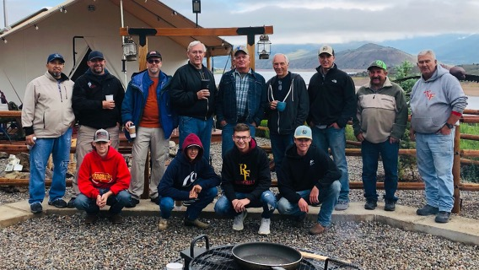

Slide 2
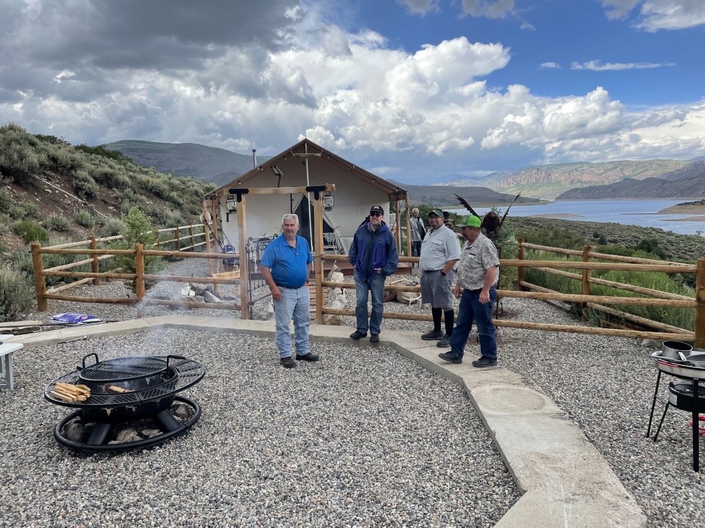

Slide 3


Slide 4
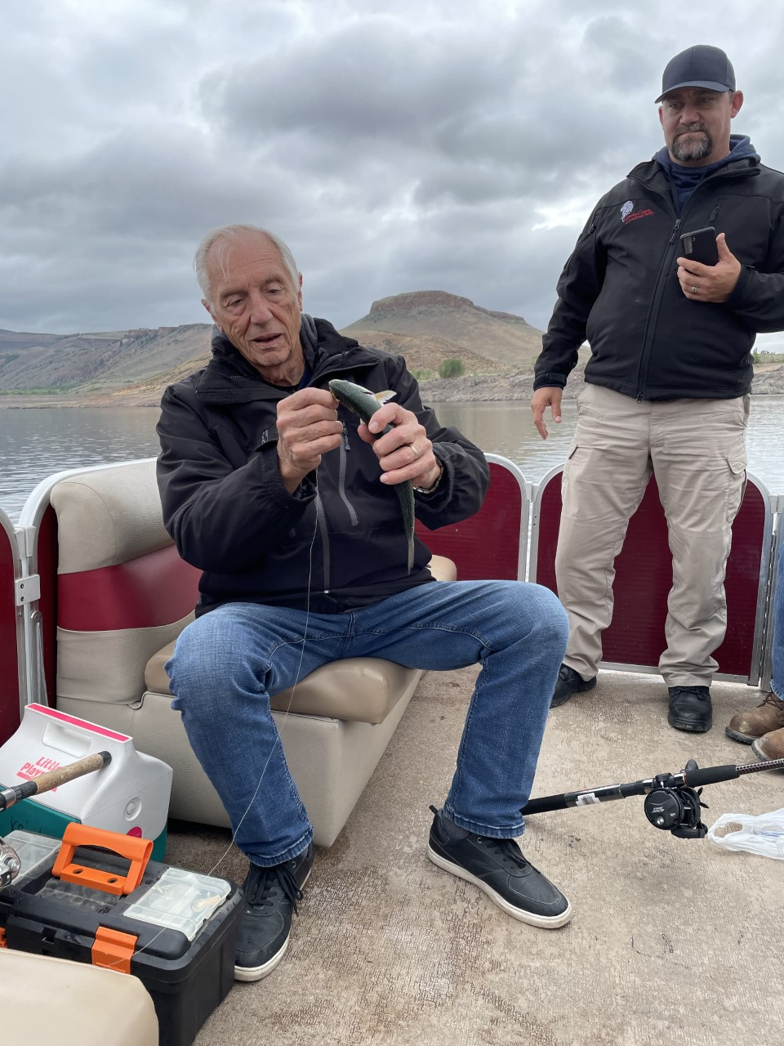

Slide 5
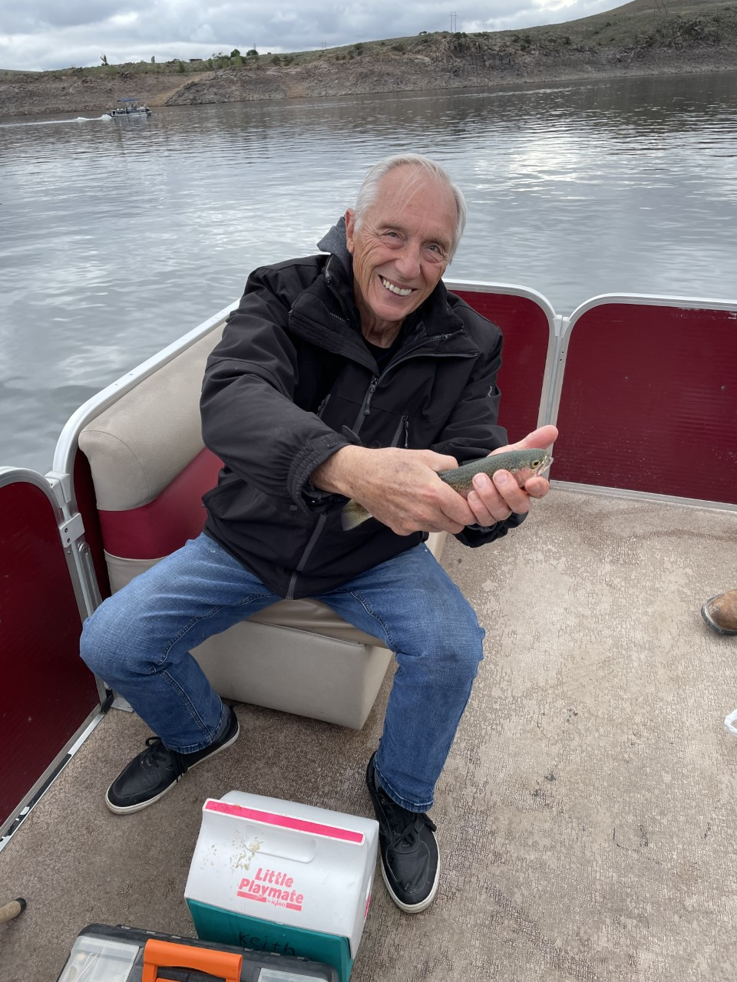

Slide 6
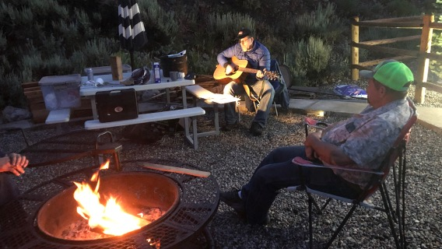

Slide 7


Slide 8
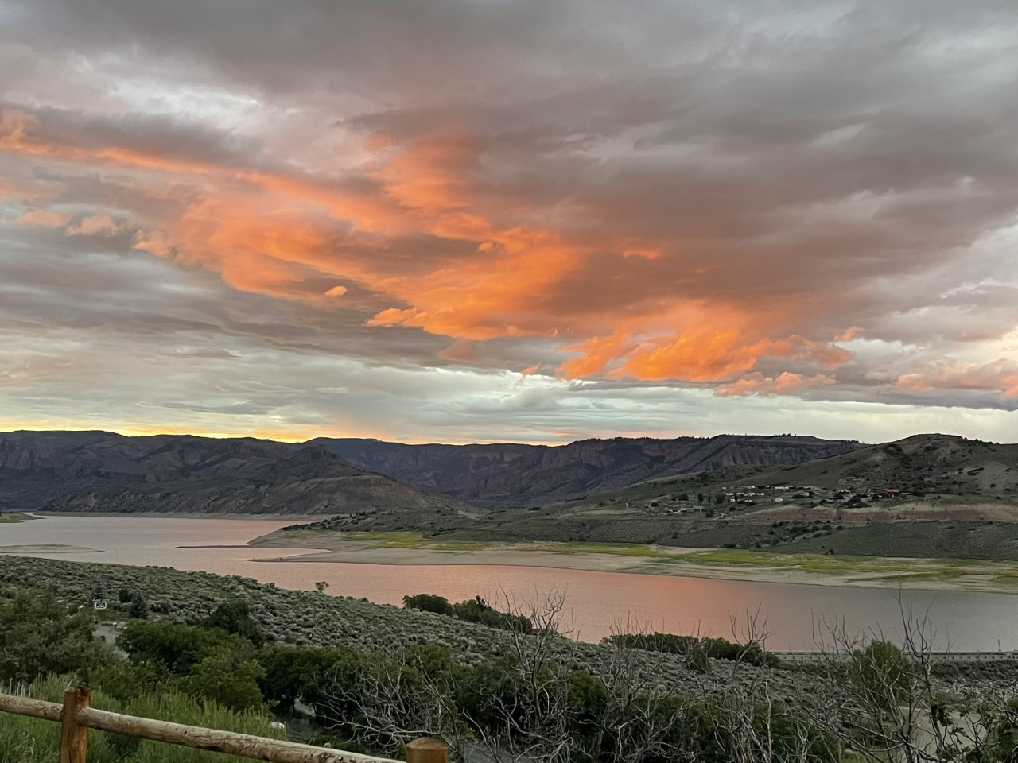

Slide 9


Slide 10

“A Glimpse of Glory”
Luke 9:27-36

Slide 11
“A Glimpse of Glory”
Luke 9:27-36
Intro: The word, “glory” comes from the Latin, gloria, which means fame or renown.
Scripturally it speaks of God’s splendor or magnificence, Ps. 19:1.
It can also speak about God’s manifest presence, Acts 4:31.
Paul reminds us that honor and praise are bestowed on Him by how we live, 1 Cor. 10:31.

Slide 12
“A Glimpse of Glory”
Luke 9:27-36
I. The Setting
The question of who Jesus is was the central issue in Luke Ch. 9, Vss, 7-9, 19 & 20.
Peter’s response to Jesus’ acknowledgement of His coming suffering and death showed a human viewpoint regarding God’s kingdom,
Matt. 16:21-23.
Man says one must save his life to live, Jesus says life comes out of death.

Slide 13
“A Glimpse of Glory”
Luke 9:27-36
II. The Connection
Jesus’ comment in vs. 27 was in reference to the upcoming Transfiguration.
The event was recorded to give us a glimpse of God’s glory.

Slide 14
“A Glimpse of Glory”
Luke 9:27-36
III. The Chosen Three
Deuteronomic Law requires two or three witnesses to establish the truth of a matter. Three were sufficient.
Jesus was grooming these three for special ministry in establishing His church.
While John does not record this event, his Apocalyptic book, “Revelation” sufficed to show the glory of God.

Slide 15
“A Glimpse of Glory”
Luke 9:27-36
IV. The Lord in Prayer
Luke’s Gospel account clearly shows the divinity of Jesus, as well as emphasizing prayer.
Almost every major event was begun with prayer.
Luke links prayer with God’s manifestation of His power and grace.

Slide 16
“A Glimpse of Glory”
Luke 9:27-36
V. The Transfiguration
The word, trans means “a crossing”. In His transfiguration Jesus “crossed” over from the “human” to the divine.
Moses and Elijah represented the Law and the prophets of the OT. Their work was completed in Christ.
The word, departure is “exodus”, corresponding to that of Moses. Jesus’ substitutionary death on Calvary begins the “exodus” of men’s’ souls held captive to sin and death.

