Slide 1

Accessibility at Adobe
Rob Haverty Manager, Product Management Accessibility
Notes:
Adobe has a strong commitment to the accessibility and usability of our products and services. One of our core accessibility principles is Partnership. We are committed to working with the disability community and our customers to ensure that any issues that prevent an individual from using our products are addressed in a timely manner.

Slide 2

Accessibility in Education
Notes:
The update to Title II of the ADA has increased focus on the accessibility of webpages and content like PDF documents.
Title II Scope of impact​
All state and local government entities​
Websites and web applications​
Mobile applications​
PDF documents posted on websites​
WCAG 2.1 level AA​
In light of Title II Adobe has increased focus on ensuring the content developed using our creative tools can be fully accessible and support not only WCAG 2.1 Level AA as dictated by Title II but also WCAG 2.2 Level AA for broader application.

Slide 3
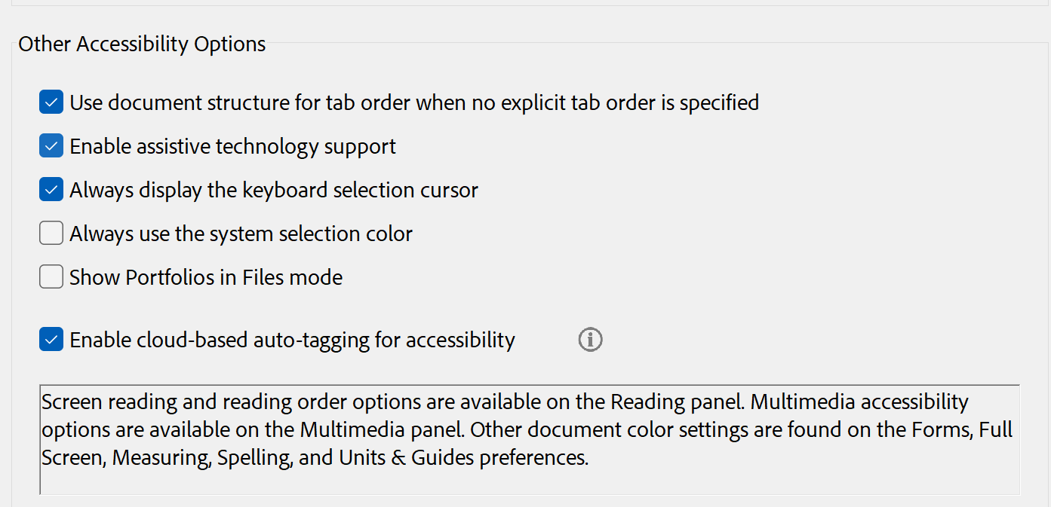
PDF Accessibility – Acrobat Pro and Reader
Notes:
With the auto-tag API integrated into Acrobat Pro and Reader, students can now automatically tag documents for a better reading experience with assistive technology such as screen readers.
The API also makes it easier to create accessibility PDFs for authors.

Slide 4
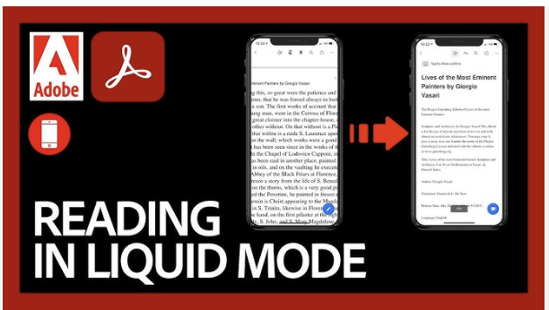
Reading in Liquid Mode
Notes:
Adobe Liquid Mode improves mobile PDF readability.
Like reader modes on websites, Liquid Mode turns PDFs into a more readable format for smaller screens. You can rest assured that it doesn’t change the PDF itself, but rather, it reformats headings, paragraphs, and images to create a better flow for mobile viewing. And if you’re creating one, you no longer need to rely on figuring out how to create a mobile-friendly PDF. Plus, it creates an outline with collapsible and expandable sections for you to easily navigate within larger documents.
Liquid Mode also makes mobile PDFs more responsive to your needs. You can search text within the document, expand its images, and — to make it even easier on the eyes — alter the font size and spacing between words to suit your reading preference.

Slide 5
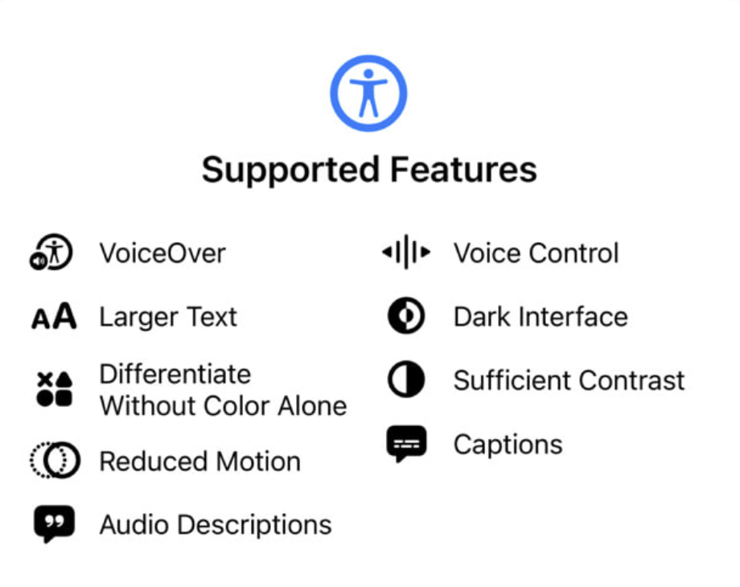
Apple Accessibility Nutrition Label
Premiere iOS (iPhone & iPad)
Project Splash (iPhone & iPad)
Frame.io (iPhone)
Lightroom (iOS)
Acrobat Mobile
Notes:
The new accessibility nutrition label for iPhone and iPad will enable students to quickly identify tools that support their accessibility needs. Some of Adobe’s products that will have good support as indicated by the nutrition label are:
Premiere iOS (iPhone & iPad)
Project Splash (iPhone & iPad)
Frame.io (iPhone)
Lightroom (iOS)

Slide 6

Express Roadmap
Notes:
Adobe Express is dedicated to ensuring that everyone has access to creative expression. With the upcoming April 2026 deadline for Title II of the ADA the product teams are increasing their efforts to support creating accessible content.

Slide 7
Closer Slide

